Slide 1
MID-PROJECT REVIEW
Mental Health Sentiment
Classification with TRABSA
Transformer-based Attention BiLSTM Sentiment Analysis
Team 29
March 27, 2026
1 / 8

Slide 2
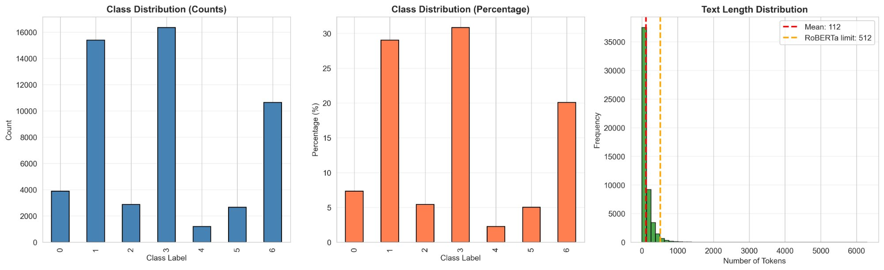
The Problem
Class Distribution & Text Length Analysis
Mental health posts on social media often express varying emotional intensities
Need: Automated classification into 7 categories — Anxiety, Depression, Bipolar, Normal, Personality Disorder, Stress, Suicidal
Challenge: Long, context-dependent text with subtle emotional cues
Goal: Achieve >80% accuracy on the test set
52,681
Reddit posts
7
Mental health classes
2 / 8

Slide 3
Solution: TRABSA Model Architecture
Why This Architecture?
Model Breakdown
RoBERTa
Captures long-range context & semantic meaning
Stage 1
RoBERTa Base
125M params · final layer extraction
Attention
Weights important words for mental health sentiment
Stage 2
Custom Attention
8 heads · 768→512 dimension reduction
BiLSTM
Models bidirectional dependencies in emotional language
Stage 3
BiLSTM
hidden_dim=128 · 1 layer · bidirectional
Dense Head
Maps learned representations to 7 classes
Stage 4
Dense Layers
256→128→7 classes
Trainable Parameters: ~46M · RoBERTa base frozen · Tesla T4 GPU (Google Colab)
3 / 8

Slide 4
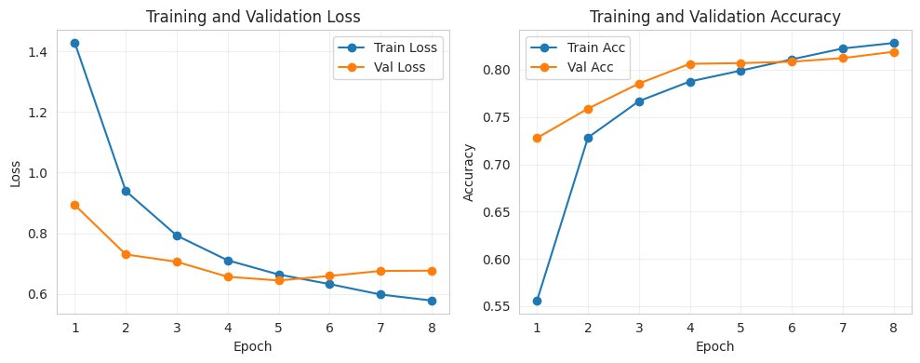
Training Results: 8 Epochs on Full Dataset
Training Loss & Validation Accuracy over 8 Epochs
Test Accuracy
81.3%
Baseline Accuracy (LR+TF-IDF)
74.2%
Improvement
+7.1 pp
Dataset Size
52,681
Train/Val/Test Split
70/15/15%
Training Time
~2 hours (GPU)
Best Model Epoch
Epoch 5
Early Stopping
Triggered @ Epoch 8
4 / 8

Slide 5
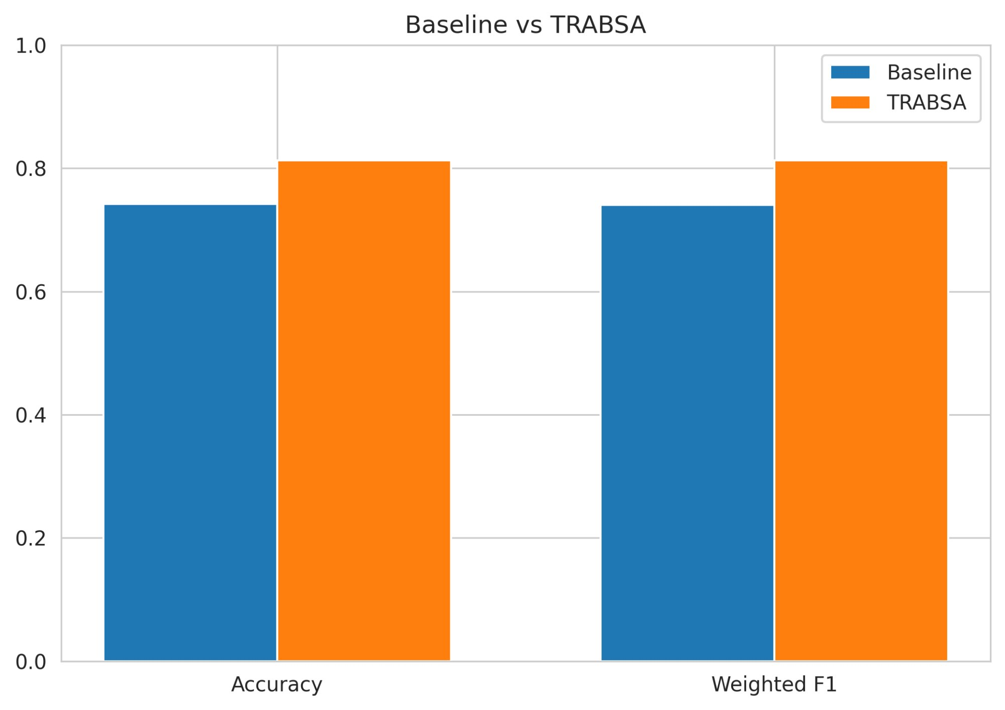
TRABSA vs. Baseline: Head-to-Head
Baseline Model
TRABSA Model ✓ WINNER
Logistic Regression + TF-IDF
VS
Transformer + Attention + BiLSTM
Simple, interpretable, good baseline
Captures deep semantic & contextual patterns
74.2% Accuracy
81.3% Accuracy (+7.1 pp)
Accuracy and F1-Score Comparison Across Both Models
5 / 8

Slide 6
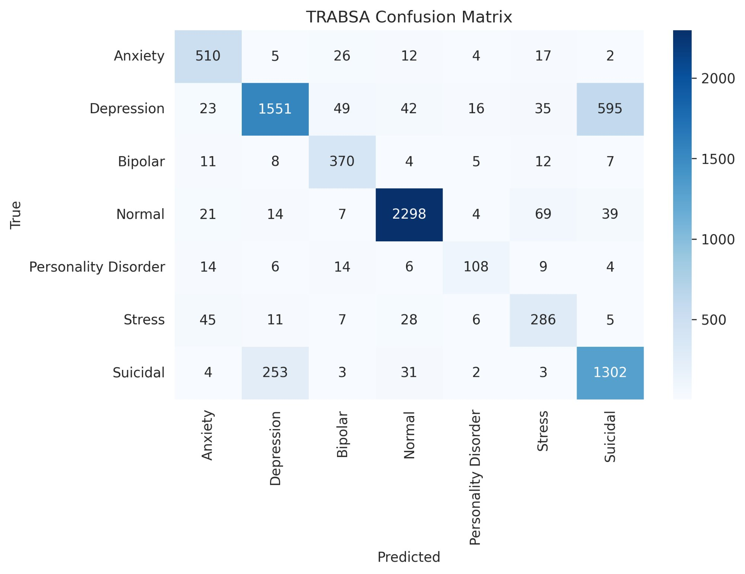
Where We Succeed & Struggle
TRABSA Confusion Matrix (Test Set)
Strong Performance
Anxiety & Depression: 85%+ accuracy (most common classes)
Normal: 88% recall — clear distinction from health posts
Areas for Improvement
Suicidal vs. Stress: Confusion due to shared urgency
Personality Disorder: Lower recall (~2% of dataset)
Next Steps
LinearSVC & BiLSTM+GloVe baselines (Phase 2) · SHAP & LIME explainability (Phase 5)
6 / 8

Slide 7
Rigorous & Reproducible Methodology
Reproducibility Measures
Validation & Testing
✓
Fixed random seeds (PyTorch, NumPy, random)
✓
Separate test set (15%, unseen during training)
✓
Stratified train/val/test split (class balance preserved)
✓
Class-weighted loss (handles class imbalance)
✓
All dependencies pinned in requirements.txt
✓
ReduceLROnPlateau scheduler (adaptive learning)
✓
Explicit device specification (GPU/CPU fallback)
✓
Early stopping (prevents overfitting)
✓
Smoke test suite validates all pipeline components
✓
Baseline comparison contextualizes 81.3% accuracy
✓
Code hosted with all artifacts
✓
Stratified splits across all 7 classes
7 / 8

Slide 8
Summary & Path Forward
What We Accomplished
What's Next?
Key Takeaway
Phase 1 ✓ Data pipeline on 52,681 posts
Phase 3 ✓ Full 4-stage TRABSA trained & validated
Phase 4 ✓ Class weights, early stopping, LR scheduling
Phase 5 (partial) ✓ Metrics, confusion matrix, comparison charts
LinearSVC + Vanilla BiLSTM (GloVe) baselines — Phase 2 completion
SHAP & LIME explainability — Phase 5 completion
Optional: 2-layer BiLSTM variant vs current 1-layer
Optional: additional minority-class mitigation experiments
Core objective achieved: TRABSA adapted and validated for 7-class mental health classification at 81.3% accuracy.
Remaining work (LinearSVC baseline, SHAP/LIME) are final-phase enhancements — not blockers. Project is ~80% aligned with abstract at mid-review.
Team 29 · March 27, 2026 · Mental Health Sentiment Classification with TRABSA
Thank you!
8 / 8

