Slide 1
物質科学のための計算数理 II
Numerical Analysis for Material Science II
10th: Density Functional Theory (3)
Dec. 14 (Fri)
Lecturer: Mitsuaki Kawamura (河村光晶)

Slide 2
Schedule (This semester W1, W2)
Sep. 28 (Fri) Guidance Y
Oct. 5 (Fri) Monte Carlo method O
Oct. 12 (Fri) Monte Carlo method O
Oct. 19 (Fri) Monte Carlo method O
Oct. 26 (Fri) Exact diagonalization Y
Nov. 2 (Fri) Exact diagonalization Y
Nov. 9 (Fri) Molecular dynamics O (1st report problem will be announced.)
Nov. 30 (Fri) Standard DFT code K
Dec. 7 (Fri) Density functional theory K
Dec. 14 (Fri) Density functional theory K
Dec. 21 (Fri) Density functional theory K
Dec. 25 (Tue) Density functional theory K (遠隔講義室)
Jan. 11 (Fri) (2nd)Report problem K
※ Lecturers: Y … Yamaji, K … Kawamura, O… Ohgoe

Slide 3
Schedule in this section (DFT)
Nov. 30 (Fri) Standard DFT code
First-principles calculation and Density functional theory (Lecture)
One-body Schrödinger eq. for periodic system and Bloch theorem (L)
Numerical solution of Kohn-Sham (one-body Schrödinger) eq. (L)
Hands-on DFT code (Tutorial)
Version control system : Git (T)
Dec. 7 (Fri) Kohn-Sham eq.
Plane-wave basis and Pseudopotentials (L)
Iterative eigenvalue solution method (L & T)
Dec. 14 (Fri) Self-Consistent loop
Hartree potential (Poisson eq.), Atomic potential, XC potential
Update (Broyden's method)
Visualization of grid data (T)
Dec. 21 (Fri) Total Energy
Total energy
Brillouin-zone integral (Tetrahedron method)
Coulomb potential for periodic point charge (Ewald sum)
Dec. 25 (Tue) Advanced subjects for productive calculation (遠隔講義室)
Generalized gradient correction
Non-local pseudopotentials (Norm-conserving, ultrasoft, PAW)
Procedure
Jan. 11 (Fri) (2nd) Report problem, Question time

Slide 4
Today’s Schedule
Kohn-Sham potential
Hartree term
(Pseudo) atomic potential
Exchange-correlation term
SCF loop (Solution of non-linear equation)
(Quasi) newton method
Broyden's method
Visualization of grid data
Xcrysden structure format (XSF)

Slide 5
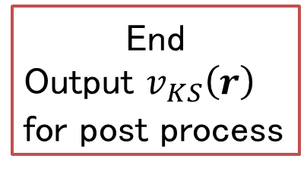
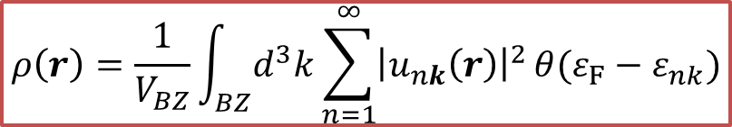
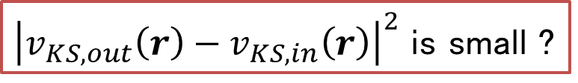
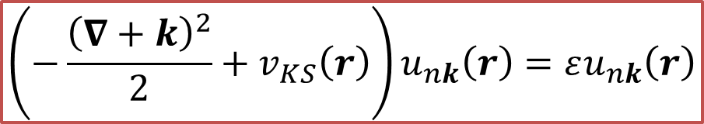

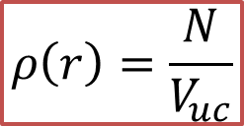
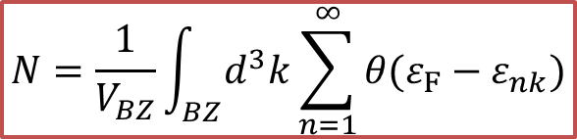
DFT loop
Unit lattice vector
atomic position
pseudopotential file
$$ρ\left(r\right)=\frac{N}{V_{uc}}$$
Initial density is
uniform
$$v_{KS}\left[ρ\right]\left(r\right)$$
$$\left(−\frac{{\left(∇+k\right)}^{2}}{2}+v_{KS}\left(r\right)\right)u_{nk}\left(r\right)=εu_{nk}\left(r\right)$$
$$N=\frac{1}{V_{BZ}}\int_{BZ}{d^{3}k}\sum_{n=1}^{∞}{θ(ε_{F}−ε_{nk})}$$
$$ρ\left(r\right)=\frac{1}{V_{BZ}}\int_{BZ}{d^{3}k}\sum_{n=1}^{∞}{{\left|u_{nk}\left(r\right)\right|}^{2}}θ(ε_{F}−ε_{nk})$$
End
Output $v_{KS}\left(r\right)$
for post process
${\left|v_{KS,out}\left(r\right)−v_{KS,in}\left(r\right)\right|}^{2}$ is small ?
No
Yes

Slide 6
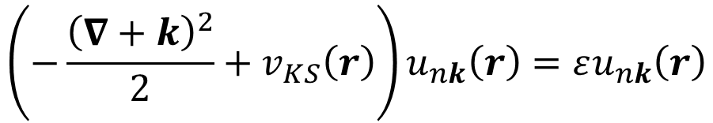
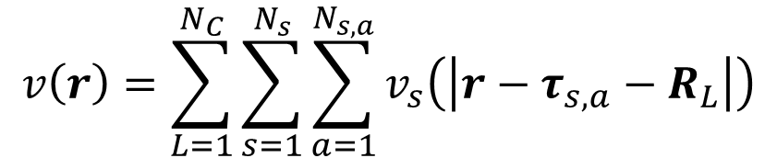
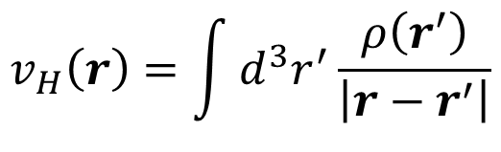
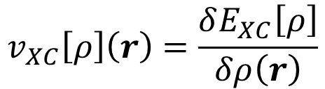
Kohn-Sham potential
$$\left(−\frac{{\left(∇+k\right)}^{2}}{2}+v_{KS}\left(r\right)\right)u_{nk}\left(r\right)=εu_{nk}\left(r\right)$$
$$v_{KS}[ρ]\left(r\right)=v\left(r\right)+v_{H}\left(r\right)+v_{XC}\left[ρ\right]\left(r\right)$$
$$v\left(r\right)=\sum_{L=1}^{N_{C}}{\sum_{s=1}^{N_{s}}{\sum_{a=1}^{N_{s,a}}{v_{s}\left(\left|r−τ_{s,a}−R_{L}\right|\right)}}}$$
Atomic (pseudo) potential :
Hartree potential :
$$v_{H}\left(r\right)=\int{d^{3}r^{′}}\frac{ρ\left(r^{′}\right)}{\left|r−r^{′}\right|}$$
$$v_{XC}\left[ρ\right]\left(r\right)=\frac{δE_{XC}\left[ρ\right]}{δρ\left(r\right)}$$
Exchange-correlation potential :

Slide 7
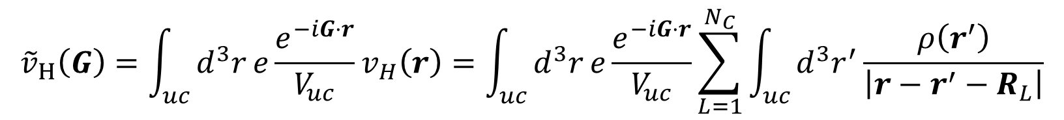
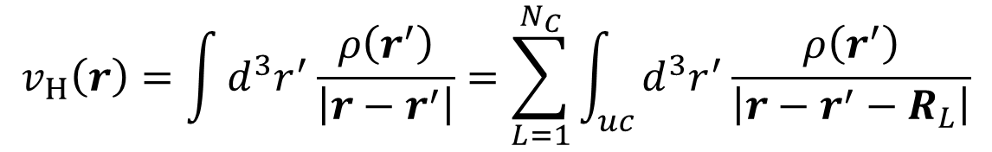
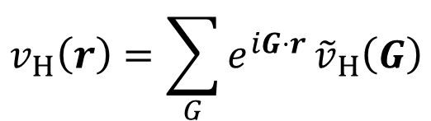
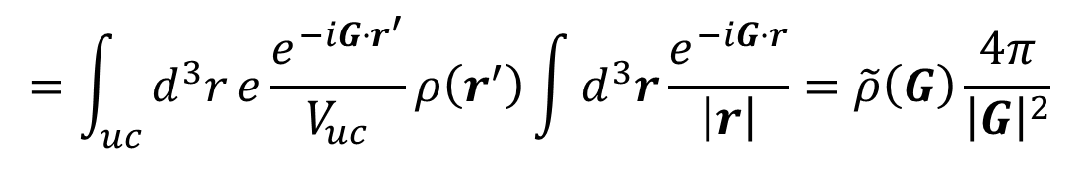
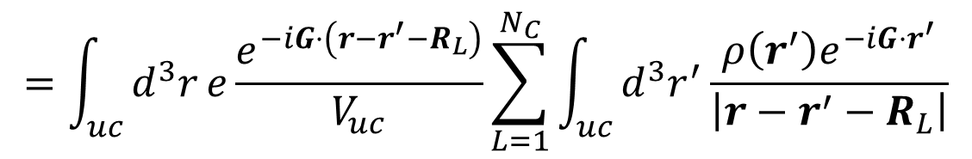
Hartree potential (hartree_pot@rho_v.F90)
$$v_{H}\left(r\right)=\int{d^{3}r^{′}}\frac{ρ\left(r^{′}\right)}{\left|r−r^{′}\right|}=\sum_{L=1}^{N_{C}}{\int_{uc}{d^{3}r^{′}}}\frac{ρ\left(r^{′}\right)}{\left|r−r^{′}−R_{L}\right|}$$
$${\tilde{v}}_{H}\left(G\right)=\int_{uc}{d^{3}r}e\frac{e^{−iG⋅r}}{V_{uc}}v_{H}\left(r\right)=\int_{uc}{d^{3}r}e\frac{e^{−iG⋅r}}{V_{uc}}\sum_{L=1}^{N_{C}}{\int_{uc}{d^{3}r^{′}}}\frac{ρ\left(r^{′}\right)}{\left|r−r^{′}−R_{L}\right|}$$
$$=\int_{uc}{d^{3}r}e\frac{e^{−iG⋅\left(r−r^{′}−R_{L}\right)}}{V_{uc}}\sum_{L=1}^{N_{C}}{\int_{uc}{d^{3}r^{′}}}\frac{ρ\left(r^{′}\right)e^{−iG⋅r^{′}}}{\left|r−r^{′}−R_{L}\right|}$$
$$=\int_{uc}{d^{3}r}e\frac{e^{−iG⋅r^{′}}}{V_{uc}}ρ\left(r^{′}\right)\int{d^{3}r}\frac{e^{−iG⋅r}}{\left|r\right|}=\tilde{ρ}\left(G\right)\frac{4π}{{\left|G\right|}^{2}}$$
$$v_{H}\left(r\right)=\sum_{G}{e^{iG⋅r}}{\tilde{v}}_{H}\left(G\right)$$

Slide 8
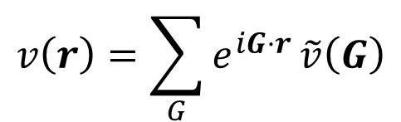
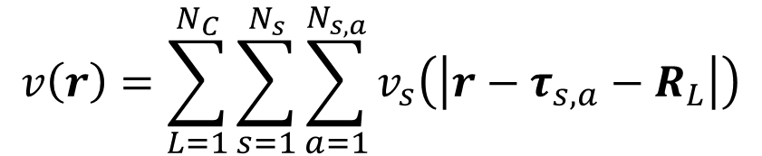
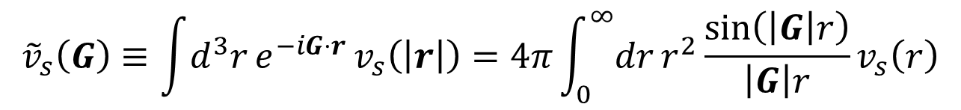
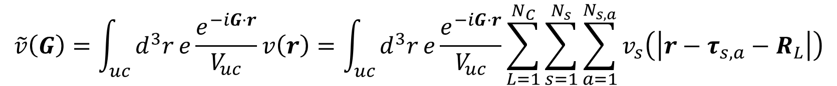
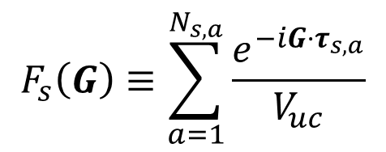
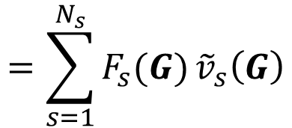
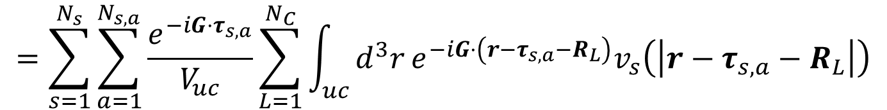
Periodic atomic potential (generate_vps@rho_v.F90)
$$v\left(r\right)=\sum_{L=1}^{N_{C}}{\sum_{s=1}^{N_{s}}{\sum_{a=1}^{N_{s,a}}{v_{s}\left(\left|r−τ_{s,a}−R_{L}\right|\right)}}}$$
$$\tilde{v}\left(G\right)=\int_{uc}{d^{3}r}e\frac{e^{−iG⋅r}}{V_{uc}}v\left(r\right)=\int_{uc}{d^{3}r}e\frac{e^{−iG⋅r}}{V_{uc}}\sum_{L=1}^{N_{C}}{\sum_{s=1}^{N_{s}}{\sum_{a=1}^{N_{s,a}}{v_{s}\left(\left|r−τ_{s,a}−R_{L}\right|\right)}}}$$
$$=\sum_{s=1}^{N_{s}}{\sum_{a=1}^{N_{s,a}}{\frac{e^{−iG⋅τ_{s,a}}}{V_{uc}}}}\sum_{L=1}^{N_{C}}{\int_{uc}{d^{3}r}}e^{−iG⋅\left(r−τ_{s,a}−R_{L}\right)}v_{s}\left(\left|r−τ_{s,a}−R_{L}\right|\right)$$
$$F_{s}\left(G\right)≡\sum_{a=1}^{N_{s,a}}{\frac{e^{−iG⋅τ_{s,a}}}{V_{uc}}}$$
$$=\sum_{s=1}^{N_{s}}{F_{s}(G)}{\tilde{v}}_{s}\left(G\right)$$
$${\tilde{v}}_{s}\left(G\right)≡\int{d^{3}r}e^{−iG⋅r }v_{s}\left(\left|r\right|\right)=4π\int_{0}^{∞}{dr}r^{2}\frac{\sin\left(\left|G\right|r\right)}{\left|G\right|r}v_{s}\left(r\right)$$
$$v\left(r\right)=\sum_{G}{e^{iG⋅r}}\tilde{v}\left(G\right)$$

Slide 9
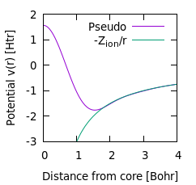
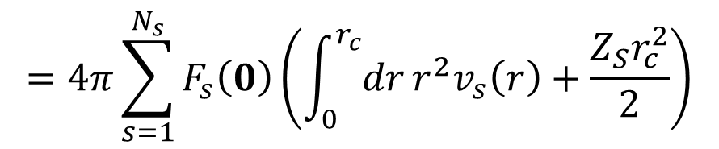
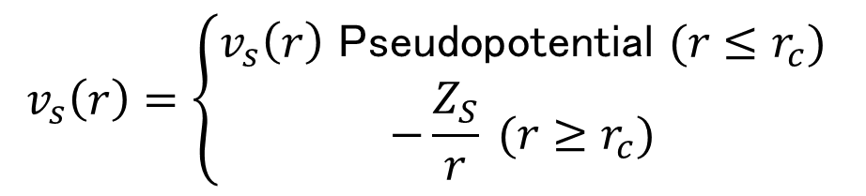
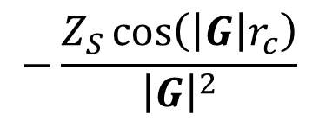
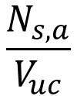
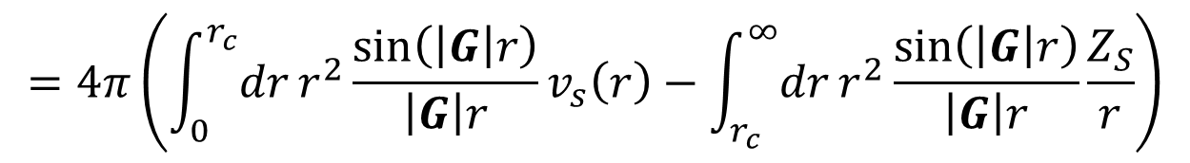

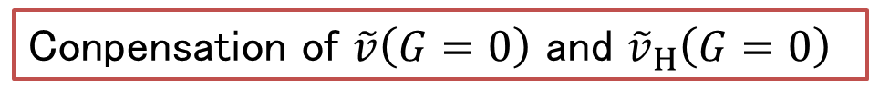
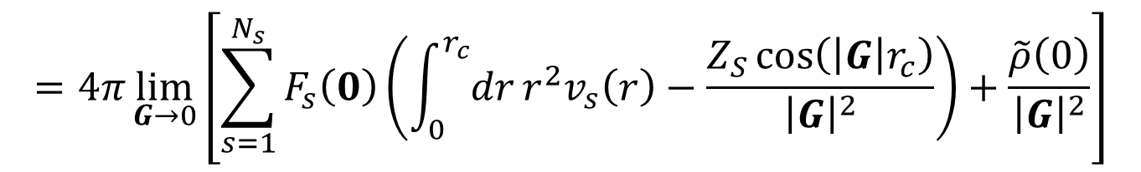
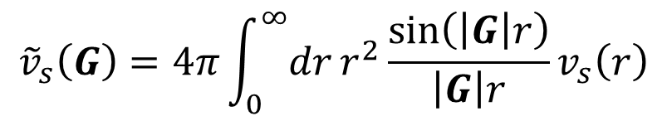

Pseudopotential (generate_vps@rho_v.F90)
$${\tilde{v}}_{s}\left(G\right)=4π\int_{0}^{∞}{dr}r^{2}\frac{\sin\left(\left|G\right|r\right)}{\left|G\right|r}v_{s}\left(r\right)$$
$$v_{s}\left(r\right)=\left\{\begin{aligned}v_{s}\left(r\right) \text{Pseudopotential} (r≤r_{c}) \\ −\frac{Z_{S}}{r} (r≥r_{c}) \end{aligned}\right.$$
$$=4π\left(\int_{0}^{r_{c}}{dr}r^{2}\frac{\sin\left(\left|G\right|r\right)}{\left|G\right|r}v_{s}\left(r\right)−\int_{r_{c}}^{∞}{dr}r^{2}\frac{\sin\left(\left|G\right|r\right)}{\left|G\right|r}\frac{Z_{S}}{r}\right)$$
$$−\frac{Z_{S}\cos\left(\left|G\right|r_{c}\right)}{{\left|G\right|}^{2}}$$
Conpensation of $\tilde{v}\left(G=0\right)$ and ${\tilde{v}}_{H}\left(G=0\right)$
$$\frac{N}{V_{uc}}$$
$$\frac{N_{s,a}}{V_{uc}}$$
Al (Z_{ion}=3)
$$\lim_{G→0}\left({\tilde{v}}_{s}\left(G\right)+{\tilde{v}}_{H}\left(G\right)\right)$$
$$=4π\lim_{G→0}\left[\sum_{s=1}^{N_{s}}{F_{s}\left(0\right)}\left(\int_{0}^{r_{c}}{dr}r^{2}v_{s}\left(r\right)−\frac{Z_{S}\cos\left(\left|G\right|r_{c}\right)}{{\left|G\right|}^{2}}\right)+\frac{\tilde{ρ}\left(0\right)}{{\left|G\right|}^{2}}\right]$$
$$=4π\sum_{s=1}^{N_{s}}{F_{s}\left(0\right)}\left(\int_{0}^{r_{c}}{dr}r^{2}v_{s}\left(r\right)+\frac{Z_{S}r_{c}^{2}}{2}\right)$$

Slide 10
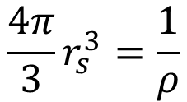
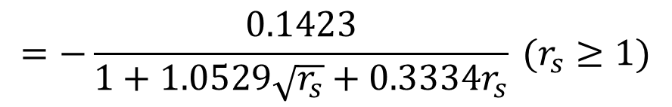
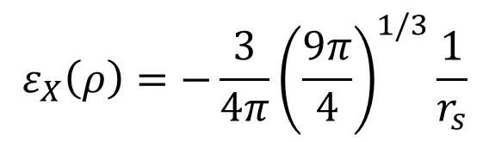

Exchange-correlation potential in LDA (xc_pot@rho_v.F90)
$$v_{XC}^{LDA}\left(ρ\left(r\right)\right)=ε_{XC}\left(ρ\left(r\right)\right)+ρ\left(r\right)\frac{dε_{XC}\left(ρ\right)}{dρ}{\left.​\right|}_{ρ=ρ\left(r\right)}=ε_{XC}\left(ρ\left(r\right)\right)−\frac{r_{s}}{3}\frac{dε_{XC}\left(ρ\right)}{dr_{s}}$$
$$ε_{XC}\left(ρ\right)=ε_{X}\left(ρ\right)+ε_{C}\left(ρ\right)$$
$$\frac{4π}{3}r_{s}^{3}=\frac{1}{ρ}$$
$$ε_{X}\left(ρ\right)=−\frac{3}{4π}{\left(\frac{9π}{4}\right)}^{1/3}\frac{1}{r_{s}}$$
$$ε_{C}\left(ρ\right)=−0.0480+0.031\ln{r_{s}}−0.0116 r_{s}+0.0020r_{s}\ln{r_{s}} (r_{s}≤1)$$
$$=−\frac{0.1423}{1+1.0529\sqrt{r_{s}}+0.3334r_{s}} (r_{s}≥1)$$
J. P. Perdew and A. Zunger, Phys. Rev. B 23, 5048 (1981).

Slide 11



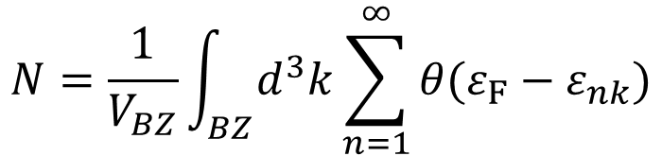
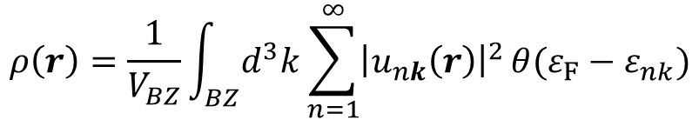

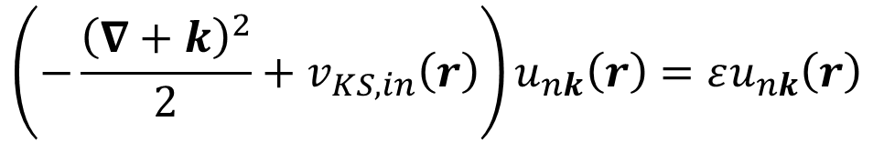

Update $v_{KS}(r)$
$$\left(−\frac{{\left(∇+k\right)}^{2}}{2}+v_{KS,in}\left(r\right)\right)u_{nk}\left(r\right)=εu_{nk}\left(r\right)$$
$$N=\frac{1}{V_{BZ}}\int_{BZ}{d^{3}k}\sum_{n=1}^{∞}{θ(ε_{F}−ε_{nk})}$$
$$v_{KS,in}\left(r\right)$$
$$v_{KS,out}\left(r\right)$$
$$ρ\left(r\right)=\frac{1}{V_{BZ}}\int_{BZ}{d^{3}k}\sum_{n=1}^{∞}{{\left|u_{nk}\left(r\right)\right|}^{2}}θ(ε_{F}−ε_{nk})$$
$$v_{KS}[ρ]\left(r\right)$$
Plane mixing
$$v_{KS,new}\left(r\right)=v_{KS,in}\left(r\right)+β\left(v_{KS,out}\left(r\right)−v_{KS,in}\left(r\right)\right)$$
$$0<β≤1$$

Slide 12
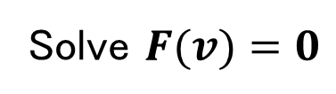


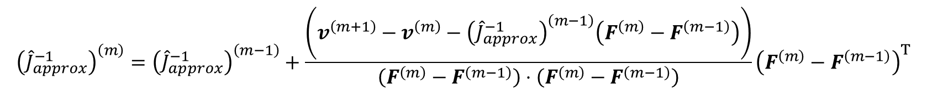


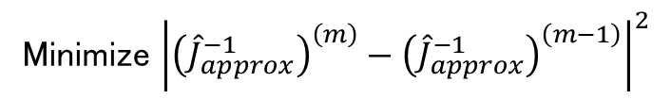


Broyden's method
$$F\left[v_{in}\right](r)=v_{out}\left[v_{in}\right](r)−v_{in}(r)$$
$$J_{ij}≡\frac{∂F_{i}}{∂v_{j}}$$
$$F\left(v\right)+\hat{J}Δv=0$$
$$F(v)=v_{out}(v)−v$$
$$Δv^{(m)}=−{\left({\hat{J}}^{−1}\right)}^{(m)} F^{(m)}$$
Solve $F(v)=0$
$$v^{(m+1)}=v^{(m)}+Δv^{(m)}$$
Newton's method
Approximate ${\hat{J}}^{−1}$, and update it iteratively → Quasi Newton's method
$$F^{(m)}−F^{\left(m−1\right)}={\left({\hat{J}}_{approx}^{−1}\right)}^{\left(i\right)}\left(v^{\left(m\right)}−v^{\left(m−1\right)}\right)$$
Minimize ${\left|{\left({\hat{J}}_{approx}^{−1}\right)}^{\left(m\right)}−{\left({\hat{J}}_{approx}^{−1}\right)}^{\left(m−1\right)}\right|}^{2}$
C. G. Broyden, Marh. Compur. 19, 577 (1965).
$${\left({\hat{J}}_{approx}^{−1}\right)}^{\left(m\right)}={\left({\hat{J}}_{approx}^{−1}\right)}^{\left(m−1\right)}+\frac{\left(v^{\left(m+1\right)}−v^{\left(m\right)}−{\left({\hat{J}}_{approx}^{−1}\right)}^{\left(m−1\right)}\left(F^{\left(m\right)}−F^{\left(m−1\right)}\right)\right)}{\left(F^{\left(m\right)}−F^{\left(m−1\right)}\right)⋅\left(F^{\left(m\right)}−F^{\left(m−1\right)}\right)}{\left(F^{\left(m\right)}−F^{\left(m−1\right)}\right)}^{T}$$

Slide 13
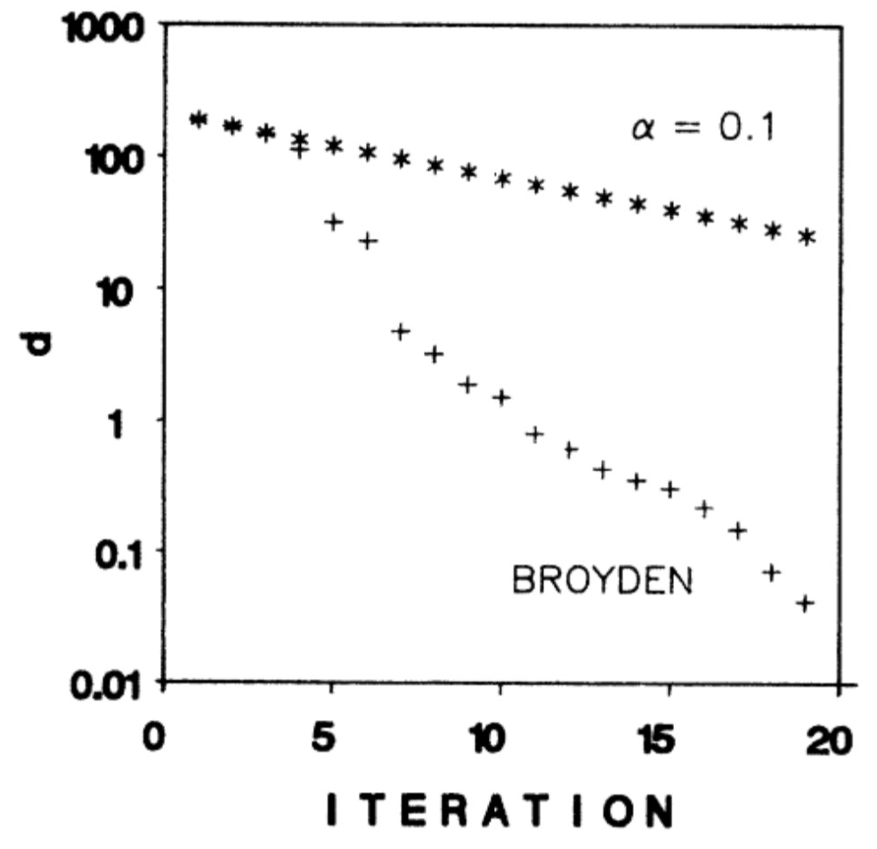
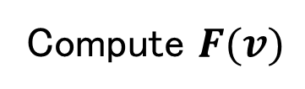
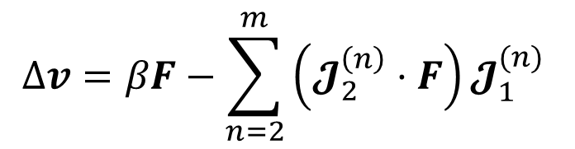

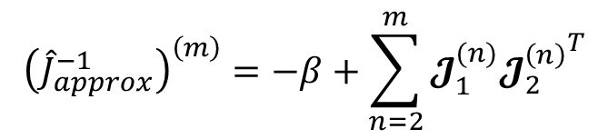



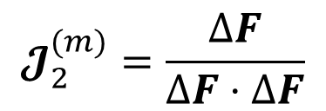
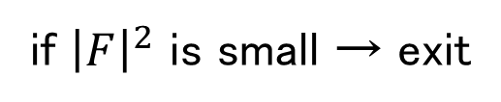
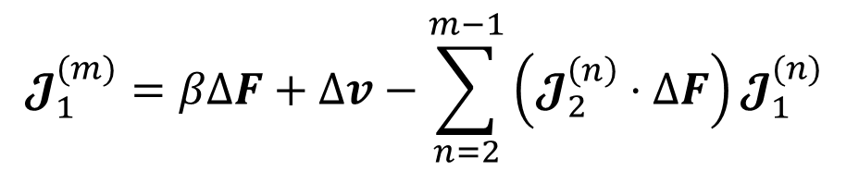
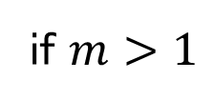
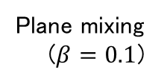
Practical algorithm (scf_loop@scf.F90)
do iteration : $m = 1, 2, 3, ⋯$
G. P. Srivastava, J. Phys. A: Math. Gen. 17, L317 (1984).
Compute $F(v)$
G. P. Srivastava J. Phys. A: Math. Gen. 17, 2737 (1984).
if ${\left|F\right|}^{2}$ is small → exit
$${\left({\hat{J}}_{approx}^{−1}\right)}^{\left(m\right)}=−β+\sum_{n=2}^{m}{𝓙_{1}^{(n)}{𝓙_{2}^{\left(n\right)}}^{T}}$$
if $m>1$
$$ΔF=F−F_{old}$$
$$𝓙_{1}^{(m)}=βΔF+Δv−\sum_{n=2}^{m−1}{\left(𝓙_{2}^{\left(n\right)}⋅ΔF\right)𝓙_{1}^{(n)} }$$
Plane mixing
($β=0.1$)
$$𝓙_{2}^{(m)}=\frac{ΔF}{ΔF⋅ΔF}$$
end if
$$Δv=βF−\sum_{n=2}^{m}{\left(𝓙_{2}^{\left(n\right)}⋅F\right)𝓙_{1}^{(n)} }$$
$$F_{old}=F$$
$$v=v+Δv$$
W(001) surface
D. Singh, et al, Phys. Rev. B 34, 8391, (198).
end do

Slide 14
Tutorial
&CONTROL
calculation = 'scf'
/
&SYSTEM
nbnd = 5
nat = 1
ntyp = 1
ecutwfc =30.000000
ecutrho = 120.000000
/
&ELECTRONS
mixing_beta = 0.3
conv_thr = 1.000000e-5
electron_maxstep = 100
/
CELL_PARAMETERS
0.000000 2.024700 2.024700
2.024700 0.000000 2.024700
2.024700 2.024700 0.000000
ATOMIC_SPECIES
Al al.lda.lps
ATOMIC_POSITIONS
Al 0.000000 0.000000 0.000000
K_POINTS
8 8 8
$ cd ~/pwdft/
$ git checkout master
$ git pull
$ make clean; make
$ cd sample/Al/
$ ../../src/pwdft.x < scf.in
Iteration 1
Average LOBPCG steps : 20
delta Vks [eV] : 2.7895180896787383E-003
Iteration 2
Average LOBPCG steps : 8
delta Vks [eV] : 1.9722767387705393E-003
Iteration 3
Average LOBPCG steps : 9
delta Vks [eV] : 3.3737045076316851E-005
Iteration 4
Average LOBPCG steps : 1
delta Vks [eV] : 2.3594012412709303E-005
Iteration 5
Average LOBPCG steps : 2
delta Vks [eV] : 1.0001898370361127E-006
Converged ! iter = 5

Slide 15

Band structure plot
One-shot calculation with previously computed $v_{KS}(r)$
$ ../../src/pwdft.x < band.in
$ gnuplot
gnuplot> set ylabel "Energy from E_F [eV]"
gnuplot> unset xlabel
gnuplot> plot [][:40] "band.dat", \
x**2*0.5*27.21138456-11.514956871425214 tit "k^2/2-E_F", \
(x-1.42)**2*0.5*27.2-11.5 tit "(k-G)^2/2-E_F"
Band structure of Aluminum
→ Free electron
+ Brillouin-zone periodicity
(folding)
+ small potential effect

Slide 16


Visualization of grid data
Real-space grid data
Potential $v_{KS}\left(r\right), v\left(r\right), v_{H}\left(r\right), v_{XC}(r)$
Charge density $ρ(r)$
Kohn-Sham orbital $u_{nk}(r)$
Etc.
Reciprocal-space grid data
Kohn-Sham energy $ε_{nk}$
Fermi velocity ${∇_{k}ε}_{nk}$
Berry connection $\left\langle u_{nk} | i∇_{k} | u_{nk}\right\rangle$
Berry curvature$∇_{k}×\left\langle u_{nk} | i∇_{k} | u_{nk}\right\rangle$
Etc.
Isosurface
Section

Slide 17

Real space : XSF
XCrysDen : Crystalline structure viewer (like VESTA)
http://www.xcrysden.org/
XCrysden Structure File (XSF) format
http://www.xcrysden.org/doc/XSF.html
Unit cell + Atomic position (structure) + Volume (grid) data
Unit : Angstrom
The grid data should include data at all edge of
the unit cell.
We need additional data at these points : copy from original points

Slide 18
XSF format
Unit lattice vectors [Å]
CRYSTAL
PRIMVEC
0.00000E+00 0.20247E+01 0.20247E+01
0.20247E+01 0.00000E+00 0.20247E+01
0.20247E+01 0.20247E+01 0.00000E+00
PRIMCOORD
1 1
Al 0.00000E+00 0.00000E+00 0.00000E+00
BEGIN_BLOCK_DATAGRID_3D
3D_PWSCF
DATAGRID_3D_UNKNOWN
21 21 21
0.00000E+00 0.00000E+00 0.00000E+00
0.00000E+00 0.20247E+01 0.20247E+01
0.20247E+01 0.00000E+00 0.20247E+01
0.20247E+01 0.20247E+01 0.00000E+00
0.76311E+02 0.67851E+02 0.45909E+02 0.18866E+02 -0.39980E+01 -0.16986E+02
-0.20120E+02 -0.17490E+02 -0.13890E+02 -0.11749E+02 -0.11130E+02 -0.11749E+02
-0.13890E+02 -0.17490E+02 -0.20120E+02 -0.16986E+02 -0.39980E+01 0.18866E+02
0.45909E+02 0.67851E+02 0.76311E+02 0.67851E+02 0.52697E+02 0.28399E+02
0.40345E+01 -0.12896E+02 -0.19773E+02 -0.19031E+02 -0.15398E+02 -0.12470E+02
:
END_DATAGRID_3D
END_BLOCK_DATAGRID_3D
Number of atoms in unit cell
The second number is always "1"
Atomic position in [Å]
Not fractional coordinate
Data grid number. FFT grid + 1
(Including all edge of unit cell)
Grid shift from atomic position (usually 0)
Cell of grid data (usually the same as u.c.
Volume data

Slide 19
Input/Output grid data (griddata.F90)
module griddata
contains
subroutine read_griddata(filename, gdata)
use gvec, only : g_rh
character(*),intent(in) :: filename
real(8),intent(out) :: gdata(g_rh%nft(1),g_rh%nft(2),g_rh%nft(3))
end subroutine read_griddata
subroutine write_griddata(filename, gdata)
use gvec, only : g_rh
character(*),intent(in) :: filename
real(8),intent(in) :: gdata(g_rh%nft(1),g_rh%nft(2),g_rh%nft(3))
end subroutine write_griddata
end module griddata
In pwdft.F90,
program pwdft
use griddata, only : read_griddata, write_griddata
if(calculation == "scf") then
call write_griddata("vks.xsf", Vks)
else
call read_griddata("vks.xsf", Vks)
end if
end program pwdft

Slide 20




Display $v_{KS}(r)$ with VESTA
$ cd ~/pwdft/sample/Si/
$ ../../src/pwdft.x < scf.in
$ vesta vks.xsf
Semiconductor
Diamond structure (lattice is FCC)
Each Si atom has 4 bonds.
"Objects" → "Properties" → "Isosurfaces..."

Slide 21



Cross section
"Objects" → "Properties" → "Sections..."
"Edit" → "Lattice Planes..."

Slide 22

Report problem 2
Modify pwdft.F90 to output the grid data of charge density $ρ(r)$
as a file "rho.xsf".
Then plot the charge density of Si.
Explain the shape of $ρ(r)$ (where do the electrons locate ?).
Hint : $ρ(r)$ is stored in the following variable
module rho_v
!
implicit none
!
real(8),allocatable :: &
& Vks(:), & !< (g_rh%nr) Kohn-Sham potential [Htr]
& Vps(:), & !< (g_rh%nr) Pseudopotential [Htr]
& rho(:) !< (g_rh%nr) Charge density
Modified code should be submitted as a diff file generated by
$ cd ~/pwdft/
$ git add src
$ git commit
$ git show > 12142018.diff

Slide 23
Today's summary
Kohn-Sham potential
Hartree potential is computed with FFT
Charge compensation of Hartree and ionic potential
Exchange correlation potential
SCF loop = Solving non-linear equation
Broyden's method
Visualize grid data (Potential, charge density Kohn-Sham orbital) as a XSF data.

