Slide 1
物質科学のための計算数理 II
Numerical Analysis for Material Science II
11th: Density Functional Theory (4)
Dec. 21 (Fri)
Lecturer: Mitsuaki Kawamura (河村光晶)

Slide 2
Schedule (This semester W1, W2)
Sep. 28 (Fri) Guidance Y
Oct. 5 (Fri) Monte Carlo method O
Oct. 12 (Fri) Monte Carlo method O
Oct. 19 (Fri) Monte Carlo method O
Oct. 26 (Fri) Exact diagonalization Y
Nov. 2 (Fri) Exact diagonalization Y
Nov. 9 (Fri) Molecular dynamics O (1st report problem will be announced.)
Nov. 30 (Fri) Density functional theory K
Dec. 7 (Fri) Density functional theory K
Dec. 14 (Fri) Density functional theory K
Dec. 21 (Fri) Density functional theory K
Dec. 25 (Tue) Density functional theory K (遠隔講義室)
Jan. 11 (Fri) (2nd)Report problem K
※ Lecturers: Y … Yamaji, K … Kawamura, O… Ohgoe

Slide 3
Schedule in this section (DFT)
Nov. 30 (Fri) Standard DFT code
First-principles calculation and Density functional theory (Lecture)
One-body Schrödinger eq. for periodic system and Bloch theorem (L)
Numerical solution of Kohn-Sham (one-body Schrödinger) eq. (L)
Hands-on DFT code (Tutorial)
Version control system : Git (T)
Dec. 7 (Fri) Kohn-Sham eq.
Plane-wave basis and Pseudopotentials (L)
Iterative eigenvalue solution method (L & T)
Dec. 14 (Fri) Self-Consistent loop
Hartree potential (Poisson eq.), Atomic potential, XC potential
Update (Broyden's method)
Visualization of grid data (T)
Dec. 21 (Fri) Total Energy
Total energy
Brillouin-zone integral (Tetrahedron method)
Coulomb potential for periodic point charge (Ewald sum)
Dec. 25 (Tue) Advanced subjects for productive calculation (遠隔講義室)
Generalized gradient correction
Non-local pseudopotentials (Norm-conserving, ultrasoft, PAW)
Procedure
Jan. 11 (Fri) (2nd) Report problem, Question time

Slide 4
Today’s Schedule
Total energy
Hartree term
Exchange correlation term
Brillouin-zone integration
Basics
Smearing method
Tetrahedron method and its improvement
Fermi surface plot

Slide 5
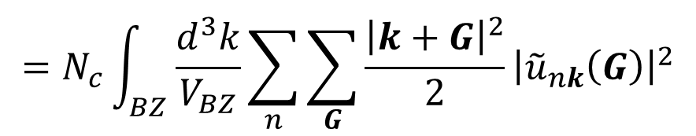
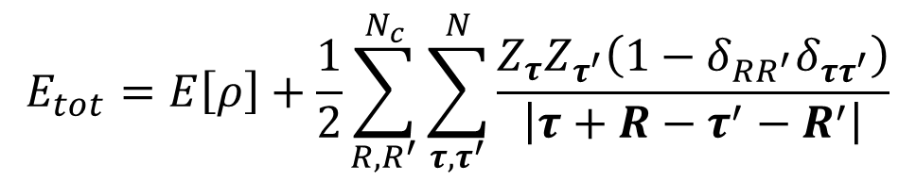
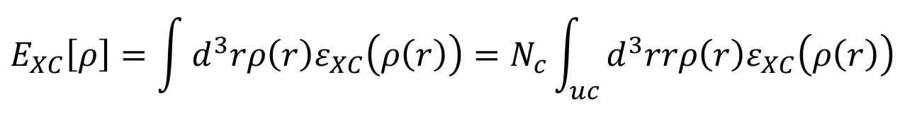
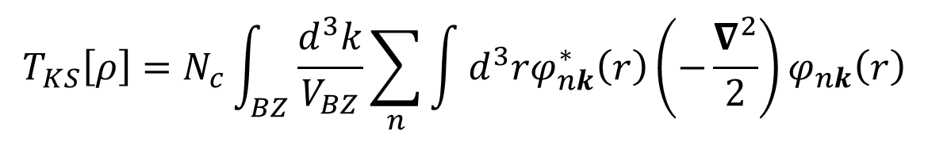
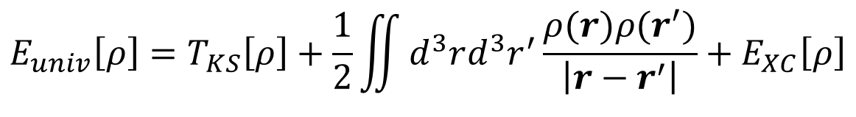
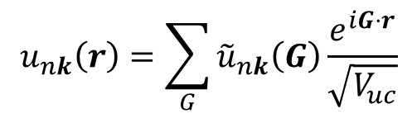
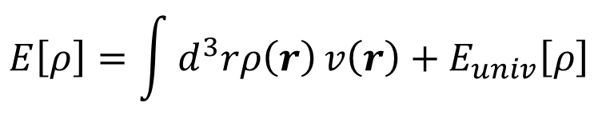
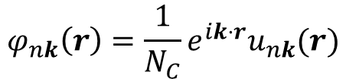
Total energy functional for DFT
$$E_{tot}=E\left[ρ\right]+\frac{1}{2}\sum_{R,R^{′}}^{N_{c}}{\sum_{τ,τ^{′}}^{N}{\frac{Z_{τ}Z_{τ^{′}}\left(1−δ_{RR^{′}}δ_{ττ^{′}}\right)}{\left|τ+R−τ^{′}−R^{′}\right|}}}$$
$$E\left[ρ\right]=\int{d^{3}rρ\left(r\right)}v\left(r\right)+E_{univ}\left[ρ\right]$$
$$E_{univ}\left[ρ\right]=T_{KS}\left[ρ\right]+\frac{1}{2}\iint{d^{3}rd^{3}r^{′}\frac{ρ(r)ρ(r^{′})}{\left|r−r^{′}\right|}}+E_{XC}\left[ρ\right]$$
$$T_{KS}\left[ρ\right]=N_{c}\int_{BZ}{\frac{d^{3}k}{V_{BZ}}}\sum_{n}{\int{d^{3}rφ_{nk}^{∗}\left(r\right)\left(−\frac{∇^{2}}{2}\right)φ_{nk}\left(r\right)}}$$
$$φ_{nk}\left(r\right)=\frac{1}{N_{C}}e^{ik⋅r}u_{nk}(r)$$
$$u_{nk}\left(r\right)=\sum_{G}{{\tilde{u}}_{nk}\left(G\right)}\frac{e^{iG⋅r}}{\sqrt{V_{uc}}}$$
$$=N_{c}\int_{BZ}{\frac{d^{3}k}{V_{BZ}}}\sum_{n}{\sum_{G}{\frac{{\left|k+G\right|}^{2}}{2}{\left|{\tilde{u}}_{nk}\left(G\right)\right|}^{2}}}$$
Local density approximation
$$E_{XC}\left[ρ\right]=\int{d^{3}rρ\left(r\right)ε_{XC}\left(ρ\left(r\right)\right)}=N_{c}\int_{uc}{d^{3}rrρ\left(r\right)ε_{XC}\left(ρ\left(r\right)\right)}$$

Slide 6
Tutorial for total energy
$ cd ~/pwdft/
$ git checkout master
$ git pull
$ make clean; make
$ cd sample/Al/
$ ../../src/pwdft.x < scf.in
Energy per u.c. [eV]
Kinetic energy : 22.571740309226847
Hartree energy : 0.10954359264556501
rho*V : 14.630190122503379
Ewald eta [Bohr^-1] : 1.4221682587100493
Ewald grid (G) : 25 25 25
Ewald grid (R) : 2 2 2
Eward energy : -73.366857049902464
XC energy : -21.802851254893593
Total energy : -57.858234280420255
$ bash vol.sh

Slide 7
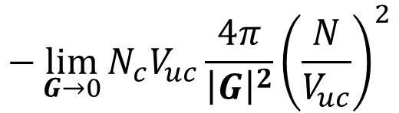
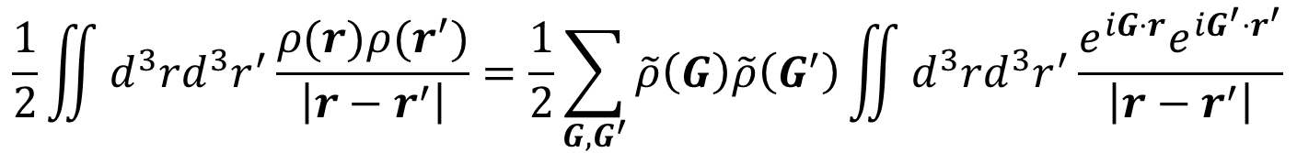
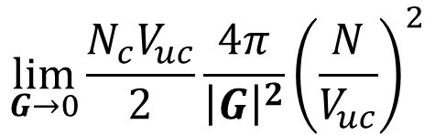
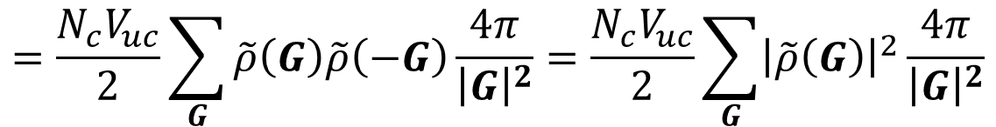
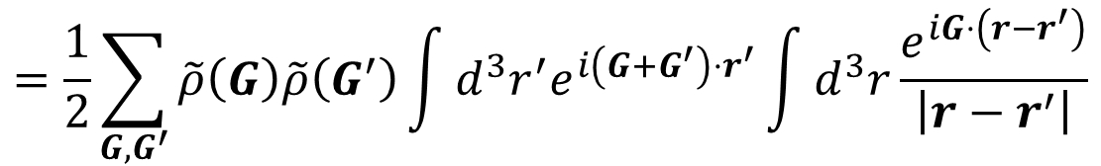
Hartree and atomic potential energy.F90
$$\frac{1}{2}\iint{d^{3}rd^{3}r^{′}\frac{ρ(r)ρ(r^{′})}{\left|r−r^{′}\right|}}=\frac{1}{2}\sum_{G, G^{′}}{\tilde{ρ}\left(G\right)\tilde{ρ}\left(G^{′}\right)}\iint{d^{3}rd^{3}r^{′}\frac{e^{iG⋅r}e^{iG^{′}⋅r^{′}}}{\left|r−r^{′}\right|}}$$
$$=\frac{1}{2}\sum_{G, G^{′}}{\tilde{ρ}\left(G\right)\tilde{ρ}\left(G^{′}\right)}\int{d^{3}r^{′}e^{i\left(G+G^{′}\right)⋅r^{′}}}\int{d^{3}r\frac{e^{iG⋅\left(r−r^{′}\right)}}{\left|r−r^{′}\right|}}$$
$$=\frac{N_{c}V_{uc}}{2}\sum_{G}{\tilde{ρ}\left(G\right)\tilde{ρ}\left(−G\right)}\frac{4π}{{\left|G\right|}^{2}}=\frac{N_{c}V_{uc}}{2}\sum_{G}{{\left|\tilde{ρ}\left(G\right)\right|}^{2}}\frac{4π}{{\left|G\right|}^{2}}$$
$$\lim_{G→0}{\frac{N_{c}V_{uc}}{2}\frac{4π}{{\left|G\right|}^{2}}{\left(\frac{N}{V_{uc}}\right)}^{2}}$$
Atomic potential term
$$\int{d^{3}rρ\left(r\right)}v\left(r\right)=\sum_{G, G^{′}}{\tilde{ρ}\left(G\right)\tilde{v}\left(G^{′}\right)}\int{d^{3}re^{iG⋅r}e^{iG^{′}⋅r^{′}}}=N_{c}V_{uc}\sum_{G, G^{′}}{\tilde{ρ}\left(G\right)\tilde{v}\left(−G\right)}$$
Compensating
divergent term
$$−\lim_{G→0}{N_{c}V_{uc}\frac{4π}{{\left|G\right|}^{2}}{\left(\frac{N}{V_{uc}}\right)}^{2}}$$

Slide 8
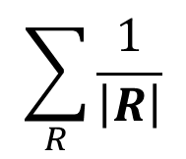
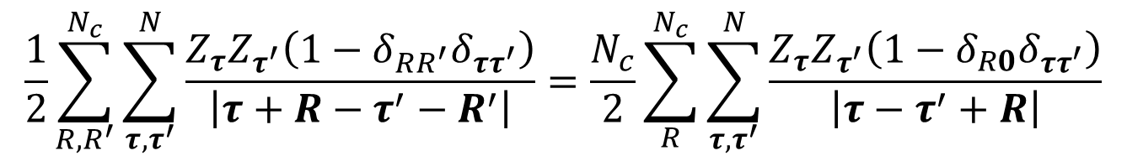
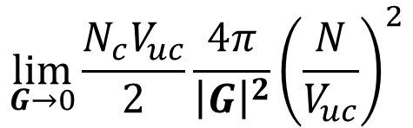
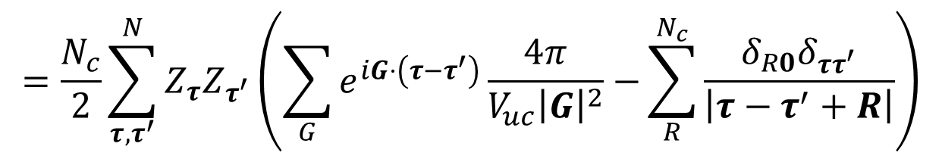
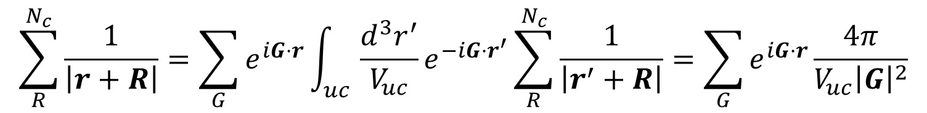
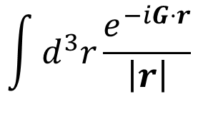
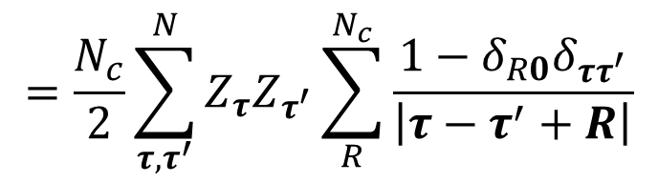
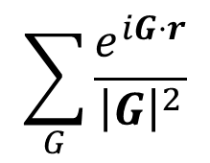
Ion-ion Coulomb repulsion
$$\frac{1}{2}\sum_{R,R^{′}}^{N_{c}}{\sum_{τ,τ^{′}}^{N}{\frac{Z_{τ}Z_{τ^{′}}\left(1−δ_{RR^{′}}δ_{ττ^{′}}\right)}{\left|τ+R−τ^{′}−R^{′}\right|}}}=\frac{N_{c}}{2}\sum_{R}^{N_{c}}{\sum_{τ,τ^{′}}^{N}{\frac{Z_{τ}Z_{τ^{′}}\left(1−δ_{R0}δ_{ττ^{′}}\right)}{\left|τ−τ^{′}+R\right|}}}$$
$$=\frac{N_{c}}{2}\sum_{τ,τ^{′}}^{N}{Z_{τ}Z_{τ^{′}}\sum_{R}^{N_{c}}{\frac{1−δ_{R0}δ_{ττ^{′}}}{\left|τ−τ^{′}+R\right|}}}$$
$$\int{d^{3}r\frac{e^{−iG⋅r}}{\left|r\right|}}$$
$$\sum_{R}^{N_{c}}{\frac{1}{\left|r+R\right|}}=\sum_{G}{e^{iG⋅r}\int_{uc}{\frac{d^{3}r^{′}}{V_{uc}}e^{−iG⋅r^{′}}}\sum_{R}^{N_{c}}{\frac{1}{\left|r^{′}+R\right|}}}=\sum_{G}{e^{iG⋅r}\frac{4π}{V_{uc}{\left|G\right|}^{2}}}$$
$$=\frac{N_{c}}{2}\sum_{τ,τ^{′}}^{N}{Z_{τ}Z_{τ^{′}}\left(\sum_{G}{e^{iG⋅\left(τ−τ^{′}\right)}\frac{4π}{V_{uc}{\left|G\right|}^{2}}−}\sum_{R}^{N_{c}}{\frac{δ_{R0}δ_{ττ^{′}}}{\left|τ−τ^{′}+R\right|}}\right)}$$
$$\lim_{G→0}{\frac{N_{c}V_{uc}}{2}\frac{4π}{{\left|G\right|}^{2}}{\left(\frac{N}{V_{uc}}\right)}^{2}}$$
Slow decay in sum
$$\sum_{R}{\frac{1}{\left|R\right|}}$$
$$\sum_{G}{\frac{e^{iG⋅r}}{{\left|G\right|}^{2}}}$$

Slide 9
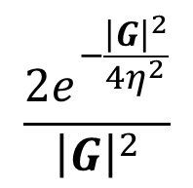
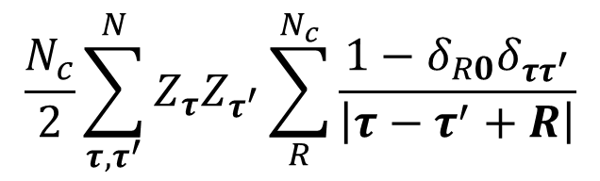
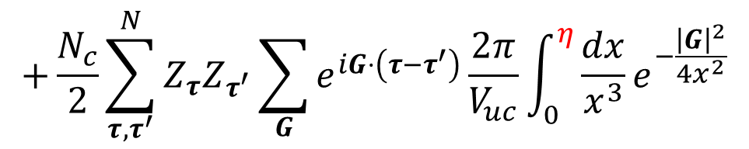
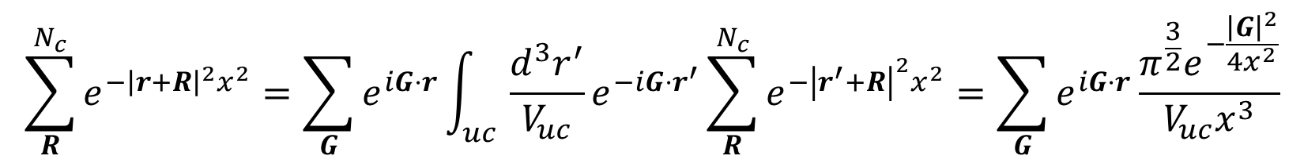
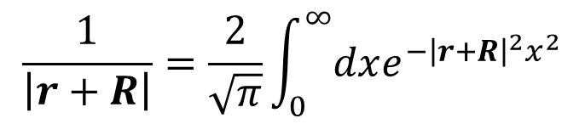
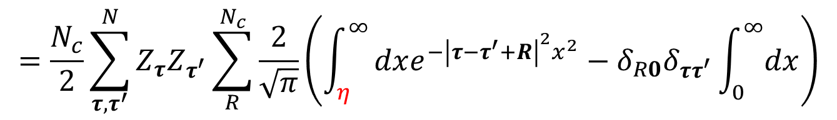

Ewald's method (1)
$$\frac{1}{\left|r+R\right|}=\frac{2}{\sqrt{π}}\int_{0}^{∞}{dxe^{−{\left|r+R\right|}^{2}x^{2}}}$$
$$\sum_{R}^{N_{c}}{e^{−{\left|r+R\right|}^{2}x^{2}}}=\sum_{G}{e^{iG⋅r}\int_{uc}{\frac{d^{3}r^{′}}{V_{uc}}e^{−iG⋅r^{′}}}\sum_{R}^{N_{c}}{e^{−{\left|r^{′}+R\right|}^{2}x^{2}}}}=\sum_{G}{e^{iG⋅r}\frac{π^{\frac{3}{2}}e^{−\frac{{\left|G\right|}^{2}}{4x^{2}}}}{V_{uc}x^{3}}}$$
$$\frac{N_{c}}{2}\sum_{τ,τ^{′}}^{N}{Z_{τ}Z_{τ^{′}}\sum_{R}^{N_{c}}{\frac{1−δ_{R0}δ_{ττ^{′}}}{\left|τ−τ^{′}+R\right|}}}$$
$$=\frac{N_{c}}{2}\sum_{τ,τ^{′}}^{N}{Z_{τ}Z_{τ^{′}}\sum_{R}^{N_{c}}{\frac{2}{\sqrt{π}}\left(\int_{η}^{∞}{dxe^{−{\left|τ−τ^{′}+R\right|}^{2}x^{2}}}−δ_{R0}δ_{ττ^{′}}\int_{0}^{∞}{dx}\right)}}$$
$$+\frac{N_{c}}{2}\sum_{τ,τ^{′}}^{N}{Z_{τ}Z_{τ^{′}}\sum_{G}{e^{iG⋅\left(τ−τ^{′}\right)}\frac{2π}{V_{uc}}}\int_{0}^{η}{\frac{dx}{x^{3}}e^{−\frac{{\left|G\right|}^{2}}{4x^{2}}}}}$$
$$\frac{{2e}^{−\frac{{\left|G\right|}^{2}}{4η^{2}}}}{{\left|G\right|}^{2}}$$
$$\cos\left(G⋅\left(τ−τ^{′}\right)\right)$$

Slide 10
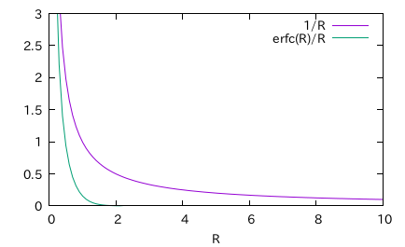
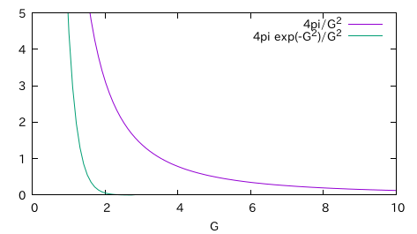
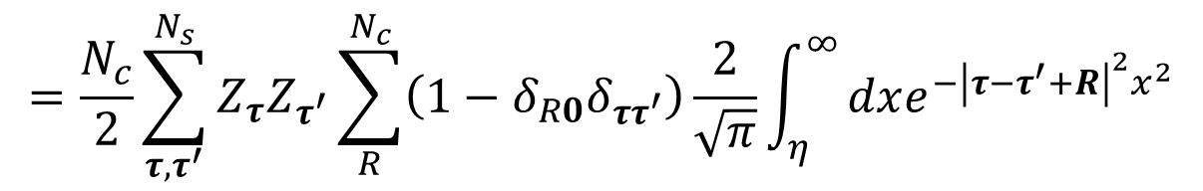
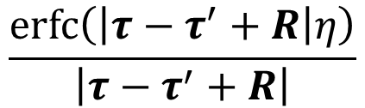
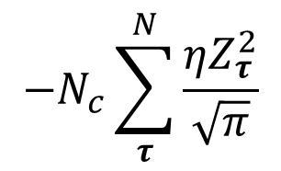
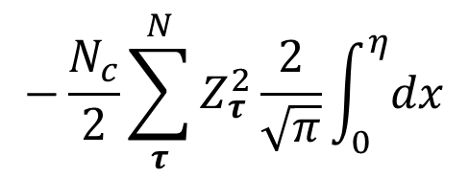
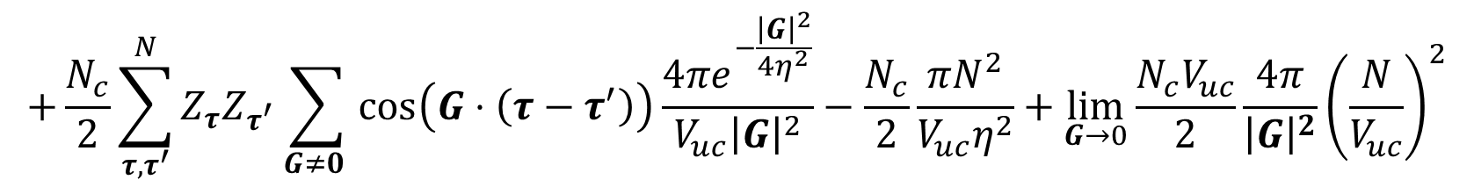
Ewald's method (2)
Complementary
error function
$$=\frac{N_{c}}{2}\sum_{τ,τ^{′}}^{N_{s}}{Z_{τ}Z_{τ^{′}}\sum_{R}^{N_{c}}{\left(1−δ_{R0}δ_{ττ^{′}}\right)\frac{2}{\sqrt{π}}\int_{η}^{∞}{dxe^{−{\left|τ−τ^{′}+R\right|}^{2}x^{2}}}}}$$
$$−\frac{N_{c}}{2}\sum_{τ}^{N}{Z_{τ}^{2}\frac{2}{\sqrt{π}}\int_{0}^{η}{dx}}$$
$$−N_{c}\sum_{τ}^{N}{\frac{ηZ_{τ}^{2}}{\sqrt{π}}}$$
$$\frac{\operatorname{erfc}\left(\left|τ−τ^{′}+R\right|η\right)}{\left|τ−τ^{′}+R\right|}$$
$$+\frac{N_{c}}{2}\sum_{τ,τ^{′}}^{N}{Z_{τ}Z_{τ^{′}}\sum_{G≠0 }{\cos\left(G⋅\left(τ−τ^{′}\right)\right)\frac{{4πe}^{−\frac{{\left|G\right|}^{2}}{4η^{2}}}}{V_{uc}{\left|G\right|}^{2}}}}−\frac{N_{c}}{2}\frac{πN^{2}}{V_{uc}η^{2}}+\lim_{G→0}{\frac{N_{c}V_{uc}}{2}\frac{4π}{{\left|G\right|}^{2}}{\left(\frac{N}{V_{uc}}\right)}^{2}}$$

Slide 11
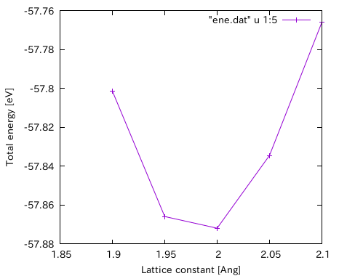
Optimize lattice constant
($ bash vol.sh)
$ grep "Total energy" scf*.out | \
sed -e 's/scf//g' -e 's/.out://g' > ene.dat
$ gnuplot
gnuplot> set xlabel "Lattice constant [Ang]"
gnuplot> set ylabel "Total energy [eV]"
gnuplot> plot "ene.dat" u 1:5 w lp

Slide 12
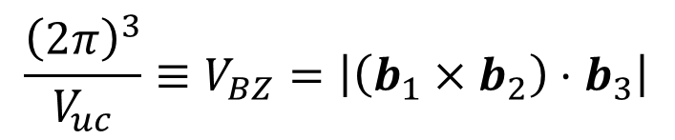
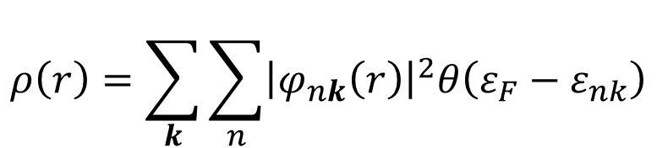

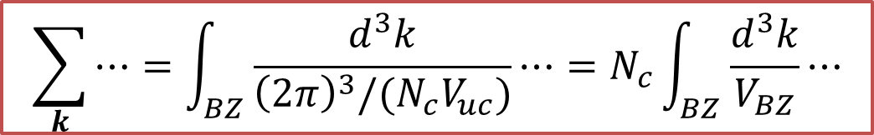
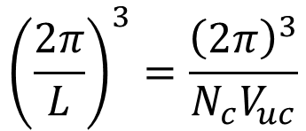

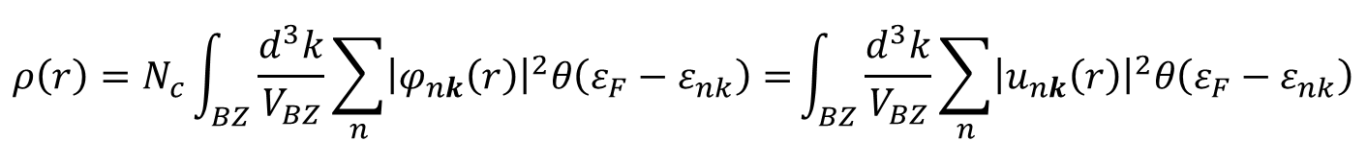
Brillouin-zone integration
$$ρ\left(r\right)=\sum_{k}{\sum_{n}{{\left|φ_{nk}\left(r\right)\right|}^{2}θ\left(ε_{F}−ε_{nk}\right)}}$$
Born-von Karman's boundary condition :
$$φ_{nk}\left(r+L\right)=φ_{nk}\left(r\right) :L→∞$$
$${\left(\frac{2π}{L}\right)}^{3}=\frac{{\left(2π\right)}^{3}}{N_{c}V_{uc}}$$
The size of each state in the reciprocal space :
$$\sum_{k}{⋯}=\int_{BZ}{\frac{d^{3}k}{{\left(2π\right)}^{3}/(N_{c}V_{uc})}⋯}=N_{c}\int_{BZ}{\frac{d^{3}k}{V_{BZ}}⋯}$$
$$V_{uc}=\left|\left(a_{1}×a_{2}\right)⋅a_{3}\right|$$
$$\frac{{\left(2π\right)}^{3}}{V_{uc}}≡V_{BZ}=\left|\left(b_{1}×b_{2}\right)⋅b_{3}\right|$$
$$ρ\left(r\right)=N_{c}\int_{BZ}{\frac{d^{3}k}{V_{BZ}}\sum_{n}{{\left|φ_{nk}\left(r\right)\right|}^{2}θ\left(ε_{F}−ε_{nk}\right)}=}\int_{BZ}{\frac{d^{3}k}{V_{BZ}}\sum_{n}{{\left|u_{nk}\left(r\right)\right|}^{2}θ\left(ε_{F}−ε_{nk}\right)}}$$

Slide 13

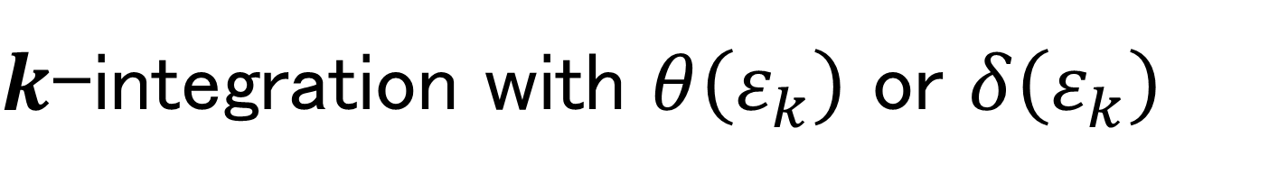

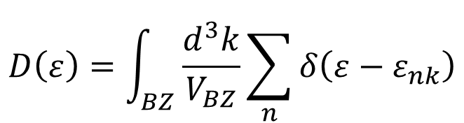
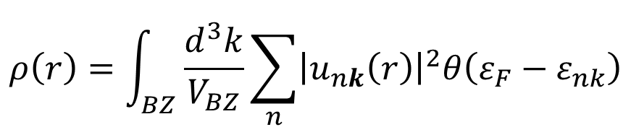
$k$-integration with $θ\left(ε_{k}\right)$ or $δ\left(ε_{k}\right)$
Charge density
Density of states
$$ρ\left(r\right)=\int_{BZ}{\frac{d^{3}k}{V_{BZ}}\sum_{n}{{\left|u_{nk}\left(r\right)\right|}^{2}θ\left(ε_{F}−ε_{nk}\right)}}$$
$$D\left(ε\right)=\int_{BZ}{\frac{d^{3}k}{V_{BZ}}\sum_{n}{δ\left(ε−ε_{nk}\right)}}$$
Using $θ(ε_{F}−ε_{nk})$ as is
Too many k points are required.
$$N_{k}$$
Broadening
M. Methfessel, A. T. Paxton, Phys. Rev. B 40, 3616 (1989).
Replace $θ(ε_{F}−ε_{nk})$ with a smeared function such as the error function.
Tetrahedron
O. Jepsen and O. K. Andersen, Solid State Commun. 9, 1763 (1971).

Slide 14

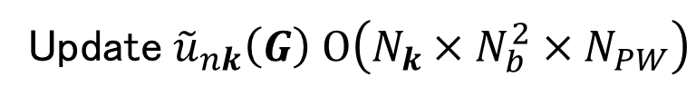
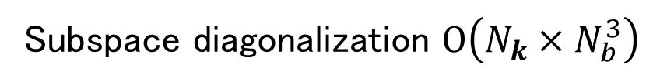

Why we need to reduce $k$-points?
E.g. 1 DFT calculation of crystals with plane wave and pseudopotencial.
$v_{KS}\left(r\right)u_{nk}\left(r\right)$ (for all orbitals) $O\left(N_{k}×N_{b}×N_{PW}\log{N_{PW}}\right)$
Subspace diagonalization $O\left(N_{k}×N_{b}^{3}\right)$
Update${\tilde{u}}_{nk}\left(G\right) O\left(N_{k}×N_{b}^{2}×N_{PW}\right)$
E.g. 2 Hartree-Fock, hybrid DFT, TC, GW
${\hat{v}}_{Fock}u_{nk}\left(r\right)$ (for all orbitals) $O\left(N_{k}^{2}×N_{b}^{2}×N_{PW}\log{N_{PW}}\right)$
※ $N_{b}$ ～ The number of electrons
The reduction of k-points without loss of accuracy is the best way for efficient calculation.

Slide 15

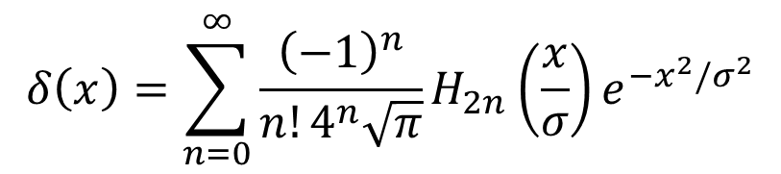
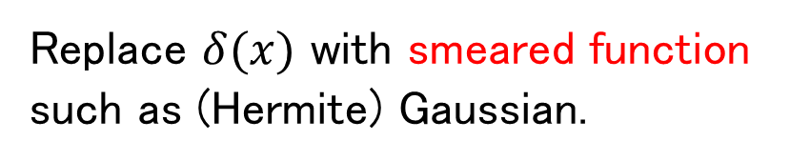


Broadening method
We can calculate only on discrete k-points.
$$ε_{k}$$
Replace $δ(x)$ with smeared function such as (Hermite) Gaussian.
$$δ\left(x\right)=\sum_{n=0}^{∞}{\frac{{\left(−1\right)}^{n}}{{n!4}^{n}\sqrt{π}}H_{2n}\left(\frac{x}{σ}\right)e^{−x^{2}/σ^{2}}}$$
M. Methfessel and A. T. Paxton, Phys. Rev. B 40, 3616 (1989).
This method becomes worse when smeared function not cover all energy range.
$$σ$$
$$k$$
True band structure

Slide 16

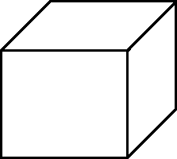
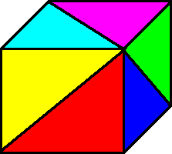

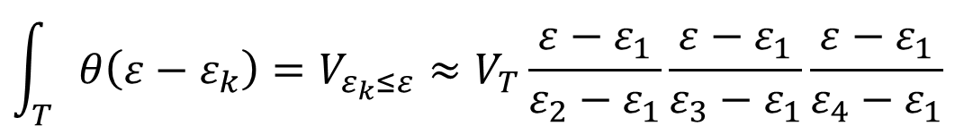










Interpolation method libtetrabz_occ_main@libtetrabz/libtetrabz_occ_mod.F90
$$ε_{1}$$
O. Jepsen and O. K. Andersen, Solid State Commun. 9, 1763 (1971)
$$ε_{4}$$
$$V_{T}$$
$$V_{T}=\frac{V_{BZ}}{6N_{k}}$$
$$ε_{2}$$
$$ε_{3}$$
When we use linear interpolation, the next is satisfied.
If $ε_{1}≤ε≤ε_{2}≤ε_{3}≤ε_{4}$,
$$\int_{T}{θ\left(ε−ε_{k}\right)}=V_{ε_{k}≤ε}≈V_{T}\frac{ε−ε_{1}}{ε_{2}−ε_{1}}\frac{ε−ε_{1}}{ε_{3}−ε_{1}}\frac{ε−ε_{1}}{ε_{4}−ε_{1}}$$
$$\int_{T}{δ\left(ε−ε_{k}\right)}=\frac{∂}{∂ε}\int_{T}{θ\left(ε−ε_{k}\right)}$$
These expressions are not applicable for higher order (2nd , 3rd ・・・) interpolation !
If $ε_{1}≤ε_{2}≤ε≤ε_{3}≤ε_{4}, ⋯$
If $ε_{1}≤ε_{2}≤ε_{3}≤ε≤ε_{4}, ⋯$
If $ε_{1}≤ε_{2}≤ε_{3}≤ε_{4}≤ε, ⋯$

Slide 17
Systematic error in tetrahedron method
(Traditional) tetrahedron method linearly interpolate the function of k (such as wave function, KS energy, etc. ).
T
T
If the sign of curvature of these function is always negative, we overestimete.
Not Interpolating
But Fitting

Slide 18




Optimized tetrahedron method
M. Kawamura et al., Phys. Rev. B 89, 094515 (2014).
Optimized tetrahedron method
Conventional tetrahedron method
T
T
$$k$$
$$k$$
Higher order interpolation of $ε_{k}$, etc.
Fit this function into a linear function in the tetrahedron
Tetrahedron method with fitted linear function
Linear interpolation of $ε_{k}$, etc.
Tetrahedron method with interpolated linear function

Slide 19







Library of tetrahedron method
LibTetraBZ
http://libtetrabz.osdn.jp/
Fortran/C/C++
MPI + OpenMP (Thread safe)
$$\sum_{n}{\int_{BZ}{\frac{d^{3}k}{V_{BZ}}δ\left(ε−ε_{nk}\right)}X_{nk}}$$
$$\sum_{n,n^{′}}{\int_{BZ}{\frac{d^{3}k}{V_{BZ}}δ\left(ε_{F}−ε_{nk}\right)δ\left(ε_{F}−ε_{n^{′}k}^{′}\right)X_{nn^{′}k}}}$$
$$\sum_{n}{\int_{BZ}{\frac{d^{3}k}{V_{BZ}}θ\left(ε−ε_{nk}\right)X_{nk}}}$$
$$\sum_{n,n^{′}}{\int_{BZ}{\frac{d^{3}k}{V_{BZ}}θ\left(ε_{n^{′}k}^{′}−ε_{F}\right)θ\left(ε_{F}−ε_{nk}\right)X_{nn^{′}k}}}$$
$$\sum_{n,n^{′}}{\int_{BZ}{\frac{d^{3}k}{V_{BZ}}\frac{θ\left(ε_{n^{′}k}^{′}−ε_{F}\right)θ\left(ε_{F}−ε_{nk}\right)}{ε_{n^{′}k}^{′}−ε_{nk}}X_{nn^{′}k}}}$$
$$\sum_{n,n^{′}}{\int_{BZ}{\frac{d^{3}k}{V_{BZ}}θ\left(ε_{F}−ε_{n^{′}k}^{′}\right)θ\left(ε_{F}−ε_{nk}\right)δ\left(ε_{n^{′}k}^{′}−ε_{nk}+ω\right)X_{nn^{′}k}(ω)}}$$
$$\sum_{n,n^{′}}{\int_{BZ}{\frac{d^{3}k}{V_{BZ}}\frac{θ\left(ε_{F}−ε_{n^{′}k}^{′}\right)θ\left(ε_{F}−ε_{nk}\right)}{ε_{n^{′}k}^{′}−ε_{nk}+iω}X_{nn^{′}k}(ω)}}$$

Slide 20


LibTetraBZ
$ cd ~/
$ git clone git://git.osdn.net/gitroot/libtetrabz/libtetrabz.git
$ cd libtetrabz
$ touch Makefile.in aclocal.m4 configure
$ ./configure; make
$ cd example
$ ./dos.x
Which tetrahedron method ?(1 = Linear, 2 = Optimized): 2⏎
k-point mesh ?: 10⏎
$ gnuplot
gnuplot> set xlabel "Energy"
gnuplot> set ylabel "DOS"
gnuplot> plot "dos.dat" w l
$$ε_{k}=−\cos{k_{x}}−\cos{k_{y}}−\cos{k_{z}}$$

Slide 21










Fermi energy with bisection method libtetrabz_fermieng@libtetrabz/src/libtetrabz_occ_mod.F90
$$N=\sum_{n}{\int_{BZ}{\frac{d^{3}k}{V_{BZ}}θ\left(ε_{F}−ε_{nk}\right)}}$$
$$ε_{up}=\max{\{ε_{nk}\}}$$
$$ε_{low}=\min{\{ε_{nk}\}}$$
do iteration
$$ε_{F}=\left(ε_{up}+ε_{low}\right)/2$$
$$\tilde{N}=\sum_{n}{\int_{BZ}{\frac{d^{3}k}{V_{BZ}}θ\left(ε_{F}−ε_{nk}\right)}}$$
if $\left|\tilde{N}<N\right|$ is small → Finish
else if $\tilde{N}<N$
$$ε_{low}=ε_{F}$$
else if $\tilde{N}>N$
$$ε_{up}=ε_{F}$$
end if
end do iteration

Slide 22

Iso surface with tetrahedron method
FermiSurfer
Input file format
http://fermisurfer.osdn.jp/en/_build/html/fermisf_input_en.html

Slide 23


Report problem 3
(1) Modify dos.F90 or dos_c.c to compute DOS with Gaussian broadening method.
$$\int_{BZ}{\frac{d^{3}k}{V_{BZ}}δ\left(ε−ε_{k}\right)}≈\frac{1}{N_{k}}\sum_{k}^{N_{k}}{\frac{1}{σ\sqrt{π}}e^{−{\left(\frac{ε−ε_{k}}{σ}\right)}^{2}}}$$
Plot DOS at each $N_{k}$ and $σ$, then compare with tetrahedron methods (Linear and optimized)
Note:
Replace
call libtetrabz_fermieng(ltetra,bvec,nb,nge,eig,ngw,wght,ef,nelec)
to
ef = 0.0d0
(2) Output $ε_{k}$ and $\left|∇_{k}ε_{k}\right|$ in the FermiSurfer format (vf.frmsf).
Modified code should be submitted as a diff file generated by
$ cd ~/libtetrabz/
$ git add example
$ git commit
$ git show > 12212018.diff

Slide 24
Today's summary
Total energy
Hartree, atomic, XC, kinetic, Ewald energy
Coulomb repulsion of periodically aligned ions is computed efficiently with Ewald's method.
Brillouin zone integration
Tetrahedron method
Optimized tetrahedron method
Library
Fermi surface

