Slide 1
物質科学のための計算数理 II
Numerical Analysis for Material Science II
12th: Density Functional Theory (5)
Dec. 25 (Tue)
Lecturer: Mitsuaki Kawamura (河村光晶)

Slide 2
Schedule (This semester W1, W2)
Sep. 28 (Fri) Guidance Y
Oct. 5 (Fri) Monte Carlo method O
Oct. 12 (Fri) Monte Carlo method O
Oct. 19 (Fri) Monte Carlo method O
Oct. 26 (Fri) Exact diagonalization Y
Nov. 2 (Fri) Exact diagonalization Y
Nov. 9 (Fri) Molecular dynamics O (1st report problem will be announced.)
Nov. 30 (Fri) Density functional theory K
Dec. 7 (Fri) Density functional theory K
Dec. 14 (Fri) Density functional theory K
Dec. 21 (Fri) Density functional theory K
Dec. 25 (Tue) Density functional theory K (遠隔講義室)
Jan. 11 (Fri) (2nd)Report problem K
※ Lecturers: Y … Yamaji, K … Kawamura, O… Ohgoe

Slide 3
Schedule in this section (DFT)
Nov. 30 (Fri) Standard DFT code
First-principles calculation and Density functional theory (Lecture)
One-body Schrödinger eq. for periodic system and Bloch theorem (L)
Numerical solution of Kohn-Sham (one-body Schrödinger) eq. (L)
Hands-on DFT code (Tutorial)
Version control system : Git (T)
Dec. 7 (Fri) Kohn-Sham eq.
Plane-wave basis and Pseudopotentials (L)
Iterative eigenvalue solution method (L & T)
Dec. 14 (Fri) Self-Consistent loop
Hartree potential (Poisson eq.), Atomic potential, XC potential
Update (Broyden's method)
Visualization of grid data (T)
Dec. 21 (Fri) Total Energy
Total energy
Brillouin-zone integral (Tetrahedron method)
Coulomb potential for periodic point charge (Ewald sum)
Dec. 25 (Tue) Advanced subjects for productive calculation (遠隔講義室)
Generalized gradient correction
Non-local pseudopotentials (Norm-conserving, ultrasoft, PAW)
Magnetism
Jan. 11 (Fri) Parctice

Slide 4
Today’s Schedule
Spin density functional theory
Collinear magnetism
Non-collinear magnetism
Beyond local density approximation
Generalized gradient approximation
Non-local pseudopotential
Norm conserving pseudopotential
Ultrasoft pseudopotential
Projector augmented wave (PAW)
Pseudopotential library

Slide 5
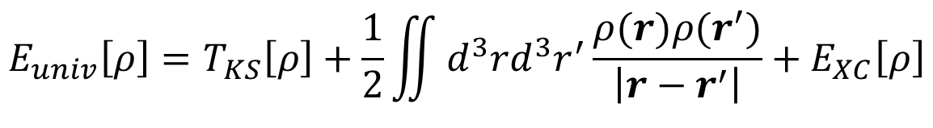
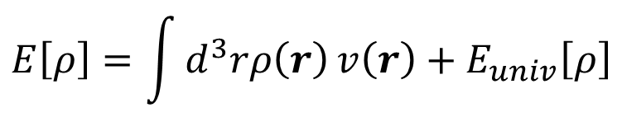
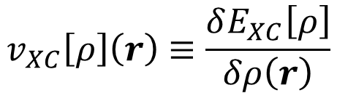
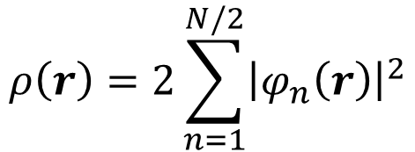
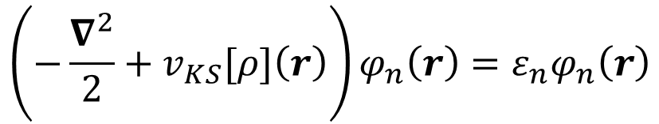
Density functional theory in non-spin polarized case
$$E\left[ρ\right]=\int{d^{3}rρ\left(r\right)}v\left(r\right)+E_{univ}\left[ρ\right]$$
$$E_{univ}\left[ρ\right]=T_{KS}\left[ρ\right]+\frac{1}{2}\iint{d^{3}rd^{3}r^{′}\frac{ρ(r)ρ(r^{′})}{\left|r−r^{′}\right|}}+E_{XC}\left[ρ\right]$$
$$\left(−\frac{∇^{2}}{2}+v_{KS}[ρ]\left(r\right)\right)φ_{n}\left(r\right)=ε_{n}φ_{n}\left(r\right)$$
$$v_{XC}\left[ρ\right]\left(r\right)≡\frac{δE_{XC}\left[ρ\right]}{δρ\left(r\right)}$$
$$ρ\left(r\right)=2\sum_{n=1}^{N/2}{{\left|φ_{n}\left(r\right)\right|}^{2}}$$

Slide 6
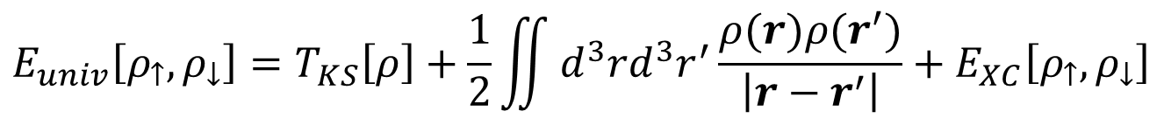
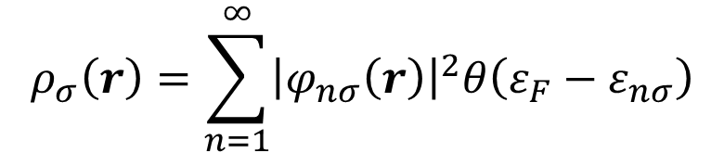
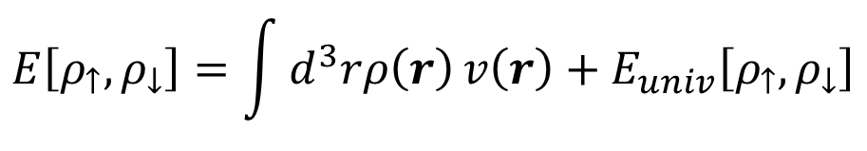
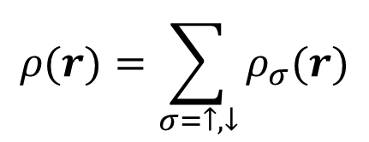
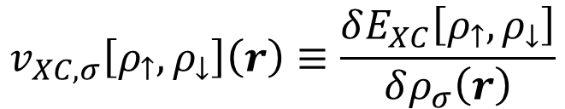
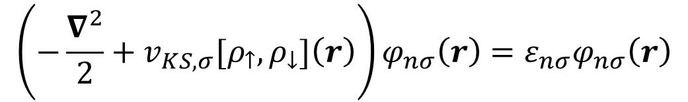
Spin density functional theory
$$E\left[ρ_{↑},ρ_{↓}\right]=\int{d^{3}rρ\left(r\right)}v\left(r\right)+E_{univ}\left[ρ_{↑},ρ_{↓}\right]$$
$$E_{univ}\left[ρ_{↑},ρ_{↓}\right]=T_{KS}\left[ρ\right]+\frac{1}{2}\iint{d^{3}rd^{3}r^{′}\frac{ρ(r)ρ(r^{′})}{\left|r−r^{′}\right|}}+E_{XC}\left[ρ_{↑},ρ_{↓}\right]$$
$$\left(−\frac{∇^{2}}{2}+v_{KS,σ}[ρ_{↑},ρ_{↓}]\left(r\right)\right)φ_{nσ}\left(r\right)=ε_{nσ}φ_{nσ}\left(r\right)$$
$$v_{XC,σ}\left[ρ_{↑},ρ_{↓}\right]\left(r\right)≡\frac{δE_{XC}\left[ρ_{↑},ρ_{↓}\right]}{δρ_{σ}\left(r\right)}$$
$$ρ_{σ}\left(r\right)=\sum_{n=1}^{∞}{{\left|φ_{nσ}\left(r\right)\right|}^{2}θ\left(ε_{F}−ε_{nσ}\right)}$$
$$ρ(r)=\sum_{σ=↑,↓}{ρ_{σ}(r)}$$

Slide 7
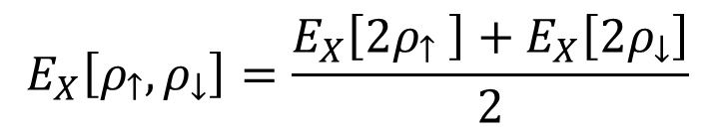
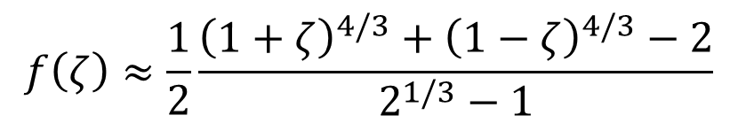


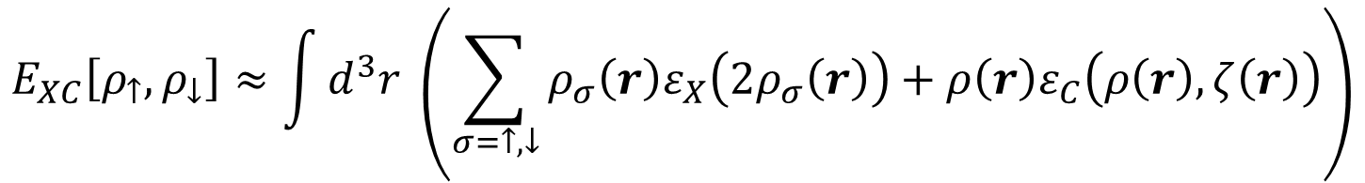
Exchange correlation energy
$$E_{XC}\left[ρ_{↑},ρ_{↓}\right]$$
$$E_{X}\left[ρ_{↑},ρ_{↓}\right]=\frac{E_{X}\left[{2ρ}_{↑} \right]+E_{X}\left[2ρ_{↓}\right]}{2}$$
The "exchange" effect acts only the same spin.
Local Spin Density Approximation (LSDA)
$$E_{XC}\left[ρ_{↑},ρ_{↓}\right]≈\int{d^{3}r \left(\sum_{σ=↑,↓}{ρ_{σ}\left(r\right)ε_{X}\left(2ρ_{σ}\left(r\right)\right)}+ρ\left(r\right)ε_{C}\left(ρ\left(r\right),ζ\left(r\right)\right)\right)}$$
$$ζ=\left(ρ_{↑}−ρ_{↓}\right)/ρ$$
$$ε_{C}\left(ρ,ζ\right)=ε_{C}\left(ρ,0\right)\left(1−f\left(ζ\right)\right)+ε_{C}\left(ρ,1\right)f\left(ζ\right)$$
$$f\left(ζ\right)≈\frac{1}{2}\frac{{\left(1+ζ\right)}^{4/3}+{\left(1−ζ\right)}^{4/3}−2}{2^{1/3}−1}$$

Slide 8
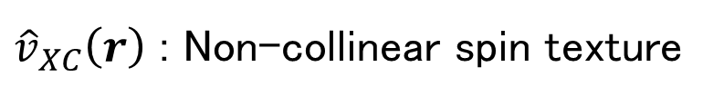

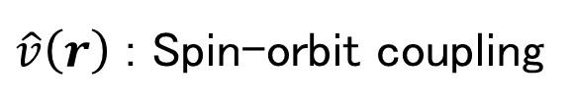

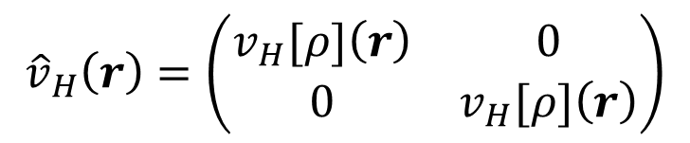
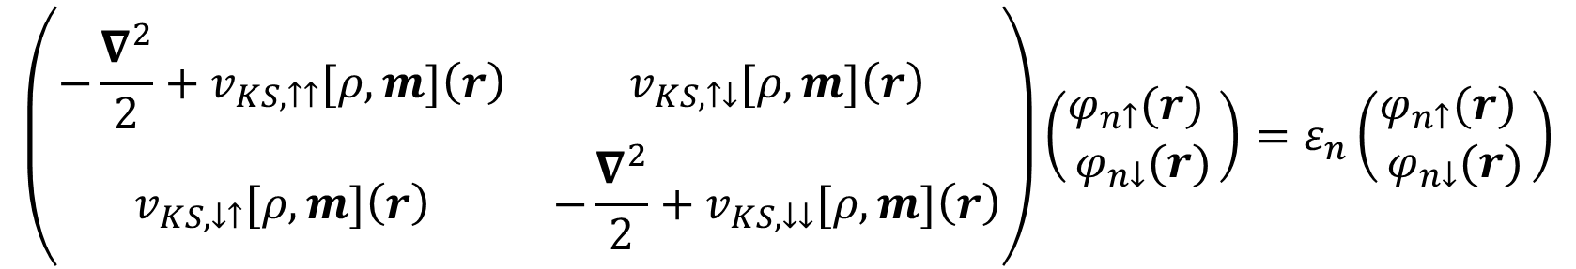

Collinear and non-collinear spin
$$ρ_{↑}(r),ρ_{↓}(r)$$
$$ρ(r),m_{z}(r)$$
$$ρ\left(r\right),m_{x}\left(r\right),m_{y}\left(r\right),m_{z}(r)$$
$$\left(\begin{matrix}−\frac{∇^{2}}{2}+v_{KS,↑↑}[ρ,m]\left(r\right) & v_{KS,↑↓}[ρ,m]\left(r\right) \\ v_{KS,↓↑}[ρ,m]\left(r\right) & −\frac{∇^{2}}{2}+v_{KS,↓↓}[ρ,m]\left(r\right)\end{matrix}\right)\left(\begin{matrix}φ_{n↑}(r) \\ φ_{n↓}(r)\end{matrix}\right)=ε_{n}\left(\begin{matrix}φ_{n↑}(r) \\ φ_{n↓}(r)\end{matrix}\right)$$
$${\hat{v}}_{H}\left(r\right)=\left(\begin{matrix}v_{H}[ρ]\left(r\right) & 0 \\ 0 & v_{H}[ρ]\left(r\right)\end{matrix}\right)$$
$\hat{v}\left(r\right)$ : Spin-orbit coupling
${\hat{v}}_{XC}\left(r\right)$ : Non-collinear spin texture

Slide 9
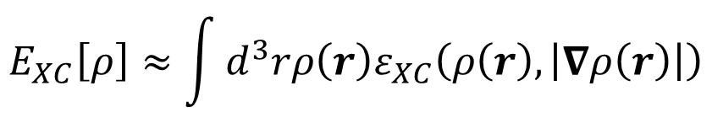
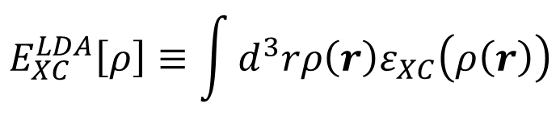
Beyond LDA : Generalized Gradient Approximation (GGA)
$$E_{XC}^{LDA}\left[ρ\right]≡\int{d^{3}rρ\left(r\right)ε_{XC}\left(ρ\left(r\right)\right)}$$
Underestimate bandgaps
Overestimate cohesive energy → Underestimate lattice constatnt
Magnetic state of 3d metals (e.g. the ferromagnetic bcc structure of Fe does not become the most stable state.)
$$E_{XC}\left[ρ\right]≈\int{d^{3}rρ\left(r\right)ε_{XC}\left(ρ\left(r\right),\left|∇ρ\left(r\right)\right|\right)}$$
Gradient expansion approximation (GEA)
is not improved from LDA.
Gradient is large in practice → The expansion is not so appropriate.
Generalized Gradient approximation
More flexible form
Preserve known desired conditions.

Slide 10
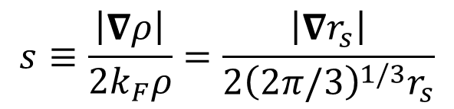
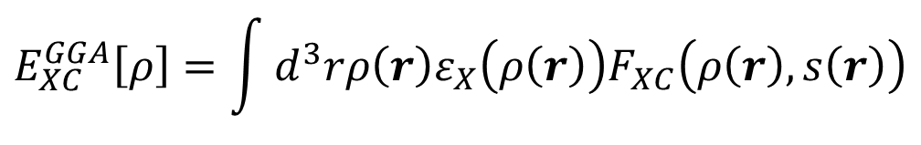
GGA functional
$$E_{XC}^{GGA}\left[ρ\right]=\int{d^{3}rρ\left(r\right)ε_{X}\left(ρ\left(r\right)\right)F_{XC}\left(ρ\left(r\right),s\left(r\right)\right)}$$
$$s≡\frac{\left|∇ρ\right|}{2k_{F}ρ}=\frac{\left|∇r_{s}\right|}{2{\left(2π/3\right)}^{1/3}r_{s}}$$
Fig. 8.1 of "Electronic Structure"
by R. M. Martin
Fig. 8.2 of "Electronic Structure"
by R. M. Martin

Slide 11
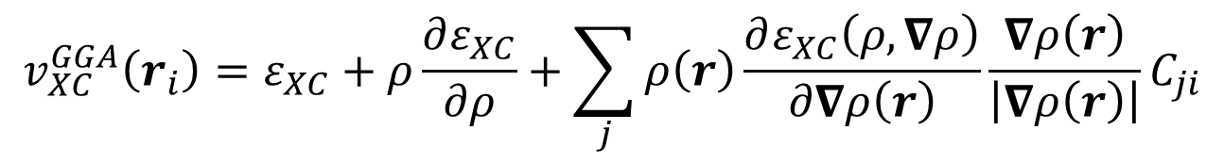
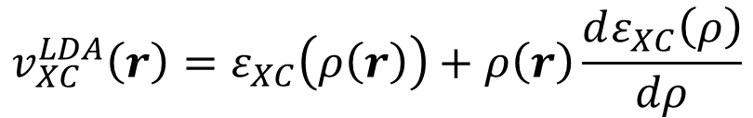
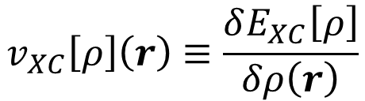
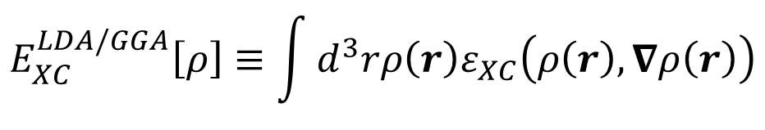
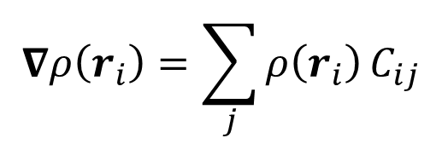
GGA XC potential
$$E_{XC}^{LDA/GGA}\left[ρ\right]≡\int{d^{3}rρ\left(r\right)ε_{XC}\left(ρ\left(r\right),∇ρ\left(r\right)\right)}$$
$$v_{XC}\left[ρ\right]\left(r\right)≡\frac{δE_{XC}\left[ρ\right]}{δρ\left(r\right)}$$
$$v_{XC}^{LDA}\left(r\right)=ε_{XC}\left(ρ\left(r\right)\right)+ρ\left(r\right)\frac{dε_{XC}\left(ρ\right)}{dρ}$$
$$δE_{XC}^{GGA}\left[ρ\right]=\int{d^{3}r}\left(ε_{XC}δρ\left(r\right)+ρ\left(r\right)\frac{∂ε_{XC}\left(ρ,∇ρ\right)}{∂ρ(r)}δρ\left(r\right)+ρ\left(r\right)\frac{∂ε_{XC}\left(ρ,∇ρ\right)}{∂∇ρ\left(r\right)}δ∇ρ\left(r\right)\right)$$
$${\hat{v}}_{XC}^{GGA}=ε_{XC}\left(ρ\left(r\right),∇ρ\left(r\right)\right)+ρ\left(r\right)\frac{∂ε_{XC}\left(ρ,∇ρ\right)}{∂ρ(r)}+ρ\left(r\right)\frac{∂ε_{XC}\left(ρ,∇ρ\right)}{∂∇ρ\left(r\right)}⋅∇$$
$$v_{XC}^{GGA}\left(r\right)=ε_{XC}\left(ρ\left(r\right),∇ρ\left(r\right)\right)+ρ\left(r\right)\frac{∂ε_{XC}\left(ρ,∇ρ\right)}{∂ρ(r)}−∇\left(ρ\left(r\right)\frac{∂ε_{XC}\left(ρ,∇ρ\right)}{∂∇ρ\left(r\right)}\right)$$
$$v_{XC}^{GGA}\left(r_{i}\right)=ε_{XC}+ρ\frac{∂ε_{XC}}{∂ρ}+\sum_{j}{ρ\left(r\right)\frac{∂ε_{XC}\left(ρ,∇ρ\right)}{∂∇ρ\left(r\right)}}\frac{∇ρ\left(r\right)}{\left|∇ρ\left(r\right)\right|}C_{ji}$$
$$∇ρ\left(r_{i}\right)=\sum_{j}{ρ\left(r_{i}\right)}C_{ij}$$

Slide 12
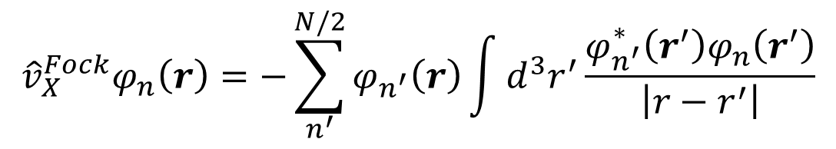

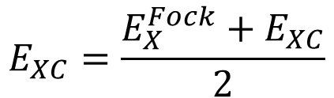
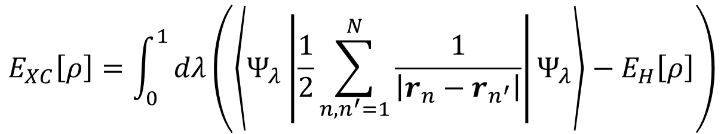


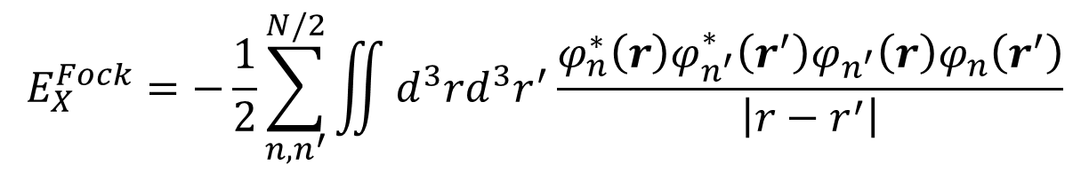
Beyond LDA : Hybrid functional
Coupling constant integral (adiabatic connection) form
$$E_{XC}\left[ρ\right]=\int_{0}^{1}{dλ\left(\left\langle Ψ_{λ}\left|\frac{1}{2}\sum_{n,n^{′}=1}^{N}{\frac{1}{\left|r_{n}−r_{n^{′}}\right|}}\right|Ψ_{λ}\right\rangle −E_{H}\left[ρ\right]\right)}$$
$$E_{X}^{Fock}=−\frac{1}{2}\sum_{n,n^{′}}^{N/2}{\iint{d^{3}rd^{3}r^{′}\frac{φ_{n}^{∗}\left(r\right){φ_{n^{′}}^{∗}\left(r^{′}\right)φ_{n^{′}}\left(r\right)φ}_{n}\left(r^{′}\right)}{\left|r−r^{′}\right|}}}$$
$$λ=1$$
$$λ=0$$
$$E_{XC}^{GGA}\left[ρ\right]$$
$$E_{XC}=\frac{E_{X}^{Fock}+E_{XC}}{2}$$
$${\hat{v}}_{X}^{Fock}φ_{n}\left(r\right)=−\sum_{n^{′}}^{N/2}{φ_{n^{′}}\left(r\right)\int{d^{3}r^{′}\frac{φ_{n^{′}}^{∗}\left(r^{′}\right)φ_{n}\left(r^{′}\right)}{\left|r−r^{′}\right|}}}$$
For PW basis, it can be done with FFT. $O\left(N_{k}^{2}N_{b}^{2}N_{PW}\log{N_{PW}}\right)$

Slide 13
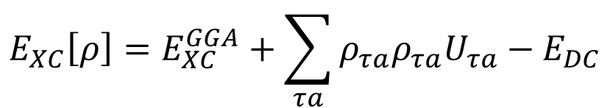
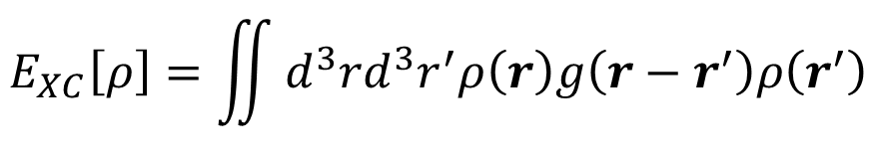
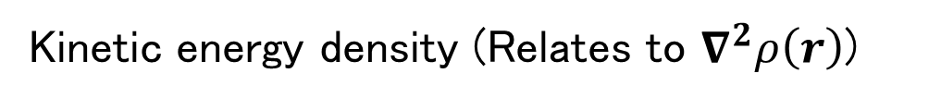
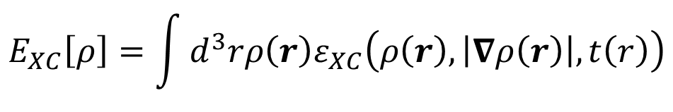
Beyond LDA : Other functional
van der Waals functional
$$E_{XC}\left[ρ\right]=\iint{d^{3}rd^{3}r^{′}ρ\left(r\right)g\left(r−r^{′}\right)ρ\left(r^{′}\right)}$$
Organic solid
Graphite (layer distance)
Mirror potential for surface
DFT+U
$$E_{XC}\left[ρ\right]=E_{XC}^{GGA}+\sum_{τa}{ρ_{τa}ρ_{τa}U_{τa}}−E_{DC}$$
meta-GGA
$$E_{XC}\left[ρ\right]=\int{d^{3}rρ\left(r\right)ε_{XC}\left(ρ\left(r\right),\left|∇ρ\left(r\right)\right|,t\left(r\right)\right)}$$
Kinetic energy density (Relates to $∇^{2}ρ\left(r\right)$)

Slide 14
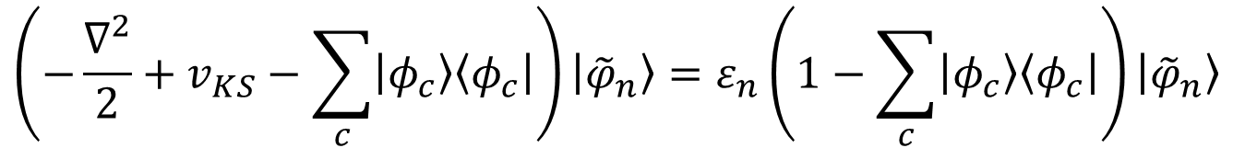
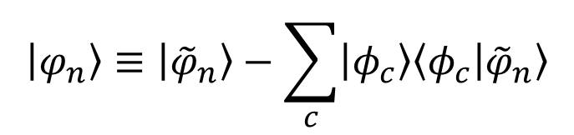
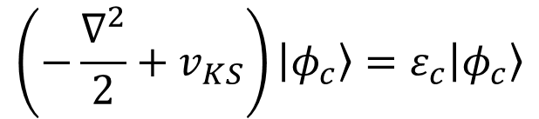
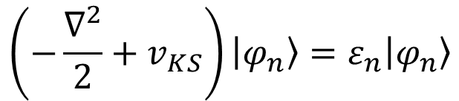
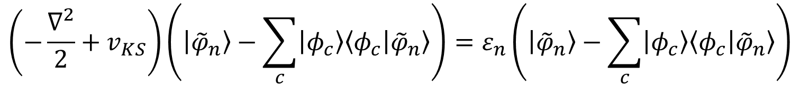


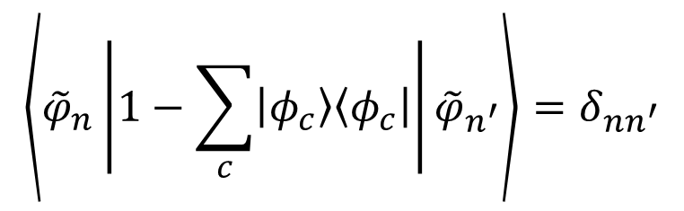
Modern pseudopotential
Concept of modern pseudopotential : Orthogonalized Plane Wave (OPW)
$$\left(−\frac{∇^{2}}{2}+v_{KS}\right)|φ_{n}〉=ε_{n}|φ_{n}〉$$
$$〈φ_{c} | φ_{c^{′}}〉=δ_{cc^{′}}$$
$$〈φ_{c} | φ_{n}〉=0$$
$$|φ_{n}〉≡|{\tilde{φ}}_{n}〉−\sum_{c}{|φ_{c}〉〈φ_{c} | {\tilde{φ}}_{n}〉}$$
$$\left(−\frac{∇^{2}}{2}+v_{KS}\right)|φ_{c}〉=ε_{c}|φ_{c}〉$$
$$\left(−\frac{∇^{2}}{2}+v_{KS}\right)\left(|{\tilde{φ}}_{n}〉−\sum_{c}{|φ_{c}〉〈φ_{c} | {\tilde{φ}}_{n}〉}\right)=ε_{n}\left(|{\tilde{φ}}_{n}〉−\sum_{c}{|φ_{c}〉〈φ_{c} | {\tilde{φ}}_{n}〉}\right)$$
$$\left(−\frac{∇^{2}}{2}+v_{KS}−\sum_{c}{|φ_{c}〉〈φ_{c}|}\right)|{\tilde{φ}}_{n}〉=ε_{n}\left(1−\sum_{c}{|φ_{c}〉〈φ_{c}|}\right)|{\tilde{φ}}_{n}〉$$
$$\left\langle {\tilde{φ}}_{n}\left|1−\sum_{c}{|φ_{c}〉〈φ_{c}|}\right|{\tilde{φ}}_{n^{′}}\right\rangle =δ_{nn^{′}}$$

Slide 15





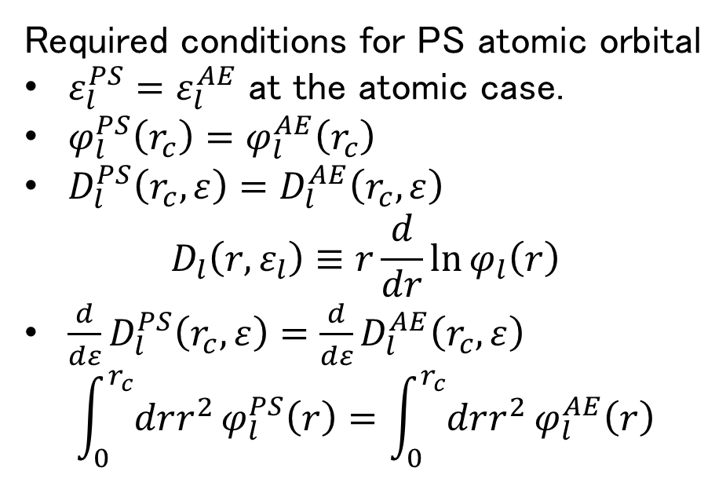
Norm conserving pseudopotential
What is the good pseudopotential (PS)
Only requires small cutoff for plane wave. ↔ Shallow
Reproduce the result of the all-electron (AE) calculation at various cases (atoms, molecule, solid, ...) → Transferability
Required conditions for PS atomic orbital
$ε_{l}^{PS}=ε_{l}^{AE}$ at the atomic case.
$φ_{l}^{PS}\left(r_{c}\right)=φ_{l}^{AE}\left(r_{c}\right)$
$D_{l}^{PS}\left(r_{c},ε\right)=D_{l}^{AE}\left(r_{c},ε\right)$
$$D_{l}\left(r,ε_{l}\right)≡r\frac{d}{dr}\ln{φ_{l}\left(r\right)}$$
$\frac{d}{dε}D_{l}^{PS}\left(r_{c},ε\right)={\frac{d}{dε}D}_{l}^{AE}\left(r_{c},ε\right)$
$$\int_{0}^{r_{c}}{drr^{2}}φ_{l}^{PS}\left(r\right)=\int_{0}^{r_{c}}{drr^{2}}φ_{l}^{AE}\left(r\right)$$
$$φ_{l}^{AE}\left(r\right)$$
$$φ_{l}^{PS}\left(r\right)$$
$$r$$
$$v_{l}^{AE}\left(r\right)$$
$$v_{l}^{PS}\left(r\right)$$
$$v_{l}^{PS}\left(r\right)=v_{l}^{AE}\left(r\right)−v_{HXC}[ρ^{PS}](r)$$

Slide 16

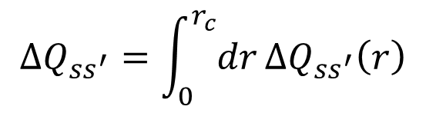

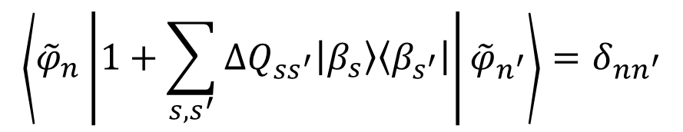




Ultrasoft pseudopotential and partial core correction
Problem : Norm-conserving condition for 1s (H), 2p (B,C,..), 3d(Ti,V,..), 4f, ...
$$φ_{l}^{NCPS}\left(r\right)$$
$$\left\langle {\tilde{φ}}_{n}\left|1+\sum_{s,s^{′}}{{ΔQ}_{ss^{′}}|β_{s}〉〈β_{s^{′}}|}\right|{\tilde{φ}}_{n^{′}}\right\rangle =δ_{nn^{′}}$$
$$φ_{l}^{AE}\left(r\right)$$
$${ΔQ}_{ss^{′}}=\int_{0}^{r_{c}}{dr}{ΔQ}_{ss^{′}}\left(r\right)$$
$$φ_{l}^{USPS}\left(r\right)$$
$${ΔQ}_{ss^{′}}\left(r\right)=φ_{s}^{AE∗}(r)φ_{s^{′}}^{AE}(r)−φ_{s}^{PS∗}(r)φ_{s^{′}}^{PS}(r)$$
$$r$$
Partial core correction (nonlinear core correction)
$$v_{XC}\left[ρ_{c}+ρ_{v}\right]≠v_{XC}\left[ρ_{c}\right]+v_{XC}\left[ρ_{v}\right]$$
$$v_{l}^{PS}\left(r\right)=v_{l}^{AE}\left(r\right)−v_{HXC}\left[ρ^{PS}\right]\left(r\right)−v_{XC}[ρ_{pc}]$$
$$v_{XC}=v_{XC}\left[ρ_{PS}+ρ_{pc}\right]$$

Slide 17
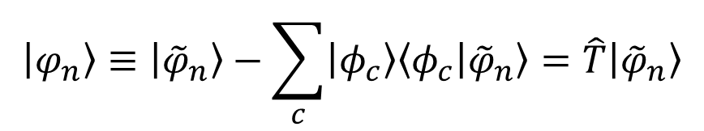
Projector augmented wave
Orthogonalized Plane Wave (OPW) again
$$|φ_{n}〉≡|{\tilde{φ}}_{n}〉−\sum_{c}{|φ_{c}〉〈φ_{c} | {\tilde{φ}}_{n}〉}=\hat{T}|{\tilde{φ}}_{n}〉$$
The final equation form is the same as US pseudopotential, but ..
We can obtain true KS orbital rather than the pseudo orbitals
(Very ?) slightly different result for the magnetic system.

Slide 18
Pseudopotential library for QE
Although we can generate PS by ourselves ...
→ Huge effort !
Good pseudopotential
Requires small cutoff energy
Well verified (compared with the AE results)
Partial core correction
Semicore (becomes harder)
Pseudopotential libraries
SG15 library
http://www.quantum-simulation.org/potentials/sg15_oncv/
Norm conserving pseudopotential
PS library
https://www.quantum-espresso.org/pseudopotentials
QE official
Standard Solid State library (SSSP)
https://www.materialscloud.org/discover/sssp/table/efficienc
Strictly verified

Slide 19
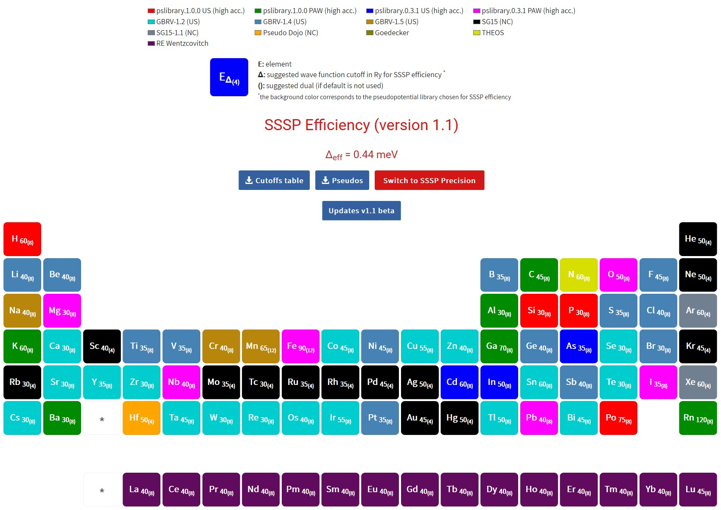
Standard Solid State Pseudopotentials
https://www.materialscloud.org/discover/sssp/table/efficiency

Slide 20
Today's summary
Magnetics system
Spin density functional theory
Local Spin Density Approximation (LSDA)
Collinear and non-collinear magnetism
Beyond LDA
Generalized Gradient Approximation
Hybrid functional
VdW, DFT+U

