Slide 1
物質科学のための計算数理 II
Numerical Analysis for Material Science II
8th: Density Functional Theory (1)
Nov. 30 (Fri)
Lecturer: Mitsuaki Kawamura (河村光晶)

Slide 2
Schedule (This semester W1, W2)
Sep. 28 (Fri) Guidance Y
Oct. 5 (Fri) Monte Carlo method O
Oct. 12 (Fri) Monte Carlo method O
Oct. 19 (Fri) Monte Carlo method O
Oct. 26 (Fri) Exact diagonalization Y
Nov. 2 (Fri) Exact diagonalization Y
Nov. 9 (Fri) Molecular dynamics O (1st report problem will be announced.)
Nov. 30 (Fri) Standard DFT code K
Dec. 7 (Fri) Density functional theory K
Dec. 14 (Fri) Density functional theory K
Dec. 21 (Fri) Density functional theory K
Dec. 25 (Tue) (2nd)Report problem K (遠隔講義室)
Jan. 11 (Fri) Density functional theory K
※ Lecturers: Y … Yamaji, K … Kawamura, O… Ohgoe

Slide 3
Schedule in this section (DFT)
Nov. 30 (Fri) Standard DFT code
First-principles calculation and Density functional theory (Lecture)
One-body Schrödinger eq. for periodic system and Bloch theorem (L)
Numerical solution of Kohn-Sham (one-body Schrödinger) eq. (L)
Hands-on DFT code (Tutorial)
Version control system : Git (T)
Dec. 7 (Fri) Kohn-Sham eq.
Plane-wave basis and Pseudopotentials (L)
Iterative eigenvalue solution method (L & T)
Dec. 14 (Fri) Self-Consistent loop
Hartree potential (Poisson eq.)
Brillouin-zone integral (Tetrahedron method)
Visualization (T)
Dec. 21 (Fri) Total Energy
Coulomb potential for periodic point charge (Ewald sum)
Dec. 25 (Tue) (2nd)Report problem K (遠隔講義室)
Jan. 11 (Fri) Density functional theory K

Slide 4
Today’s Schedule
What is the first-principles study
Density functional theory
Kohn-Sham method
Periodic system (Bulk crystal)
Bloch theorem
How to solve Kohn-Sham eq. with computer
DFT code
Git clone
Charge density
Band structure
Fermi surface
Density of states (DOS), Partial DOS

Slide 5
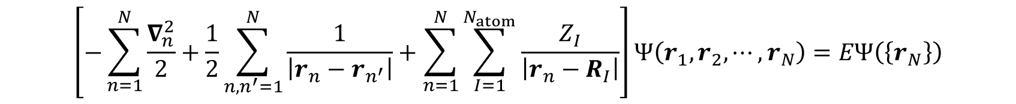
Electrons in materials
$$\left[−\sum_{n=1}^{N}{\frac{∇_{n}^{2}}{2}}+\frac{1}{2}\sum_{n,n^{′}=1}^{N}{\frac{1}{\left|r_{n}−r_{n^{′}}\right|}}+\sum_{n=1}^{N}{\sum_{I=1}^{N_{atom}}{\frac{Z_{I}}{\left|r_{n}−R_{I}\right|}}}\right]Ψ\left(r_{1},r_{2},⋯,r_{N}\right)=EΨ\left(\left\{r_{N}\right\}\right)$$
Information of electronic structure
Charge density
Magnetic moment
Superconductivity
Optical spectrum
etc.
Single H₂O molecule : N = 10
Single C₆₀ molecule : N = 360
Bulk crystal, liquid, glass, ・・・ :
N > 10²⁴
Both numerically and analytically unsolvable.
Can we obtain a few quantities such as
Ground-state energy
Ground-state charge density
without solving this equation ?

Slide 6

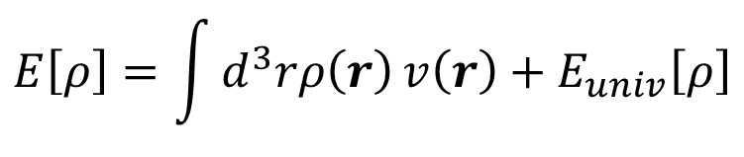

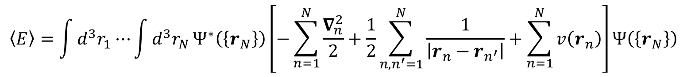

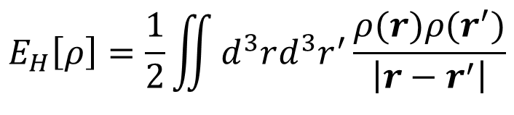

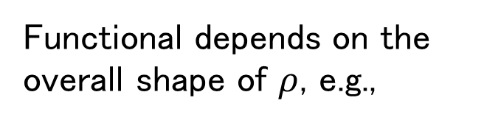
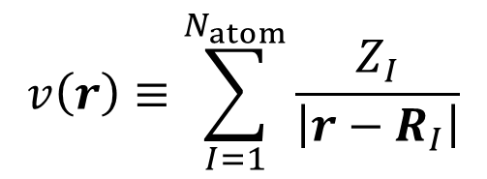

Density functional theory
$$\left\langle E\right\rangle =\int{d^{3}r_{1}⋯}\int{d^{3}r_{N}}Ψ^{∗}\left(\left\{r_{N}\right\}\right)\left[−\sum_{n=1}^{N}{\frac{∇_{n}^{2}}{2}}+\frac{1}{2}\sum_{n,n^{′}=1}^{N}{\frac{1}{\left|r_{n}−r_{n^{′}}\right|}}+\sum_{n=1}^{N}{v\left(r_{n}\right)}\right]Ψ\left(\left\{r_{N}\right\}\right)$$
$$E\left[ρ\right]=\int{d^{3}rρ\left(r\right)}v\left(r\right)+E_{univ}\left[ρ\right]$$
$$v\left(r\right)≡\sum_{I=1}^{N_{atom}}{\frac{Z_{I}}{\left|r−R_{I}\right|}}$$
Universal functional $E_{univ}\left[ρ\right]$ exists.
$$E\left[ρ\right]$$
Functional depends on the overall shape of $ρ$, e.g.,
$$E_{H}\left[ρ\right]=\frac{1}{2}\iint{d^{3}rd^{3}r^{′}\frac{ρ(r)ρ(r^{′})}{\left|r−r^{′}\right|}}$$
$$E_{GS}$$
Hohenberg-Kohn theorem
Phys. Rev. 136, B864 (1964).
$$ρ_{GS}$$
$$ρ$$

Slide 7
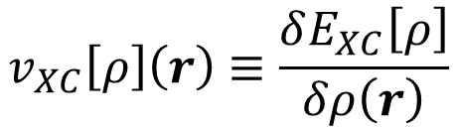
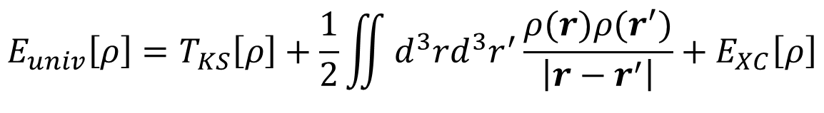
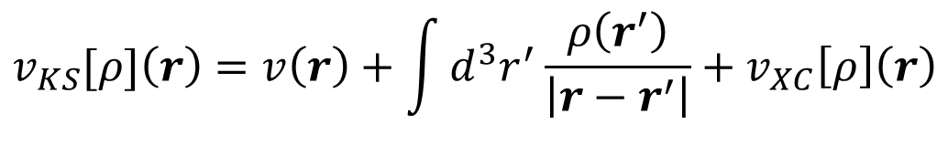
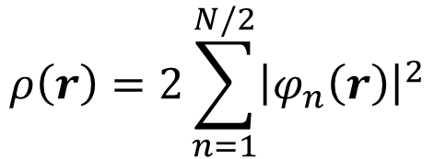
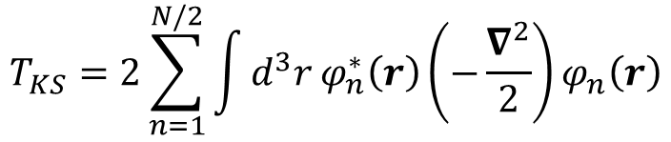
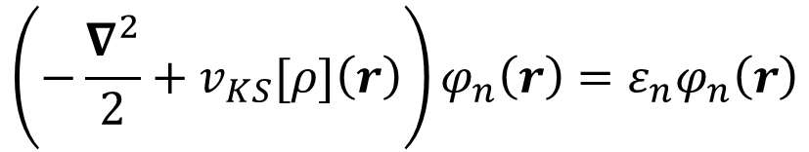
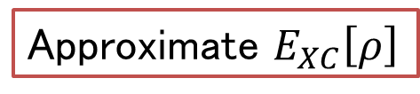

Kohn-Sham method
W. Kohn and L. J. Sham,
Phys. Rev. 140, A1133 (1965).
$$E_{univ}\left[ρ\right]=T_{KS}\left[ρ\right]+\frac{1}{2}\iint{d^{3}rd^{3}r^{′}\frac{ρ(r)ρ(r^{′})}{\left|r−r^{′}\right|}}+E_{XC}\left[ρ\right]$$
Kinetic energy of non-interacting system whose charge density is $ρ(r)$
$$\left(−\frac{∇^{2}}{2}+v_{KS}[ρ]\left(r\right)\right)φ_{n}\left(r\right)=ε_{n}φ_{n}\left(r\right)$$
$$ρ\left(r\right)=2\sum_{n=1}^{N/2}{{\left|φ_{n}\left(r\right)\right|}^{2}}$$
$$T_{KS}=2\sum_{n=1}^{N/2}{\int{d^{3}r}φ_{n}^{∗}\left(r\right)\left(−\frac{∇^{2}}{2}\right)}φ_{n}\left(r\right)$$
$$v_{KS}[ρ]\left(r\right)=v\left(r\right)+\int{d^{3}r^{′}}\frac{ρ\left(r^{′}\right)}{\left|r−r^{′}\right|}+v_{XC}\left[ρ\right]\left(r\right)$$
$$v_{XC}\left[ρ\right]\left(r\right)≡\frac{δE_{XC}\left[ρ\right]}{δρ\left(r\right)}$$
Self-consistent field (SCF)
The exact form of $E_{XC}\left[ρ\right]$ is not known.
Approximate $E_{XC}\left[ρ\right]$

Slide 8
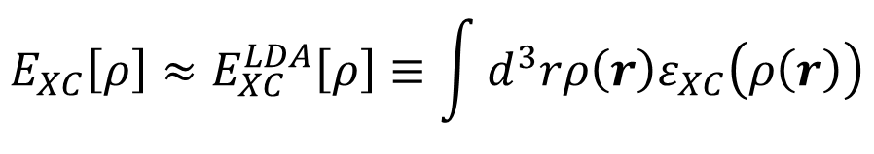
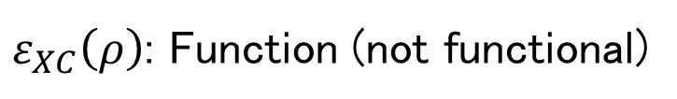
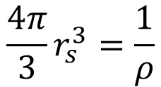
Local density approximation
$$E_{XC}\left[ρ\right]≈E_{XC}^{LDA}\left[ρ\right]≡\int{d^{3}rρ\left(r\right)ε_{XC}\left(ρ\left(r\right)\right)}$$
$ε_{XC}\left(ρ\right)$: Function (not functional)
$$v_{XC}\left[ρ\right]\left(r\right)≈v_{XC}^{LDA}\left(ρ\left(r\right)\right)≡\frac{δE_{XC}^{LDA}\left[ρ\right]}{δρ\left(r\right)}=ε_{XC}\left(ρ\left(r\right)\right)+ρ\left(r\right)\frac{dε_{XC}\left(ρ\right)}{dρ}{\left.​\right|}_{ρ=ρ\left(r\right)}$$
$ε_{XC}\left(ρ\right)$: Use the XC energy of homogeneous-electron gas
Random phase approximation : $ε_{XC}\left(ρ\right)=−\frac{0.916}{r_{s}}+0.0622\ln{r_{s}}−0.0938$
M. Gell-Mann and K. A. Brueckner, Phys. Rev. 106, 364 (1957).
$$\frac{4π}{3}r_{s}^{3}=\frac{1}{ρ}$$
Monte-Carlo method
$$ε_{XC}\left(ρ\right)=−\frac{0.916}{r_{s}}+0.031\ln{r_{s}}−0.0480−0.0116 r_{s}+0.0020r_{s}\ln{r_{s}} (r_{s}<1)$$
[Monte-Carlo] D. M. Ceperley and B.J. Alder, Phys. Rev. Lett. 45, 566 (1980).
[Parameterize] J. P. Perdew and A. Zunger, Phys. Rev. B 23, 5048 (1981).
$ε_{XC}\left(ρ,\left|∇ρ\right|\right)$: Generalized gradient correction (GGA)

Slide 9
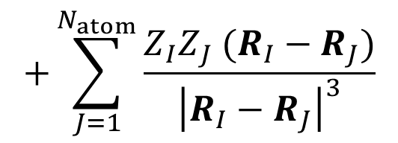
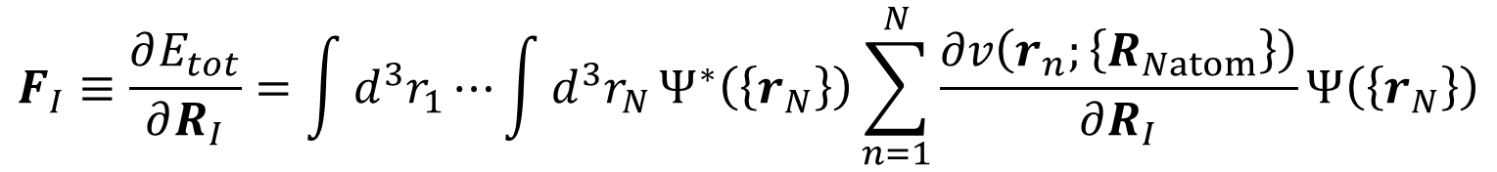

Total energy and force
$$E_{tot}=\int{d^{3}r_{1}}⋯\int{d^{3}r_{N}}Ψ^{∗}\left(\left\{r_{N}\right\}\right)\left[\sum_{n=1}^{N}{\left(\frac{∇_{n}^{2}}{2}+V\left(r_{n};\left\{R_{Natom}\right\}\right)\right)}+\frac{1}{2}\sum_{n,n^{′}=1}^{N}{\frac{1}{\left|r_{n}−r_{n^{′}}\right|}}\right]Ψ\left(\left\{r_{N}\right\}\right)$$
$$+\frac{1}{2}\sum_{I,J=1}^{N_{atom}}{\frac{Z_{I}Z_{J}}{\left|R_{I}−R_{J}\right|}}$$
Nuclear-nuclear interaction
Finding the lowest-energy (stable) structure
Structure optimization : One of the most popular usage of DFT
$$F_{I}≡\frac{∂E_{tot}}{∂R_{I}}=\int{d^{3}r_{1}}⋯\int{d^{3}r_{N}}Ψ^{∗}\left(\left\{r_{N}\right\}\right)\sum_{n=1}^{N}{\frac{∂v\left(r_{n};\left\{R_{Natom}\right\}\right)}{∂R_{I}}}Ψ\left(\left\{r_{N}\right\}\right)$$
Hellman-Feynmann theorem
$$+\sum_{J=1}^{N_{atom}}{\frac{Z_{I}Z_{J} (R_{I}−R_{J})}{{\left|R_{I}−R_{J}\right|}^{3}}}$$

Slide 10
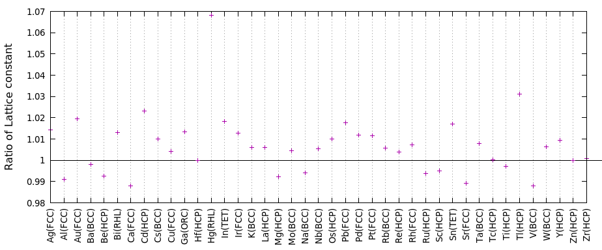

Structure optimization
GGA-PBE functional : J. Perdew, K. Burke, and M. Ernzerhof Phys. Rev. Lett. 77, 3865 (1996)
Other usage : Formation (Cohesive) energy
A + B → C + Energy
$$E_{C}−(E_{A}+E_{B})$$
Magnetic moment (Spin density functional theory) : $E\left[n_{↑},n_{↓}\right]$

Slide 11

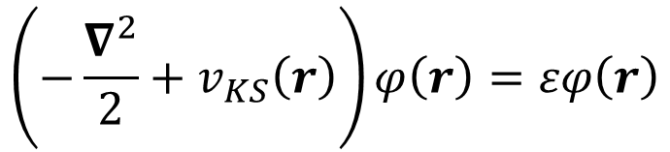

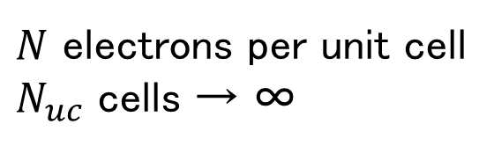
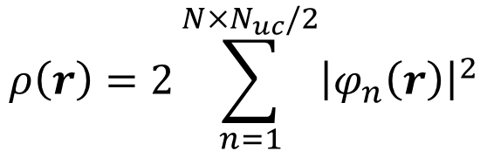
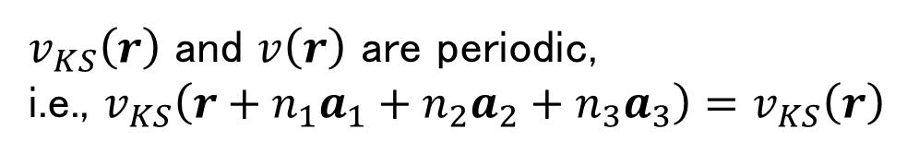

Kohn-Sham eq. for periodic system (1)
$v_{KS}\left(r\right)$ and $v\left(r\right)$ are periodic,
i.e., $v_{KS}\left(r+n_{1}a_{1}+n_{2}a_{2}+n_{3}a_{3}\right)=v_{KS}\left(r\right)$
$$\left(−\frac{∇^{2}}{2}+v_{KS}\left(r\right)\right)φ\left(r\right)=εφ\left(r\right)$$
Unit lattice vectors (Not unique)
$$ρ\left(r\right)=2\sum_{n=1}^{N×N_{uc}/2}{{\left|φ_{n}\left(r\right)\right|}^{2}}$$
$N$ electrons per unit cell
$N_{uc}$ cells → ∞
Equation to solve in the whole region of bulk crystal
$$a_{1}$$
$$a_{1}$$
$$a_{2}$$
Unit cell

Slide 12
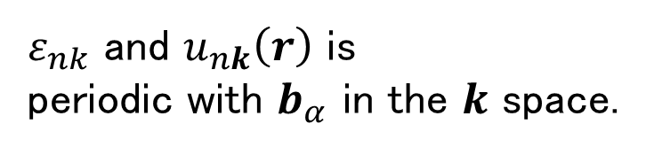
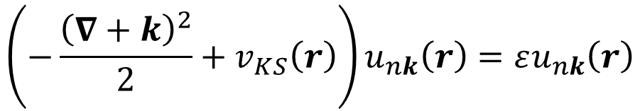
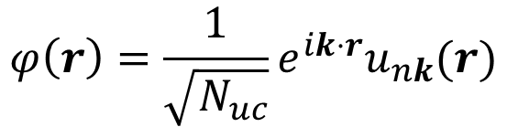
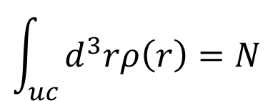
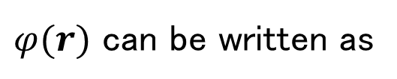

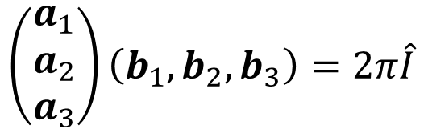

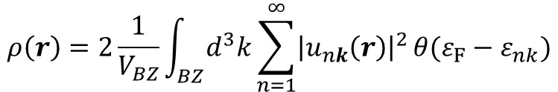

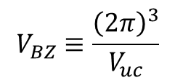
Kohn-Sham eq. for periodic system (2)
Bloch’s theorem
$$φ\left(r\right)=\frac{1}{\sqrt{N_{uc}}}e^{ik⋅r}u_{nk}(r)$$
$φ(r)$ can be written as
$$u_{nk}\left(r+n_{1}a_{1}+n_{2}a_{2}+n_{3}a_{3}\right)=u_{nk}\left(r\right)$$
$$\int_{uc}{d^{3}rρ\left(r\right)=N}$$
$$\left(−\frac{{\left(∇+k\right)}^{2}}{2}+v_{KS}\left(r\right)\right)u_{nk}\left(r\right)=εu_{nk}\left(r\right)$$
$$ρ\left(r\right)=2\frac{1}{V_{BZ}}\int_{BZ}{d^{3}k}\sum_{n=1}^{∞}{{\left|u_{nk}\left(r\right)\right|}^{2}}θ(ε_{F}−ε_{nk})$$
Equation to solve only in the unit cell
$$V_{BZ}≡\frac{{\left(2π\right)}^{3}}{V_{uc}}$$
$$ε_{nk}$$
$$\left(\begin{matrix}a_{1} \\ a_{2} \\ a_{3}\end{matrix}\right)\left(b_{1},b_{2},b_{3}\right)=2π\hat{I}$$
Band structure
Unit reciprocal lattice vectors
$ε_{nk}$ and $u_{nk}\left(r\right)$ is
periodic with $b_{α}$ in the $k$ space.
$$k$$
$$b_{1}$$

Slide 13
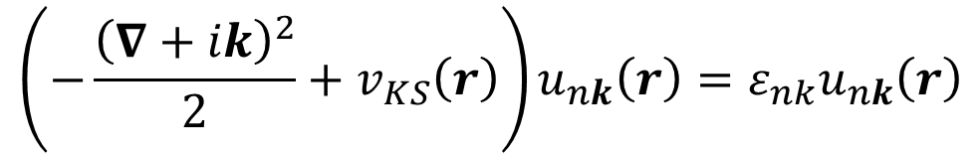


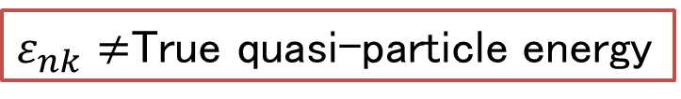
One-body energy level
e
$$\left(−\frac{{\left(∇+ik\right)}^{2}}{2}+v_{KS}\left(r\right)\right)u_{nk}\left(r\right)=ε_{nk}u_{nk}\left(r\right)$$
e
$ε_{nk}≠$True quasi-particle energy
e
e
Qualitative analyzation
Angle resolved photo electronic spectroscopy
de Haas-van Alphen oscillation
Susceptibility
Unit [eV] | LDA | GW | Exp.
Si | 0.54 | 1.32 | 1.17
LiCl | 6.07 | 9.34 | 9.40
AlP | 1.52 | 2.59 | 2.50
AlAs | 1.25 | 2.15 | 2.23
AlSb | 0.99 | 1.64 | 1.68
GaP | 1.82 | 2.55 | 2.39
GaAs | 0.37 | 1.22 | 1.52
InP | 0.57 | 1.44 | 1.42
$$ε_{nk}$$
Inversed magnetic field (1/H)
Band gap
$$k$$
X. Zhu and S. Louie, Phys. Rev. B 43, 14142 (1991).

Slide 14
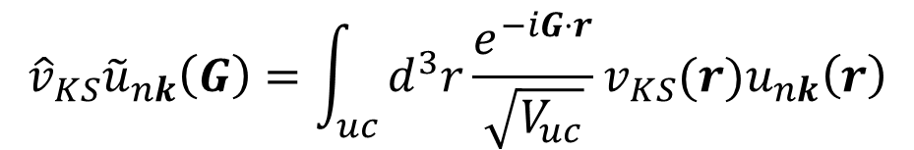
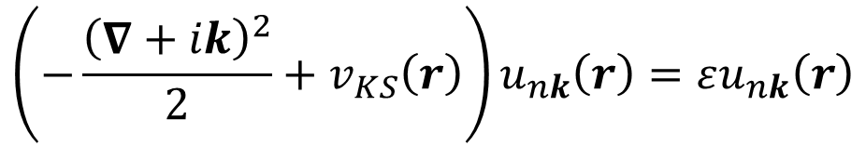
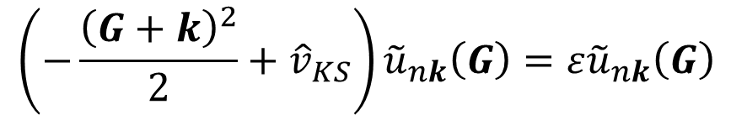
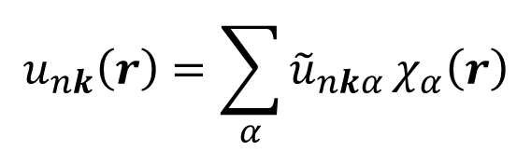
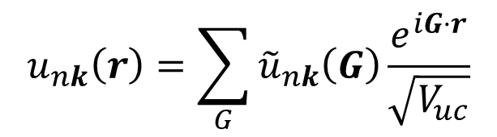
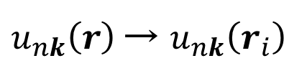
How to solve Kohn-Sham eq. : Basis
$$\left(−\frac{{\left(∇+ik\right)}^{2}}{2}+v_{KS}\left(r\right)\right)u_{nk}\left(r\right)=εu_{nk}\left(r\right)$$
$u_{nk}\left(r\right)$→ $u_{nk}\left(r_{i}\right)$
Huge numerical cost !
Not efficient.
Pseudopotential (plane wave, real space grid, FEM)
Local basis (atomic orbital, Gaussian)
Augmented wave (complicated basis)
Mixed basis (PW + Local, augmented + Local)
$$u_{nk}\left(r\right)=\sum_{α}{{\tilde{u}}_{nkα}}χ_{α}\left(r\right)$$
$$u_{nk}\left(r\right)=\sum_{G}{{\tilde{u}}_{nk}\left(G\right)}\frac{e^{iG⋅r}}{\sqrt{V_{uc}}}$$
$$\left(−\frac{{\left(G+k\right)}^{2}}{2}+{\hat{v}}_{KS}\right){\tilde{u}}_{nk}\left(G\right)=ε{\tilde{u}}_{nk}\left(G\right)$$
Plane waves below the
Cutoff frequency
$${{\hat{v}}_{KS}\tilde{u}}_{nk}\left(G\right)=\int_{uc}{d^{3}r}{\frac{e^{−iG⋅r}}{\sqrt{V_{uc}}}v}_{KS}(r)u_{nk}\left(r\right)$$

Slide 15






Pseudopotential
Electronic state at core level (e.g. 1s state for Fe)
hardly affects the chemical properties
(chemical reaction, conduction, superconductivity, etc.)
Pseudopotential is generated
in the calculation of single atom
$$u_{n}\left(r\right)$$
$$u_{n,ps}\left(r\right)$$
True
Pseudo
$$ε_{n}$$
valence
$$r$$
2p
2s
Then,
used for the calculation of
molecule, solid, etc.
1s
$$v_{ps}\left(r\right)$$
$$v\left(r\right)$$
only reproduce the
energy and long-range behavior
of valence state.
Transferability
Norm conserving
Ultrasoft
Projector augmented wave
Similar to the potential of an ion.

Slide 16
QuantumESPRESSO: plane wave and pseudopotential based code
Before the explanation, we should start to install because it takes long time.
mac OSX in ECCS
$ mkdir -p ~/bin/
$ echo 'export PATH=$HOME/bin:$PATH' >> ~/.profile
$ git clone https://gitlab.com/QEF/q-e.git -b qe-6.3 ~/q-e
$ cd ~/q-e/
$ ./configure CC=gcc-8; make pw pp; cp bin/* ~/bin/
Prompt. We do not need type this.

Slide 17
Quantum ESPRESSO
Web page : https://www.quantum-espresso.org/
Developer : P Giannozzi (University of Udine, Italy), et al. (Many)
Language : Fortran (Mainly)
Feature:
Total energy, force, MD, chemical reaction path, charge/spin density
Band structure, density of states, Fermi surfaces
LDA, GGA, Van der Waals, exact exchange functional
MPI+OpenMP parallelism, GPGPU
Phonon and electron-phonon interaction
X-ray absorption spectra, Optical spectra
Many-body perturbation theory (GW, Bethe-Salpeter eq.)
Wannier function, Berry's phase
Etc.
Manuals : https://www.quantum-espresso.org/resources/users-manual
Pseudopotential library
SSSP (https://www.materialscloud.org/discover/sssp/table/efficiency)
PSLibrary (https://www.quantum-espresso.org/pseudopotentials)

Slide 18
Visualization tools
FermiSurfer : Fermi-surface viewer
$ git clone https://scm.osdn.net/gitroot/fermisurfer/fermisurfer.git -b 1.10.1 ~/fermisurfer
$ cd ~/fermisurfer/
$ touch Makefile.in aclocal.m4 configure
$ ./configure --prefix=$HOME; make; make install
VESTA : Crystal-structure viewer (Also charge density, etc.)
$ wget https://jp-minerals.org/vesta/archives/3.4.5/VESTA.dmg
$ hdiutil mount VESTA.dmg
$ cp -rf /Volumes/VESTA/VESTA ~/
$ echo 'alias vesta="open -a $HOME/VESTA/VESTA.app"' >> ~/.profile
$ source ~/.profile

Slide 19
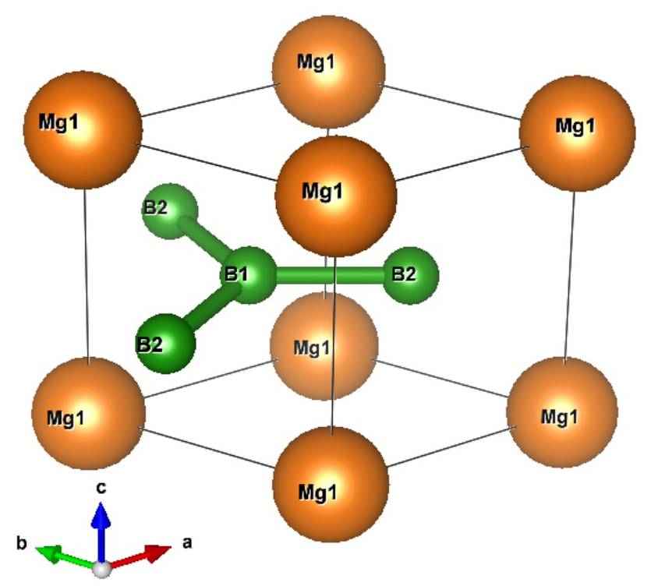
Tutorial : MgB₂
$ wget https://osdn.net/projects/educational-pwdft/storage/113018.tgz
$ tar xzvf 113018.tgz -C ~/
$ cd ~/113018/
$ vesta mgb2.xsf
Metal
Superconductivity : T_{C} = 39 K
Stacked Mg triangular lattice and B honeycomb lattice

Slide 20
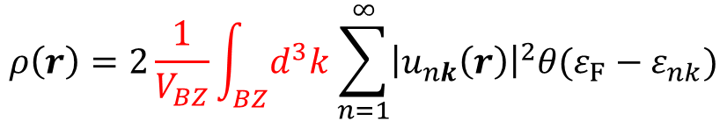
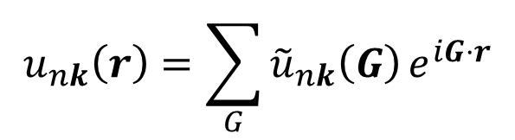
Structure optimization & input file
$ mpirun -np 2 ~/bin/pw.x -npool 2 -in relax.in | tee relax.out
Variation-cell structure relaxation
Number of atoms in the unit cell
&CONTROL
calculation = 'vc-relax'
pseudo_dir = './'
/
&SYSTEM
ibrav = 0
nat = 3
ntyp = 2
ecutwfc = 35.000000
ecutrho = 280.000000
occupations = 'tetrahedra_opt'
/
&ELECTRONS
/
&IONS
/
&CELL
/
Number of kinds of atom
Cutoff energy of plane-waves for
wave functions [Ry]
$$u_{nk}\left(r\right)=\sum_{G}{{\tilde{u}}_{nk}\left(G\right)}e^{iG⋅r}$$
Cutoff depends on the pseudopotential
Cutoff energy of plane-waves for
the charge density [Ry]
Integration scheme for the
numerical integration in
$$ρ\left(r\right)=2\frac{1}{V_{BZ}}\int_{BZ}{d^{3}k}\sum_{n=1}^{∞}{{\left|u_{nk}\left(r\right)\right|}^{2}θ(ε_{F}−ε_{nk})}$$

Slide 21
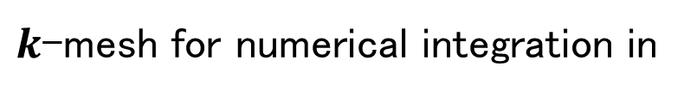


Input-file format
Unit lattice vectors (Å unit)
CELL_PARAMETERS angstrom
3.200000 0.000000 0.000000
-1.600000 2.771281 0.000000
0.000000 0.000000 3.700000
ATOMIC_SPECIES
B 10.811000 b_pbe_v1.4.uspp.F.UPF
Mg 24.305000 Mg.pbe-n-kjpaw_psl.0.3.0.UPF
ATOMIC_POSITIONS crystal
Mg 0.000000 0.000000 0.000000
B 0.333333 0.666667 0.500000
B 0.666667 0.333333 0.500000
K_POINTS automatic
12 12 8 0 0 0
Element
Relative atomic mass
Pseudopotential file name
Atomic position in the
fractional coordinate
$$R=x_{1}a_{1}+x_{2}a_{2}+x_{3}a_{3}$$
$k$-mesh for numerical integration in
$$ρ\left(r\right)=2\frac{1}{V_{BZ}}\int_{BZ}{d^{3}k}\sum_{n=1}^{∞}{{\left|u_{nk}\left(r\right)\right|}^{2}}θ(ε_{F}−ε_{nk})$$
Dense k-mesh improves accuracy and increases numerical cost.

Slide 22
Result
$ grep volume relax.out
relax.out: unit-cell volume = 221.4261 (a.u.)^3
relax.out: new unit-cell volume = 204.22304 a.u.^3 ( 30.26273 Ang^3 )
relax.out: new unit-cell volume = 193.53924 a.u.^3 ( 28.67956 Ang^3 )
relax.out: new unit-cell volume = 194.50016 a.u.^3 ( 28.82195 Ang^3 )
relax.out: new unit-cell volume = 194.38563 a.u.^3 ( 28.80498 Ang^3 )
relax.out: new unit-cell volume = 194.25661 a.u.^3 ( 28.78586 Ang^3 )
relax.out: new unit-cell volume = 194.25661 a.u.^3 ( 28.78586 Ang^3 )
relax.out: unit-cell volume = 194.2566 (a.u.)^3
$ grep -A 3 CELL_PARAMETERS relax.out
CELL_PARAMETERS (angstrom)
3.106677678 0.000000000 -0.000000000
-1.553338839 2.690461490 0.000000000
0.000000000 -0.000000000 3.620638395
:
--
CELL_PARAMETERS (angstrom)
3.072422829 0.000000000 0.000000000
-1.536211414 2.660795917 0.000000000
0.000000000 0.000000000 3.521167214
Exp. (XRD)
a = 3.085 Å, c = 3.523 Å
volume : 29.04 Å³

Slide 23
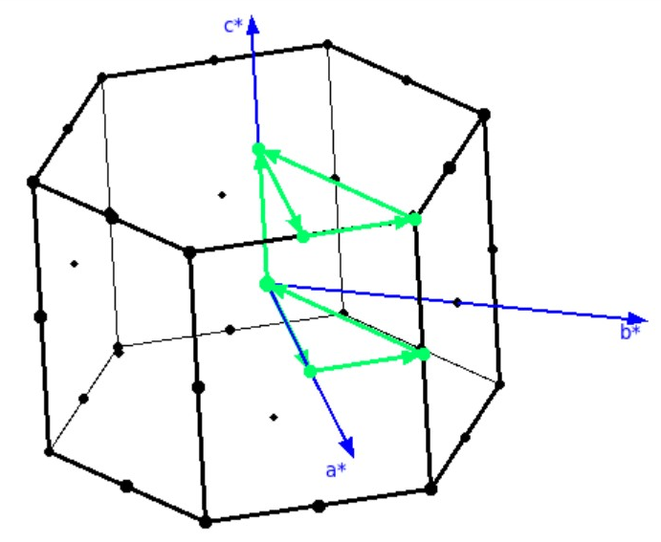
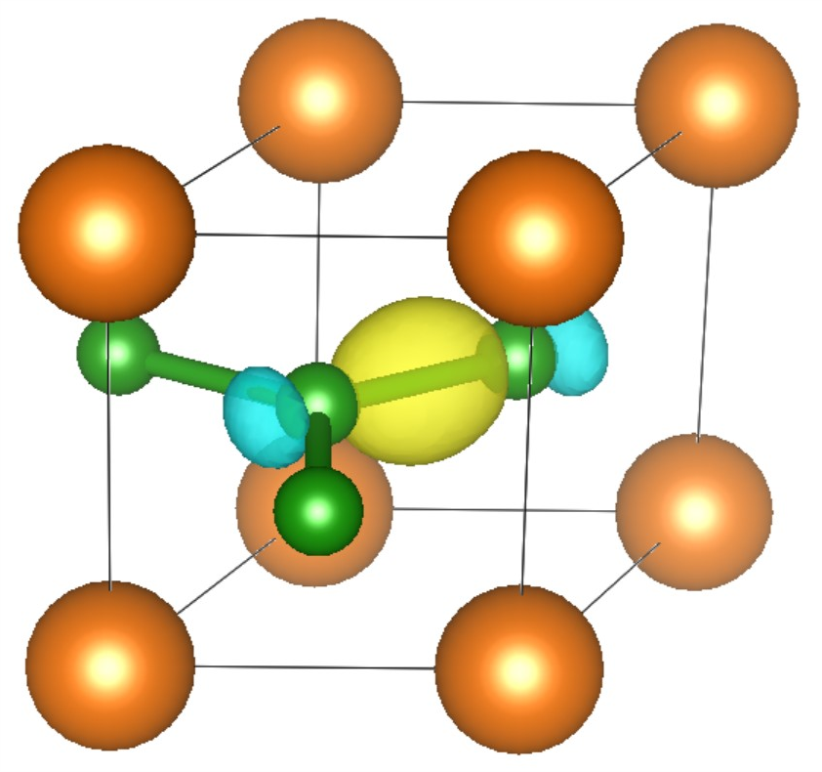
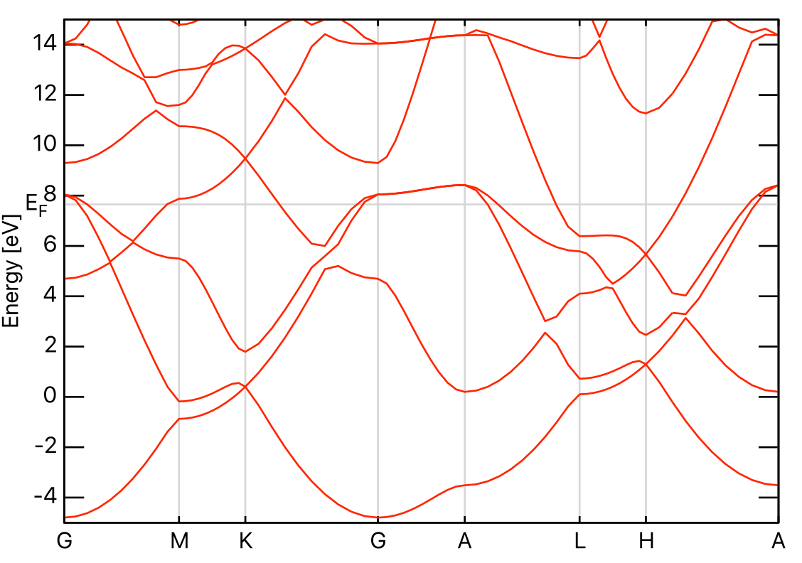
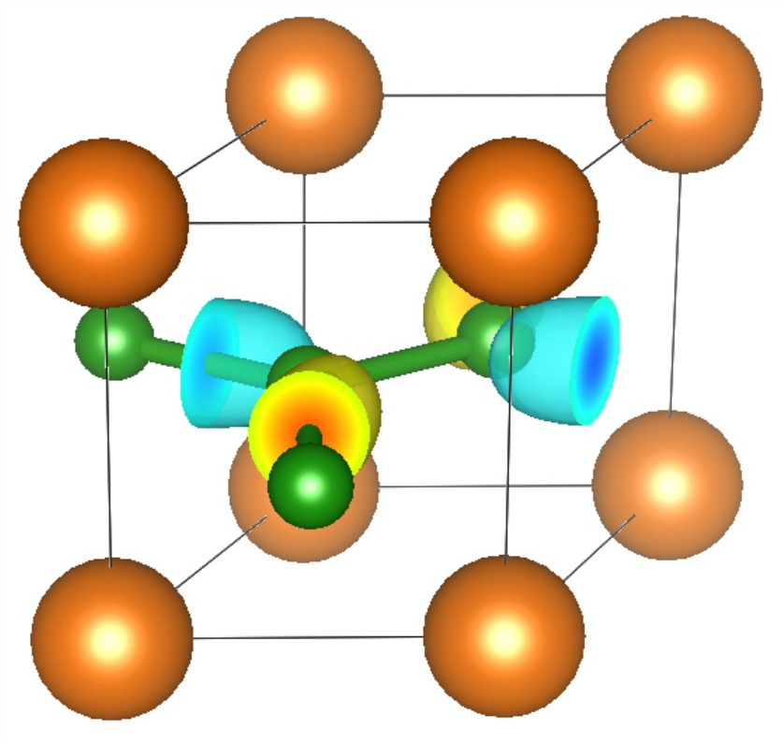
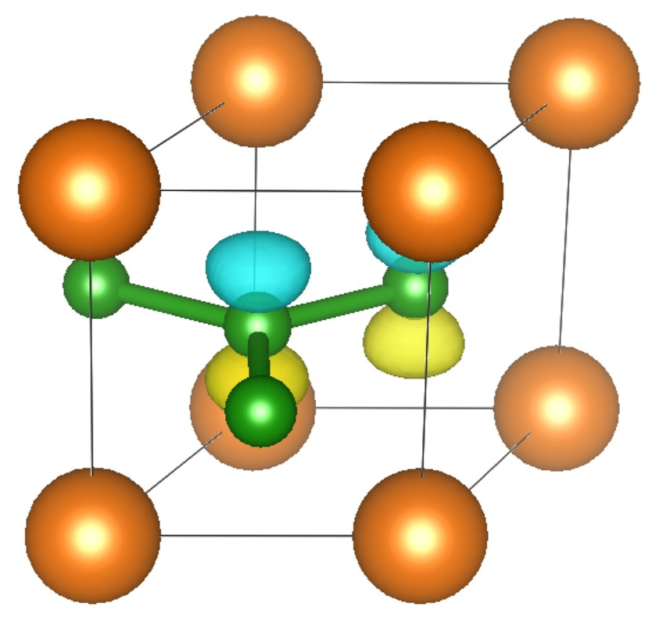

Band structure
A
$ mpirun -np 2 ~/bin/pw.x -npool 2 -in nonscf.in
$ mpirun -np 2 ~/bin/bands.x -npool 2 -in bands.in
$ gnuplot band.gp
H
L
Γ
K
$ mpirun -np 1 ~/bin/pp.x -npool 1 -in pp.in
$ vesta tmp.pp_K001_B00*.xsf
M
$$u_{nk}(r)$$

Slide 24
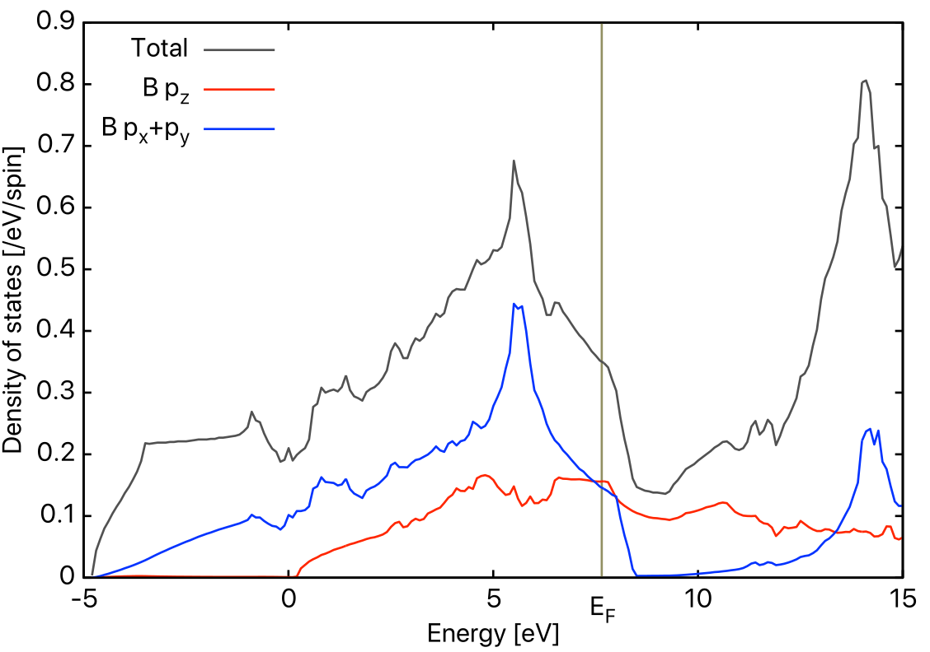





Density of states & Fermi surface
$ mpirun -np 2 ~/bin/pw.x -npool 2 -in dense.in
$ mpirun -np 2 ~/bin/projwfc.x -npool 2 -in pdos.in |tee pdos.out
$ gnuplot pdos.gp
$$D\left(ε\right)=\frac{1}{V_{BZ}}\int_{BZ}{d^{3}k}\sum_{n=1}^{∞}{δ(ε−ε_{nk})}$$
$$D_{p}\left(ε\right)=\frac{1}{V_{BZ}}\int_{BZ}{d^{3}k}\sum_{n=1}^{∞}{δ(ε−ε_{nk})}$$
$$×{\left|\int{d^{3}rψ_{p}^{∗}\left(r\right)φ_{nk}\left(r\right)}\right|}^{2}$$
Fermi surface :
Isosurface at $ε_{nk}=ε_{F}$
$ mpirun -np 1 ~/bin/fermi_proj.x -in proj_pz.in
$ mv proj.frmsf pz.frmsf
$ mpirun -np 1 ~/bin/fermi_proj.x -in proj_pxy.in
$ mv proj.frmsf pxy.frmsf
$ fermisurfer pz.frmsf
$ fermisurfer pxy.frmsf

Slide 25
Why do we perform DFT calculation ?
DFT calculation
Directly compute (predict)
properties of materials.
Compute effective single-body state,
Kohn-Sham orbitals.
Force or total energy.
Construct Hubbard model or local spin model.
Fit into model atomic force field.
Perform Monte-Carlo simulation, exact diagonalization for more accurate calculation of exotic phenomena.
Perform classical MD for
large-size system or log-time scale.

Slide 26
Today's summary
Basics of DFT calculation
Hohenberg-Kohn theorem
Kohn-Sham method
Exchange correlation functional
Total energy and force
Kohn-Sham eq. in periodic system (bulk crystal)
Bloch theorem
Band structure
Numerical method to solve Kohn-Sham eq.
Plane-wave (and other) basis
Pseudopotential
Usage of a DFT code : Quantum ESPRESSO

Slide 27





Reference books
Electronic Structure: Basic Theory and Practical Methods
Richard M. Martin
Cambridge University Press
Errata : https://es.polytechnique.fr/Electronic_Structure/errata
日本語訳
物質の電子状態 上下
寺倉清之、寺倉郁子、善甫康成
シュプリンガー
固体‐構造と物性
金森 順次郎, 川村 清, 米沢 富美子, 寺倉 清之
岩波
絶版
岩波オンデマンド

