Slide 1
物質科学のための計算数理 II
Numerical Analysis for Material Science II
9th: Density Functional Theory (2)
Dec. 7 (Fri)
Lecturer: Mitsuaki Kawamura (河村光晶)

Slide 2
Schedule (This semester W1, W2)
Sep. 28 (Fri) Guidance Y
Oct. 5 (Fri) Monte Carlo method O
Oct. 12 (Fri) Monte Carlo method O
Oct. 19 (Fri) Monte Carlo method O
Oct. 26 (Fri) Exact diagonalization Y
Nov. 2 (Fri) Exact diagonalization Y
Nov. 9 (Fri) Molecular dynamics O (1st report problem will be announced.)
Nov. 30 (Fri) Standard DFT code K
Dec. 7 (Fri) Density functional theory K
Dec. 14 (Fri) Density functional theory K
Dec. 21 (Fri) Density functional theory K
Dec. 25 (Tue) (2nd)Report problem K (遠隔講義室)
Jan. 11 (Fri) Density functional theory K
※ Lecturers: Y … Yamaji, K … Kawamura, O… Ohgoe

Slide 3
Schedule in this section (DFT)
Nov. 30 (Fri) Standard DFT code
First-principles calculation and Density functional theory (Lecture)
One-body Schrödinger eq. for periodic system and Bloch theorem (L)
Numerical solution of Kohn-Sham (one-body Schrödinger) eq. (L)
Hands-on DFT code (Tutorial)
Version control system : Git (T)
Dec. 7 (Fri) Kohn-Sham eq.
Plane-wave basis and Pseudopotentials (L)
Iterative eigenvalue solution method (L & T)
Dec. 14 (Fri) Self-Consistent loop
Hartree potential (Poisson eq.)
Brillouin-zone integral (Tetrahedron method)
Visualization (T)
Dec. 21 (Fri) Total Energy
Coulomb potential for periodic point charge (Ewald sum)
Dec. 25 (Tue) (2nd)Report problem K (遠隔講義室)
Jan. 11 (Fri) Density functional theory K

Slide 4
Today’s Schedule
Kohn-Sham eq. in periodic system
Plane-wave representation
Iterative diagonalization
Matrix-vector product
Kinetic energy term
Potential term
Visualize

Slide 5
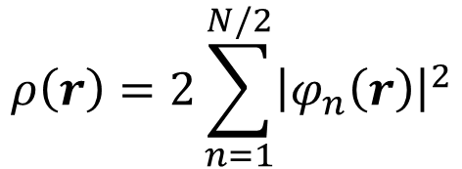
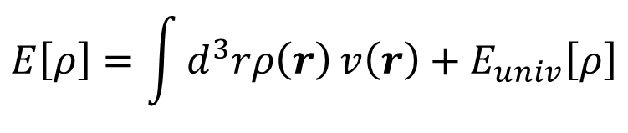
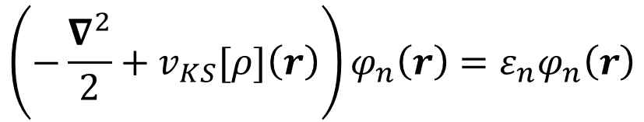
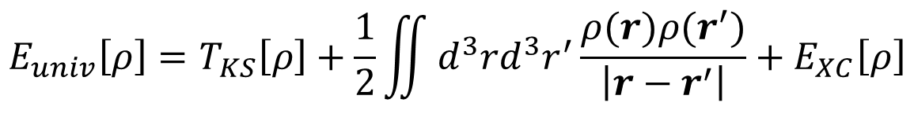
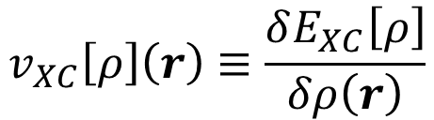
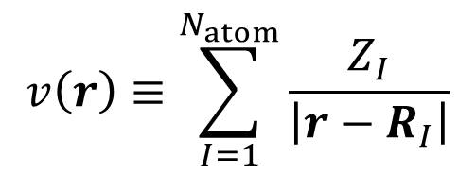
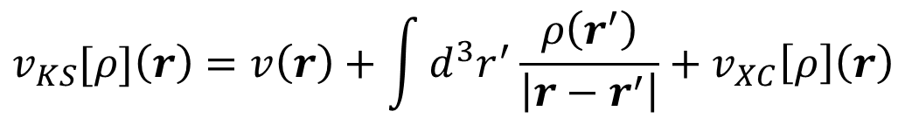
Kohn-Sham method
last week
$$E\left[ρ\right]=\int{d^{3}rρ\left(r\right)}v\left(r\right)+E_{univ}\left[ρ\right]$$
$$v\left(r\right)≡\sum_{I=1}^{N_{atom}}{\frac{Z_{I}}{\left|r−R_{I}\right|}}$$
$$E_{univ}\left[ρ\right]=T_{KS}\left[ρ\right]+\frac{1}{2}\iint{d^{3}rd^{3}r^{′}\frac{ρ(r)ρ(r^{′})}{\left|r−r^{′}\right|}}+E_{XC}\left[ρ\right]$$
Kinetic energy of non-interacting system whose charge density is $ρ(r)$
$$\left(−\frac{∇^{2}}{2}+v_{KS}[ρ]\left(r\right)\right)φ_{n}\left(r\right)=ε_{n}φ_{n}\left(r\right)$$
$$ρ\left(r\right)=2\sum_{n=1}^{N/2}{{\left|φ_{n}\left(r\right)\right|}^{2}}$$
$$v_{KS}[ρ]\left(r\right)=v\left(r\right)+\int{d^{3}r^{′}}\frac{ρ\left(r^{′}\right)}{\left|r−r^{′}\right|}+v_{XC}\left[ρ\right]\left(r\right)$$
$$v_{XC}\left[ρ\right]\left(r\right)≡\frac{δE_{XC}\left[ρ\right]}{δρ\left(r\right)}$$
Self-consistent field (SCF)

Slide 6

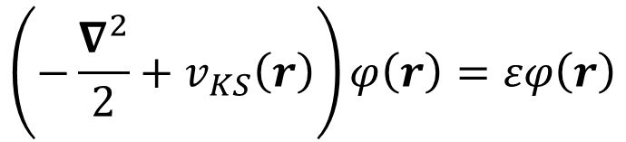

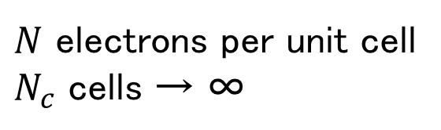
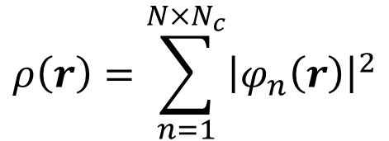
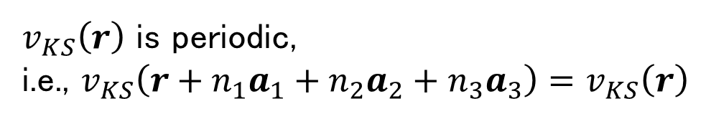

Kohn-Sham eq. for periodic system (1)
last week
$v_{KS}\left(r\right)$ is periodic,
i.e., $v_{KS}\left(r+n_{1}a_{1}+n_{2}a_{2}+n_{3}a_{3}\right)=v_{KS}\left(r\right)$
$$\left(−\frac{∇^{2}}{2}+v_{KS}\left(r\right)\right)φ\left(r\right)=εφ\left(r\right)$$
Unit lattice vectors (Not unique)
$$ρ\left(r\right)=\sum_{n=1}^{N×N_{c}}{{\left|φ_{n}\left(r\right)\right|}^{2}}$$
$N$ electrons per unit cell
$N_{c}$ cells → ∞
Equation to solve in the whole region of bulk crystal
$$a_{1}$$
$$a_{1}$$
$$a_{2}$$
Unit cell

Slide 7
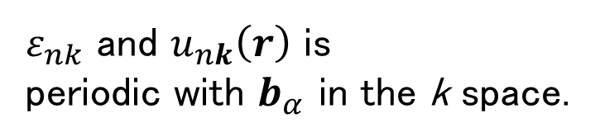
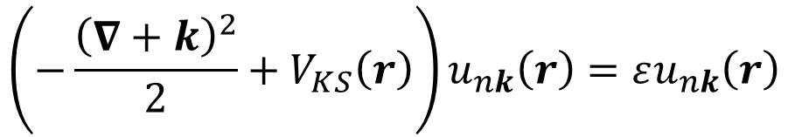
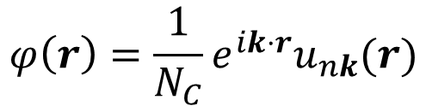
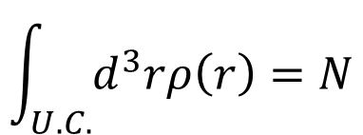
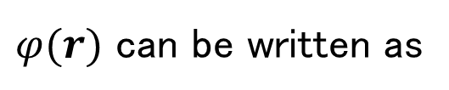

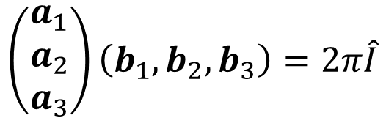

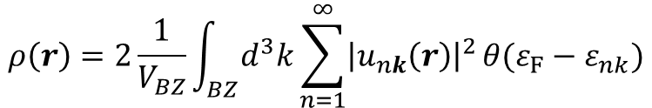

Kohn-Sham eq. for periodic system (2)
last week
$$φ\left(r\right)=\frac{1}{N_{C}}e^{ik⋅r}u_{nk}(r)$$
$φ(r)$ can be written as
Bloch’s theorem
$$\int_{U.C.}{d^{3}rρ\left(r\right)=N}$$
$$\left(−\frac{{\left(∇+k\right)}^{2}}{2}+V_{KS}\left(r\right)\right)u_{nk}\left(r\right)=εu_{nk}\left(r\right)$$
$$ρ\left(r\right)=2\frac{1}{V_{BZ}}\int_{BZ}{d^{3}k}\sum_{n=1}^{∞}{{\left|u_{nk}\left(r\right)\right|}^{2}}θ(ε_{F}−ε_{nk})$$
Equation to solve only in the unit cell
$$ε_{nk}$$
Band structure
$$\left(\begin{matrix}a_{1} \\ a_{2} \\ a_{3}\end{matrix}\right)\left(b_{1},b_{2},b_{3}\right)=2π\hat{I}$$
Unit reciprocal lattice vectors
$ε_{nk}$ and $u_{nk}\left(r\right)$ is
periodic with $b_{α}$ in the k space.
$$k$$
$$b_{1}$$

Slide 8
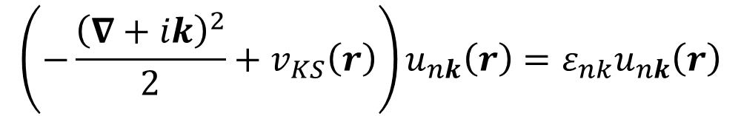
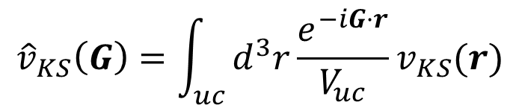
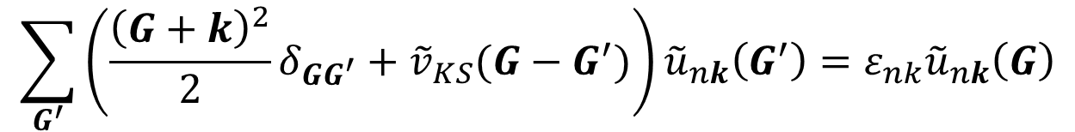
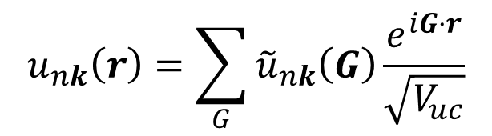
How to solve Kohn-Sham eq. : Basis
last week
$$\left(−\frac{{\left(∇+ik\right)}^{2}}{2}+v_{KS}\left(r\right)\right)u_{nk}\left(r\right)=ε_{nk}u_{nk}\left(r\right)$$
$$u_{nk}\left(r\right)=\sum_{G}{{\tilde{u}}_{nk}\left(G\right)}\frac{e^{iG⋅r}}{\sqrt{V_{uc}}}$$
$$\sum_{G^{′}}{\left(\frac{{\left(G+k\right)}^{2}}{2}δ_{GG^{′}}+{\tilde{v}}_{KS}(G−G^{′})\right)}{\tilde{u}}_{nk}\left(G^{′}\right)=ε_{nk}{\tilde{u}}_{nk}\left(G\right)$$
$${\hat{v}}_{KS}\left(G\right)=\int_{uc}{d^{3}r}{\frac{e^{−iG⋅r}}{V_{uc}}v}_{KS}(r)$$

Slide 9
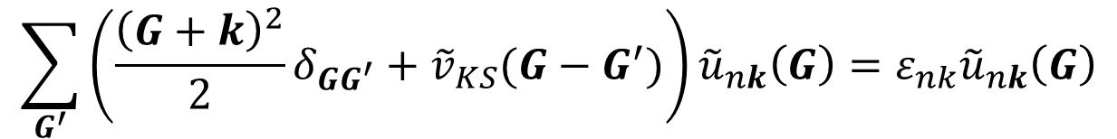
Unit in this lecture
Input and output :
Length : Angstrom
Energy : Electron volt
Useful to read by VESTA
Inside program code:
Length : Atomic unit (Bohr radius). 1 [Bohr] = 0.529177249 [Å]
Energy : Atomic unit (Hartree). 1 [E_{h}] = 27.21138456 [eV]
[Bohr⁻¹]
$$\sum_{G^{′}}{\left(\frac{{\left(G+k\right)}^{2}}{2}δ_{GG^{′}}+{\tilde{v}}_{KS}(G−G^{′})\right)}{\tilde{u}}_{nk}\left(G\right)=ε_{nk}{\tilde{u}}_{nk}\left(G\right)$$
[E_{h}]
[E_{h}]

Slide 10

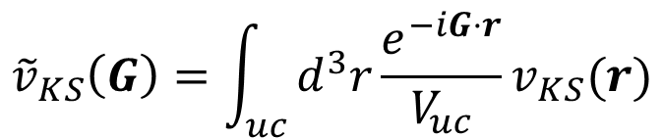

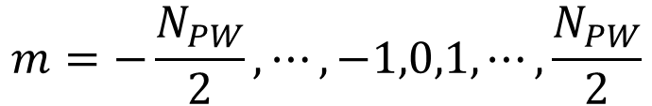
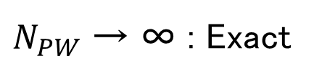
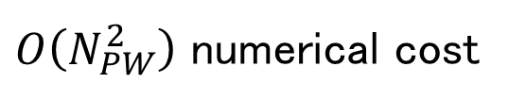
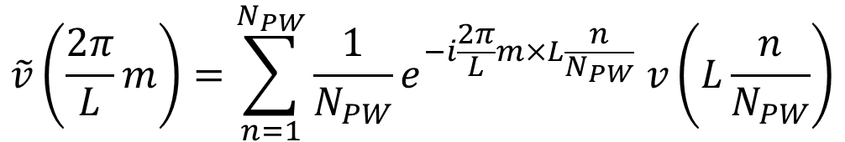

Fourier Transformation
$${\tilde{v}}_{KS}\left(G\right)=\int_{uc}{d^{3}r}{\frac{e^{−iG⋅r}}{V_{uc}}v}_{KS}(r)$$
Discretize (considering one dimension)
$$\tilde{v}\left(\frac{2π}{L}m\right)=\sum_{n=1}^{N_{PW}}{\frac{1}{N_{PW}}}e^{−i\frac{2π}{L}m×L\frac{n}{N_{PW}}} v\left(L\frac{n}{N_{PW}}\right)$$
$N_{PW}$ → ∞ : Exact
$$m=−\frac{N_{PW}}{2},⋯,−1,0,1,⋯,\frac{N_{PW}}{2}$$
$$N_{PW}×N_{PW}$$
$$V$$
$$\tilde{V}$$
$O\left(N_{PW}^{2}\right)$ numerical cost
Fast Fourier Transformation (FFT) : $O\left(N_{PW}\ln{N_{PW}}\right)$ numerical cost
We do not detail in this lecture. We just use FFT numerical library.

Slide 11
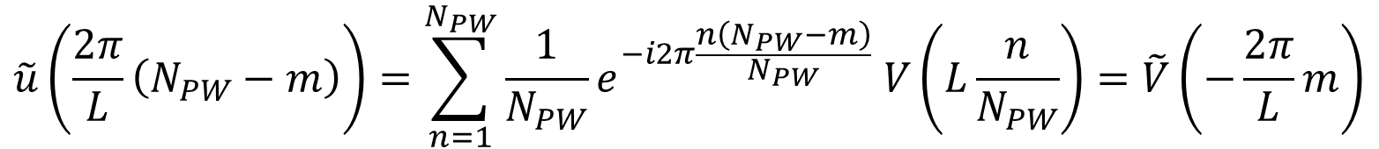
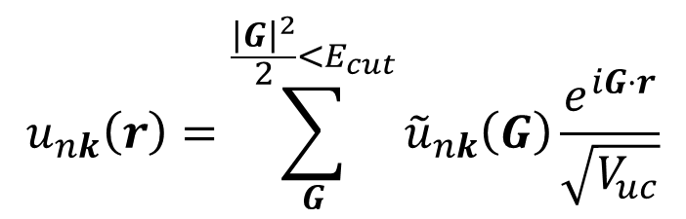
Cutoff frequency
$$u_{nk}\left(r\right)=\sum_{G}^{\frac{{\left|G\right|}^{2}}{2}<E_{cut}}{{\tilde{u}}_{nk}\left(G\right)\frac{e^{iG⋅r}}{\sqrt{V_{uc}}}}$$
$$\tilde{u}\left(\frac{2π}{L}\left(N_{PW}−m\right)\right)=\sum_{n=1}^{N_{PW}}{\frac{1}{N_{PW}}}e^{−i2π\frac{n\left(N_{PW}−m\right)}{N_{PW}}} V\left(L\frac{n}{N_{PW}}\right)=\tilde{V}\left(−\frac{2π}{L}m\right)$$

Slide 12
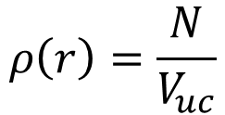
Very simple plane-wave DFT program
$ cd ~
$ git clone git://git.osdn.net/gitroot/educational-pwdft/pwdft.git
$ cd pwdft
$ cp make.inc.mac make.inc
$ make
$ cd sample/Al/
$ ../../src/pwdft.x < direct.in
&CONTROL
calculation = 'direct'
/
&SYSTEM
nbnd = 10
nat = 1
ntyp = 1
ecutwfc = 60.000000
ecutrho = 240.000000
/
&ELECTRONS
/
CELL_PARAMETERS
0.000000 2.024700 2.024700
2.024700 0.000000 2.024700
2.024700 2.024700 0.000000
ATOMIC_SPECIES
Al al.lda.lps
ATOMIC_POSITIONS
Al 0.000000 0.000000 0.000000
K_POINTS
1
0.0 0.0 0.0
Aluminum
Face centered cubic (fcc)
Metal
Almost free electron
keep
"ecutrho" ≧ 4*ecutwfc
Only perform first SCF step
$$ρ\left(r\right)=\frac{N}{V_{uc}}$$
Initial density is
uniform

Slide 13

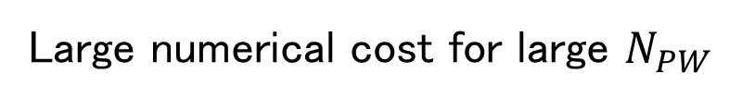
direct@diag_direct.F90
http://mitsuaki1987.github.io/pwdft/index.html
lwork = -1
allocate(work(1))
call zheev('V', 'U', npw, ham, npw, eval_full, work, lwork, rwork, info)
lwork = nint(dble(work(1)))
deallocate(work)
allocate(work(lwork))
call zheev('V', 'U', npw, ham, npw, eval_full, work, lwork, rwork, info)
deallocate(work)
Workspace (memory size) query : Do not need to care.
Diagonalize Hamiltonian matrix "ham"
Computational cost : $O\left(N_{PW}^{3}\right)$
Memory size : $O(N_{PW}^{3})$
Changing "ecutrho" and "ecutwfc"
and see "Kohn-Sham Time" in Standard output
keep ecutrho ≧ 4*ecutwfc
Large numerical cost for large $N_{PW}$
We only need lower energy (occupied) band.

Slide 14
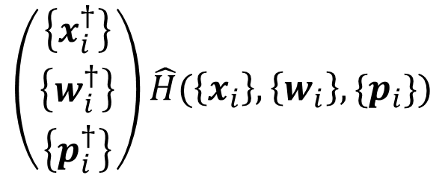

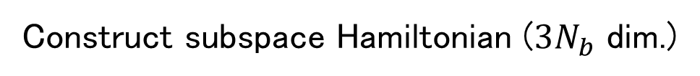

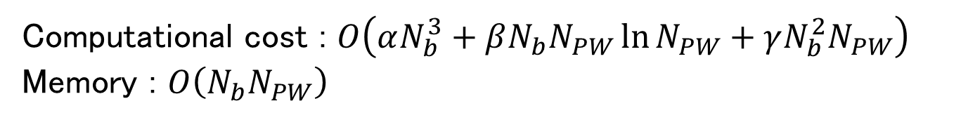


Locally Optimal Block Preconditioned Conjugate Gradient (LOBPCG) method
One of the iterative eigen solution methods
A. V. Knyazev, SIAM J. Sci. Compute. 23, 517 (2001).
山田進 他, 日本計算工学会論文集, 20060027 (2006).
For computing $N_{b}$ eigenvector, at each step
Construct subspace Hamiltonian ($3N_{b}$ dim.)
Approx. eigenvector $x_{1},x_{2},⋯x_{N_{b}}$
$$\left(\begin{matrix}\left\{x_{i}^{†}\right\} \\ \left\{w_{i}^{†}\right\} \\ \left\{p_{i}^{†}\right\}\end{matrix}\right)\hat{H}(\left\{x_{i}\right\},\left\{w_{i}\right\},\{p_{i}\})$$
Residual vector $\left\{w_{i}=\hat{H}|x_{i}〉−ε_{i}|x_{i}〉\right\}$
CG vector $p_{1},p_{2},⋯p_{N_{b}}$
Diagonalize with direct method
Take lowest $N_{b}$ vectors as approximate eigenvectors at next step
Loop until all $\left\{|r_{i}〉\right\}$ become smaller than the threshold
Computational cost : $O\left(αN_{b}^{3}+βN_{b}N_{PW}\ln{N_{PW}}+γN_{b}^{2}N_{PW}\right)$
Memory : $O\left(N_{b}N_{PW}\right)$

Slide 15


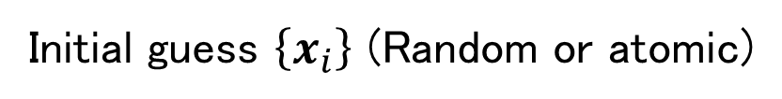










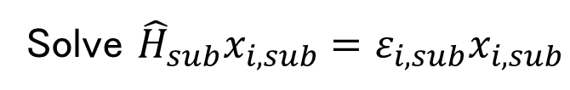






Algorithm of LOBPCG method lobpcg_main@lobpcg.F90
Initial guess $\left\{x_{i}\right\}$ (Random or atomic)
$$\left\{p_{i}\right\}=0$$
$$\left\{P_{i}\right\}=0$$
$$\left\{X_{i}=\hat{H}x_{i}\right\}$$
$$\left\{ε_{i}=X_{i}^{†}x_{i}\right\}$$
do iteration
$$\left\{w_{i}=X_{i}−ε_{i}x_{i}\right\}$$
All $\left|w_{i}\right|$ are small enough ? → Exit
$$\left\{w_{i}=\hat{P}w_{i}\right\}$$
$$\left\{w_{i}=w_{i}/\left|w_{i}\right|\right\}$$
$$\left\{W_{i}=\hat{H}w_{i}\right\}$$
$${\hat{H}}_{sub}={\left(\left\{W_{i}\right\},\left\{X_{i}\right\},\left\{P_{i}\right\}\right)}^{†}\left(\left\{w_{i}\right\},\left\{x_{i}\right\},\left\{p_{i}\right\}\right)$$
$${\hat{O}}_{sub}={\left(\left\{w_{i}\right\},\left\{x_{i}\right\},\left\{p_{i}\right\}\right)}^{†}\left(\left\{w_{i}\right\},\left\{x_{i}\right\},\left\{p_{i}\right\}\right)$$
Solve ${\hat{H}}_{sub}x_{i,sub}=ε_{i,sub}x_{i,sub}$
Take lowest $N_{b}$ : ${\left\{x_{i,sub}\right\}}_{low}$
$$\left(\left\{x_{i}\right\} \right)=\left(\left\{w_{i}\right\},\left\{x_{i}\right\},\left\{p_{i}\right\}\right)\left({\left\{x_{i,sub}\right\}}_{low}\right)$$
$$\left(\left\{p_{i}\right\} \right)=\left(\left\{w_{i}\right\},\left\{0\right\},\left\{p_{i}\right\}\right)\left({\left\{x_{i,sub}\right\}}_{low}\right)$$
$$\left(\left\{X_{i}\right\} \right)=\left(\left\{W_{i}\right\},\left\{X_{i}\right\},\left\{P_{i}\right\}\right)\left({\left\{x_{i,sub}\right\}}_{low}\right)$$
$$\left(\left\{P_{i}\right\} \right)=\left(\left\{W_{i}\right\},\left\{0\right\},\left\{P_{i}\right\}\right)\left({\left\{x_{i,sub}\right\}}_{low}\right)$$
$$\left\{x_{i}=x_{i}/\left|x_{i}\right|\right\}$$
$$\left\{X_{i}=X_{i}/\left|X_{i}\right|\right\}$$
$$\left\{p_{i}=p_{i}/\left|p_{i}\right|\right\}$$
$$\left\{P_{i}=P_{i}/\left|P_{i}\right|\right\}$$
end do iteration

Slide 16
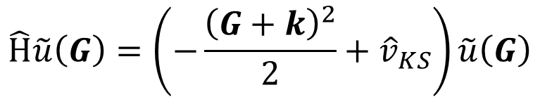

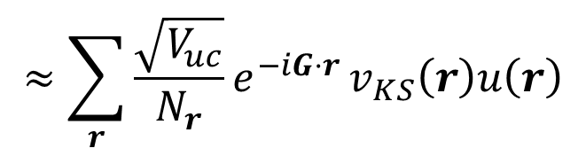
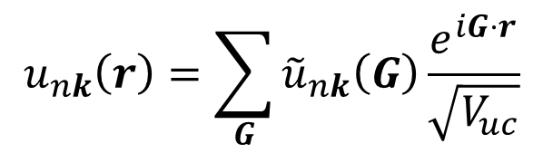
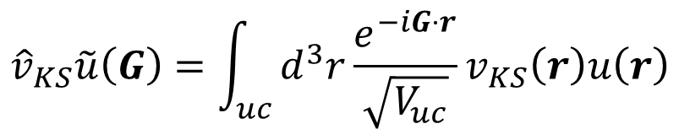
Hamiltonian vector product h_psi@hamiltonian.F90
$$\left\{W_{i}=\hat{H}w_{i}\right\}$$
$$\hat{H}\tilde{u}\left(G\right)=\left(−\frac{{\left(G+k\right)}^{2}}{2}+{\hat{v}}_{KS}\right)\tilde{u}\left(G\right)$$
$${\hat{v}}_{KS}\tilde{u}\left(G\right)=\int_{uc}{d^{3}r}\frac{e^{−iG⋅r}}{\sqrt{V_{uc}}}v_{KS}\left(r\right)u\left(r\right)$$
$$≈\sum_{r}{\frac{\sqrt{V_{uc}}}{N_{r}}e^{−iG⋅r}}v_{KS}\left(r\right)u\left(r\right)$$
$$u_{nk}\left(r\right)=\sum_{G}{{\tilde{u}}_{nk}\left(G\right)\frac{e^{iG⋅r}}{\sqrt{V_{uc}}}}$$
Done in subroutine hpsi in hamiltonian.F90

Slide 17
Running iterative method
$ cd ~/pwdft/sample/Al/
$ ../../src/pwdft.x < iterative.in
&CONTROL
calculation = 'iterative'
/
&SYSTEM
nbnd = 10
nat = 1
ntyp = 1
ecutwfc = 60.000000
ecutrho = 240.000000
/
&ELECTRONS
/
CELL_PARAMETERS
0.000000 2.024700 2.024700
2.024700 0.000000 2.024700
2.024700 2.024700 0.000000
ATOMIC_SPECIES
Al al.lda.lps
ATOMIC_POSITIONS
Al 0.000000 0.000000 0.000000
K_POINTS
1
0.0 0.0 0.0
See "Kohn-Sham Time" in
Standard output
keep ecutrho ≧ 4*ecutwfc

Slide 18
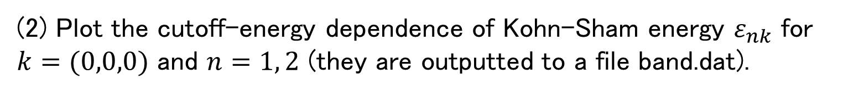
Report problem 1
(1) Compare the computational time of direct method and LOBPCG method by changing ecutrho and ecutwfc.
keep ecutrho ≧ 4*ecutwfc
Time [sec]
ecutwfc [Ry]
(2) Plot the cutoff-energy dependence of Kohn-Sham energy $ε_{nk}$ for
$k=(0,0,0)$ and $n=1, 2$ (they are outputted to a file band.dat).

Slide 19
What is the command "git"
$ git clone ssh://user-name@133.11.72.58:/home/Student/Public/pwdft
Backup code
Port program in any system
Merge modifications
Compare diff
Log each modification with comment
Etc.

Slide 20
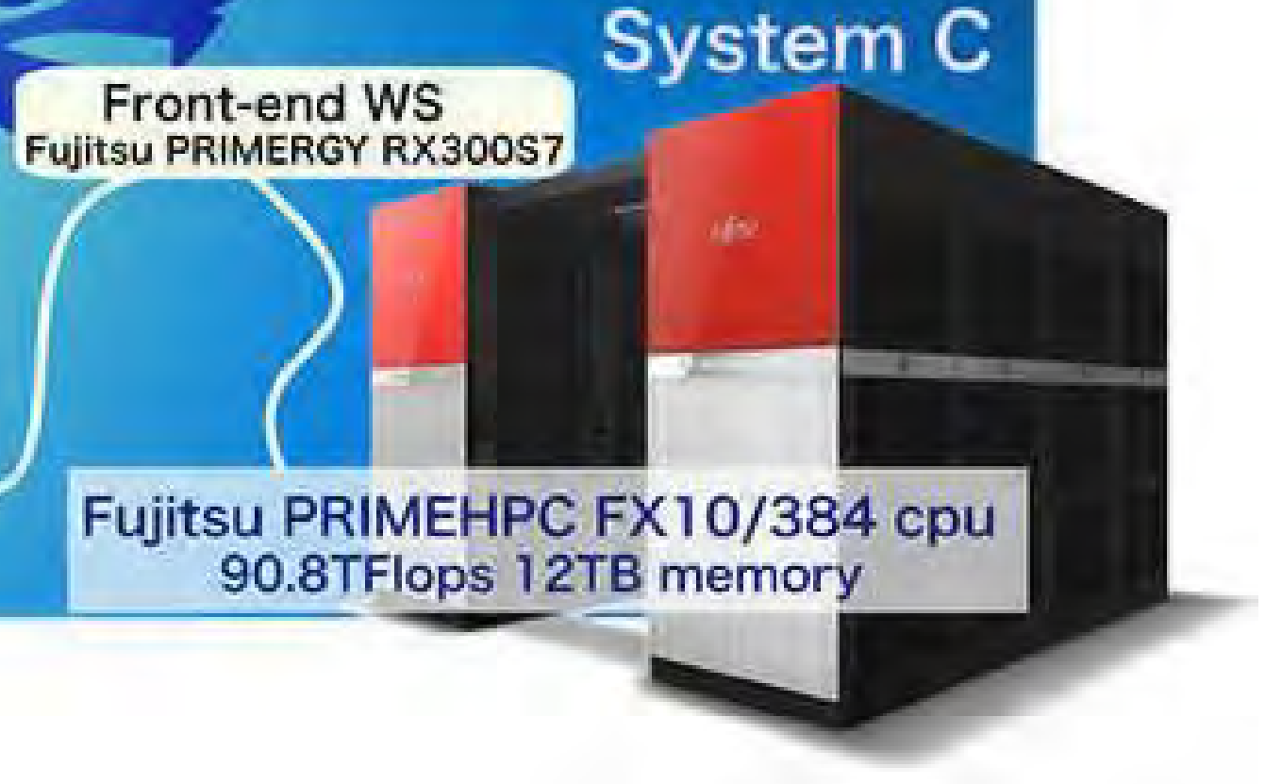
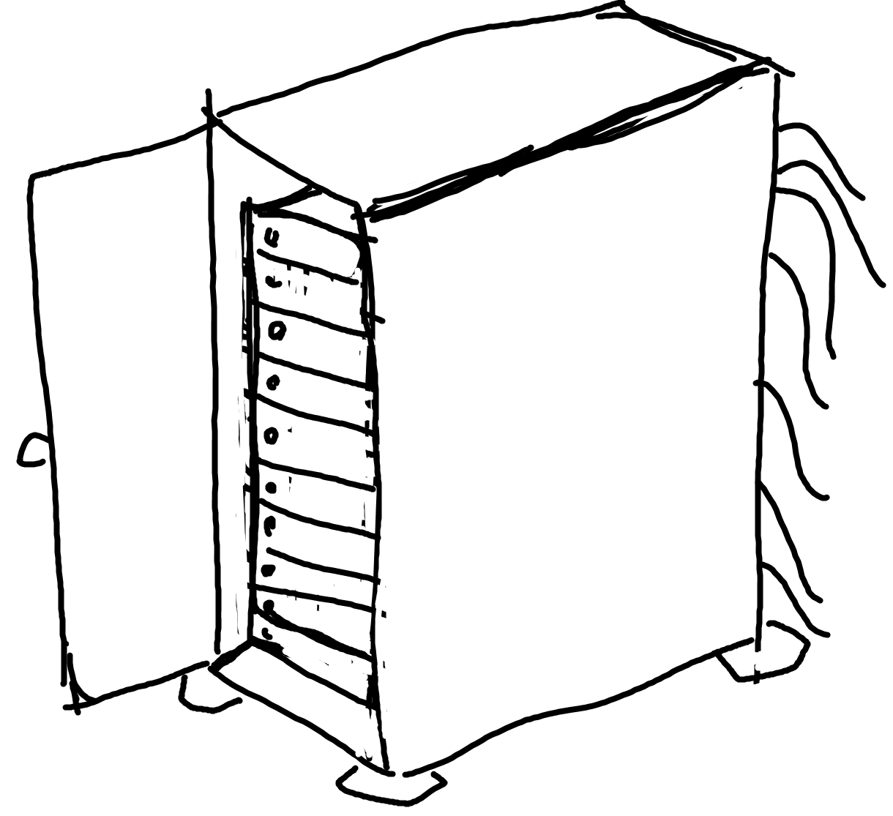

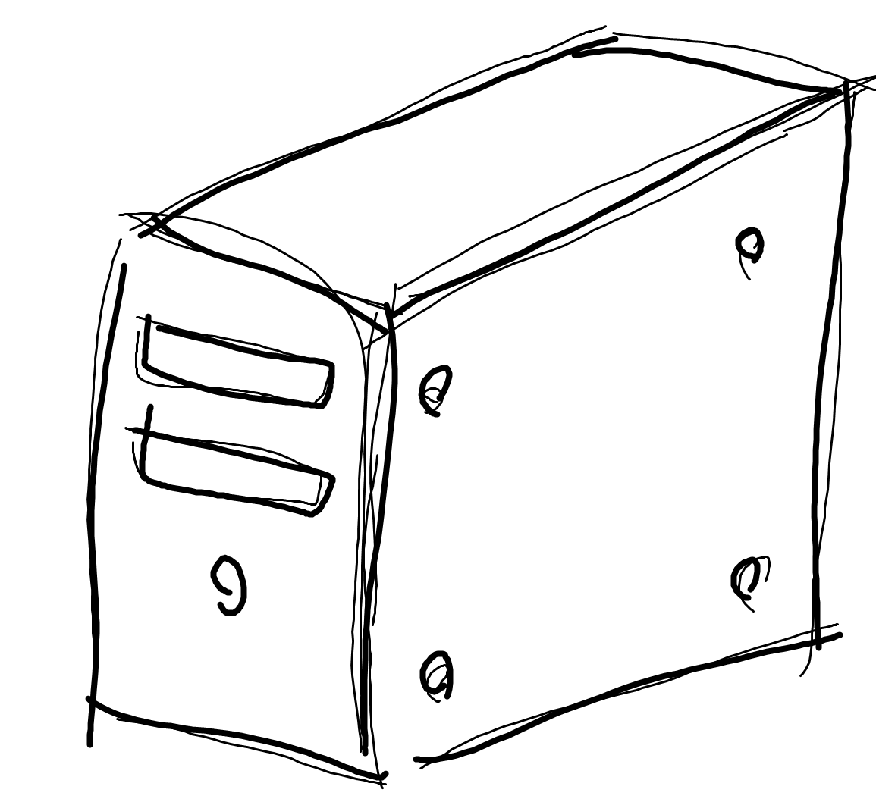



Considered case 1
System C
Laptop PC
PC cluster
Labo PC
System B
・ Where is the latest source code ?
・ We need to update source code easily.
Home PC

Slide 21
Considered case 2
Program
System A
System B
Speed up with symmetry
Program
System A
OpenMP
Program
System A
OpenMP+MPI
Program
System A
System B
・ We need to trace when was it broken.
・ We need to be available to return the stable (no error) code.

Slide 22



Version control
Logging :
Who
When
What
modified
Program (commit 1)
Repository
server
Program (commit 2)
Program (commit 3)
$$⋮$$
Program (commit 10)
Latest
$ git pull
update modification
Program (commit 11)
$ git pull
Update latest version
$ git commit
$ git push
local repository
local repository
Modify

Slide 23


When modified simultaneously
Program (commit 1)
Repository
server
Program (commit 2)
Program(commit 3)
$ git push
$$⋮$$
Program (commit 10)
Program (commit 11)
Latest
Program (commit 12)
$ git pull
commit 10+
commit 11+
local repo
$ git push
local repo
commit

Slide 24
Tutorial
$ cd ~/pwdft/
$ git branch -a
$ git config --global user.name "user-name"
$ git config --global user.email "user-name@bkks"
$ git checkout -b user-name
$ echo "Hello, I am user-name." > user-name.txt
$ git add user-name.txt
$ git commit (vi is used)
$ git push --set-upstream origin user-name
$ git branch -a

Slide 25
Example of branches
V0.1
V0.2
V1.0
Master
Hotfix (Bug fix)
Release
Develop
Feature (new features)
"A successful branch in git"

Slide 26
Today's summary
Plane-wave representation of Kohn-Sham eq.
Direct method and LOBPCG method
Hamiltonian-vector product with FFT
Git

