Slide 1
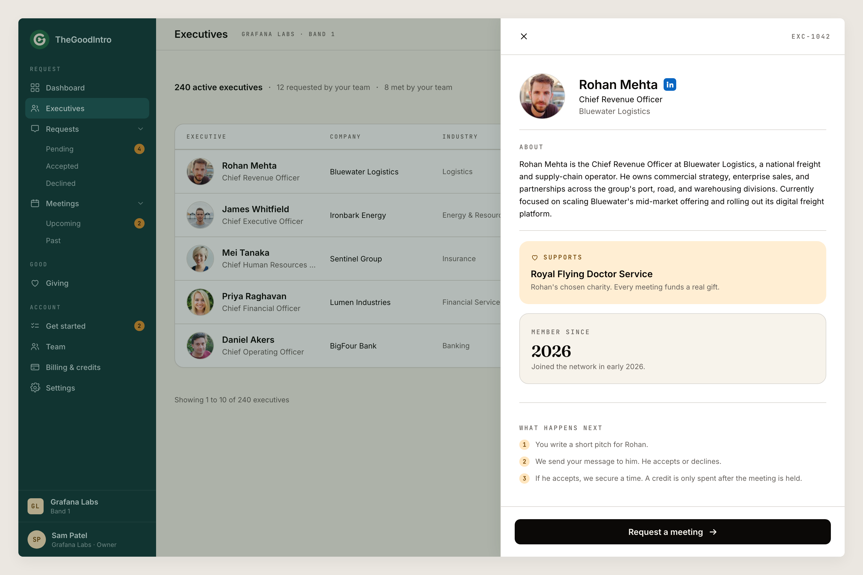
A PREVIEW OF THE PLATFORM
Browse vetted leaders, request a meeting with a written reason, and see the gift each one funds.
This is what your team would use.

