Slide 1
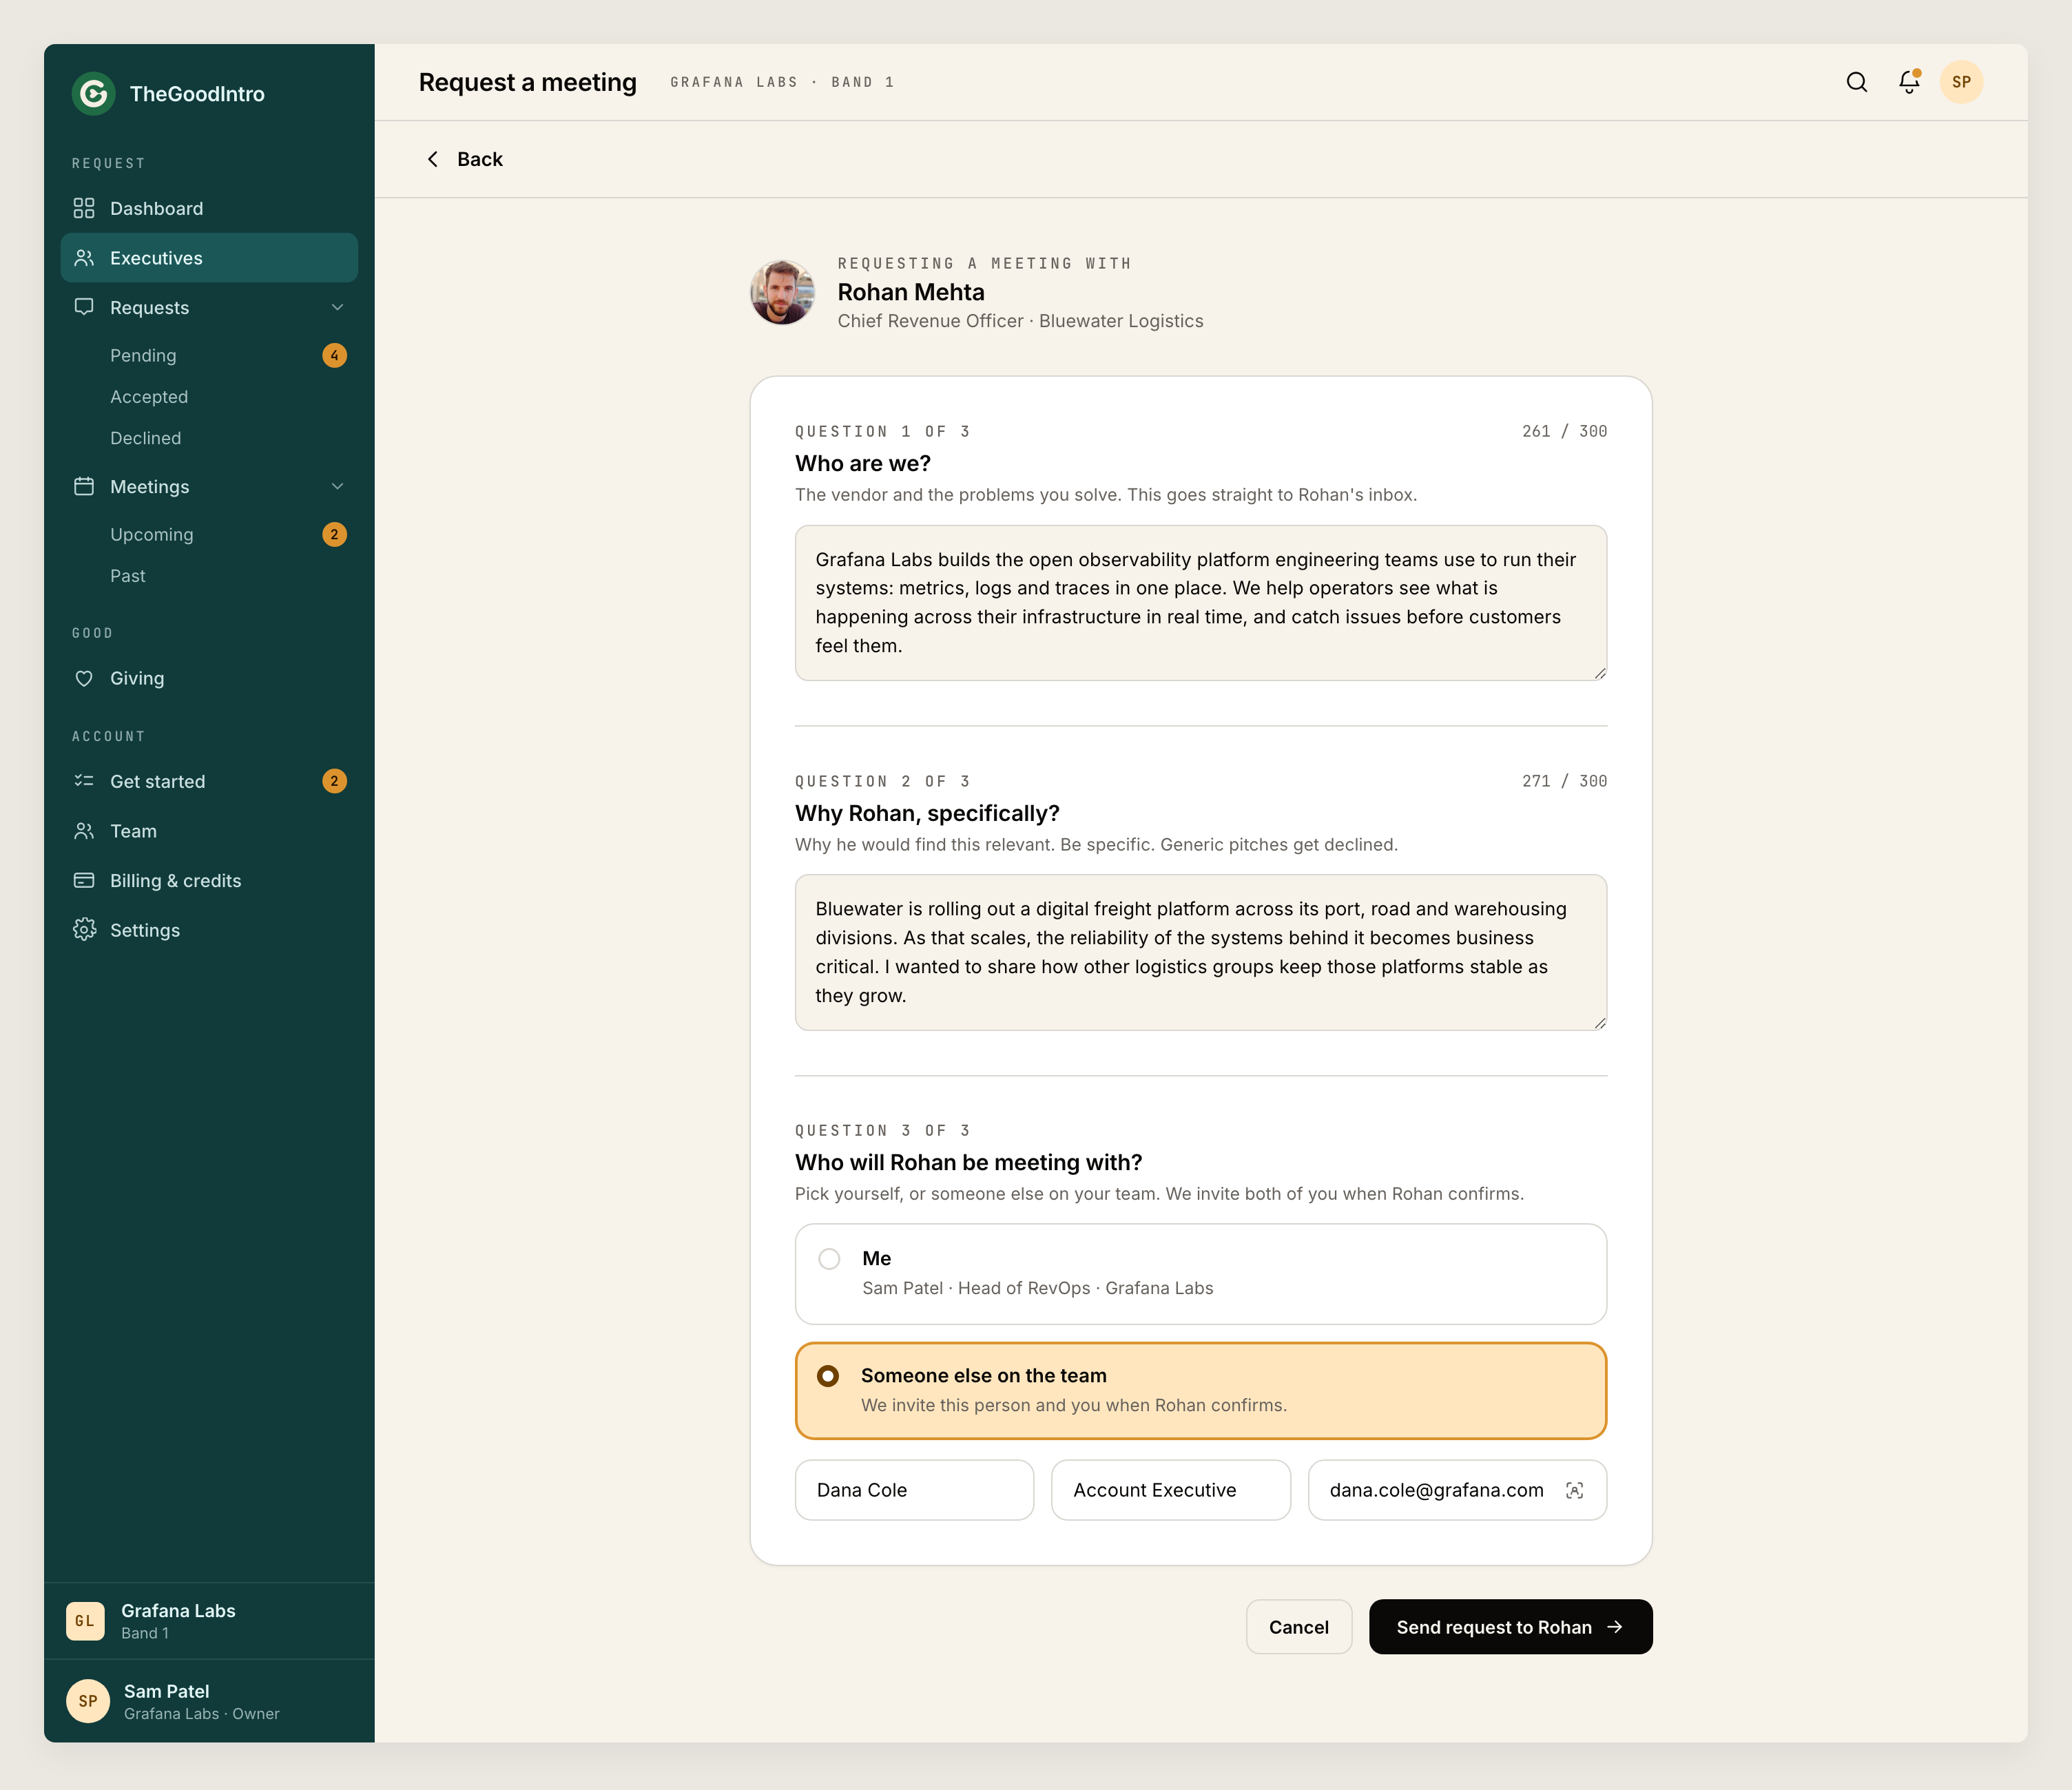
Demo Platform
A meeting your team earns.

