Slide 1
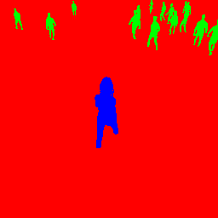

Encoder
Decoder
Output
Input
Skip Connection
Conv+ReLU+BatchNorm
BilinearUpsample
MaxPool
Softmax
1x1Conv

