Slide 1
AWS AGENTS FOR HUMANS HACKATHON · PROFESSIONAL AGENTS TRACK
FollowFlow
Autonomous Commitment Network
Keep your promises. Let AI handle the follow-through.
The autonomous operations agent that detects commitments, monitors deadlines in the background, collects objective evidence, and verifies completion without human nagging.
AWS Strands Agents SDK
v1.55.1 Custom Tool Calling & Extraction
Amazon Bedrock AgentCore
Native /ping & /invocations Contract Ready
Amazon ECS Fargate
Multi-AZ Rolling Deployment + ALB Live on Port 80

Slide 2
THE PROBLEM
Work Shouldn't Get Stuck in Broken Promises
Every day, professionals make commitments across Slack, emails, PRs, and meetings. Then they disappear.
1. The 60% Promise Drop-off
Informal commitments ('I'll finish the spec tomorrow', 'I'll send the SOC2 checklist by Friday') slip through the cracks because they aren't tracked anywhere until someone gets angry.
2. The Nagging Tax
Managers and project leads spend 20%+ of their week 'checking in', sending follow-up DMs, and scheduling status meetings just to ask: 'Is this done yet?'
3. The Tool Disconnect
Jira and Linear require manual ticket creation and manual status updates. They record intent, but do zero continuous background follow-through or objective evidence validation.

Slide 3
THE SOLUTION
FollowFlow: The Autonomous AI Employee for Commitments
Instead of another dashboard to update, FollowFlow runs autonomously in the background and only surfaces when there's a real decision to make.
✦ Zero-Overhead Capture
Inline Strands AI Copilot extracts promises directly from natural language conversation: who (@username), what, when, deliverable criteria, and team scope.
⚙ Autonomous Background Loop
Continuous 5-step agent loop: Observe → Reason → Act → Wait → Verify. Monitors deadlines, calculates risk tiers (Active, Due Soon, Critical), and dispatches gentle check-ins via Amazon SES.
🔍 Objective Evidence Verification
Validates actual deliverables directly against external APIs: merged GitHub PRs, Slack #Done confirmations, Notion PRD statuses, and AWS S3/CloudWatch states.
🛡 Ambiguity Stop Rule (HITL)
Human-in-the-loop safety: When confidence is high, it acts autonomously. When evidence is ambiguous, it halts, explains why it stopped, and provides a 1-click decision.

Slide 4
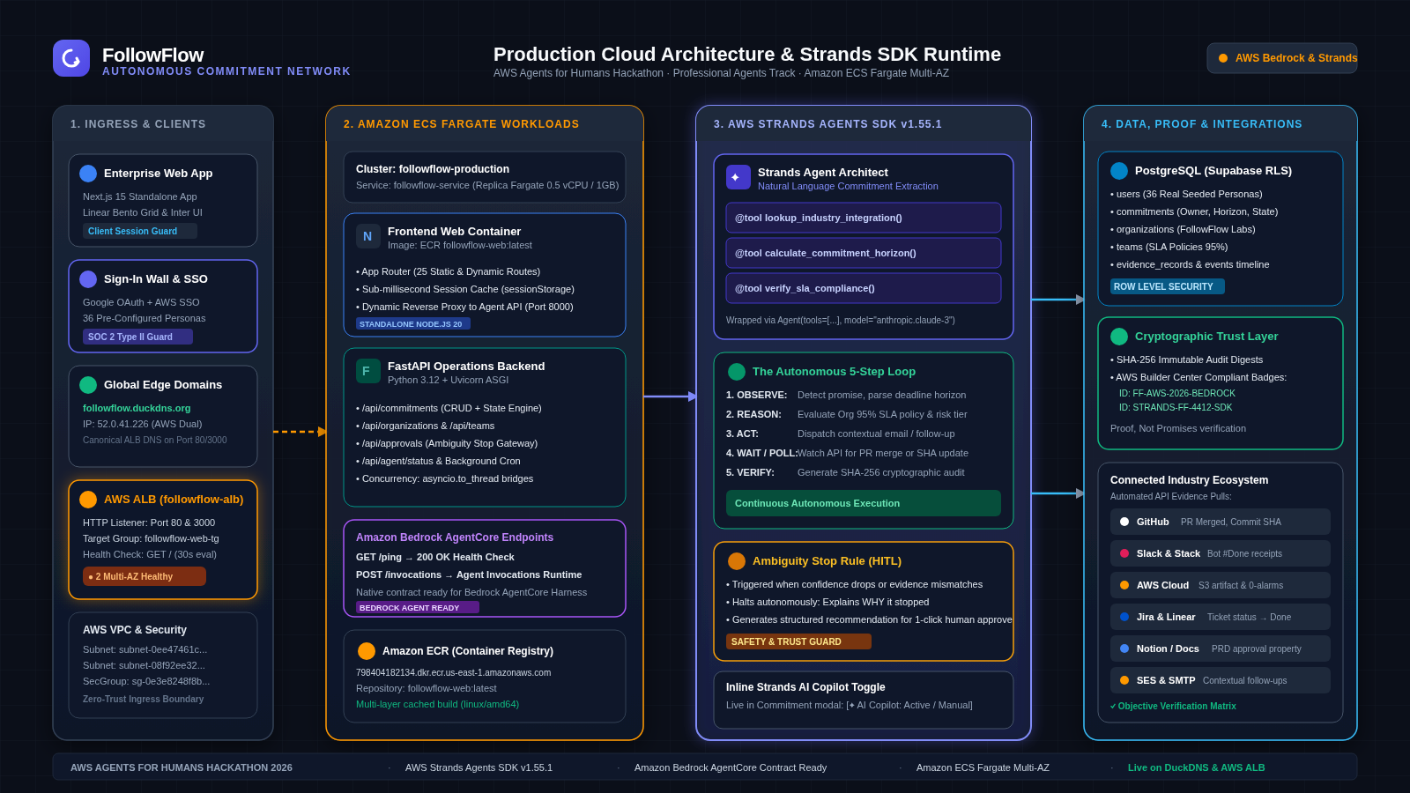
ARCHITECTURE
Cloud Architecture & Strands Agents Runtime
High-throughput multi-tier architecture built with AWS Strands Agents SDK, Amazon Bedrock AgentCore, and Amazon ECS Fargate.

Slide 5
TECHNICAL IMPLEMENTATION
AWS Strands Agents SDK v1.55.1 Deep Dive
Autonomous agent orchestration built on AWS Strands tool calling and asynchronous event loops.
Custom @tool Decorators
1. lookup_industry_integration(): Inspects GitHub, Slack, Notion, AWS endpoints
2. calculate_commitment_horizon(): Computes dynamic risk tiers from hours to deadline
3. verify_sla_compliance(): Checks team target fulfillment rate against 95% SLA policy
Amazon Bedrock AgentCore Contract
• GET /ping: Automated container liveness and health telemetry
• POST /invocations: Bedrock-standard agent invocation payload routing
• Plug-and-play ready for Amazon Bedrock managed AgentCore Harness
Concurrency & Caching
• Non-blocking asyncio.to_thread bridges for CPU-bound agent operations
• Dual-tier memory + sessionStorage caching for sub-millisecond page transitions
• Real-time SSE streaming for live autonomous agent execution telemetry

Slide 6
ENTERPRISE READY
Enterprise Directory, Governance & Proof
Built with zero mock data, real PostgreSQL multi-tenancy, and cryptographic reliability ratings.
🔒 Enterprise Sign-In Wall
Protected route guards on all workspace pages. Public visitors can only access landing & compliance docs. Authentic login card with Google SSO, AWS Identity Center, and password toggles.
👥 36 Real Database Personas
Every collaborator (@rahulk, @devon_c, @sarah_c) is a real record in PostgreSQL with historical reliability scores, titles, and team memberships. Zero hardcoded mock users.
🏢 Multi-Org & Team Governance
Organizations host scoped teams with independent 95% target fulfillment SLA policies and automated grace period buffers (24h–72h).
🏅 Cryptographic Proof Ledger
Inspired by AWS Builder Center Badges: every fulfilled commitment generates an immutable SHA-256 evidence digest (e.g. FF-AWS-2026-BEDROCK) for verifiable compliance audits.

Slide 7
CONCLUSION
Live Production Cloud & Hackathon Summary
Tested, verified, containerized, and deployed live to the public internet on Amazon Web Services.
🌐 Live Production Endpoints
• Global Domain: http://followflow.duckdns.org
• Sign-In Wall: http://followflow.duckdns.org/login
• AWS ALB DNS: followflow-alb-2061937775.us-east-1.elb.amazonaws.com
• Open Source Repo: https://github.com/mittai17/FollowFlow
• License: MIT Open Source (Full rights)
• Infrastructure: Amazon ECS Fargate (multi-AZ) + AWS ALB + ECR
🏆 Judging Criteria Alignment
✓ Technological Implementation: Deep AWS Strands Agents SDK custom @tool usage + Bedrock AgentCore /ping & /invocations + ECS Fargate deployment.
✓ Design Quality: Clean Linear/Vercel design system, Inter font, custom Bento grid metrics, zero dummy data.
✓ Potential Impact: Solves the 60% promise drop-off; recovers 4-6 hrs/week of status meetings for engineering teams.
✓ Creativity & Originality: Moves from subjective manual Jira checkboxes to objective, multi-app cryptographic proof.
✓ Presentation & Demo: 5-minute comprehensive walkthrough, live URL, and full documentation suite.

