Slide 1
Inception Presentation
SAI SRI LAKSHMI NANNAPANENI-1002077755
AMAN MITTAL-1001979035
RUKESH SAI KASTURI-1002049844
PAVAN SAI AKULA-1002082165
GitHub: https://github.com/mittal-aman7/Brownie_ASE

Slide 2
BROWNIE
Brownie is a development framework for Ethereum smart contracts that streamlines the development process. It uses Python as its primary programming language, making it accessible to developers of all skill levels. Brownie offers built-in testing tools, simplified deployment scripts, and the ability to interact with contracts through Python scripts, making it easier to develop, test, and deploy smart contracts. It also provides gas estimation tools to optimize contract efficiency. With an active developer community and a range of resources, Brownie is a powerful tool for Ethereum developers looking to enhance their smart contract development workflow.

Slide 3
FEATURES OF BROWNIE:
Python Based Development
Built-in Testing
Deployment Automation Via Scripting
Brownie simplifies the deployment process with easy-to-use deployment scripts, facilitating the transition from development to production. Also, developers can interact with smart contracts using Python scripts, enabling easy simulation of contract interactions, debugging, and testing.
Brownie uses Python, a popular and widely-used programming language, making it accessible to developers who are already familiar with Python.
It provides a robust testing environment with built-in tools for creating and running tests, ensuring the reliability and security of smart contracts.

Slide 4
Unlocking Brownie's Full Potential: Post-Bug Fixes Features
Byte Arrays Not Parsed Elegantly
Fetch Contract’s Previously Triggered Events
Error with Vyper Tests
Addressing this will enhance the reliability of tests and ensure that contracts deployed are robust and error-free
By refining this, we aim to improve the developer experience and the efficiency of the framework .
Adding this feature make it possible to create a log of all the events triggered by the user, which make it easier to troubleshoot and documentation

Slide 5
NAVIGATING BROWNIE:
Creating a New Project
Installation
Writing a Smart Contract
Compiling the Smart Contract
To install you need to have pyhton installed on your system with 3.6 or higher and then use command prompt to run the script.
pip install eth-brownie
In command prompt run the command.
brownie init MyProject
This command will create a project structure with the necessary files and directories.
Inside the project directory, there will “contracts” folder. We need to create a smart contract file inside this folder with
.sol extension
After opening the file, we can write a smart contract in solidity
To compile we use the below code
brownie compile
Brownie will compile your contract and generate JSON files with contract metadata in the "build" directory.

Slide 6
NAVIGATING BROWNIE:
Testing Smart Contract
Run the Test
To create a test files for the smart contract we need to Create test files in the "tests" directory to write tests for your smart contract.
These test files are in python.
After creating the test files, we need to run the command on the command prompt.
brownie test

Slide 7
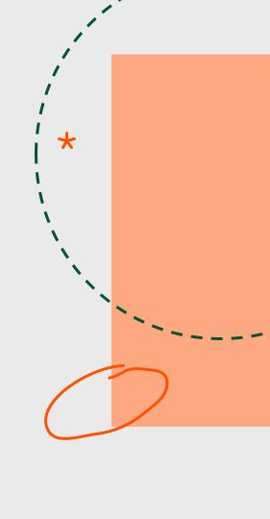
COMPETITORS OF BROWNIE
Brownie vs. Truffle
Brownie is a Python-based system that emphasizes thorough testing and detailed gas usage reports while smoothly integrating with Python's tools. including its roots in JavaScript, extensive suite including an IDE, and larger community, Truffle is a favorite among those familiar with JavaScript.
Brownie vs. Hardhat
Python-based Brownie caters to Python fans and offers native testing and in-depth gas analytics. Contrarily, Hardhat is built on TypeScript and JavaScript and emphasizes cutting-edge features like native TypeScript support and built-in Solidity stack traces, making it desirable to developers in the JS ecosystem.

Slide 8
WHY BROWNIE?
Python Proficiency: Given our strong background in Python and the team's preference for the language, opting for Brownie in our debugging process enhances our efficiency. We can leverage our Python skills to swiftly identify and resolve bugs, making the debugging of live issues a more streamlined and effective endeavor.
Ease of Use: Brownie's user-friendly and intuitive development environment simplifies the debugging process. We can quickly set up and get started with debugging without a steep learning curve, which is especially beneficial when dealing with live bugs that in short time.
Gas Estimation: When debugging live contracts, understanding gas costs is crucial. Brownie provides gas estimation tools that help you optimize your smart contracts for cost-efficiency, ensuring that our bug fixes don't introduce unexpected gas cost issues.

Slide 9
PROJECT ENHANCEMENT & BUG FIXING
Make Brownie work with all contract type.
Make Brownie work appropriately when contracts are not properly linked.
Work on the open issues such as:
Errors with Vyper tests #1653
Bytes array not parsed elegantly #1568

Slide 10
REFRENCES
https://eth-brownie.readthedocs.io/en/stable/index.html
https://github.com/eth-brownie/brownie
https://www.quicknode.com/guides/other-chains/polygon/how-to-deploy-a-smart-contract-with-brownie
https://chainstack.com/the-brownie-tutorial-series-part-1/
https://ethereum.stackexchange.com/questions/87963/which-ethereum-framework-to-choose-truffle-vs-brownie
https://mirabdulhaseeb.medium.com/truffle-vs-hardhat-vs-brownie-lets-compare-ea08b927d084

Slide 11
QUESTIONS?

