Slide 1

COTIVITI · TOPIC 2 SUBMISSION
Provider Fraud Intelligence System
Clinical Decision Making and Pattern Recognition in Healthcare
Aditya Mittal | Michigan State University | June 2026

Slide 2

Healthcare fraud is large, evolving, and hard to catch manually
The business problem
3%
Health payers process hundreds of millions of claims every year
A nonprofit industry group (NHCAA) conservatively estimates about 3% of all healthcare spending is lost to fraud each year, tens of billions of dollars
Rules based detection systems catch known fraud patterns reliably, but cannot adapt as schemes evolve
Cotiviti's own 360 Pattern Review pairs machine learning with more than 75 credentialed human specialists who interpret the model's output by hand
That manual interpretation step is the bottleneck this project targets
conservative estimate of US healthcare spending lost to fraud each year, per NHCAA
75+
credentialed specialists Cotiviti uses to manually interpret model output into investigations

Slide 3

A two stage pipeline: detect the anomaly, then explain it
1
2
3
4
Score
Explain
Reason
Review
An XGBoost model scores each provider's billing history for fraud risk
SHAP identifies exactly which billing behaviors drove that score
An LLM agent receives the top SHAP-flagged billing anomalies, maps them to a known fraud scheme taxonomy, and produces a structured 6-part investigative brief
A human investigator reads the brief and decides what to do next
Important scope note: the system scores and explains at the PROVIDER level (a doctor or clinic's overall billing pattern) but not at the level of a single claim.
Built with: Python, XGBoost, SHAP, the Anthropic API (Claude), and Streamlit for the interface

Slide 4

The data: public Medicare claims, aggregated per provider
What's in it
Kaggle's public Medicare Provider Fraud Detection dataset
Four linked tables: provider labels, inpatient claims, outpatient claims, and beneficiary (patient) records
5,410 providers in total, labeled fraudulent or not
We engineered 23 provider level features: average reimbursement, claim volume, length of stay, physician diversity, patient demographics, and more
5,410
providers profiled
9.35%
labeled fraudulent: a meaningfully imbalanced dataset
23
engineered features per provider
Constraints
This dataset only labels whole providers as fraudulent, never individual claims. That single fact shapes everything about this system's current scope.
4
source tables joined: labels, inpatient, outpatient, beneficiary

Slide 5

How the model works: score, then explain the score
XGBoost classifier (plain English: a tree based model that learns patterns from labeled examples)
SHAP explainability (plain English: shows which inputs pushed the score up or down)
Trained on 23 provider-level aggregate features derived from inpatient claims, outpatient claims, and beneficiary records to output a fraud probability per provider
Class imbalance (9.35% fraud) is addressed by weighting each positive example by a factor of ~9.7 during training
The decision threshold is tuned to maximize F1 on the held-out test set rather than using a default 0.5 cutoff, which would be misleading under class imbalance
For every flagged provider, SHAP ranks which of the 23 features contributed most to their score
The top signals: total claim volume, average reimbursement amount, and inpatient length of stay
This turns a single fraud probability number into a list of specific, checkable behaviors

Slide 6

How the agent works: from numbers to an investigator's brief
SHAP can tell you which numbers look unusual. It can't tell you what kind of fraud that looks like, or what to check next. That's the gap the agent closes.
1
Receives the provider's top SHAP flagged behaviors, with each one compared to the population average
2
Is given a reference list of known healthcare fraud schemes (upcoding, phantom billing, unbundling, and others)
3
Reasons through the evidence and writes a structured 6 part brief: risk level, red flags, likely scheme, evidence to pursue, and a recommended action
4
Every brief explicitly states it is decision support only, not a finding of fraud
This is what "agentic" means here: the model doesn't just answer a question, it follows a defined reasoning process end to end to produce a usable work product.

Slide 7

Results: what the numbers mean in practice
0.95
0.74
72%
69%
ROC-AUC
PR-AUC
Precision
Recall
The model ranks a fraudulent provider above a non fraudulent one 95% of the time
The honest score under class imbalance — far above the ~0.09 a random guess would get
Of providers flagged as fraud, about 7 in 10 are correctly flagged
Of all true fraud providers, the model catches about 7 in 10 of them
What this means for an investigator
The model is a strong, usable first pass filter — it surfaces the right providers to look at far more often than chance
At 72% precision, roughly 1 in 4 flagged providers will turn out not to be fraudulent — this is exactly why every output is framed as decision support, not a verdict
Every brief in the demo references the provider's real numbers against the real population average, generated live from the model, not scripted

Slide 8

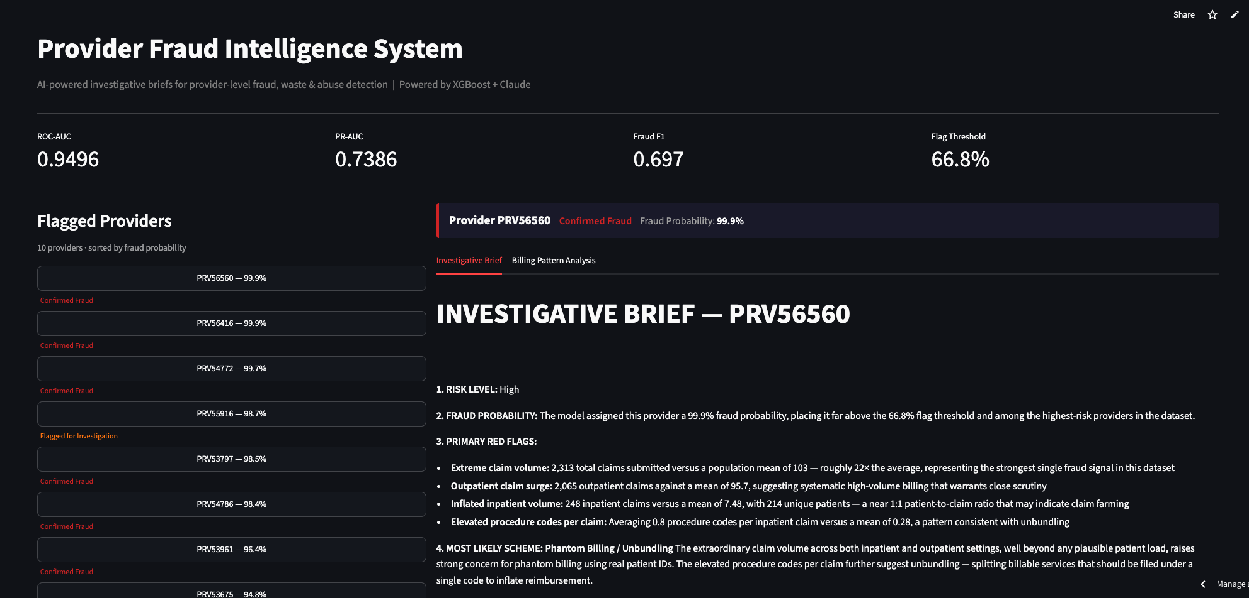
What it looks like: the investigator facing app

Slide 9

Limitations: where this proof of concept stops short
Provider level, not claim level
The dataset only labels whole providers as fraudulent. We can flag a provider's overall pattern, but not point to one specific claim. This is the single biggest gap to production.
Real false positive rate
At 72% precision, about 1 in 4 flagged providers are not actually fraudulent in our test set. A human must always review before any action is taken.
Agent output can't be independently verified
The brief's reasoning is plausible and grounded in real numbers, but there is no ground truth to confirm the scheme it names is correct.
Public, dated, anonymized data
The Kaggle dataset is several years old and does not reflect current billing behavior or any specific payer's real claims.

Slide 10

Roadmap: toward a claim level, multi agent system
With claim level fraud labels, the single agent design here could evolve into five specialized agents, each independently auditable:
1
2
3
4
5
Detection Agent
Evidence Retrieval Agent
Scheme Classification Agent
Report Drafting Agent
Review Agent
Scores individual claims using procedure codes, billing timing, and patient history
Automatically pulls the specific claim records relevant to a flag
Matches anomalies to a known fraud taxonomy, audited independently
Assembles the investigator brief from verified, evidence backed input
Checks the other agents' work against the data before a human ever sees it
Alongside this, unsupervised methods such as autoencoders trained on normal billing behavior would catch novel schemes that don't match any known pattern.

