Slide 1



BANK LOAN OF CUSTOMERS
DATA ANALYSIS PROJECT
P- 414P | Group 2 | Mentor: Gunda Bharat

Slide 2
M E E T O U R T E A M
Ms. Shruti Shivprasad Pardeshi
Mr. Sumit Rajaram Pujare
Ms. Digdarshini Das
Ahir Vishwa Bhadreshbhai
Mrs. Anjana C
Mr. Bhukya Praveen
Mr. Sagar Nathu Jedhe

Slide 3


Introduction
Basically Data analytics enables lenders to segment their customer base effectively and create personalized offerings based on individual borrower profiles. By analyzing borrower behavior, credit history, and financial patterns, lenders can identify specific customer segments with unique characteristics and needs.
The project aim to analyze the finance dataset of bank loan of customers, We got different insights by the report we created by using different tool like Excel, SQL, Tableau and Power BI.
By using this tools we did analyzing, cleaning and removing duplicates from datasets and prepared dashboards and insights and we made accurate business decisions from it.

Slide 4


C O N T E N T S
Introduction
Meet the team
KPI-1 : Year wise loan amount Stats
KPI-2 : Grade and sub grade wise revol bal
KPI-3 : Total Payment for Verified Status Vs Total Payment
for Non Verified Status
KPI-4 : State wise and Month wise Loan status
KPI-5 : Home ownership vs Last payment date stats
Dashboards & Queries : Excel, SQL, Power BI & Tableau

Slide 5
DATA S E T
Data Set | Finance_1 | Finance_2
No. of Rows | 39k | 39k
No. of Columns | 24 | 25
File Format | .csv | .xlsx
Datatype Set | Excel Data | Excel Data

Slide 6
TO O L S U S E D I N T H E P RO J E C T
MySQL
Tableau
Excel
Power-BI
Data Exploration
Retrieving Relevant Data according to KPIs
Joining multiple
Files
Visualization
Data Exploration
Data Cleaning
Visualization
Joining multiple
Files
Data Exploration
Data Cleaning in Power Query
Visualization

Slide 7







DATA A N A LY S I S P RO C E S S
Step 1
Define the Question
Step 2
Collect the data
Step 3
Clean the data
Step 4
Analyze the data
Step 5
Visualize and Share the Insights

Slide 8


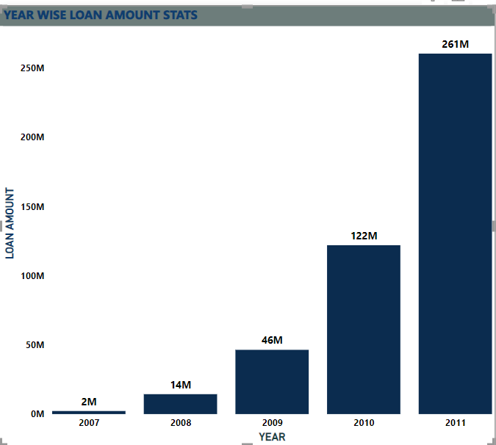
KPI-1 : YEAR WISE LOAN AMOUNT STATS
By observing this chart we can see how loan amount is increasing by year.
It is continuously increasing by each year as you see it‘s varies from 2 M to 261 M between the years 2007 to 2011.
From the year 2009, The changes in loan amount is suddenly increased with a higher rate that is very huge as compared to pervious years.

Slide 9
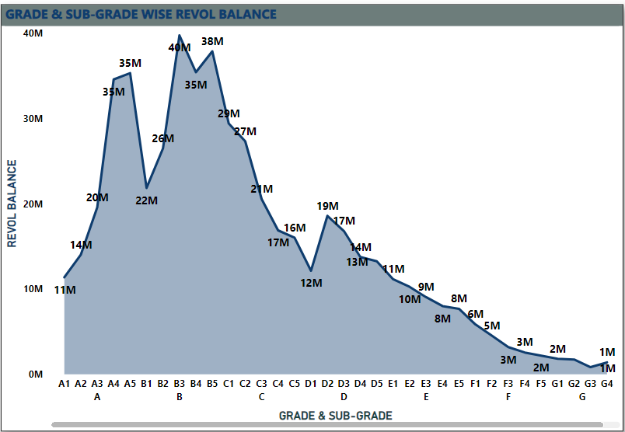
KPI-2 : GRADE AND SUB GRADE WISE REVOL_BAL
In this Grade and subgrade wise revol balance we can notice Grade B have higher revol balance than other grades & Grade G have lowest revol balance.
The average revolving balance is higher in the ‘grade B’ its around 29M and the maximum reaches in the ‘sub-grade B1’ that is 39M, In the same way the average lower revolving balance is in ‘grade G’ its around 1200K and the minimum reaches in the ‘sub-grade G5’ that is 701k.

Slide 10
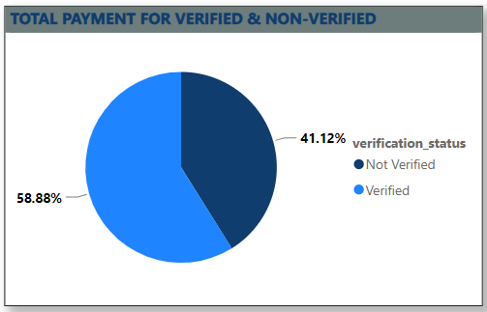
KPI-3 : TOTAL PAYMENT FOR VERIFIED VS NON VERIFIED STATUS
As we Can see in the Pie Chart that Out of $373 Million only 59% are verified i.e.
$220million
41% of $373 Million are non verified i.e. $ 154 Million. Which might be a threat to the company, , Here need to inform the verification team to take required action regarding that.

Slide 11
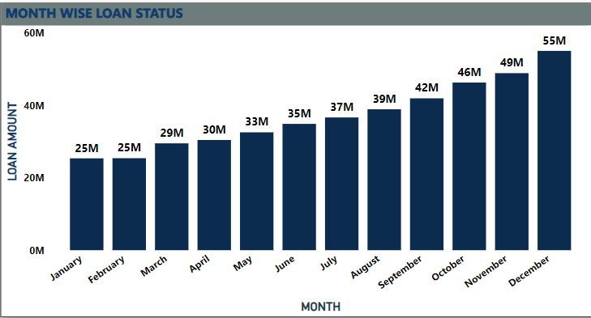
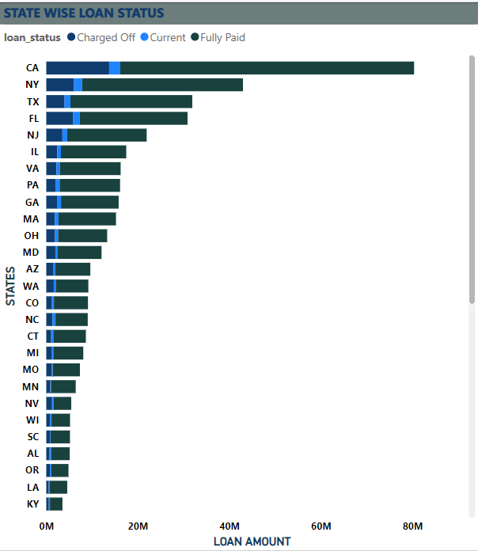
KPI-4 : STATE WISE AND MONTH WISE LOAN STATUS
In the data set we have different states and the months along with the 3 types of loan status.
In the state wise loan status we can observe that CA,NY,TX,FL & NJ are the top states to fully paid amount.
In the month wise loan status we can observe that Dec, Nov and oct have the highest amount.

Slide 12
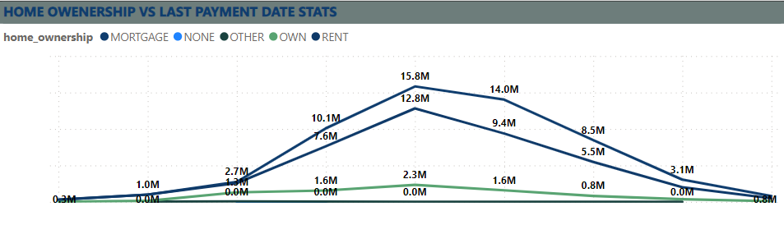
KPI-5 : HOME OWNERSHIP VS LAST PAYMENT DATE STATS
In this chart we can observe the different types of home ownerships which varies from 2008 to 2016.
The maximum amount reaches in the year 2012 were the Rent and Mortgage house owners has paid their last Payment of 12 million and 15 million. And the minimum amount is in the year 2008 and payment is 0.29 million and 0.31million.

Slide 13

DASH B OARD
Power-BI

Slide 14


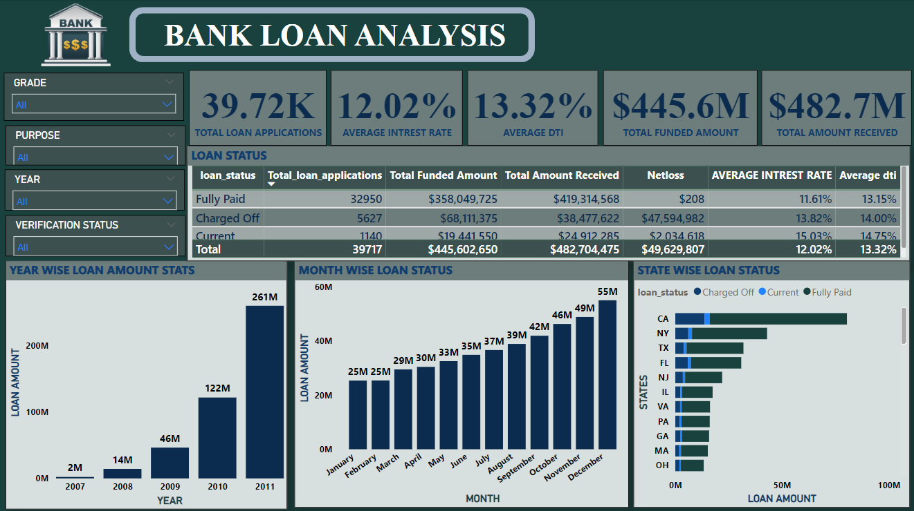
P O W E R B I DA S H B OA R D

Slide 15
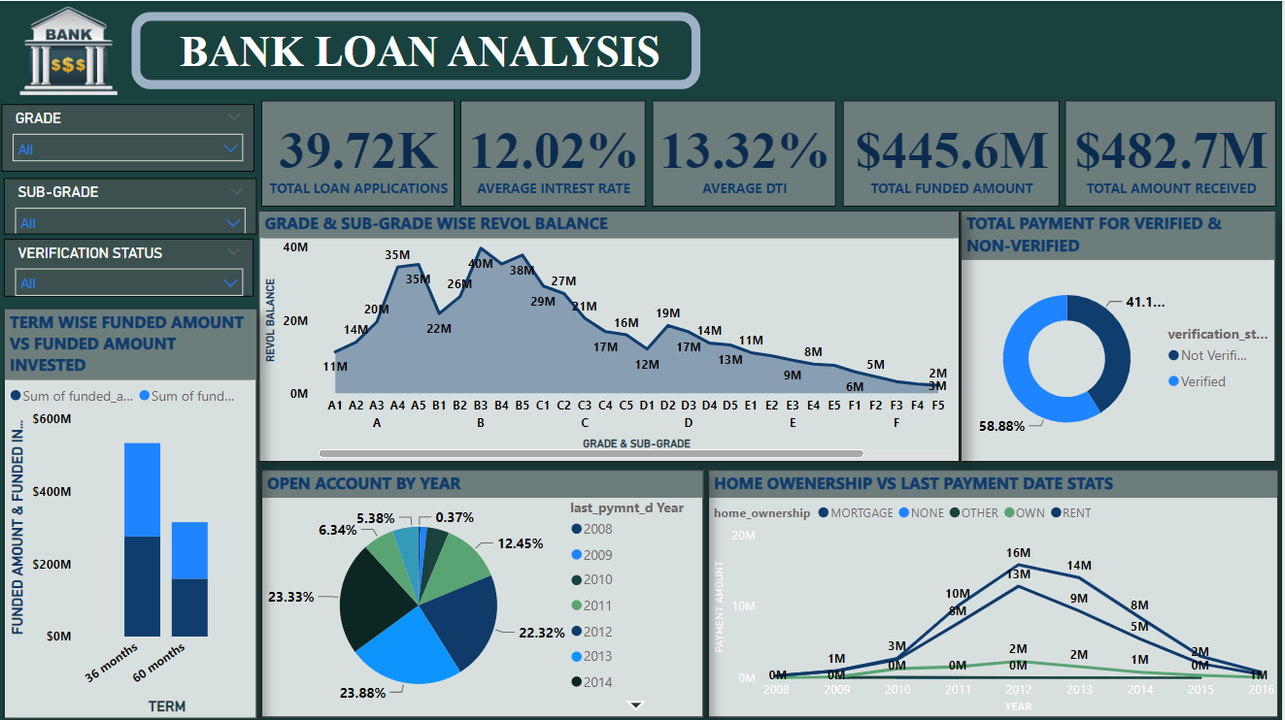
P O W E R B I DA S H B OA R D

Slide 16




CONCLUSION
Banking holds a crucial role in our day to day life. From the analysis of above dashboards and reports we can draw hidden insights like we have observed that year wise loan amount goes on increasing which is altimately a positive growth and we expect it to grow the same way also we have observed that the payment of non verified status is more as compare to verified status so we have to look into this carefully, With the use of gained insights from the finance datasets and KPI’S. Accurate Business decisions are made and can track the business state. It enables a holistic view of the business, supporting long term growth and competitiveness in the banking industry.

Slide 17


T H ANK YOU

