Slide 1

Real Estate Analysis San Francisco Bay Area
BAN 612- Data Analytics
Presentation By:
Gyati Mittal

Slide 2

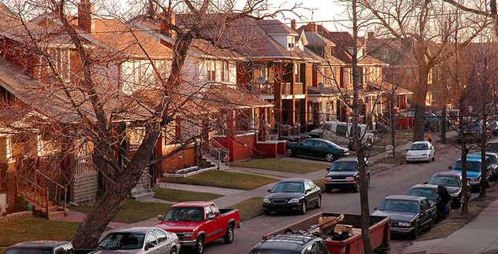

Research Questions
Price Versus Walk Score
Price Versus Parking
Percentage of units with AC installed

Slide 3


Research Question 1:
How Price varies with Walkable score ?
Through the data visualization techniques, we will verify this claim by Redfin:
https://www.redfin.com/blog/how-much-is-a-point-of-walk-score-worth/

Slide 4
In U.S. cities, homes within walking distance to jobs, schools, shopping, parks and other urban amenities are both highly desired and extremely rare. And like everything rare and desirable, walkability comes at a premium; homes highly “walkable” to amenities, everything else being equal, are more expensive than comparable homes in less “walkable” areas. People are opting to move nearby, even closer to the restaurants and bars they love walking to, rather than move out to bigger homes.
Premise: Why price increases with walk score?

Slide 5
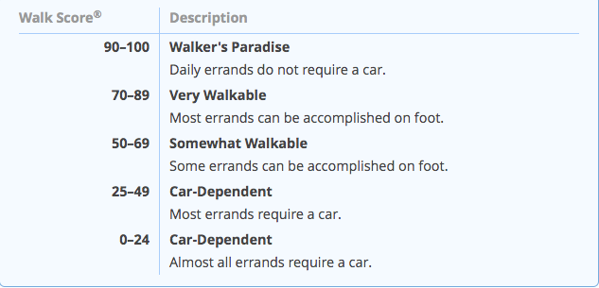

Walk Score table description

Slide 6
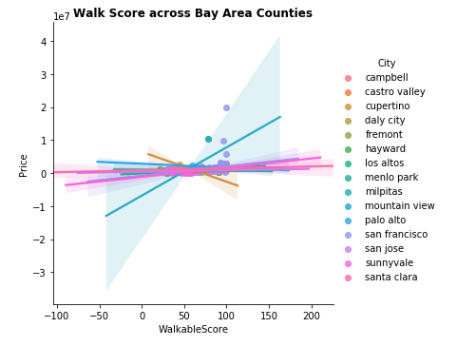
This graph shows the general distribution of walk score across all Bay area counties. - We have chosen to make lmplot for this representation with hue set as 'City' column. - Through this graph we can observe that San Francisco has the most varied walk score across all cities. - For this plot we are filtering data points with walk score greater than 20 because there are not many data points with walk score less than 20. - We also have to filter by 'beds' column to get a uniform comparison across all cities.

Slide 7
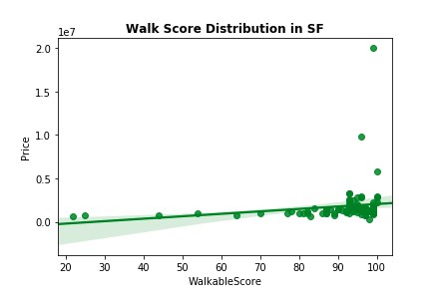
In this second plot we are using regplot to show that house price in San Francisco increases with the walk score. - Also, we can observe that the walk score is highly skewed on the higher end when it comes to San Francisco. - The above observation is not true for other cities. - We are choosing San Francisco for this plot because it has lots of data points with walk score greater than 90.

Slide 8
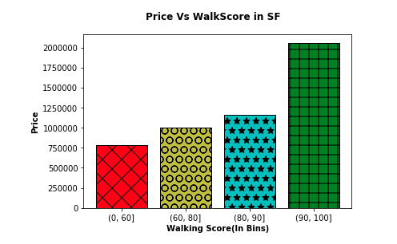
For the third graph we compare price versus walk score data for SF to verify the claim by Redfin. - We have the mean price on y-axis for all the data points with walk scores in the bin range on x-axis. - For this purpose we divide the data in bins before aggregating it by walk score. - First we group-by the data into the bins created above, then for aggregation we used the mean function. - After that we collect the aggregate statistics in a dictionary. - Through this bar plot, we can observe that the redfin claim is absolutely true. Price does increase consistently with walk score.

Slide 9


Research Question 2:
How Garage/Parking value in metro cities (like SF) is very expensive compared to smaller cities (like San Jose).
We will verify this claim made by Redfin through further visualization techniques: https://www.redfin.com/blog/does-a-garage-add-value-to-a-home/

Slide 10
Homes with garages tend to sell for more than those without in every major U.S. metro area. We compared the sale prices of 2bhk homes (like in San Francisco and San Jose) that sold in 2018 with a garage to comparable homes without a garage. We determined the percent increase in the sale price correlated with purchasing a home with a garage relative to a home without a garage.
Premise: Why price increases with Parking?

Slide 11
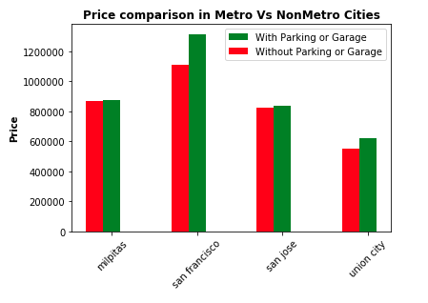
Here we are constructing a side-by-side bar plot from the dictionary.
We have the mean price on y-axis for all the data points with cities on x-axis.
Through this adjoining graph, one can observe how much difference can parking add to the home price, particularly in big metros like SF.
So we can observe that the redfin claim is absolutely true.

Slide 12


It is hard to find an in-unit AC in hilly colder cities (like SF) than in plain areas which are hotter in summer (like San Jose), which makes sense because summers in SF are milder than San Jose. We will verify through my data visualization that this is, in fact true. https://en.wikipedia.org/wiki/Climate_of_California#Temperature_range
Research Question 3:

Slide 13
The reason most homes and businesses in San Francisco don’t have air conditioning is simple, up until about 3–4 years ago it really wasn’t needed, because it wouldn’t go much over 75 more than a handful of times a year, and when it did get warm the evening fog always rolled in to bring things back down into the low 60s upper 50s.
Premise: Why SF has lesser in-unit AC’s?

Slide 14
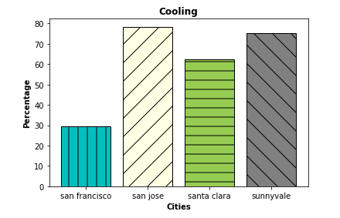

From the bar graph we can observe that the percentage of houses in SF with in-unit AC’s is significantly lower than in San Jose and other south Bay Area cities.
We have the percentage of houses in-unit AC’s on y-axis for all the data points with cities on x-axis.
So our findings are in accordance with expected trend.

Slide 15

Need extra cleaning for the data visualization:
For ‘cities’ column, there were multiple entries for a single city. For example- lower case, uppercase city names. So we converted entire cities column to lower case
For data points with non-null 'Cooling' column we are replacing it by 1 else 0
Some data points may have parking and others may have garage.
So, for all data points we are adding a new column 'PG’, for which the value will be 1 if either parking or garage is present, else 0.

Slide 16

Challenges:
Redfin was blocking the crawler so we used Chrome extension created using JavaScript
which automatically downloads html pages.
Jupyter keeps the objects alive even after they are not in use. Hence, caching in Jupyter causes issues sometimes.

Slide 17


