Slide 1
GIT

Slide 2
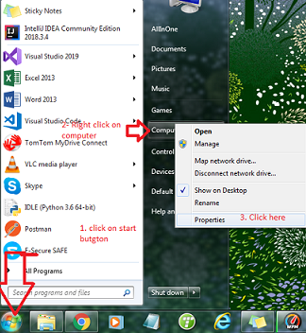
How to know Windows 32 bit or 64 bit
1. Press
Or
click on start menu or press window button on your key board, find right click on computer and click on properties

Slide 3
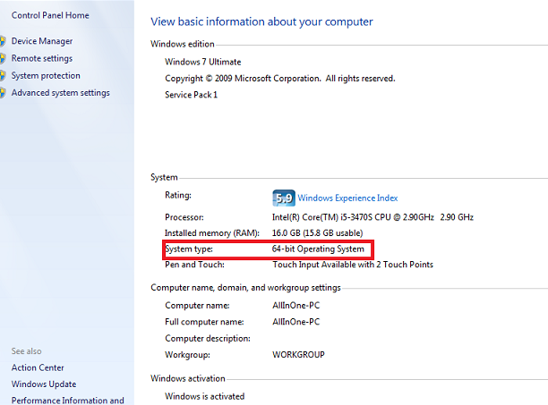
Screen shot of windows properties
System type is highlighted in red in image

Slide 4
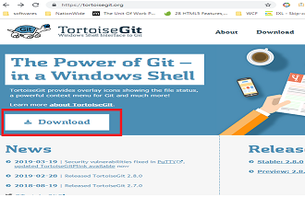
Download Tortoise Git
Go to https://tortoisegit.org/
Click on download as in below image

Slide 5
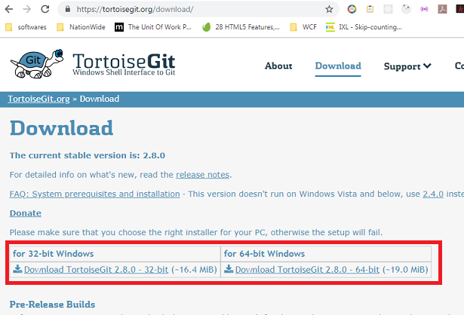
Download Tortoise Git continue
You should be on page below and download one relevant to you
If not sure then check slide (2 and 3) or download both.

Slide 6
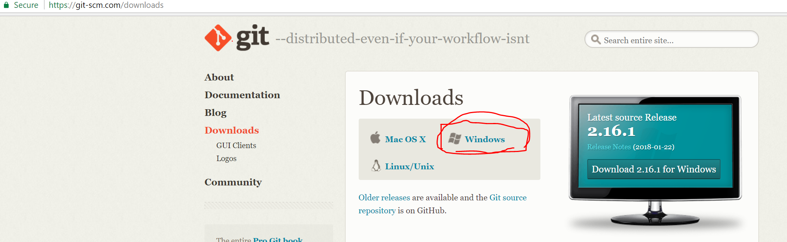
Get Git Bash (Command line Interface or CLI)
Download git bash from https://git-scm.com/downloads

Slide 7
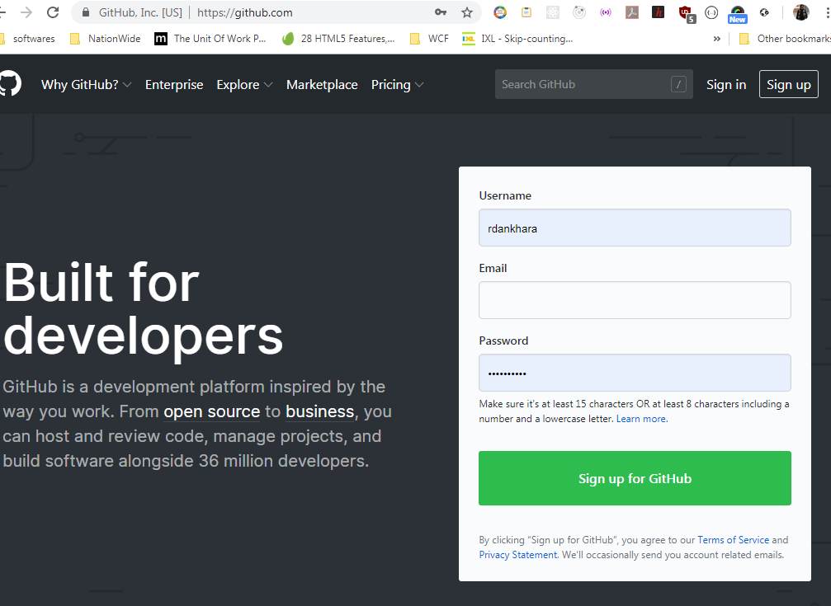
Sign up for git hub account
Got to https://github.com/

Slide 8
Sign up git hub p 2
Enter a username (for e.g. my username rdankhara)
Enter existing email (use same email which you use to submit homework)
Enter password (use same password or something you can remember)
Click green sign up button.
Go to email account you have used for registration and check email from git hub, and click on activation link.
Once done you should be able to sign In, go again on github.com and click on Sign In, enter your username and password and you should be able to log on.

Slide 9
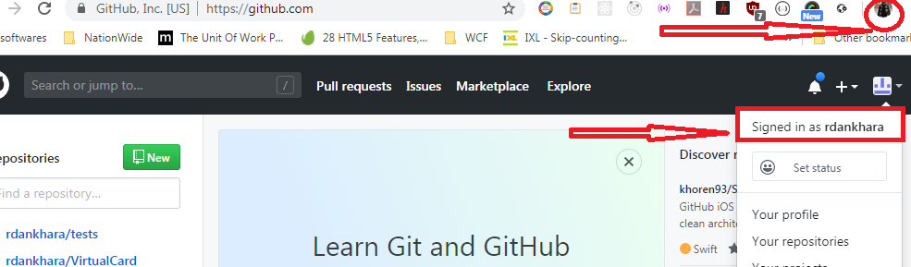
Verify that you have successfully logged into git hub.com

Slide 10
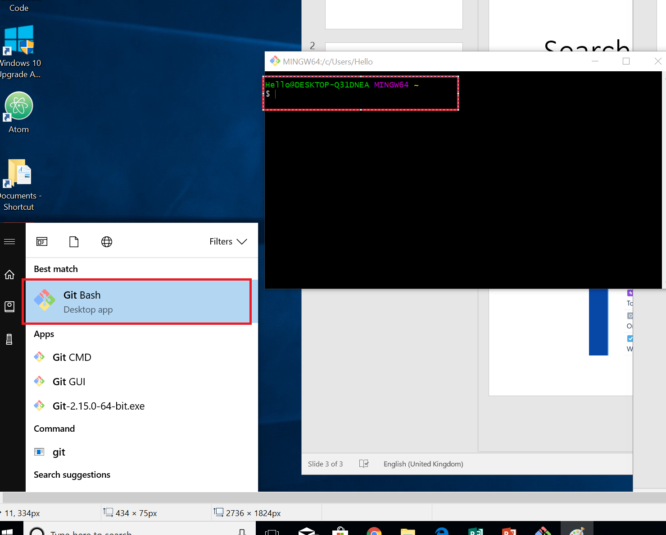
Verify install
Once downloaded double click Git-2.16.1-64-bit.exe to install git.
Verify it by typing git on start menu and you should see git bash.

Slide 11
What is Git
Version control (https://www.atlassian.com/git/tutorials/what-is-version-control ) or Source Code Management
Distributed and decentralised (No locking)
Cloud based
Easy to learn
Faster
Open source
Documentation https://git-scm.com/book/en/v2

Slide 12
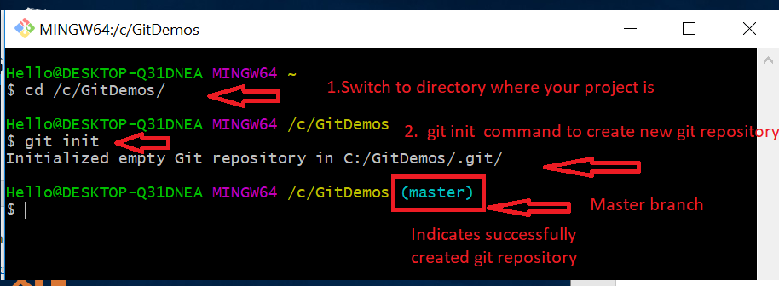
Getting started (Git Bash)
Create folder name gitdemos on your c: or d: drive
Start git bash from start menu
Type command cd /c/gitdemos/ and press enter
Type git init command and press enter (create git repository)

Slide 13
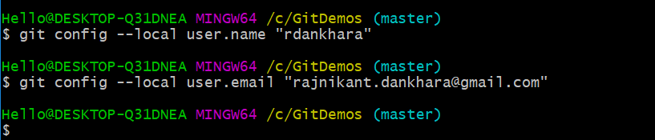
Set username and password on repository
Set username by using git config --local user.name “rdankhara”
Set email by using git config --local user.email “abc.xyx@gmail.com”

Slide 14
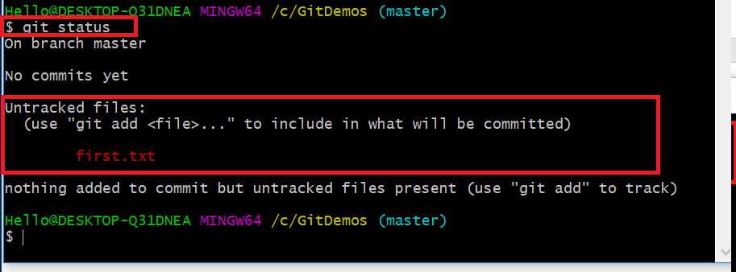
First commit
Create text file named first.txt
Add text this is first line in first file and save it.
Go to git bash and use command git status, it should show if any thing changes since last commit point.

Slide 15
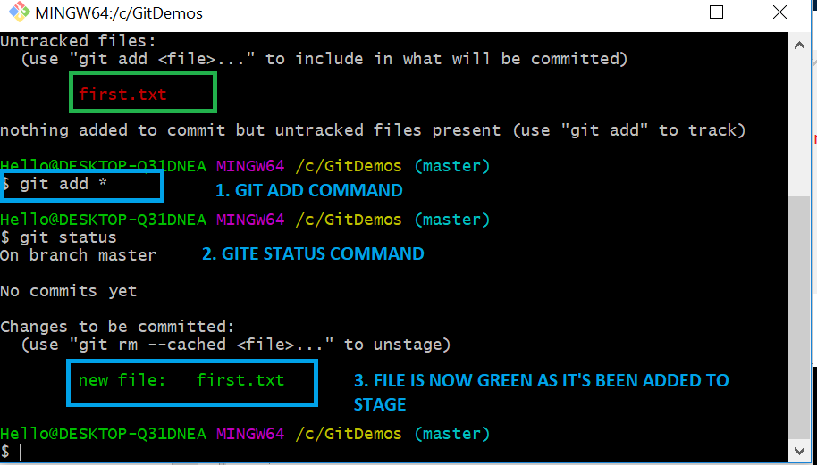
Move changes to stage using git add
Use git add * (or file name ) command to move changes to stage
Use git status command again to verify that file is now moved to stage green.

Slide 16
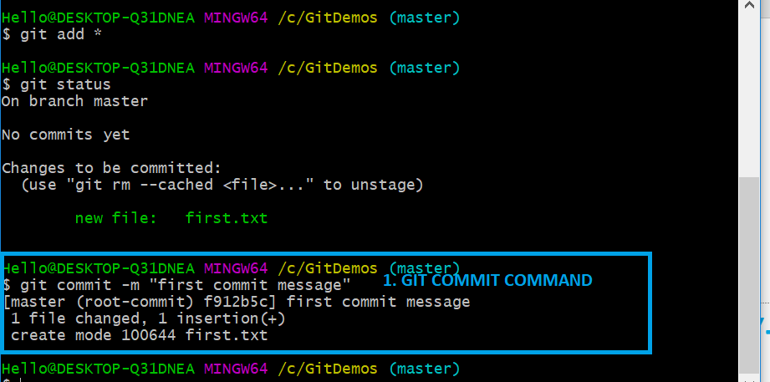
Commit using git commit –m command
Use git commit –m “first commit message” to create commit

Slide 17
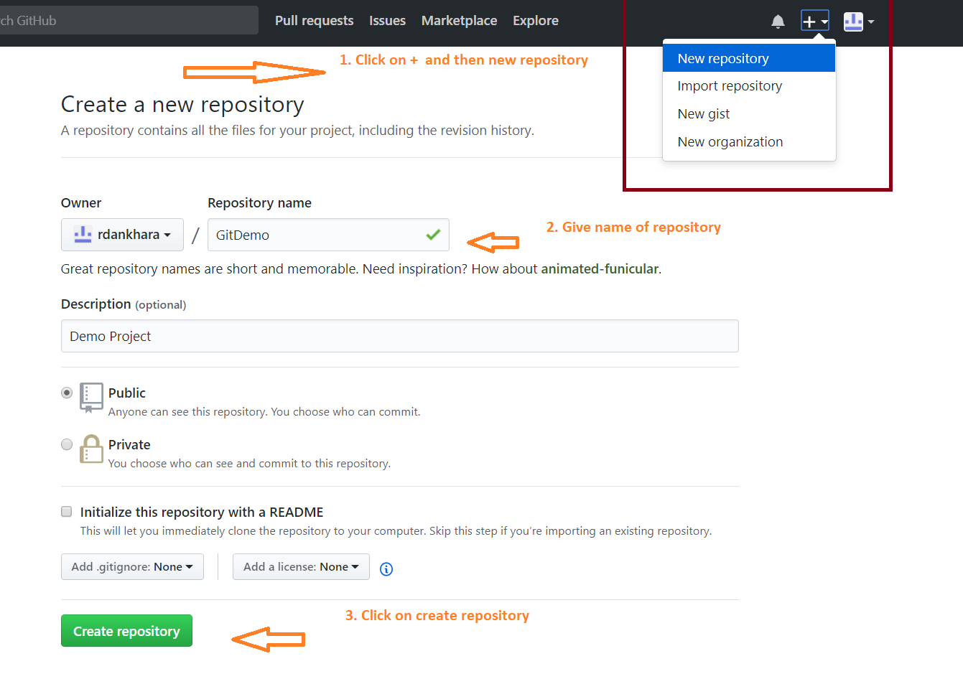
Create repositoroy on Git
Create or sign in to your account on github.com
Create repository by clicking on plus icon on top right corner

Slide 18
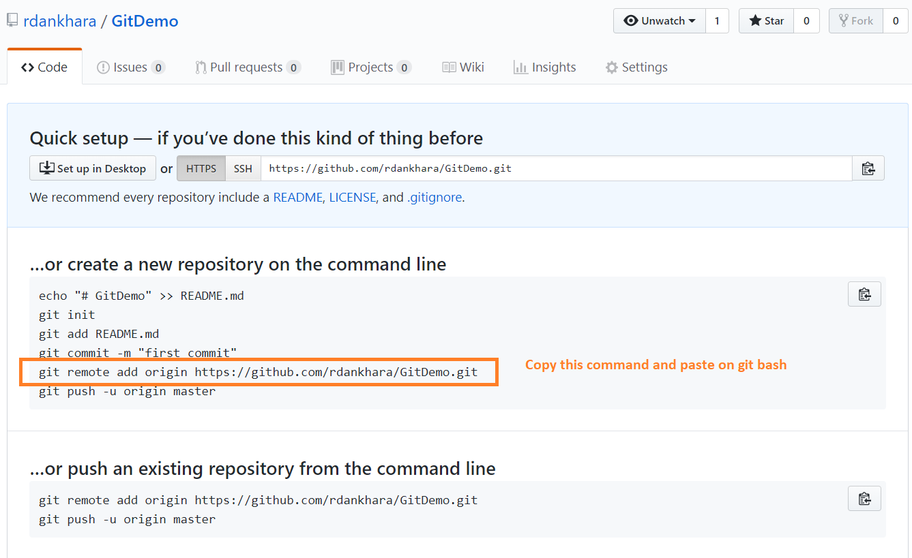
Add remote of existing repository
Go to the repository created, it should open page below
Then copy highlighted command below
git remote add origin https://github.com/rdankhara/githubdemo.git

Slide 19
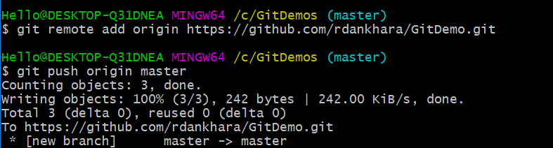
Set origin
git remote add origin https://github.com/rdankhara/GitDemo.git
git push origin master

Slide 20
Save work temporarily using git stash
Use case: you have modified some files and you want to switch to do something else, to do that you need clean repository. Follow the steps
1. git add . (stage all files)
2. git stash (it will stash all modified files and make your directory clean).
3. when you want changes back use one of command
4. git stash apply or git stash pop (will remove it from store)
More information : https://git-scm.com/docs/git-stash

Slide 21
Take latest changes from remote
git fetch
Then check out branch you want to update using command below
git checkout nameofbranch
git status (then read, it might suggest git pull if so then use git pull)
git pull (done)

Slide 22
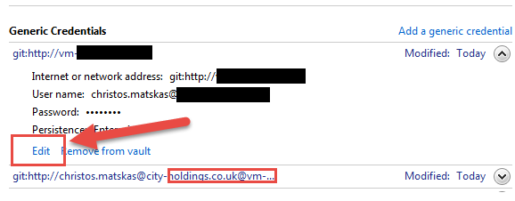
To remove existing git account on windows
Control Panel -> Credential Manager -> Generic Credentials
Then edit or remove the git user

