Slide 1
Solving Crossword Puzzles using Loopy Belief Propogation and SweepClip
Team-18

Slide 2
Project Idea
Solving crossword puzzles programmatically is a challenging task that requires understanding word patterns, semantic constraints, and efficient propagation of information across a grid.
Modern large language models (LLMs) exhibit remarkable abilities in areas such as reasoning, coding, wordplay, and question answering, among many others. However, one relatively unexplored area is their capacity to generate language under strict constraints. For instance, in poem generation, it's not just about capturing the theme accurately — the model must also conform to structural rules like rhyme and meter.
Since solving crossword puzzles also involves such constraints, we tried to optimise the LLM’s and use certain algorithms to get the desired results

Slide 3
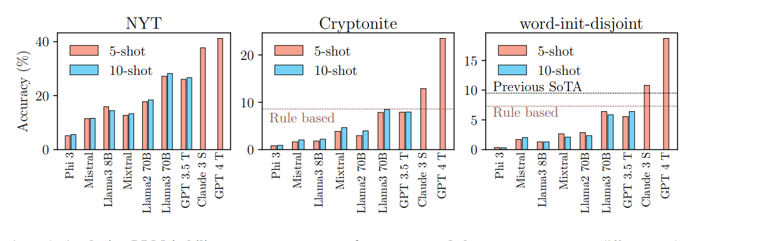
Brief Overview
Previous analysis shows that the ability of LLMs to adhere to length constraints, which is a critical component of solving crossword puzzles, is somewhat limited.
Following is the word accuracy that one gets if we just use the clues provided to generate the answers.

Slide 4
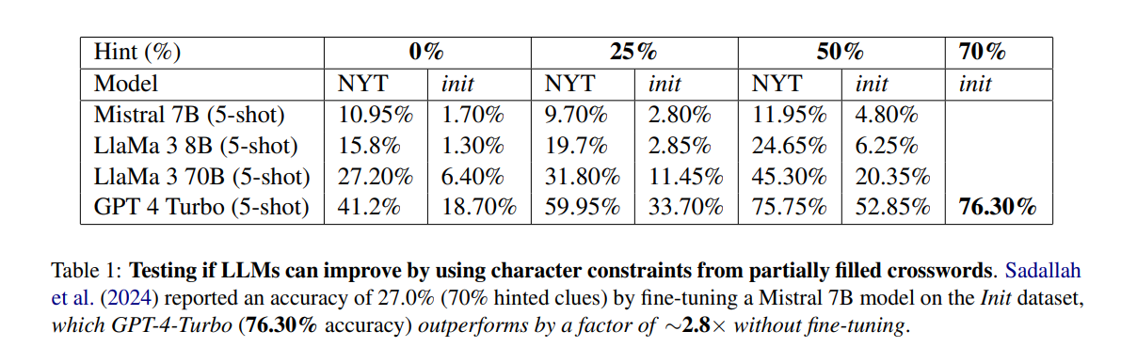
Continued…
The following is the word accuracy that is obtained when using LLMs for getting the answer for clues but after partially filling the crossword.

Slide 5
Our Approach
Hence ,we tried to implement Sweep Clip and LBP (Loopy Belief Propogation) algorithm to solve our crossword puzzles. The basic idea behind SweepClip is to generate a set of candidate answers for all clues provided with the crossword (sweep) and use a graph-based criterion to eliminate answers that do not fit (clip). It also uses depth constraint where each depth involves pruning the possible answers. This is done by removing answers that are inconsistent with the constraints (e.g., length mismatches, character mismatches, or conflicts in the crossword grid).
The LBP approach integrates a bi-encoder and a graph-based model to generate probable answers for each crossword grid position. The bi-encoder computes semantic probabilities for candidate answers, while graph-based loopy belief propagation propagates vital constraints across grid intersections. This collaborative method effectively refines letter probabilities for accurate, consistent word solutions.

Slide 6
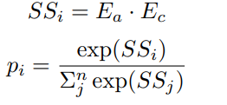
Bi-Encoder for Semantic Scoring
We have used the pretrained Bi-Encoder model (paraphrase-MiniLM-L6-v2) to evaluate how semantically similar each candidate answer is to a crossword clue.
How It Works:
Generate embeddings for the clue (Ec) and each candidate answer (Ea).
Compute semantic similarity score (SS) using the dot product of embeddings.
Apply softmax to get probability scores for each candidate being the correct answer.
Formulas:
Outcome: Each candidate is assigned a probability score based on how likely it is to be the answer, helping guide grid filling decisions.

Slide 7
Crossword Solving with Loopy Belief Propagation (LBP)
We have used Loopy Belief Propagation (LBP) to fill the crossword grid by combining probabilistic candidate answers with grid constraints.
Key Concepts:
The grid is modeled as a probabilistic graphical model.
Each cell is a VariableNode, representing 26 letter possibilities (A–Z).
Each clue is a FactorNode, which connects to VariableNodes and sends probabilistic messages.
Implementation:
Built using VariableNode, FactorNode, and CrosswordSolvingGrid classes.
25 iterations of LBP are run. Final letter is chosen greedily using highest marginal probability.

Slide 8
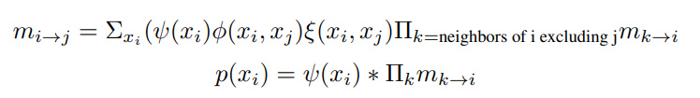
Crossword Solving with Loopy Belief Propagation (LBP)
Message Passing (LBP): Messages mi→j​ represent a node's belief about a neighbor's letter. These messages are updated using:
Potential Functions:
ψ(xi)​): Prior from Bi-Encoder
ϕ(xi,xj): Indicator for across/down match
ξ(xi​,xj​): Bigram probability for adjacent letters

Slide 9
Sweep Clip Algorithm
The Sweep Clip algorithm is typically used in optimization and graph-based tasks, where a set of constraints or variables are iteratively adjusted to reach a feasible or optimal solution. The solver is essentially performing a sweeping process, gradually refining its search space and adjusting answers at each step, where "clip" refers to cutting down or pruning incorrect or inconsistent answers
Candidate answer generation Initially, the candidate answers are generated by passing the clue and the answer length, in a particular format to an openAI model (GPT 4 Turbo).
Depth = Iteration Step At each depth, the solver refines its guesses, gradually improving the crossword state.
Constraint Pruning Answers violating clue constraints are pruned, ensuring consistency across the board.
Graph-Based Search A graph of clues is used to track relationships. Edges represent shared letters or overlaps.
Progressive Refinement Solver sweeps deeper (increasing depth) until all clues are valid or max_depth is reached.

Slide 10
Results and Observations
The Loopy Belief Propagation (LBP) algorithm had long been the standard architecture for probabilistic reasoning in solving crossword puzzles. In our implementation, we observed that LBP typically achieved an accuracy in the range of 60–80%, aligning with previously reported benchmarks.
However, the introduction of the Sweep Clip algorithm marked a significant breakthrough. It redefined the state-of-the-art by achieving a substantially higher accuracy of approximately 90–95%. This dramatic improvement was also validated through our own implementation and experiments.
The next slides present a detailed comparison and highlight the performance gains we observed using the Sweep Clip algorithm in our system.

Slide 11
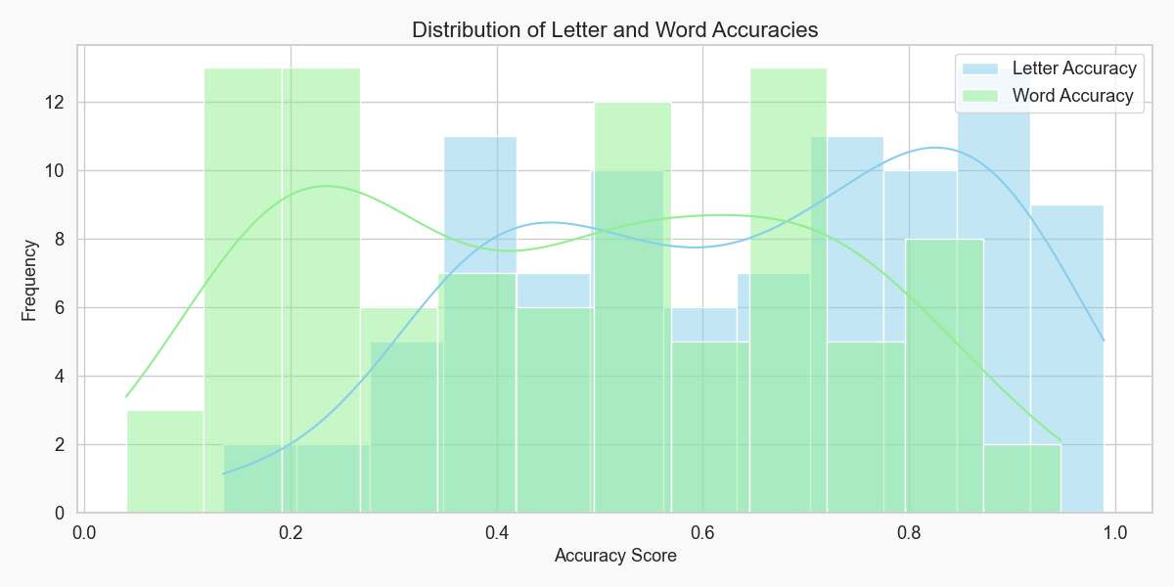
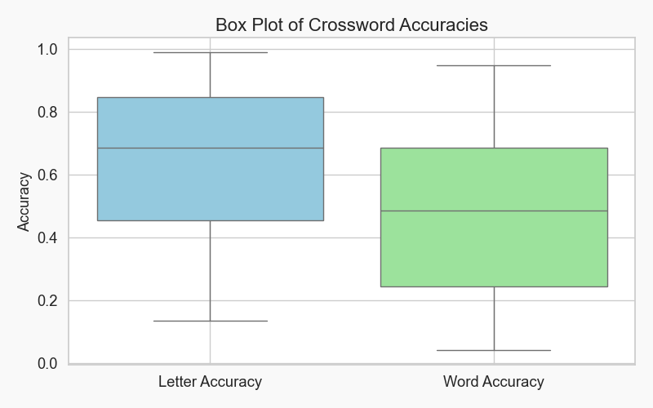
Results and Observations for LBP algorithm

Slide 12
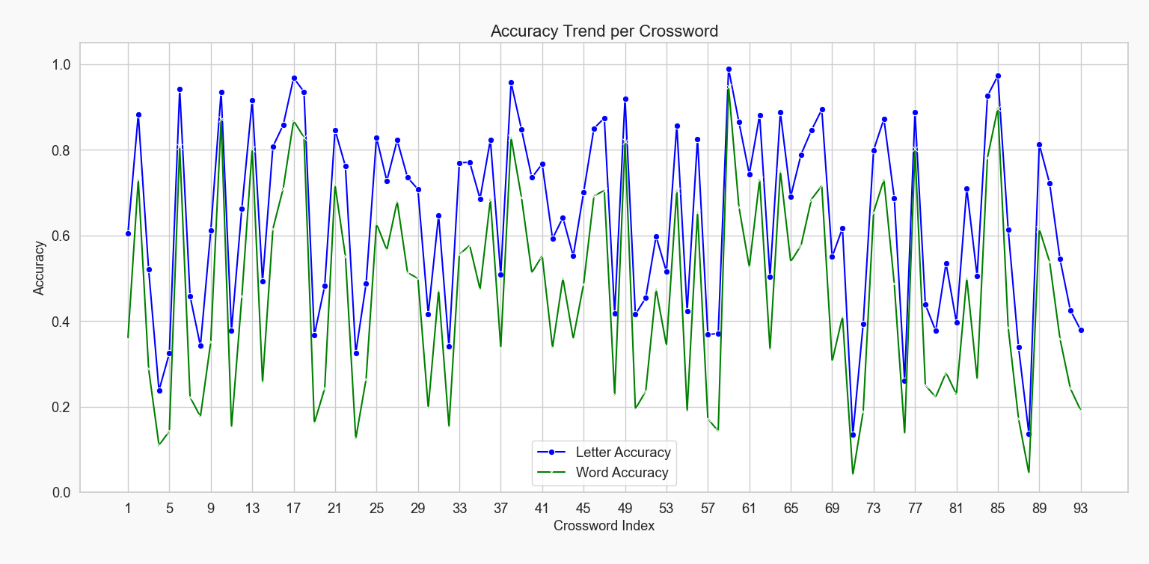
Results and Observations

Slide 13
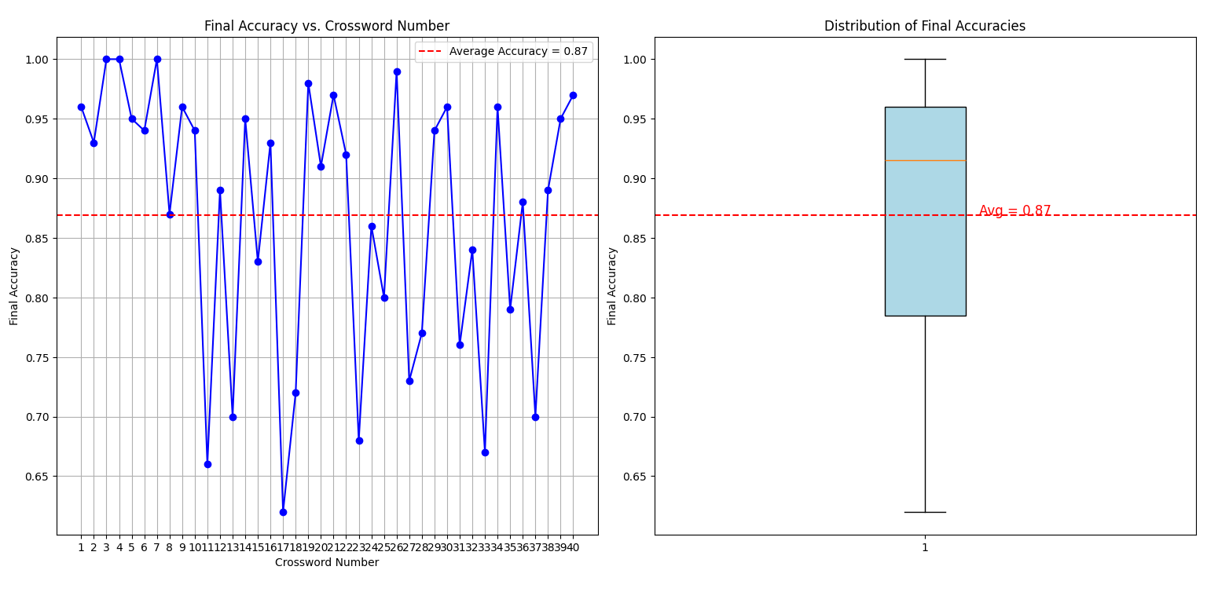
Results and Observations for Sweep Clip

Slide 14
References
https://arxiv.org/pdf/2205.09665
https://web.stanford.edu/class/cs224n/final-reports/256725260.pdf
https://platform.openai.com/docs/guides/fine-tuning#which-models-can-be-fine-tuned

