Slide 1
DNS as a Service
For Hybrid Cloud

Slide 2
Team Members
Divyapuja
Navin
Sriram (as a)
Swastik

Slide 3
DNS - Why and What?
Servers with database of public ip addresses corresponding to given hostname.
Easier to remember name than ip address.
www.google.com
216.58.217.132
DNS for Hybrid Cloud : Rapid movement into Cloud
Some services are on-prem, some are in cloud
DNS need to be resolved over VPN

Slide 4
Bind9
Berkeley Internet Name Domain
Importance of Open Source
Software to configure own Domain Name System

Slide 5
Input From User (Northbound)
Yaml file
Less confusing format
Limit on number of Subnets in each VPC
No limit on VPC
UserInput.yml will be placed in /etc folder

Slide 6
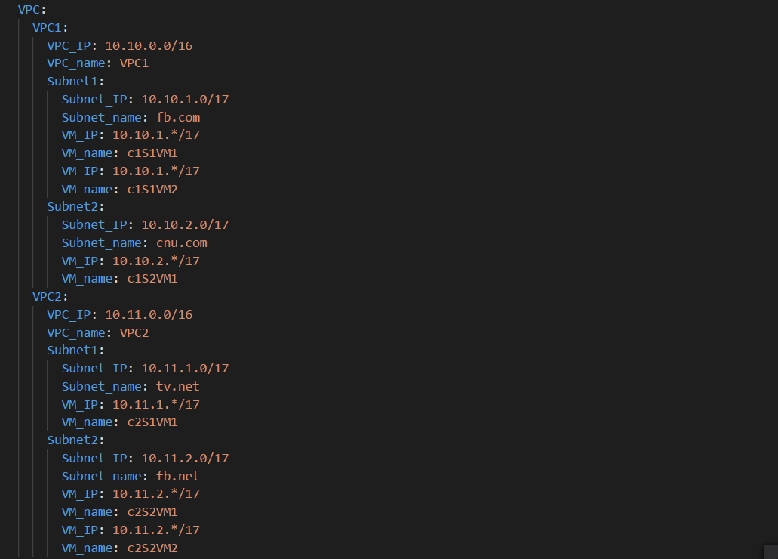

Slide 7
South Bound
Mostly Ansible for easy configuration & segregation of tasks
Earlier VM, now docker containers
Ready with soup as images containing DNS files
Infrastructure is build according to user input using ansible and Python
Maintains naming convention as per user input
DNS configurations are all files

Slide 8
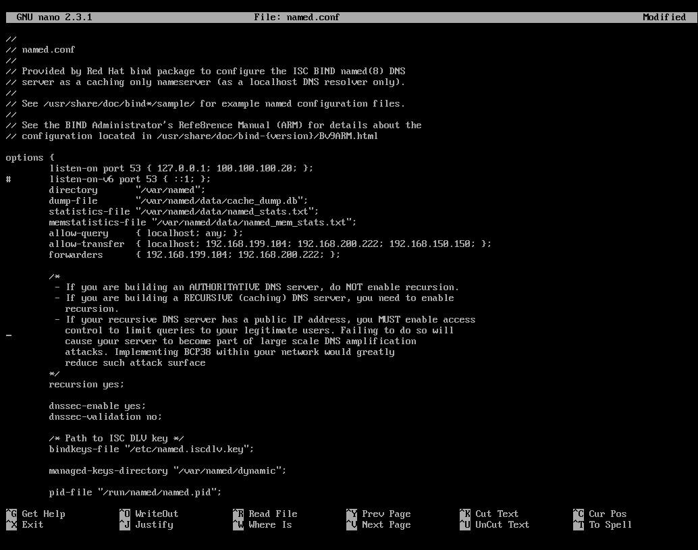
DNS Bind9 Configuration
Options

Slide 9
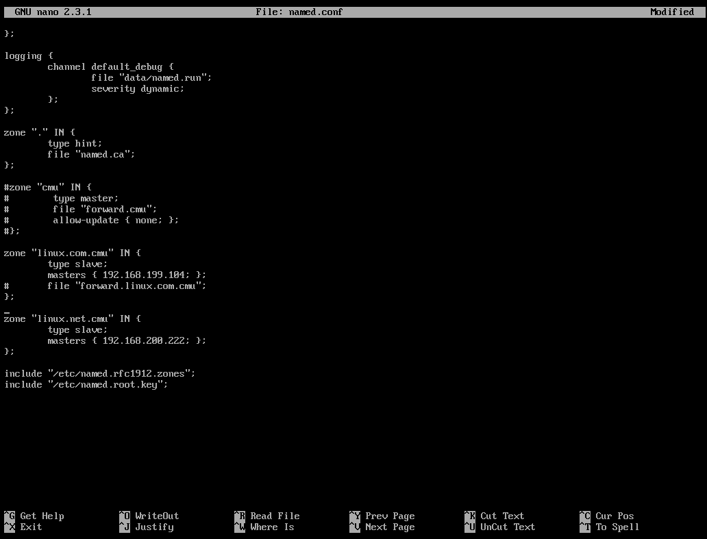
Zones

Slide 10
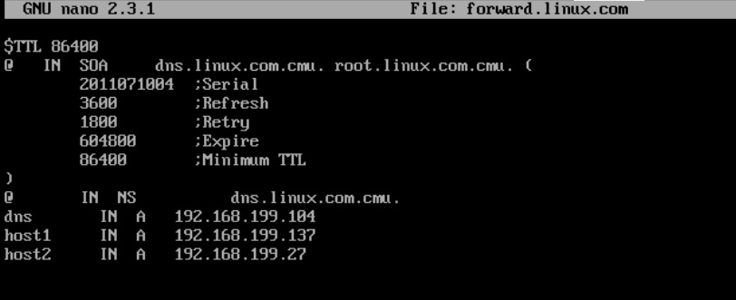
DB

Slide 11
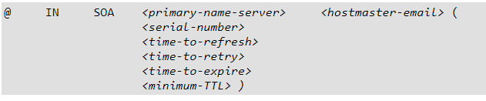
Zone File Resource Records
A Record : Name-IP mapping as well as default IP
NS Record : FQDN for authoritative nameservers for a zone
SOA Record :
CNAME Records : Saves alias of host names
Notes:
Address records, Name server records, Start of Authority record, canonical name record. The <serial-number> value is used by the slave to determine if it is using outdated zone data and should refresh it.<time-to-retry> tells the slave nameserver the interval to wait before issuing another refresh request, if the master nameserver is not answering.The <minimum-TTL> requests that other nameservers cache the zone's information for at least this amount of time.

Slide 12
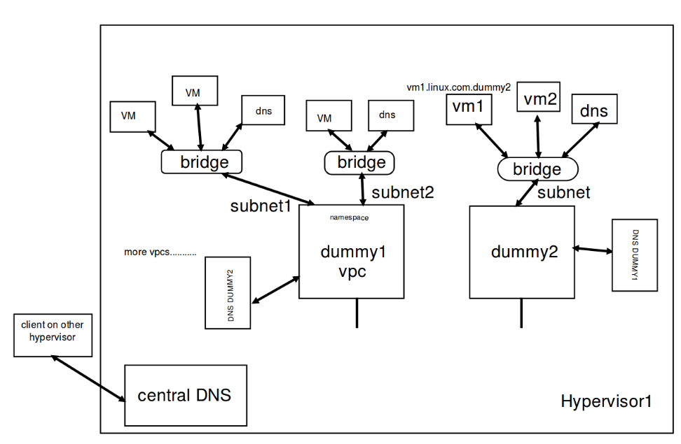
Architecture

Slide 13
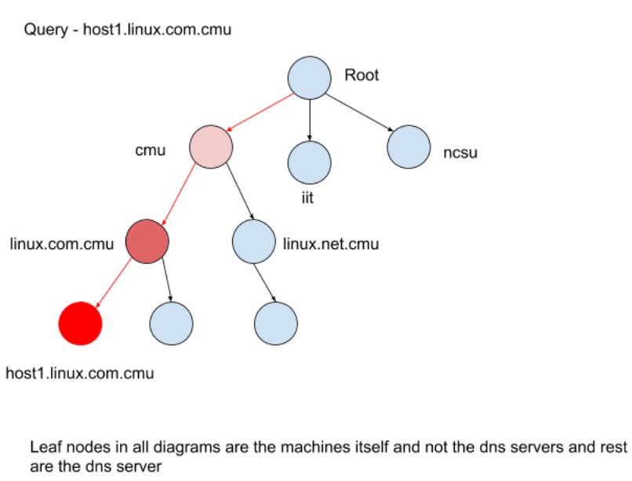
How Our Dns Works

Slide 14
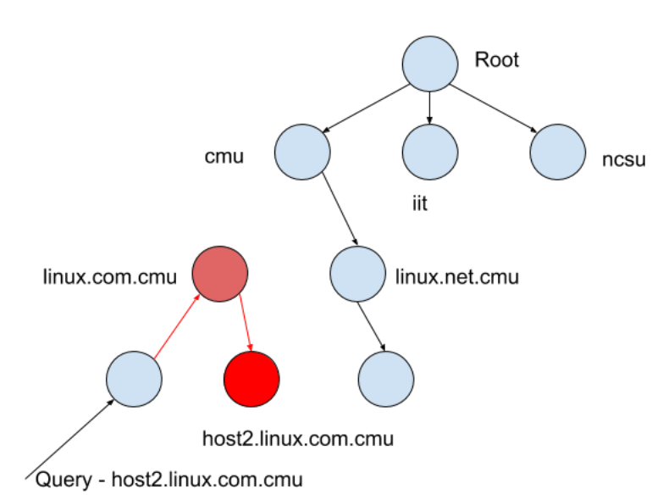

Slide 15
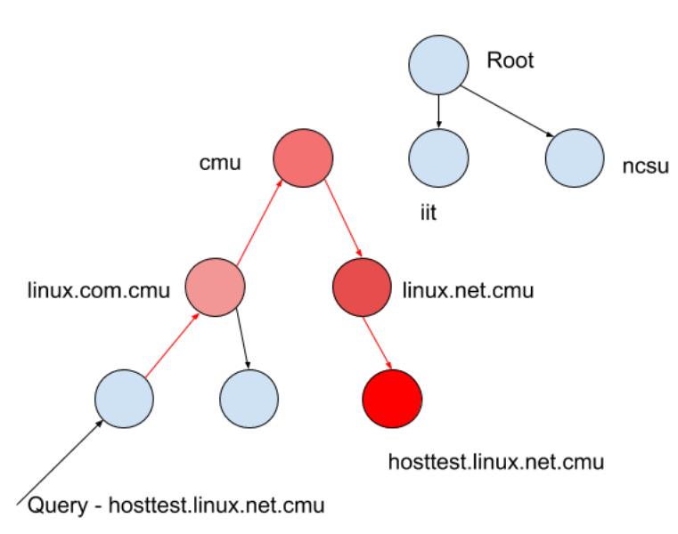

Slide 16
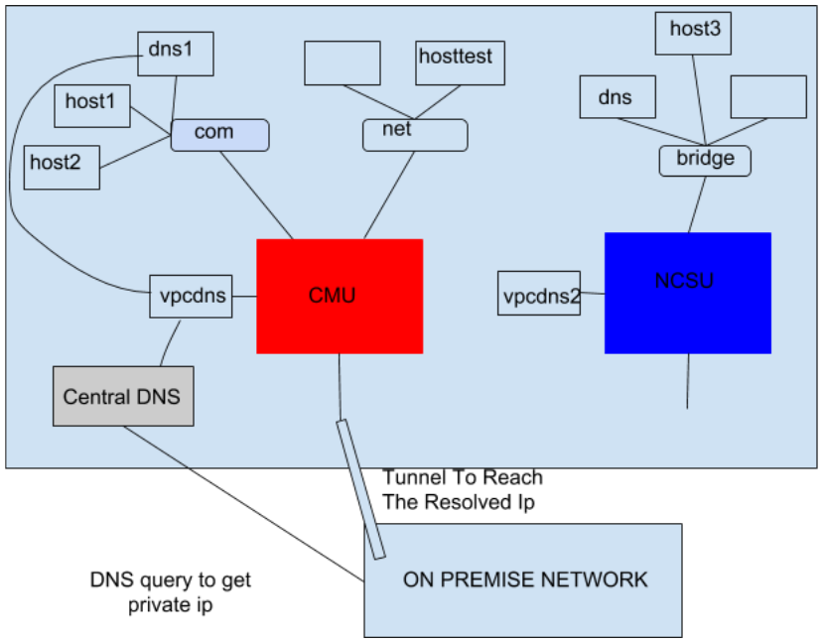
Tunnel Solution

Slide 17
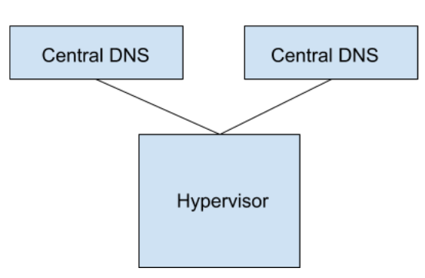
Load Balancing
Central Dns is the bottleneck as it resolves most of the queries.
We create two central dns and load balance dns queries between them.

Slide 18
How Our Solution Is Different
Users can host any server with their domain name of a type in a subnet
Two VPC can have same subnets so we cannot allow general user
Automatic concatenation for hostname

Slide 19
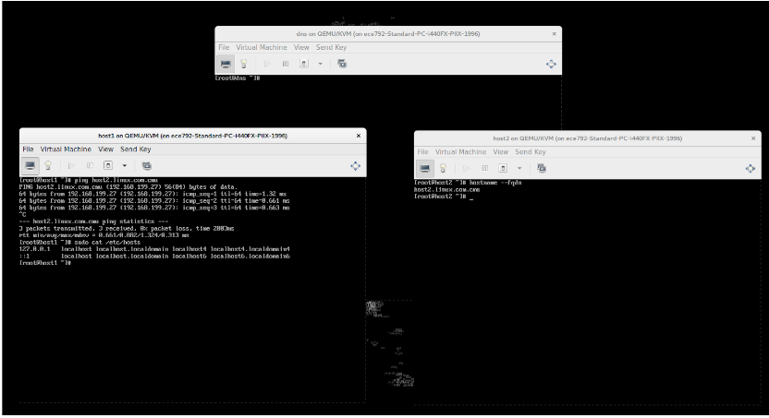

Slide 20
