Slide 1

OpenMP-Q: Quantum Task Offloading In OpenMP
Swastik Mittal, Atulya Mahesh, Frank Mueller

Slide 2

Motivation
HPC: solve numerical problems
Often use GPUs to accelerate kernels
New: use Quantum Computing kernels
Potentially lower complexity
Shor’s algorithm
Factors n bit integer in polynomial time
Estimated factor of 2048 bit RSA integers in 8 hours using 20 million noisy qubits (Craig Gidney)
Google Sycamore (Quantum Processor) : 200s to sample a specific random circuit task
Estimated classical supercomputer ~10,000 years;
~2.5 days was possible, so the exact “speedup factor” depends on the classical baseline.
Problem: lack of Quantum/HPC integration
Quantum Computing <-> Python, HPC <-> C/C++
Lack of interoperability/proprietary frameworks

Slide 3
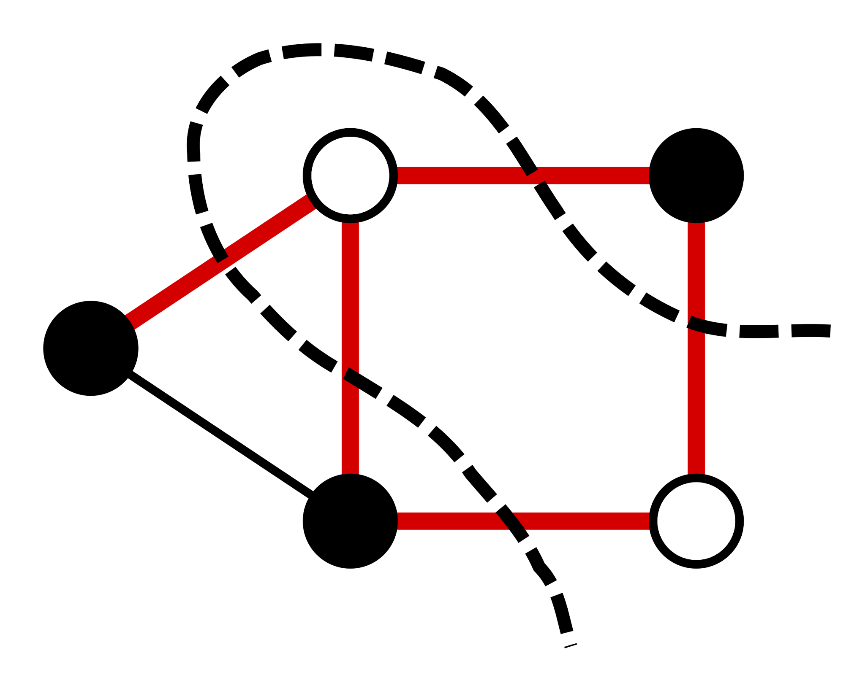
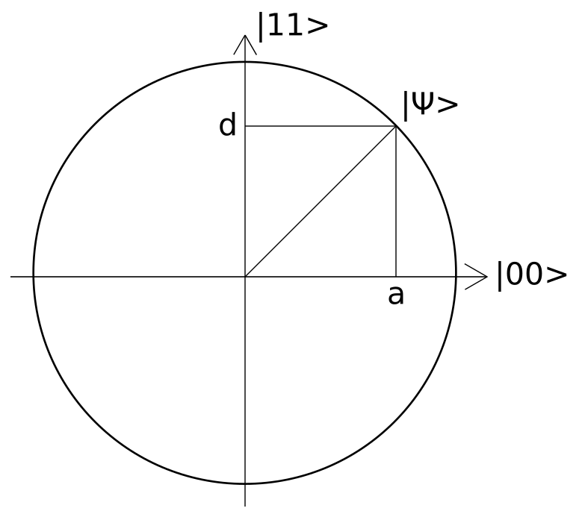
HPC-Quantum Problems
What problems can a quantum device target? Why is an integration relevant?
VQE (Variational Quantum Eigensolver)
minimizes energy (cost)
a parameterized circuit (quantum gates) followed by classical optimizer
Quantum circuit is the quantum computing analogue of a classical logic circuit.
classical loop dominates runtime (optimizer, batching, post-processing)
Max Cut Problem
Encode graph as Ising Hamiltonian.
Initial parameter values → Ansatz → observe bitstrings → estimate cost → classical update of parameter values → repeat.
Classical work: gradient/optimizer, batching, result aggregation (MPI/OpenMP)
Quantum Error Correction
Quantum computer measures its encoded qubits to detect errors
Syndrome measurement
Outcome of this measurement is fed back to the control system
Apply a correcting operation to the qubits
Feedback must happen faster than the qubits lose coherence
Real-time correctness (OpenMP-RT)
Quantum or HPC alone are not enough!

Slide 4
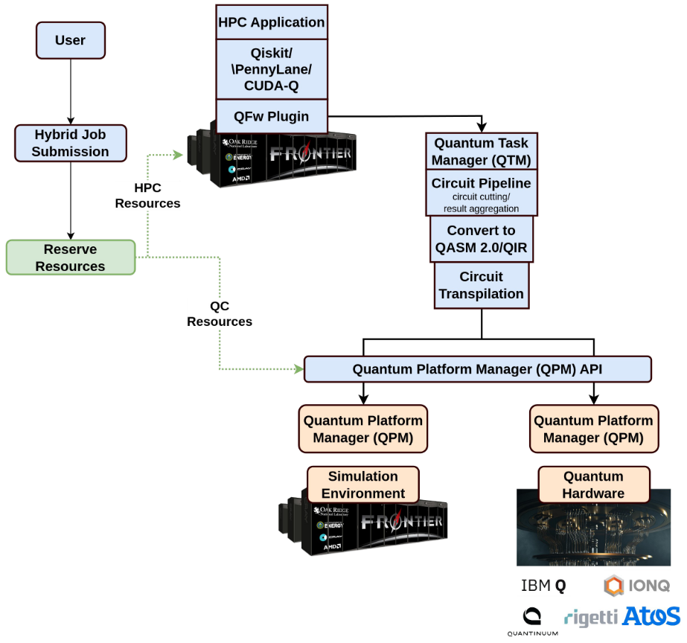
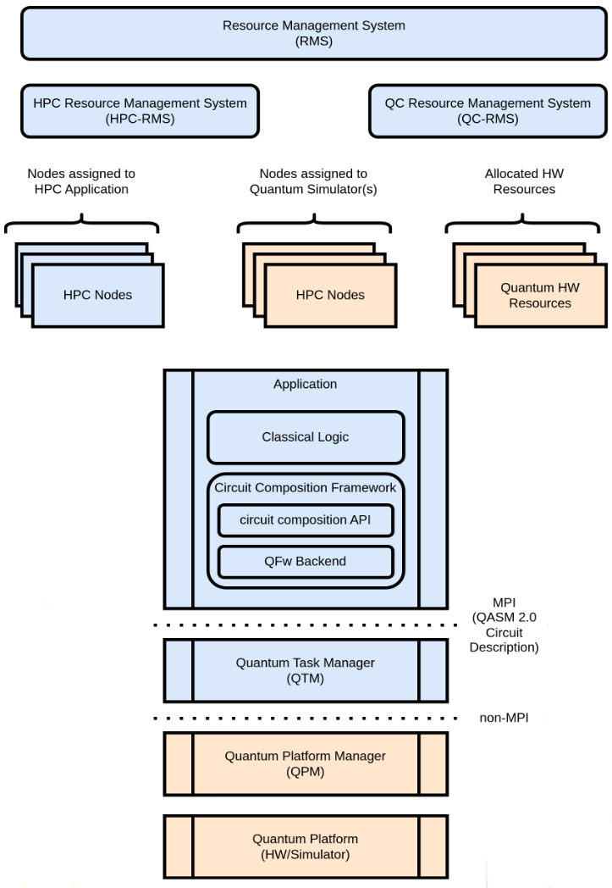
Quantum Task Pipeline
(VQE, QAOA)
Notes:
Images from oakridge

Slide 5
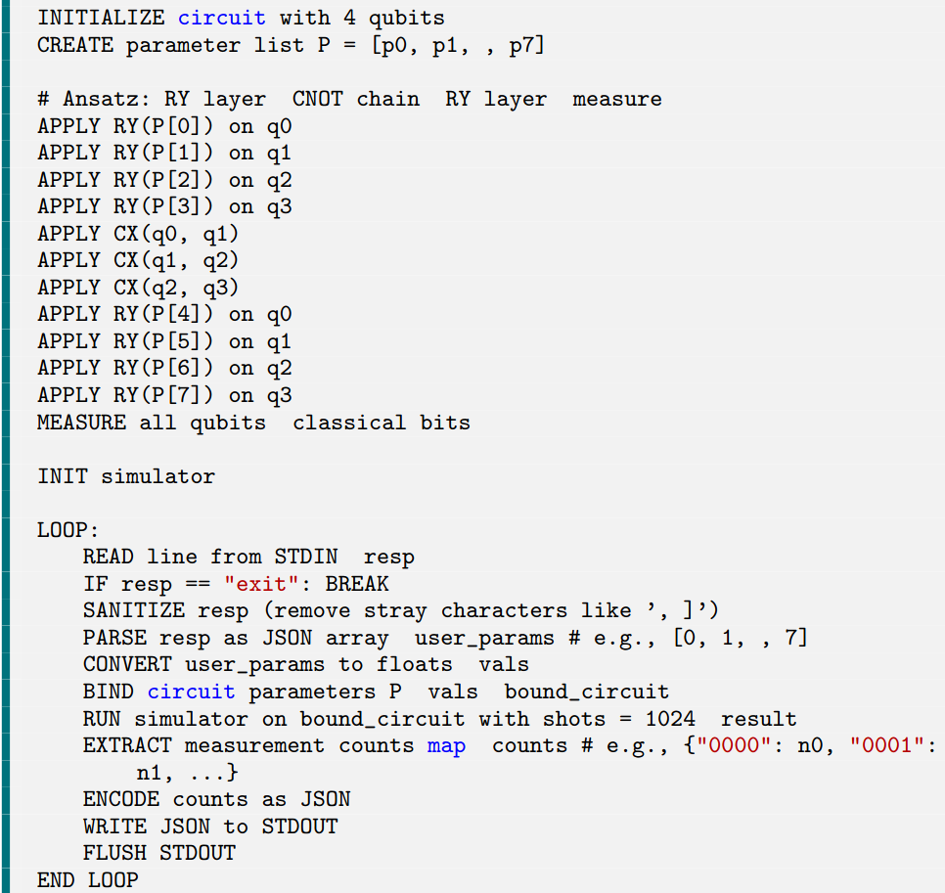
Python Based Execution Frameworks
Qistkit
Open source python quantum SDK (IBM)
Create a parametrized quantum circuit
Ansatz → observe bit strings → estimate cost → classical update of angles → repeat.
Qiskit and many other quantum frameworks provide python programming interface
Extensively used HPC frameworks use C++ (OpenMP)
QASM allows assembly level programming
Cuda-Q, Intel Quantum SDK
Build C++ Quantum SDK
Not supported by all quantum hardware
User could add additional parallelization to avail HPC benefits (using OpenMP)
Extend OpenMP - Target Quantum Device - Quantum Kernel - Execute Underlying Python Framework

Slide 6
OpenMP Offload Pipeline
User code (Initialize data)
Target Offload (#pragma omp target)
Data passed to OpenMP runtime (map clause)
Memory operations (e.g. cudamemcpy)
Kernel execution
Map data back to user variable
Back to user code

Slide 7
OpenMP Offload Pipeline
User code (Initialize data)
Target Offload (#pragma omp target)
Data passed to OpenMP runtime (map clause)
User provides quantum gate sequence
Retrieve quantum gate sequence
Wrap the gate sequence and data (circuit parameters) together to pass to python
Invoke python code
Memory operations (e.g. cudamemcpy)
Kernel execution
Retrieve quantum results
Map data back to user variable
Back to user code
How does OpenMP-runtime interact with the user code to retrieve the quantum gate sequence? C++/Python Interaction? Synchronization?

Slide 8
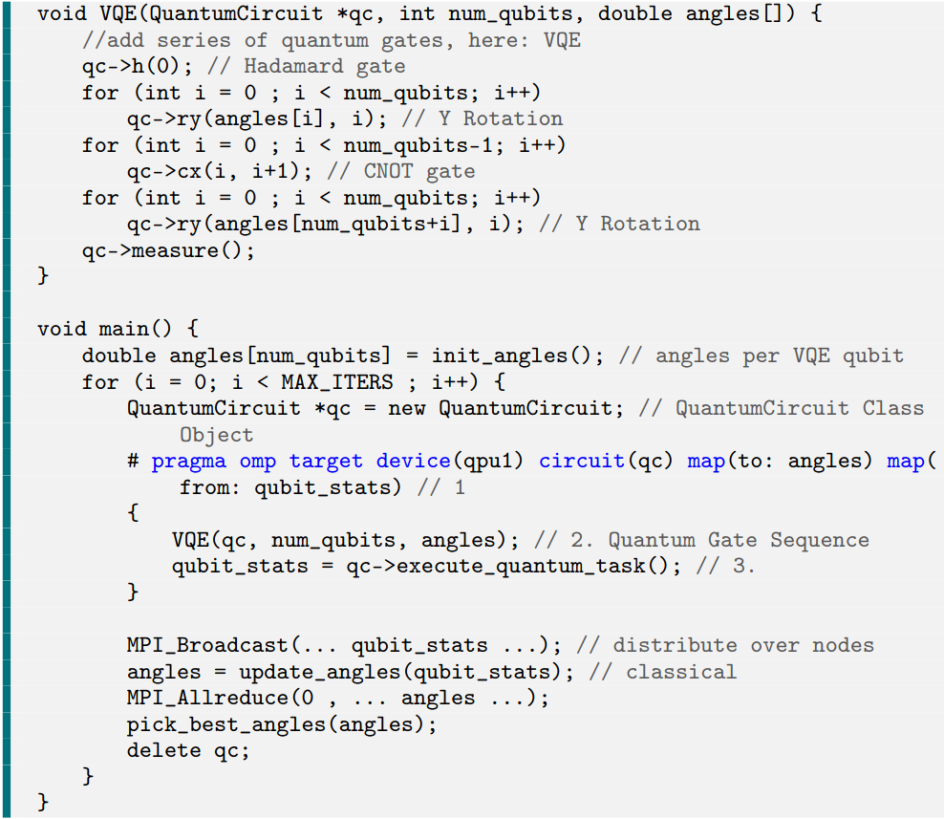
User Code <-> OpenMP Runtime
QuantumCircuit Library
OpenMP embedded C++ quantum library
Provide functions for quantum circuits, python generation + execution
Retrieve map data (initial parameters/angles)
Generate and execute python script
shared quantum object
added the circuit clause
Shares quantum object pointer
Both runtime and user code update the same memory
retrieves gate sequences and stores map data within the object
allows interaction between OpenMP runtime and user defined quantum object
OpenMP User Code
Initialize Quantum Object
OpenMP Runtime Offload
Store Mapped Data (angles) in Quantum Object

Slide 9
QPU: Design Quantum as Accelerator
OpenMP User Code
Initialize Quantum Object
OpenMP Runtime Offload
Store Mapped Data (angles) in Quantum Object
Generate Python Code (Qiskit)
How to store quantum gate sequence/ How to generate python script?
Executed code within the offload stores quantum gate sequence within shared quantum object
QuantumCircuit library generates corresponding python code for given quantum gate sequence
Append information of each gate to the python code

Slide 10
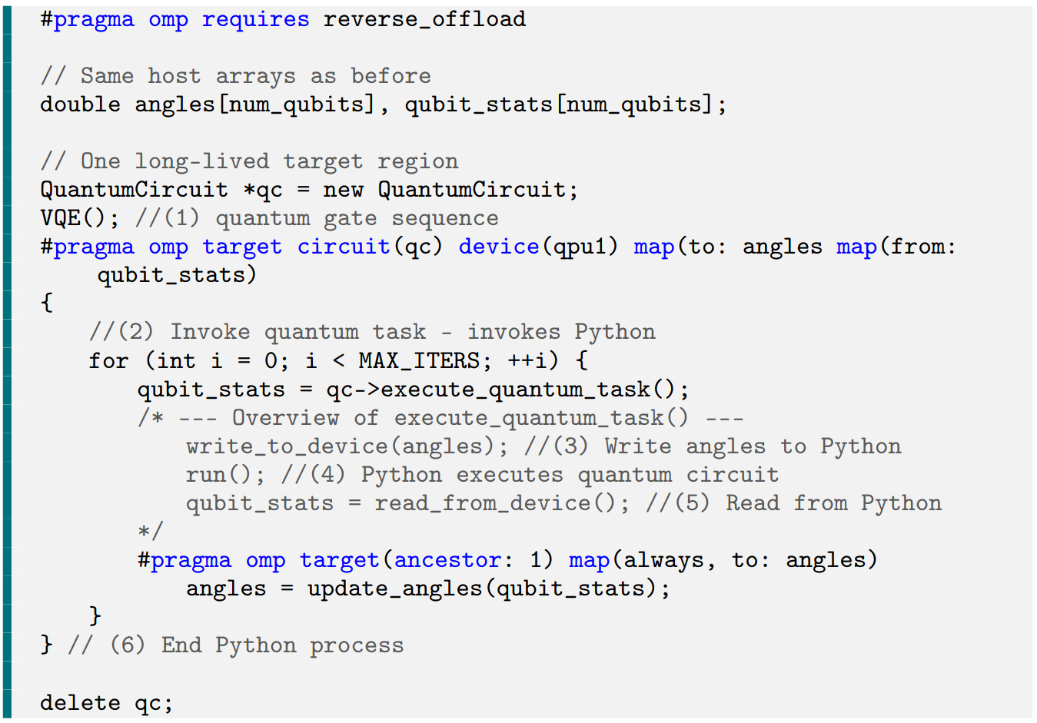
Fixing Overheads - Reverse Offload
Ansatz → observe bitstrings → estimate cost → classical update of angles → repeat.
Repeated Kernel creation + execution on the quantum device significantly adds initialization cost + time
OpenMP reverse-offload
Enable reverse-offloading
Execute kernel once
Copy evaluated result from QPU to Device
Execute classical evaluation
Copy updated angles back to QPU
Continue kernel execution
Need to push VQE outside target region
No issues as runtime can retrieve the values from quantum object
Loop pushed inside the target region
How do you synchronize C++ & Python execution? Python process cannot stop!

Slide 11
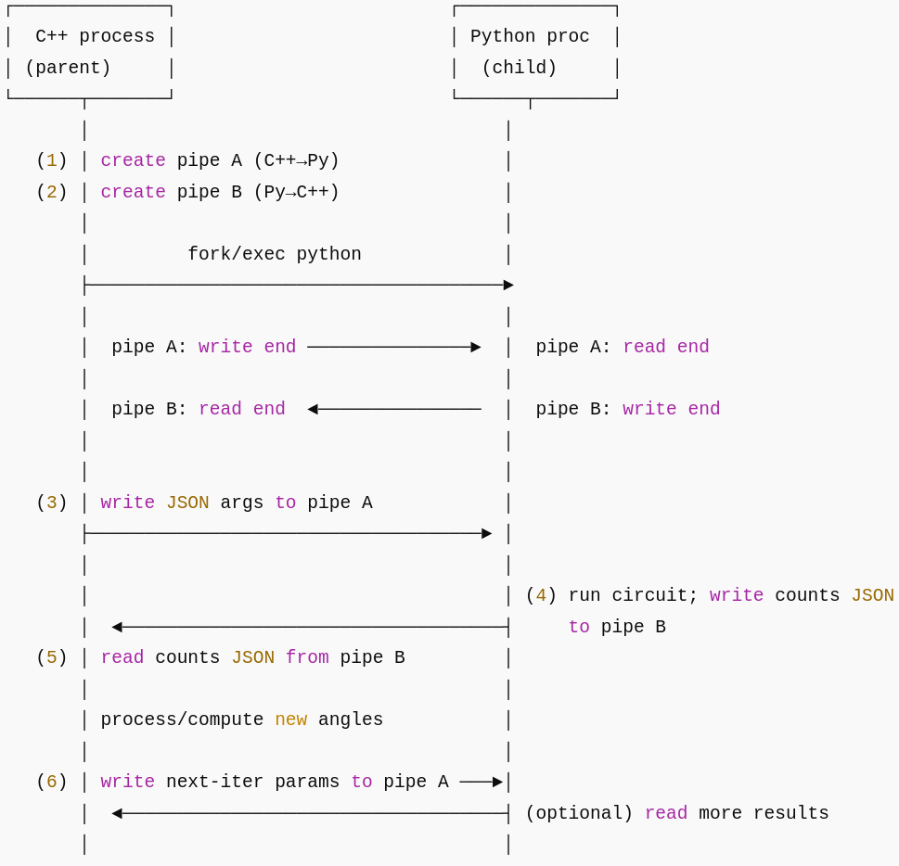
Continued Kernel Execution
Unix pipes
Bi-directional communication between OpenMP (C++) & Quantum Python Lib
Parent-Child process allow parallel execution
Python execution initialized once!
Synchronization
Wait for data from the pipe after evaluation
Quantum Device

Slide 12
Execution Pipeline
OpenMP User Code
Initialize Quantum Object
OpenMP Runtime Offload
Store Quantum Gate Seq. In Quantum Object
Store Mapped Data (angles) in Quantum Object
Invoke Unix Bridge
Generate Python Script
Store Python Script in Quantum Object
Execute Python -> Execute Quantum
Retrieve Python Result to Mapped Data (stats)
Execute HPC

Slide 13
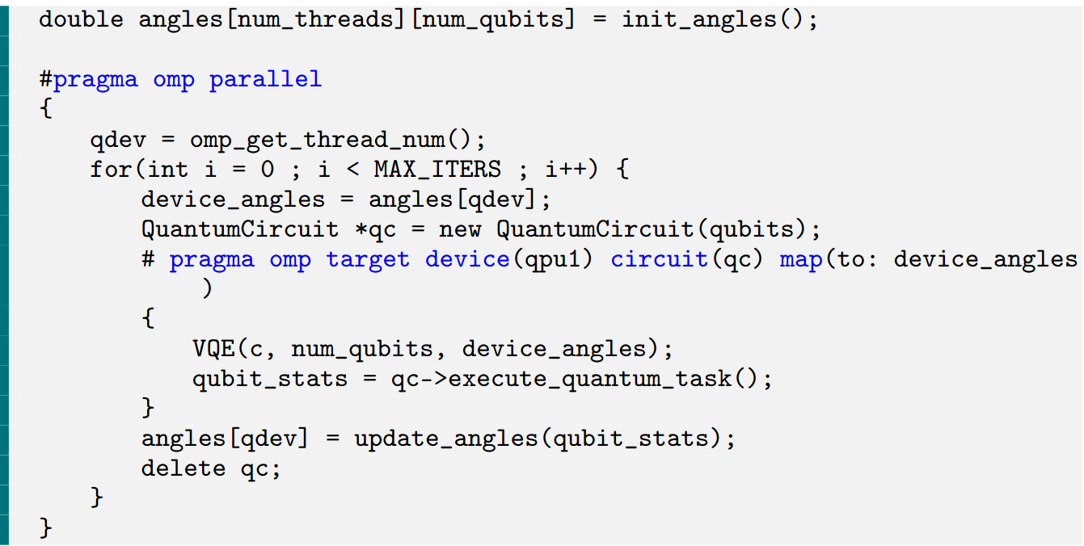
Multiple VQE runs to avoid local minima? - Multiple QPU’s
Utilizing multiple quantum devices to offload
Use OpenMP SPMD style programming
Each thread has its own quantum object
No race condition
Classical evaluation of angles in parallel
Reaping maximum performance benefit
Can integrate multi-qpu and reverse-offload together!

Slide 14
Common Queries
Why not utilize OpenMP Interop?
We generate python/qiskit jobs and submit them to a simulator or cloud QPU
no stream/queue to acquire or share via interop.
Avoids coupling to a specific accelerator API’s
Generate python code for any quantum api
Execute classically if no quantum device available
Set of problems solved would take extremely high time classically
Of no use
If not a quantum hardware then a simulator can be used (kind of executing on the host itself:))
Cuda-Q, Intel Quantum SDK vs OpenMP-Q?
Easy parallelism
There is no vs
Cuda-Q can be used as the underlying API executed by OpenMP QuantumCircuit Library
Qiskit uses rust below the python api

Slide 15
Experiments
VQE to approximate the ground-state energy of a Hamiltonian
Ansatz preparation: A parameterized quantum circuit encodes a trial wave function
Expectation estimation: The Hamiltonian is decomposed into simpler terms (e.g., Pauli strings), each measured on the quantum device to compute the energy.
Classical optimization: A classical solver updates the circuit parameters and iterates until converged.
Evaluate OpenMP-Q using a VQE implementation over several runs with different randomized initial circuit parameters.
Compare runtimes for 1–6 VQE runs (each run executing 80 iterations of classical optimizations)
Serially
Parallel via our Multi-QPU offload extension
Using reverse-offload style execution
Linux system (Ubuntu 22.04) with 16GB RAM and an Intel i9 (3.10GHz) processor

Slide 16
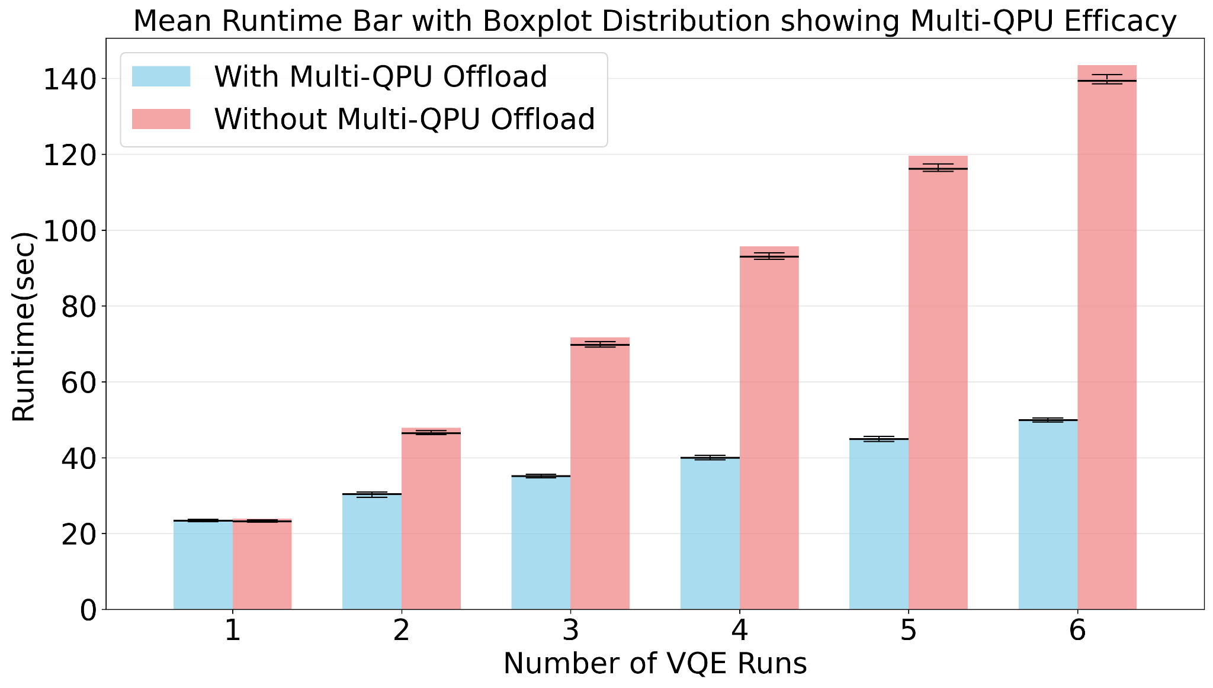
Results - Multi-QPU
Total time (y-axis) over 200 trials
A single VQE execution takes 23 seconds on average under OpenMP-Q.
Six runs consecutive require 143 seconds
Six simultaneous runs complete in just 49 seconds
2.9× overall speedup

Slide 17
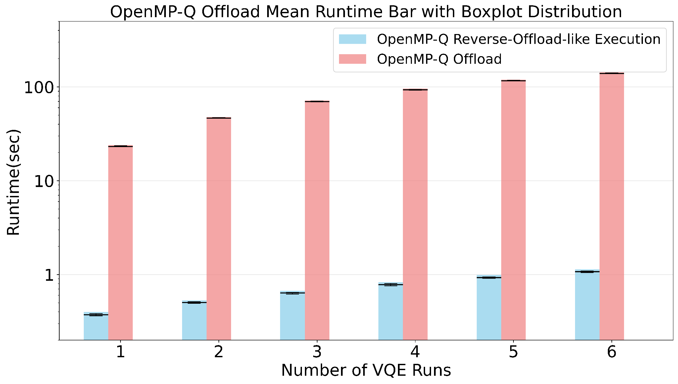
Reverse-Offload Style Execution
Single entry into target region
Python initialized and launched once
Bidirectional pipe connection is established for all six iterations
Six iterations complete in approximately 1.13 seconds, a 126× speedup compared to naive back-to-back offloads.
Exposes overhead of relaunching on the target -> rebuilding the circuit -> re-invoking Python (pipes, imports) on every iteration.
Reverse-offload only adds ≈0.05s to a single VQE run vs. calling the Python routine directly

Slide 18
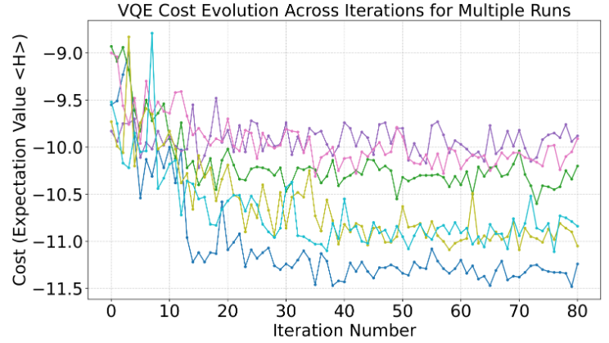
Cost Evaluation
Experiment a max-cut problem on a graph with 7 vertices
Graph shows the convergence of various QPU runs with randomized initial parameters
each colored curve corresponds to a different set of ansatz parameters
resulting in decreasing cost (y-axis)
Demonstrates correctness of OpenMP-Q

Slide 19
Conclusion
OpenMP-Q
lightweight extension to the OpenMP 5.x target model
treats quantum processors like any other offload device
Circuit clause passes a user-built quantum-circuit object to OpenMP runtime
POSIX-pipe bridge, to communicate with existing Python-based quantum software libraries
Observations
2.9x speedup for multi-qpu
Utilizing OpenMP parallel directive
126x speedup with reverse-offload
Just ~0.05s overhead to launching quantum task directly with multi-threaded benefits of OpenMP for classical optimization/evaluation

Slide 20

Thank You!!
https://github.com/mittalswastik/qpu
https://mittalswastik.github.io/

Slide 21
Q/A?

