Slide 1
AIDBRIDGE
Team Members:
Tanmay Mittal(221210108)
Vaibhav Goel(221210116)
Notes:
Be specific and direct in the title. Use the subtitle to give the specific context of the speech.
-The goal should be to capture the audience’s attention which can be done with a quote, a startling statistic, or fact. It is not necessary to include this attention getter on the slide.

Slide 2
Introduction
Issue
Millions of refugees struggle to access resources, shelter, and support.
Traditional systems are inefficient and slow.
Importance and Motivation
A digital solution can streamline resource management and aid distribution.
Geopolitics
Growing Issue
Notes:
Use the background points to post details that are not common knowledge, or that the audience will need to understand the context of the speech.
-Do not read these main points from the PowerPoint, instead elaborate on these points during the speech.

Slide 3
Problem Statement
Traditional refugee management relies on manual processes, leading to:
Delays in resource allocation.
Poor communication between refugees and aid providers.
Inefficient tracking of refugee needs and aid distribution.
Notes:
Use the background points to post details that are not common knowledge, or that the audience will need to understand the context of the speech.
-Do not read these main points from the PowerPoint, instead elaborate on these points during the speech.

Slide 4
Solution
An app using React Native & Firebase that:
Digitizes refugee registration & profiles.
Streamlines resource allocation through navigation system.
Provide communication between refugees through events .
Setting soft boundary o number of refugees to prevent clustering of refugees.
Acts as a bridge between those who needs help and those who wants to help.
Notes:
Use the background points to post details that are not common knowledge, or that the audience will need to understand the context of the speech.
-Do not read these main points from the PowerPoint, instead elaborate on these points during the speech.

Slide 5
Features Provided:
Authentication and Profile Management: Secure login for refugees and NGOs.
Navigation system: To locate nearby aids ,events and NGO’s.
Events Management : NGO hosts the events. These events are listed to refugee for participation.
Raising issues: Refugee can report issues regarding the shelter, food or any the other issues he/she faced
Notes:
Use the background points to post details that are not common knowledge, or that the audience will need to understand the context of the speech.
-Do not read these main points from the PowerPoint, instead elaborate on these points during the speech.

Slide 6
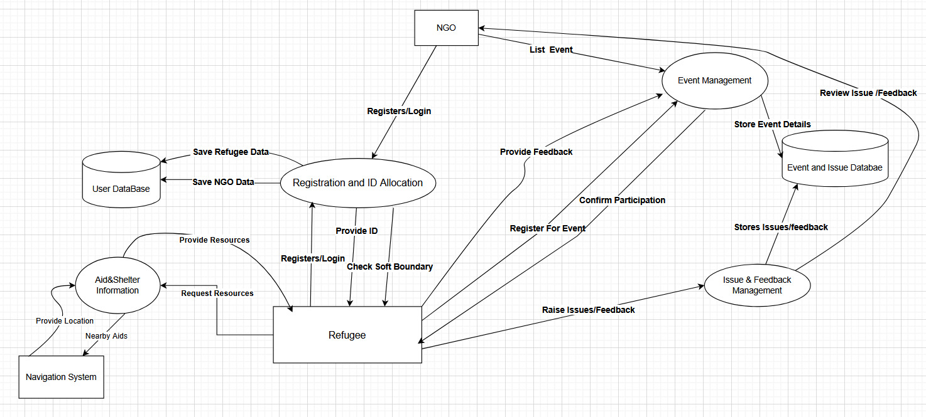
DFD
Notes:
The title of main point #3 should be clear and concise. Each piece of evidence should be summarized for clarity and cited correctly. Do not simply read the pieces of evidence, but elaborate where needed.
[type notes for elaboration here]
Be sure to transition to the counterargument and the next slide.

Slide 7
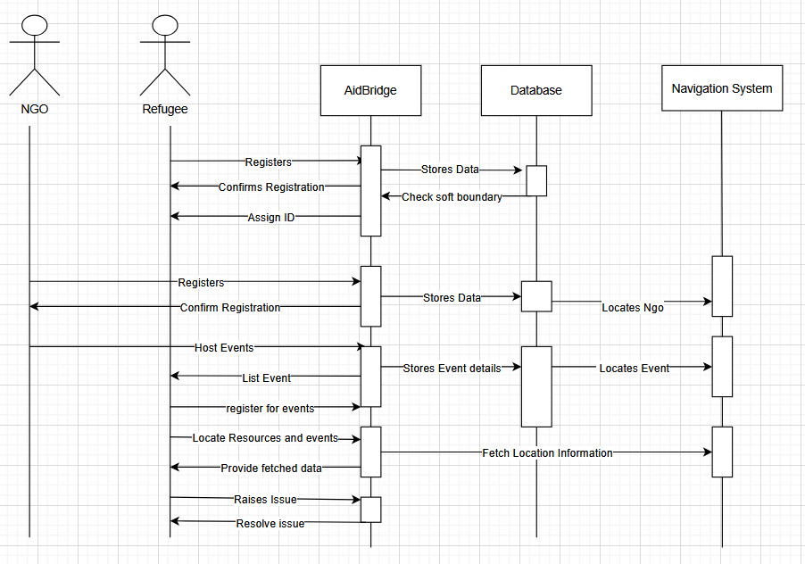
Sequence Diagram
Notes:
The title of main point #3 should be clear and concise. Each piece of evidence should be summarized for clarity and cited correctly. Do not simply read the pieces of evidence, but elaborate where needed.
[type notes for elaboration here]
Be sure to transition to the counterargument and the next slide.

Slide 8
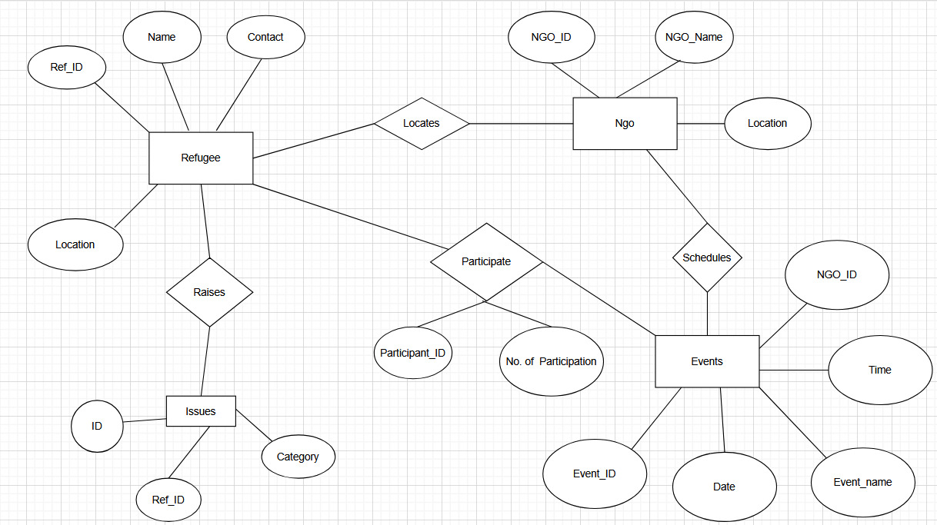
ER Diagram
Notes:
The title of main point #3 should be clear and concise. Each piece of evidence should be summarized for clarity and cited correctly. Do not simply read the pieces of evidence, but elaborate where needed.
[type notes for elaboration here]
Be sure to transition to the counterargument and the next slide.

Slide 9
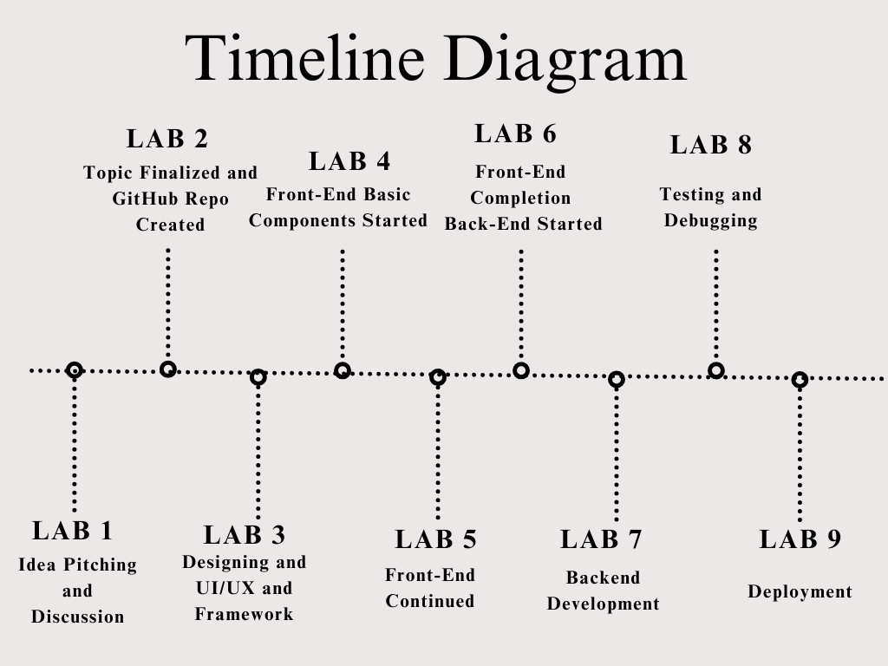
Timeline
Notes:
The title of main point #3 should be clear and concise. Each piece of evidence should be summarized for clarity and cited correctly. Do not simply read the pieces of evidence, but elaborate where needed.
[type notes for elaboration here]
Be sure to transition to the counterargument and the next slide.

Slide 10


Technology Stack
Frontend: React Native (Cross-platform development).
Backend: Firebase (Authentication, Firestore, Cloud Messaging).
Other Tools: Google Maps API (for location services), React Native UI libraries.
Frontend:
Backend:
Notes:
The title of main point #1 should be clear and concise. Each piece of evidence should be summarized for clarity and cited correctly. Do not simply read the pieces of evidence, but elaborate where needed.
[type notes for elaboration here]
Be sure to transition to main point #2 and the next slide.

Slide 11
Future Enhancements
Multi-language support for global accessibility.
Volunteer & donation management for extended support.
Incident Reporting – Real-time emergency reporting.
Notes:
Use the background points to post details that are not common knowledge, or that the audience will need to understand the context of the speech.
-Do not read these main points from the PowerPoint, instead elaborate on these points during the speech.

Slide 12
THANK YOU

