Slide 1


Slide 2
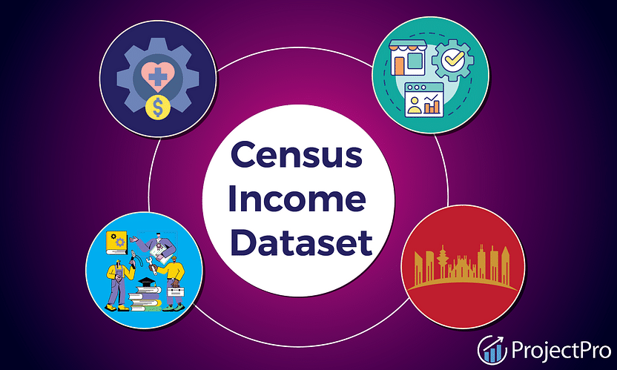
Introduction
The goal of this project is to accurately predict whether or not an adult makes more than 50000 US Dollars in an year on the basis of the feautures given.
It can be useful for employers to decide the right salary for the right candidate. This model can set the stardards of deciding right salary.

Slide 3

Flow Diagram
Check for normalization of data
Understanding Data
Missing Value Check and Correlation Heatmap
Visualization of Data and understanding relation of data
Choosing the best Model after analysing the reports
Split the data into train and test
Build different ML models and validate them through classification report and AOC curve
Hyper Parameter Tuning for reducing computation cost and avoid overfitting
Encode the categorical features
Scale the data so that none of the feature gets more importance than other
Oversampling as data is imbalanced

Slide 4
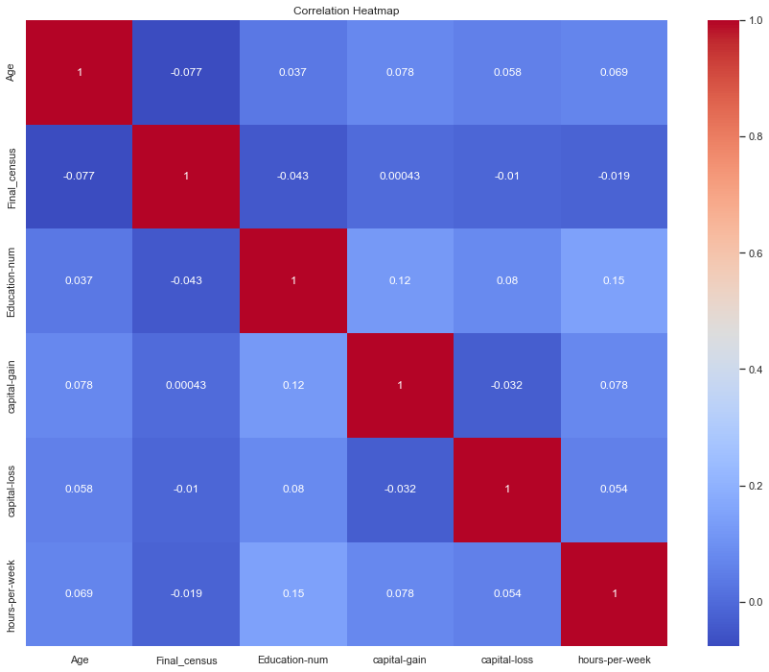
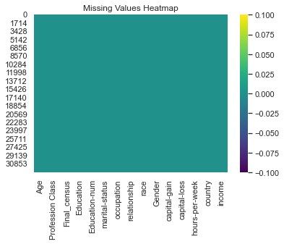

Slide 5
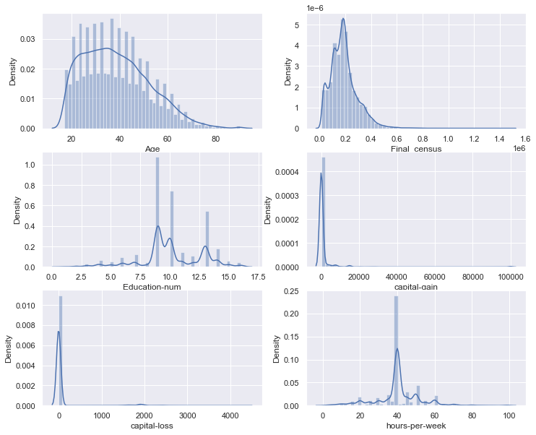
Visualization of Normalization of data

Slide 6
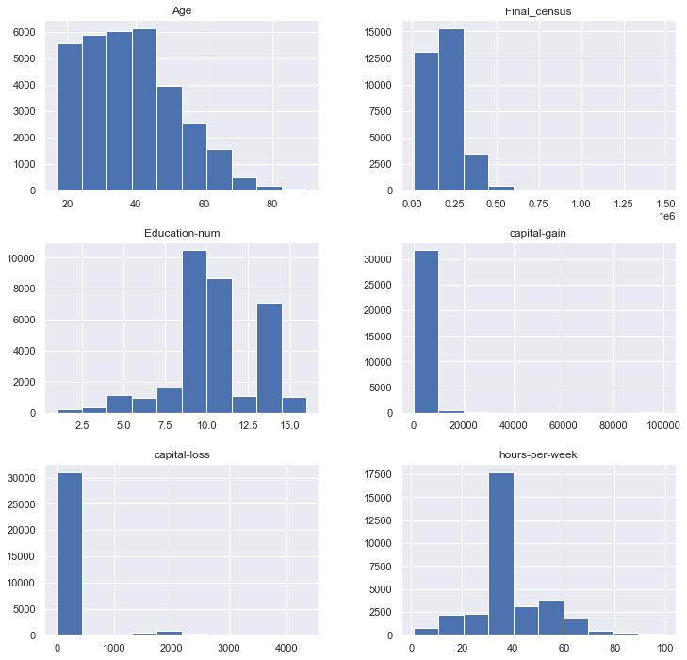
Visualizing the numerical features of the dataset using histograms to analyze the distribution of those features in the dataset

Slide 7
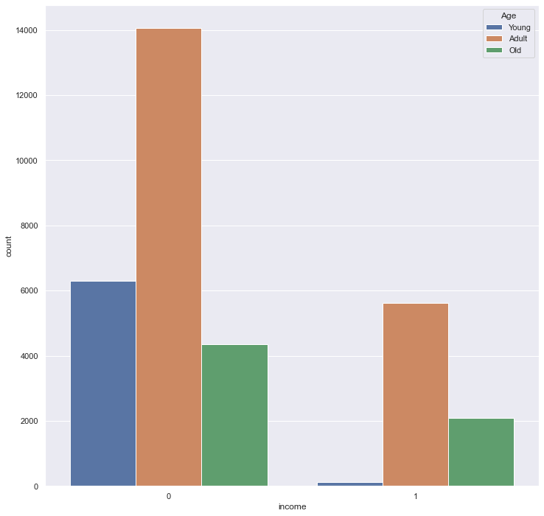
Distributing Age column in 3 significant parts and plotting it corresponding to the output feature(income)
Young ones have no contribution in income greater than 50 K dollars
Adults have larger contribution in both the segments

Slide 8
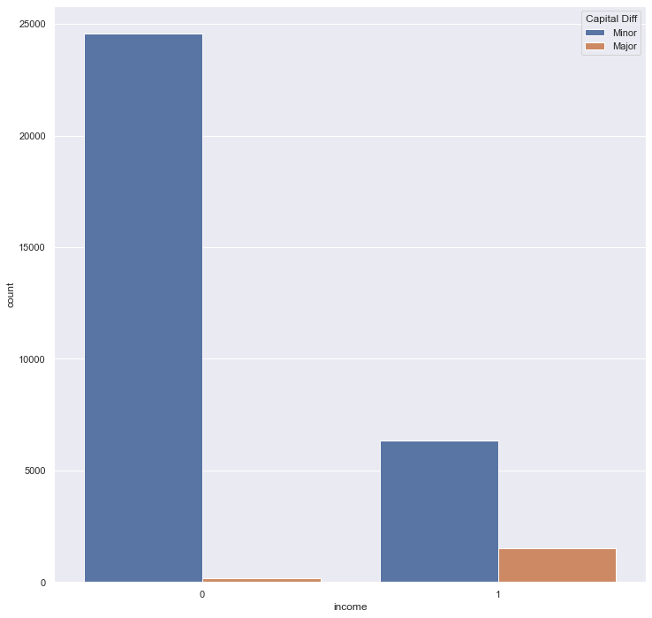
Capital gain and capital loss can be combined and transformed into a feature capital difference. Plotting the new feature corresponding to income
This graph tells that if capital difference is more than 5000 then income will be greater than 50K.
Capital difference with less than 5000 are more in income less than 50K dollars.

Slide 9
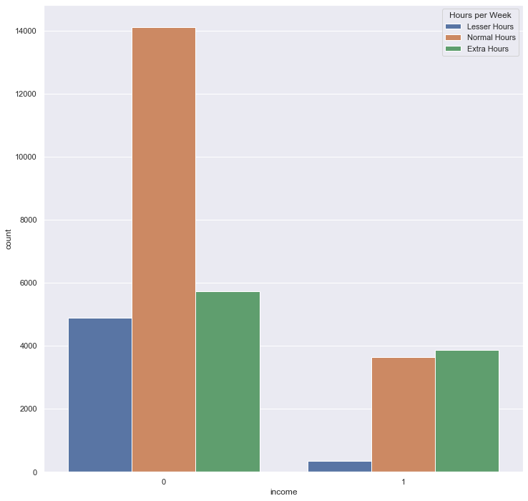
Dividing hours of week in 3 major range and plotting it corresponding to the income
Lesser hour category has negligible contribution in income group of more that 50K.
Extra hour category has highest in number with income group of more that 50K.

Slide 10
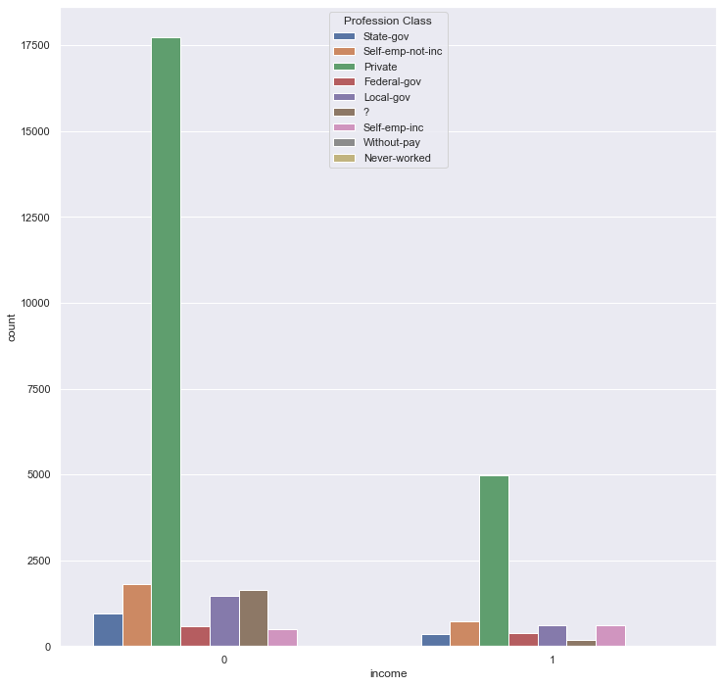
Plotting workclass corresponding to the income
Private workclass is highest in number in both income groups.
Self employed inc people are more in income group of more than 50K so it more no of chances of earning more than 50K if a person is self employed or in business if it is successfull.

Slide 11
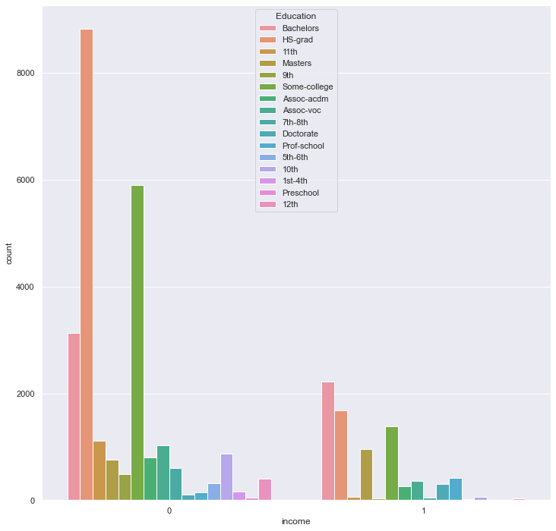
Plot of education corresponding to income
Person with masters, Doctrate, Prof-school are more in count for income group of greater than 50K dollars.

Slide 12
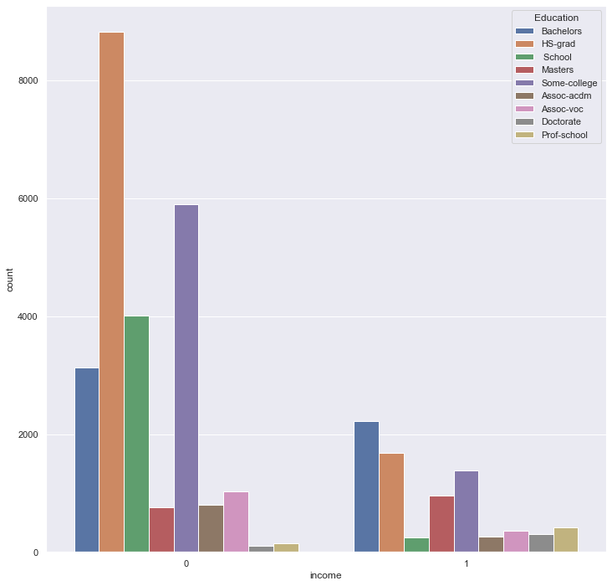
Combining the lower grades of education together

Slide 13
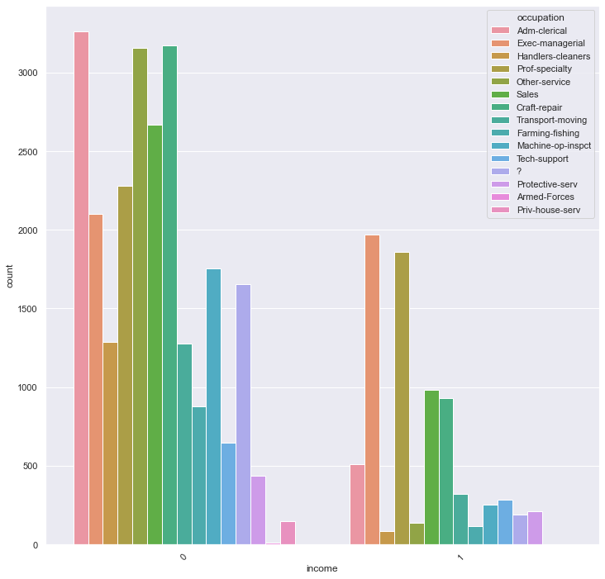
Plot of occupation corresponding to the income

Slide 14
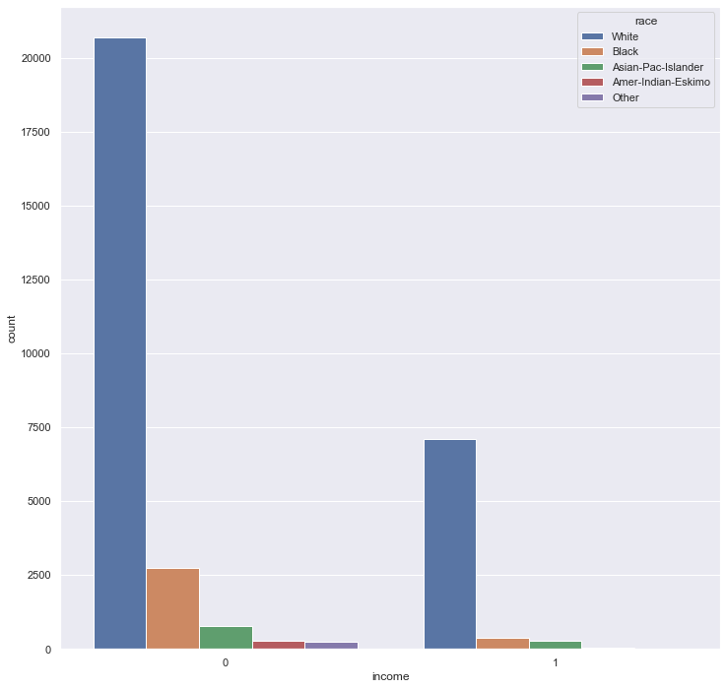
Plot of Race corresponding to the income

Slide 15
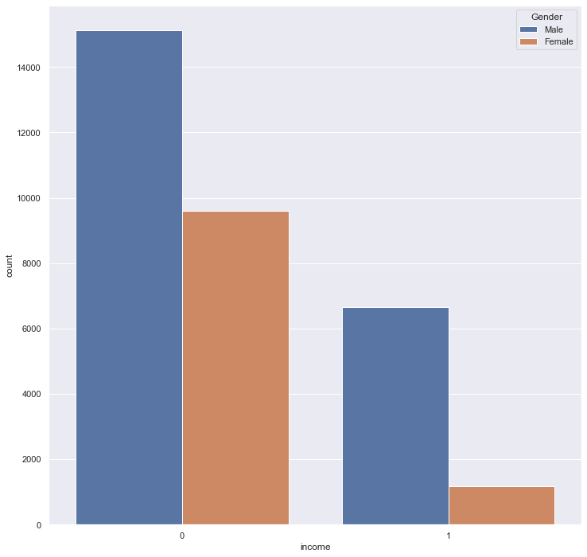
Plot of Gender corresponding to the income

Slide 16
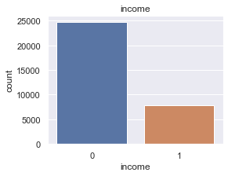
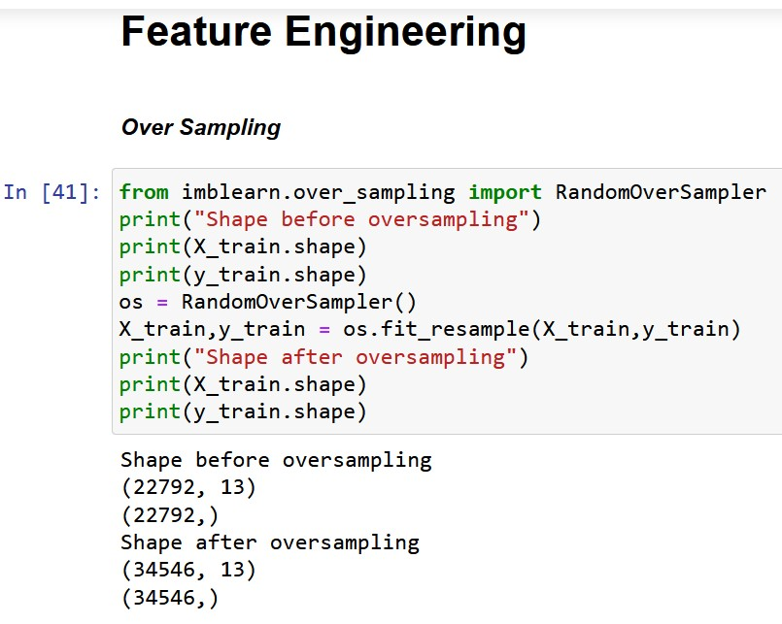
Over sampling
As it is clear from above graph that dataset was imbalanced so we need to balance it so that one category does not become dominant on other one and model takes them equivalent. Used Random over sampler to make it balanced.

Slide 17
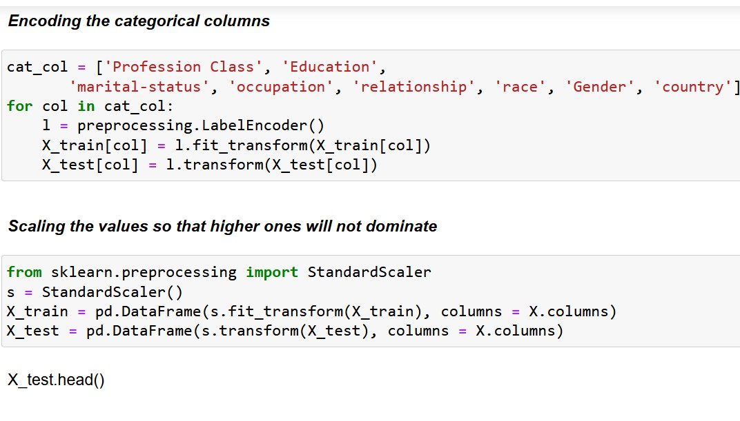
Encoding and scaling of data
As there are many categorical features so we have to encode those features and convert them into numbers.
Then scale the features on same scale so that all features are equivalent in model.

Slide 18
Comparison of ML models
Sr. No. | Algorithm | Accuracy | Precision | Recall | F1-score
1 | Logistic Regression | 0.77 | 0.76 | 0.77 | 0.76
2 | KNN Classifier | 0.82 | 0.82 | 0.81 | 0.81
3 | SVM Classifier | 0.83 | 0.87 | 0.76 | 0.81
4 | Decision Tree | 0.86 | 0.88 | 0.82 | 0.85
5 | Random Forest Classifier | 0.87 | 0.90 | 0.81 | 0.85
Random forest with GRID CV provides the highest accuracy

Slide 19
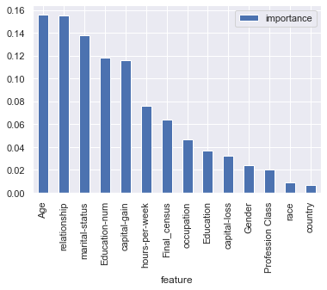
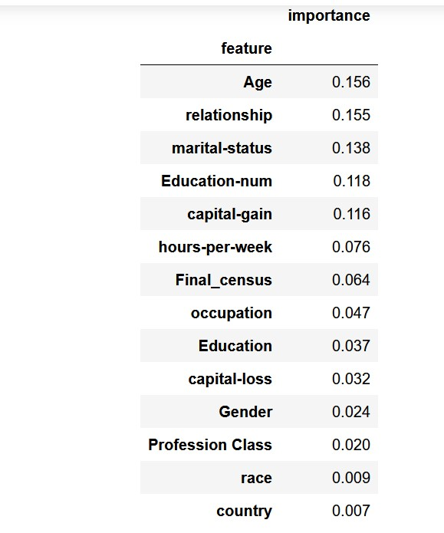
Feature Importance

Slide 20
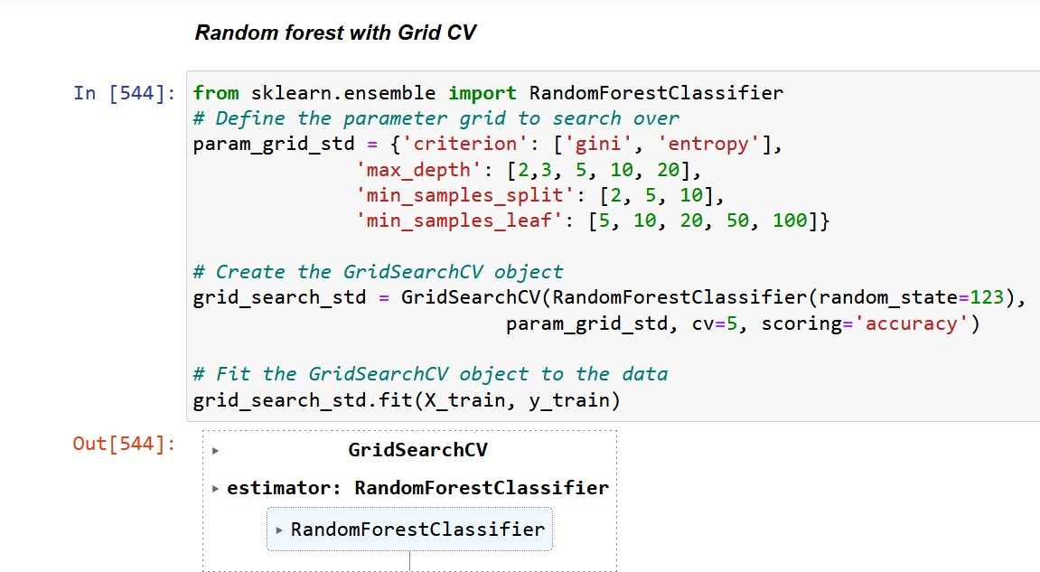
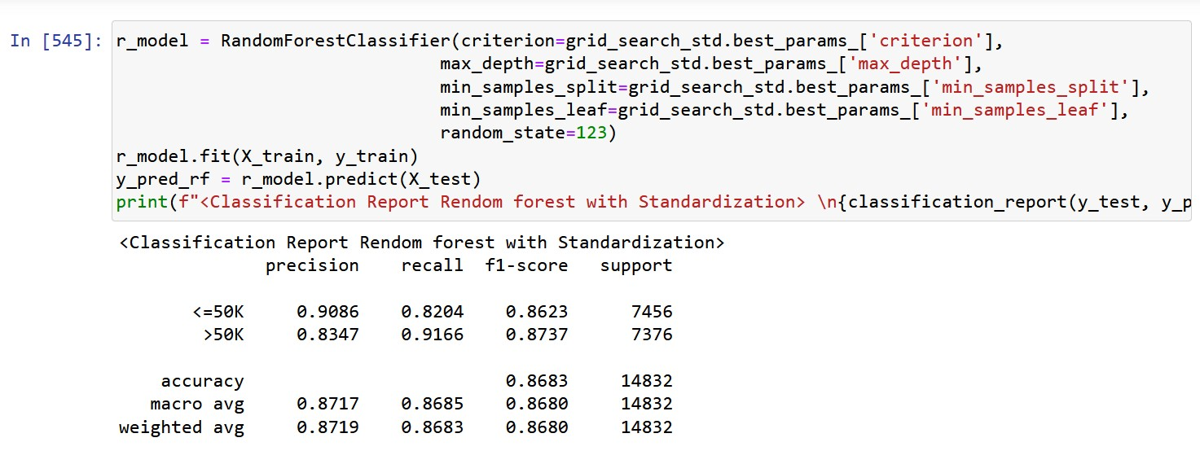
Final model building with Random forest and Hyper parameter tuning
Random forest model is giving the best results with hyper parameter tuning.

Slide 21
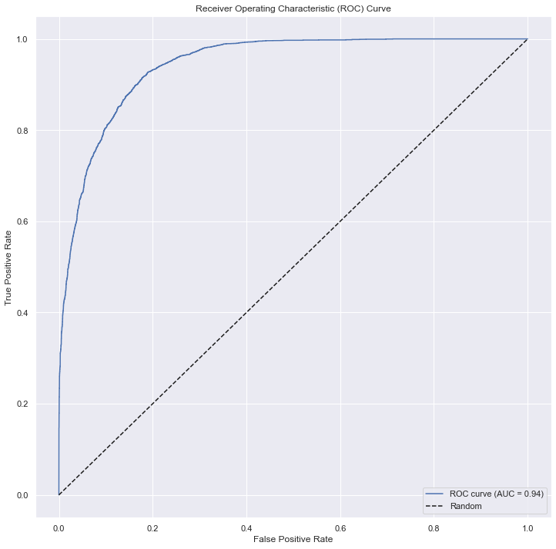
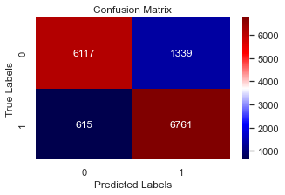
Final Results

Slide 22


Thank You
Vaibhav Mittal
mittal.vaibhav84@gmail.com

