Slide 1

Unified Release Management
December 21, 2018

Slide 2

Problem Statement
Code Merging and branching issues.
Using Large Bandwidth for Manual Testing.
Manual deployment of Binaries.
Ops team manually spinning the servers

Slide 3
As Is State -> To Be State
Manual testing
No build Pipeline
Manual deployment
Code Branching and merging issues
Low application reliability
No dashboard for release management
High capacity usage
Automate testing
. Build pipeline created
Automated deploment
GitHub merging strategy
High application reliability
Kubernetes dashboard
Minimal capcity usage.

Slide 4





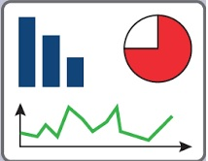
Application Architecture
Unit Testing
WRITE COMMIT
TRIGGER
Jenkins Pipeline Image
Push
IDE WriteCode
E
NV
I
RONME
N
T
Maven Test
Scripts
Build Code
Build Docker Images
Kubectl Deploy
JAVA
Groovy scripts
Node1
Node2
TESTER
Kubernetes Cluster
Report
Release
Pipeline
Report Build Pipeline

Slide 7
Thank you

