Slide 1

Cyclistic Rider Analysis
By: Ethan Mitten
Last Modified: June 25th 2021

Slide 2
What’s the Purpose?
Main Question
Understanding differences between Casual and Member Riders
Main Purpose
Turning Casual Riders Into Member Riders

Slide 3
Outline
Difference in Member Count
Difference in Average Ride Time
Difference in Ride Time for Various Bike Types
Summary
Recommendation

Slide 4
Difference in Member Count
Total Number of Riders
Casual: 255,938
Member: 273,550
Similar Number of Riders for Electric Bikes
Over 50,000 More Member Classic Bike Riders Than Casual
Docked Bike Rides Only Found for Casual Riders
Member Type | Bike Type | Number of Riders
Casual | Classic Bike | 123,270
Casual | Docked Bike | 43,262
Casual | Electric Bike | 89,406
Member | Classic Bike | 184,283
Member | Electric Bike | 89,267

Slide 5
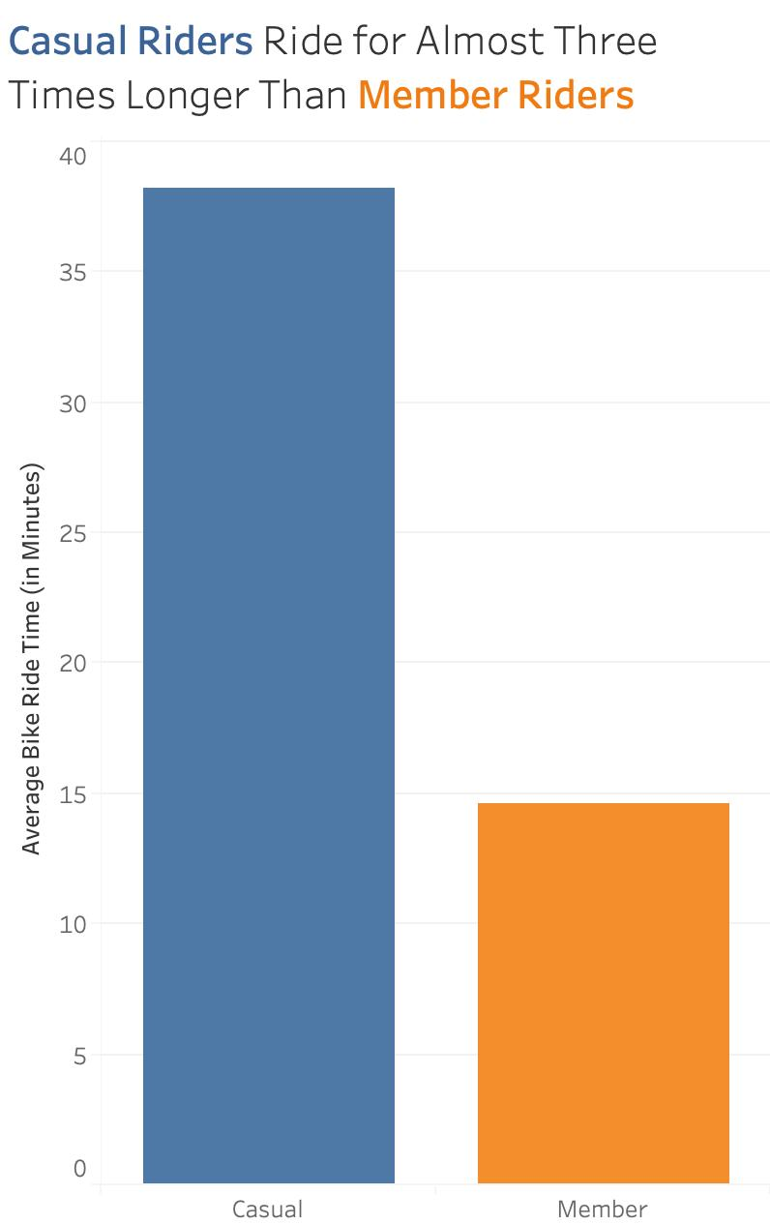
Difference in Average Ride Time
Rounded Average Ride Time
Casual: 38 minutes
Member: 14 minutes
There Looks to be a Relation Between Casual Riders and Riding for Leisure

Slide 6
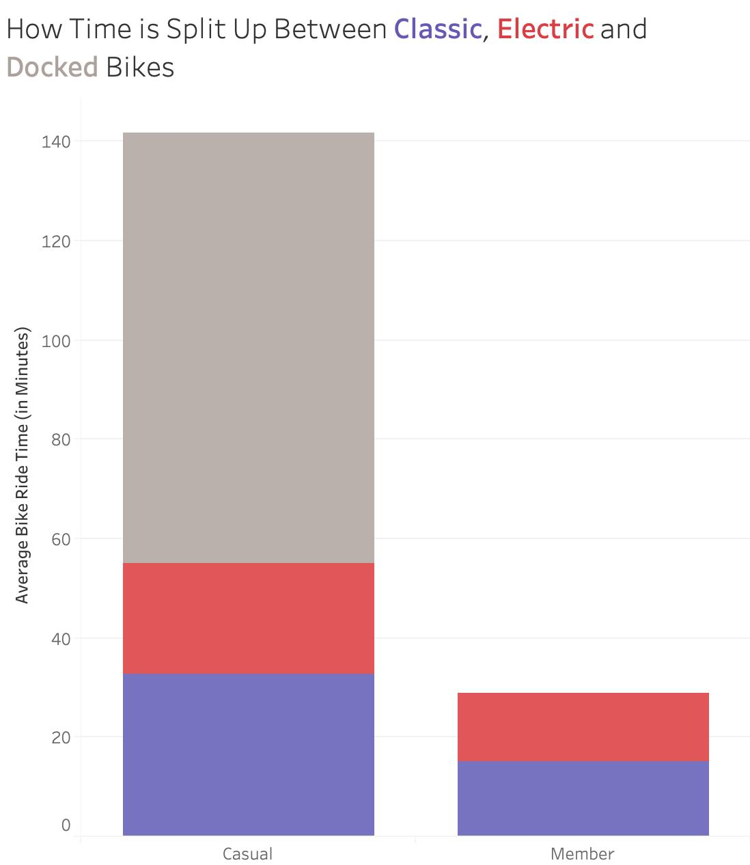
Difference in Ride Time for Various Bike Types
The Biggest Difference in Average Bike Time is Seen the Most in Classic Bikes
The Docked Bikes Again Show a Massive Difference in Ride Time Which Might Require a Bigger Dive Into What is Specifically Going on With This Bike

Slide 7
Summary
Big Difference Between Member and Casual Classic Bike Riders
Casual Riders Are Riding Bikes Almost Three Times as Long as Members
Most Noticeable Difference in Ride Times Between the Two Groups is With the Classic Bike

Slide 8
Recommendation
Primary Target Should Be Casual Riders Who are Using Classic Bikes
Find Marketing Strategy That Makes Positive Relationship Between Being a Member and Leisure Riding

Slide 9
Any Questions?

Slide 10
Thank You!

