Slide 1

IMDb Personal Data Project
Ethan Mitten

Slide 2
Thesis
The thesis that is being researched in this project is if there are certain variables that will affect the ratings, I give movies and television shows on IMDb more than others

Slide 3
Variables
The variables that will be included in this project are:
Title
Is the title of a movie or television show that was viewed and rated by me
MovieorTV
This variable describes with numbers whether this title was a movie or television show
1=Movie and 2=Television Show
Genre
This variable describes with numbers what genre the title would be considered
UserRating
This variable illustrates what the rating of a specific title was by the IMDb community
Lead
This variable shows who was the lead actor or actress in the film or television show
MyRating
MyRating shows the rating that I gave each specific title in IMDb

Slide 4
Gathering Data
To gather data for this project I used the IMDb app as well as Microsoft Excel
I went through every title I have rated on IMDb and listed out in an Excel spreadsheet the appropriate responses to each of the variables previously described
After recording all of my observations in a spreadsheet the spreadsheet was exported to RStudio
I then used the AIC correlation feature within R to determine which category was most correlated with the rating I gave each title

Slide 5
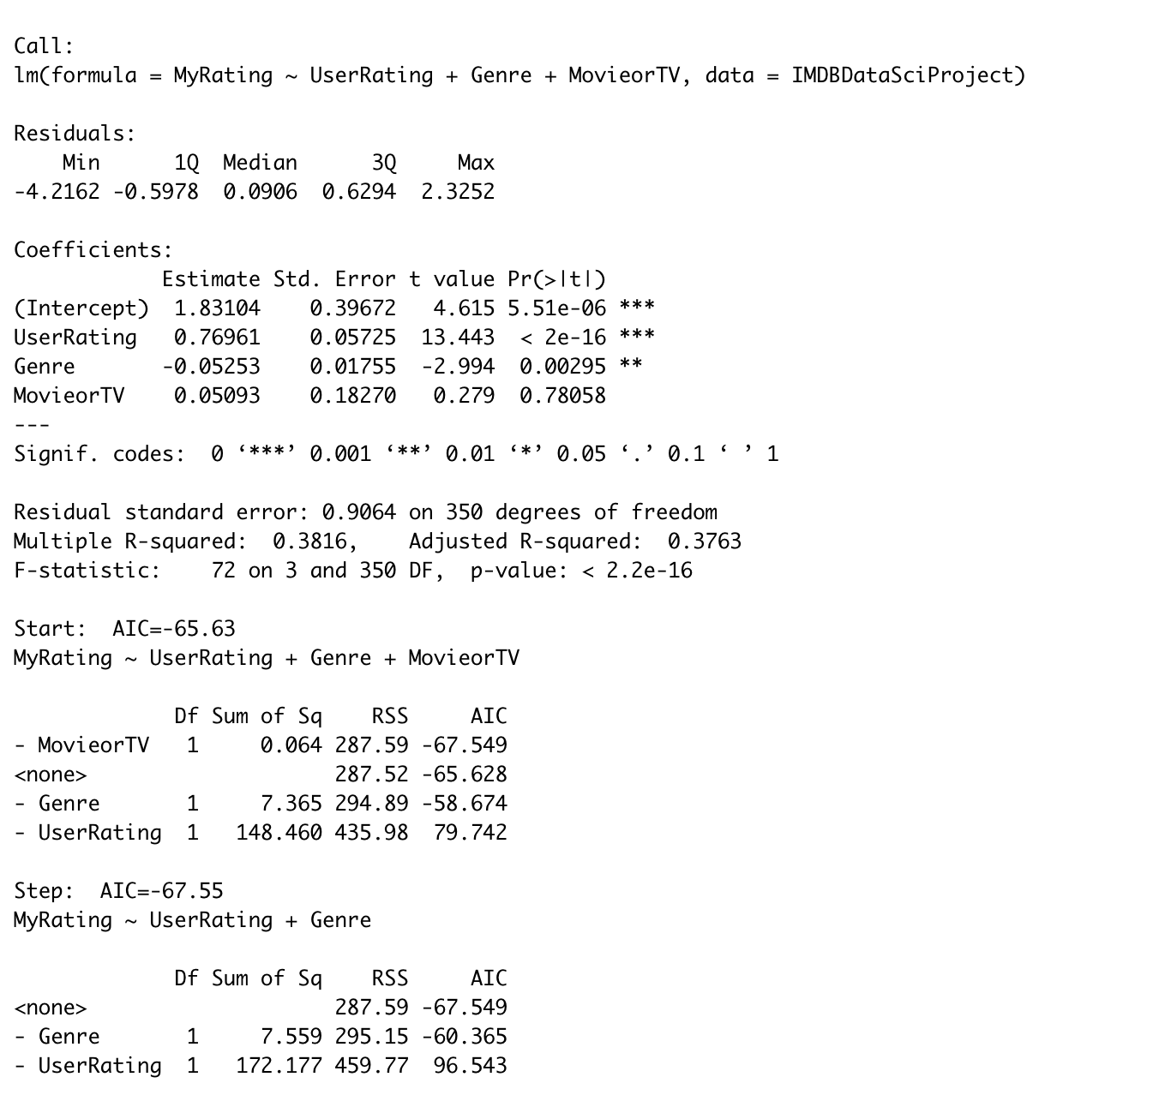
AIC Correlation
Looking at the data in the bottom part of the picture it can be concluded through the AIC test that UserRating is highly correlated with MyRating

Slide 6
Problems
Some problems faced in this project leading to some unused variables were problems with the variable lead as well as some excel spreadsheet errors with the variable genre.
With gathering excel data the genre category might be inaccurate on the idea that each title has more than one category it could be considered as, so when deciding the genre of a title it came down to my decision about what genre I thought best described the movie
With that being said there were some genres that were not used with the data that definitely could have been used which would have led to different results with the AIC
The counterargument to the previous bullet point is that the AIC between genre and UserRating was so far apart that it would have most likely not mattered if a couple of titles were switched around
When using the lead with the AIC correlation there was a problem with how it was executed just because I used names instead of numbers
Doing this project over again I would assign a specific number to every lead actor or actress and go in and put in a number for every one of them that way it could be seen whether different cast members affected the final outcome
I might also add a category for directors to see if certain directors played a part in my decision

Slide 7
Conclusion
The final conclusion of this project is that 95% of the time I will rate a movie or tv show in line with what other people rated this movie. I will very rarely think differently about a title than what the mass of people concluded about it. It has been learned that although I have different taste in entertainment quality(just a base idea of being humans and having separate interests) with the movies and television I do watch my rating will most likely be a representation of what the mass of people rated the movie.

