Slide 1

The End of Nintendo Dominance in the Video Game Market?
By: Ethan Mitten
Last Modified: August 3rd 2021

Slide 2
What’s the Purpose?
Main Question
How has Nintendo’s place in the video game market shifted throughout the years between 1980 and 2016?
Main Purpose
Discuss trends in the market for viewers to understand an overview of what is going on

Slide 3
Outline
Global Sales Leaders for Each Decade From 1980 to 2016
Shift in Consumer Taste and Effect on Global Sales Leaders
Summary

Slide 4


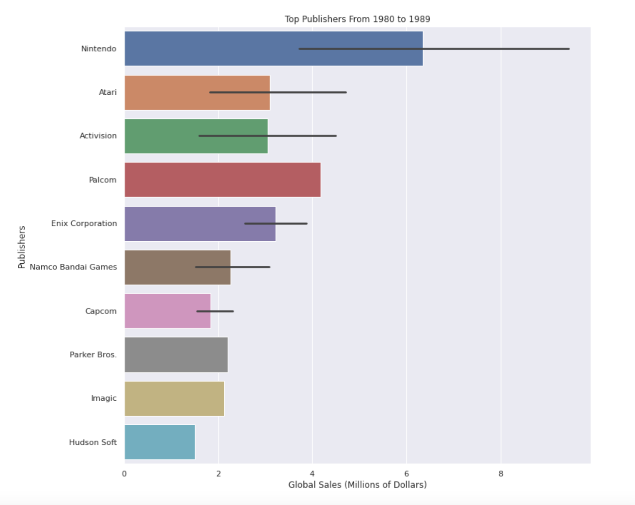
Global Sales Leaders for 1980s
Nintendo is by far the dominant publisher in the 1980s
Nintendo did two million more in global sales than next highest publisher
There are very few competitors in the market

Slide 5
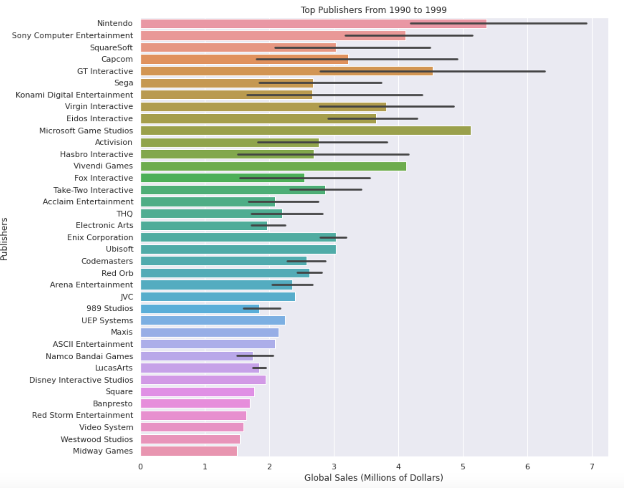
Global Sales Leaders for 1990s
Nintendo continues to be above the rest of the publishers
A lot more publishers have entered the market
Microsoft Game Studios became quick success
Only Nintendo still competing for top of global sales from publishers in 1980s

Slide 6
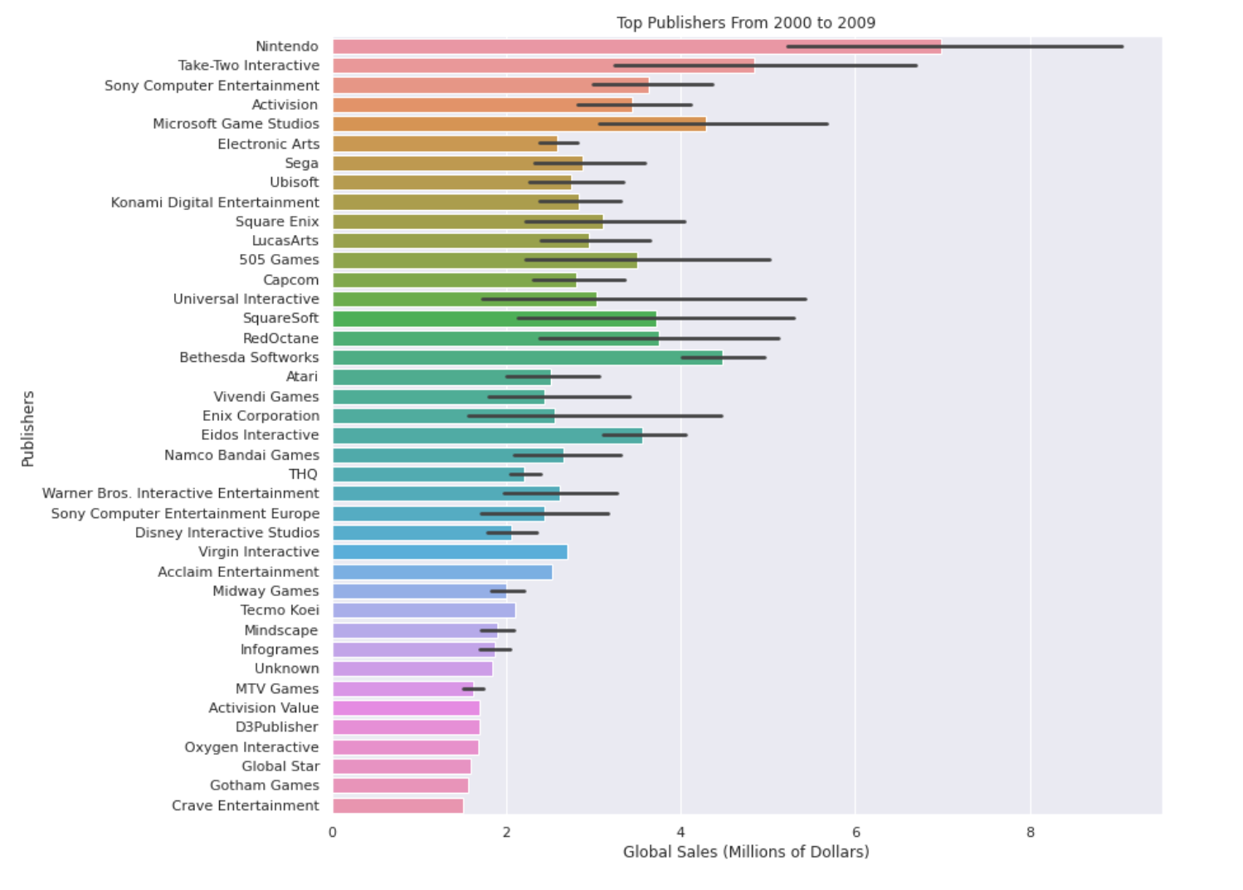
Global Sales Leaders for 2000s
Nintendo excelled in the 2000s continuing the dominant difference seen in 1980s
Microsoft Game Studios is still staying towards the top of the list
Emergence of Take-Two Interactive and Bethesda Softworks

Slide 7
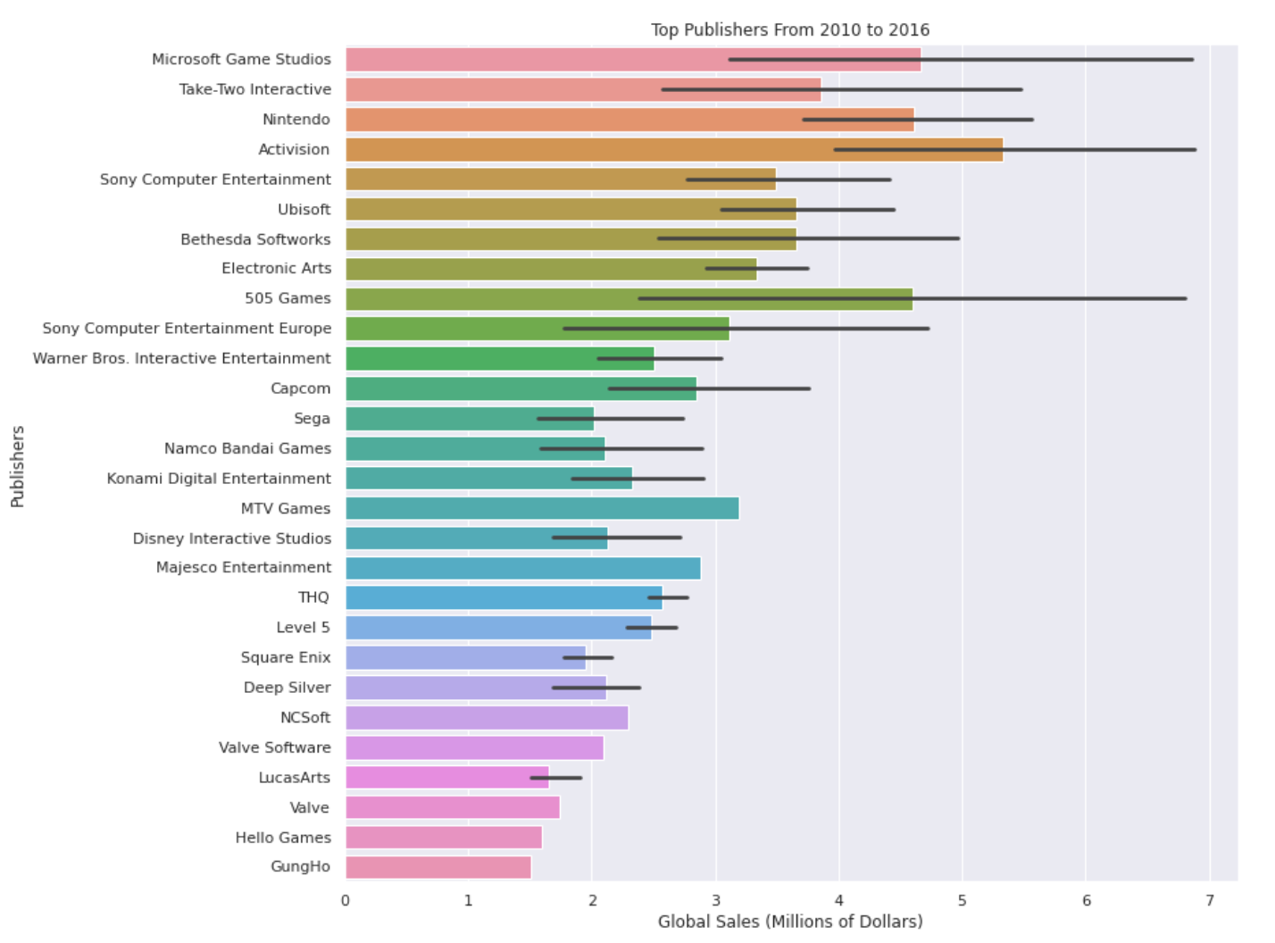
Global Sales Leaders for 2010s
Nintendo falls as top publisher after leading for multiple decades
Microsoft climbs to contest the top with 505 games
New leader of global sales is Activision
If we combined Sony Computer Entertainment divisions, it would be leading global sales leader

Slide 8
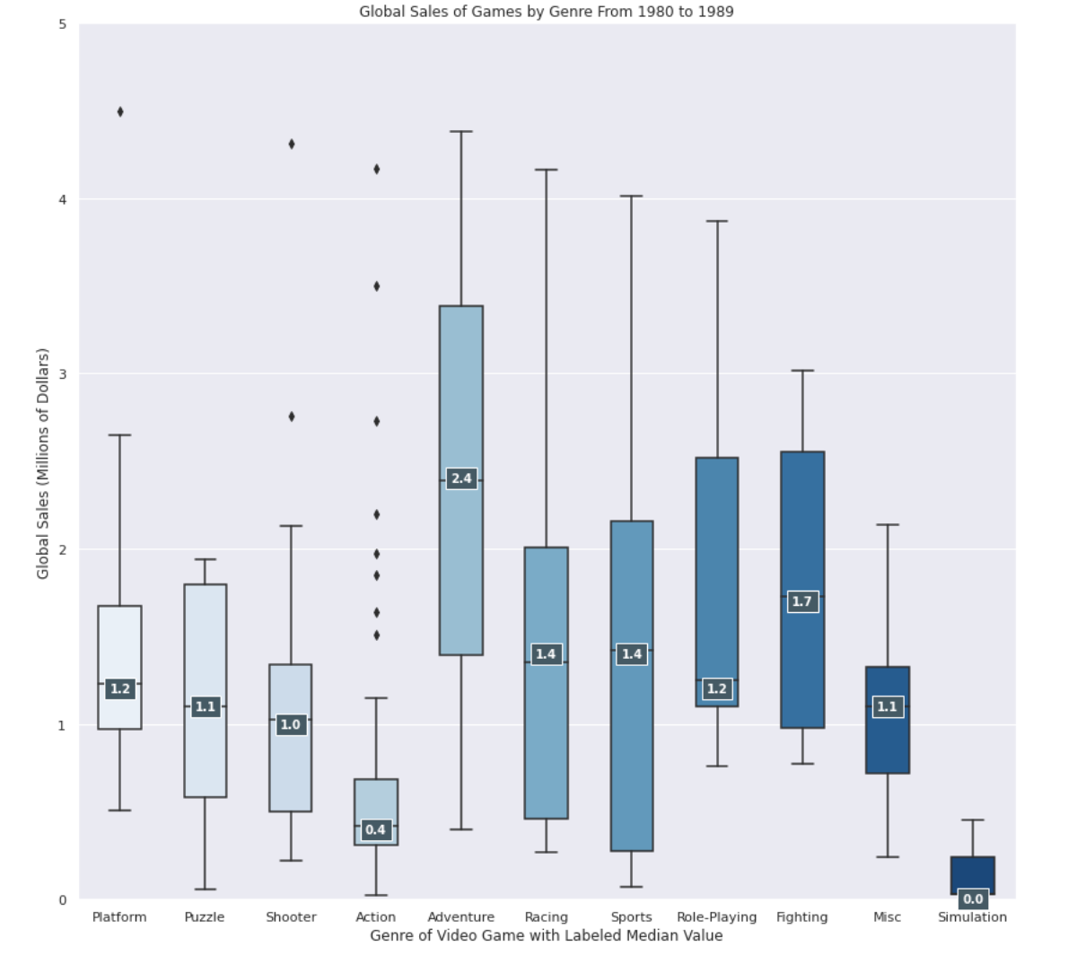
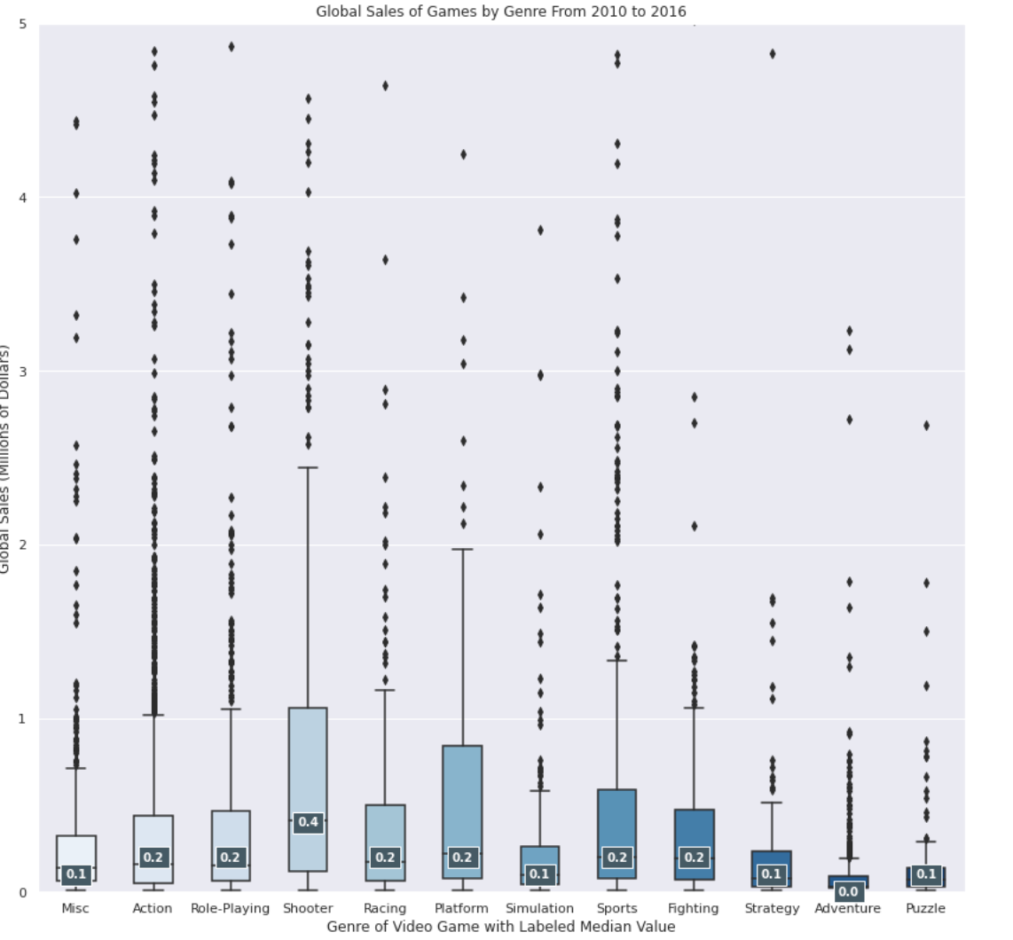
Shift in Consumer Taste and Effect on Global Sales Leaders
Consumer Taste Changing From Adventure and Fighting to Shooter Games
Could this be why Nintendo has fallen in global sales?

Slide 9
Summary
Nintendo has dominated the video game market for a long time, but change has occurred
New popularity in shooter games could be key to slipping sales of Nintendo as they do not produce many games in that genre
This popularity in shooter games could also be the reason for rise in publishers like Activision

