Slide 1
Cloud computing and simulation tools: ”CloudSim and CloudAnalyst”.
Nishant Joshi.
Mit Rajen Thakkar.

Slide 2
Index.
Cloud Computing.
CloudSim.
Feature of CloudSim.
Steps to configure CloudSim.
Continue…
VM and Task allocation policies in CloudSim.
VM space-shared and tasks space shared.
VM time-shared and tasks space shared.
VM space-shared and tasks time shared.
VM time-shared and tasks time shared.
CloudAnalyst.
Feature of CloudAnalyst.
Service broker policies.
Closest datacenter policy.
Optimize response time.
Dynamically reconfigure routing with load balancing.
Case study 1.
Case study 2.
References.

Slide 3
Cloud Computing.
Cloud Computing - Parallel and Distributed Systems.
Connected and Virtualized Computers.
Computing resources based agreements.
Provides service to the end user.
It also provides the other services.
Examples of cloud computing platform.
index
1

Slide 4
CloudSim.
CloudSim is a java based framework.
For modeling, simulation, and experimentation of application services.
index
2

Slide 5
Feature of CloudSim.
Supports modelling and simulation of cloud environment.
Platform for modelling clouds, brokers and allocation policies.
The top most is the user code.
Exposes hosts, applications, VMs, number of users.
application types, and service broker policies.
By extending this, developer can simulate individual mix of workloads.
index
3

Slide 6
Steps to configure CloudSim.
Set number of users
Initialize Variables. (Datacenter, Broker, VM list, Cloudlets list(tasks)).
Create Datacenter which will create hosts and their characteristics that are process elements, RAM, Bandwidth.
Create DatacenterBroker which communicates with Datacenter for counting cloudlets and number of VMs.
Create VirtualMachines with same parameters that of datacenter
Submit the above VMs to the Broker.
Till here the basic Infrastructure is created.
index
4

Slide 7
Continue…
Create Cloudlets that are tasks which are created with MIPS, bandwidth. There can be one or more cloudlets.
Submit this cloudlets to brokers which has VMs as well. Broker will map both the cloudlets and VMs.
Call start the simulation process.
Call Stop simulation process.
Print status of simulation.
index
5

Slide 8
VM and Task allocation policies in CloudSim
Four way to allocate VM and task allocation policies.
VM space-shared and tasks space-shared.
VM time-shared and tasks space-shared.
VM space-shared and tasks time-shared.
VM time-shared and tasks time-shared.
Consider two VMs each require two cores to execute.
Each VM have four tasks. Each require one core to execute.
index
6

Slide 9
VM space-shared and tasks space shared.
Each VM requires two cores.
Only one can run at a time.
So one of the is assigned the core.
Same happens with tasks.
Each tasks requires one core.
So two tasks can run and others are queued.
index
7

Slide 10
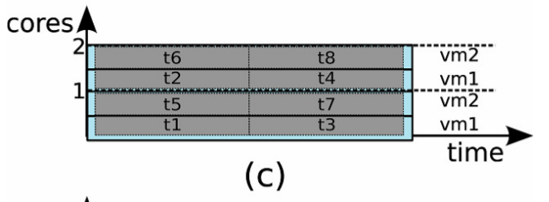
VM time-shared and tasks space shared.
VM recieves time slice of processing cores.
This slices are distributed with tasks
Here core is shared so less processing power than before
Same happens with tasks.
Each tasks requires one core.
So two tasks can run and others are queued.
index
8

Slide 11
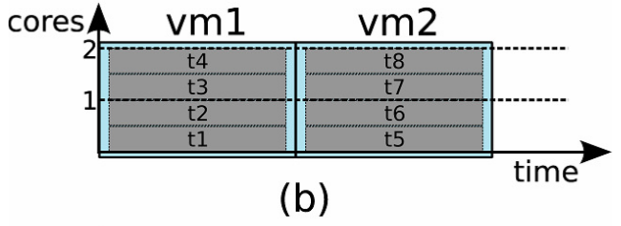
VM space-shared and tasks time shared.
VMs are space shared.
Requires two cores.
But tasks are time shared.
So tasks are assigned in slices of time.
Context switching takes place between tasks.
Takes more time to execute tasks.
index
9

Slide 12
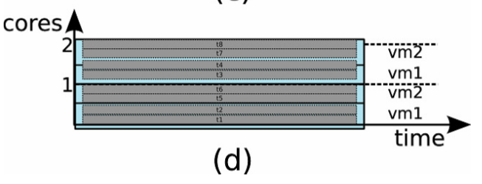
VM time-shared and tasks time shared.
Processing power shared by VMs.
Further shared power is shared by tasks.
No queuing as each task gets its own share of time and power.
index
10

Slide 13
CloudAnalyst.
Cloud Analyst is assembled on top of CloudSim tool kit
GUI based
It provides information of geographic location.
Fills the gap of present simulation tools for cloud environment.
Helps to estimate requirements of large cloud infrastructures.
index
11

Slide 14
Feature of CloudAnalyst.
Easy to use tool with a high-level of visualization.
Even better than just a toolkit with necessary parameters.
Ability to modify configuration parameters quickly and easily.
Simulation results is in the form of graph and table.
It allows to save the configuration as file (.sim) which can be loaded.
Ease of extension. To implement new policies.
index
12

Slide 15
Service broker policies.
Three service broker policies.
Closest datacenter policy.
Optimize response time policy.
Dynamically reconfigure routing with load balancing.
index
13

Slide 16
Closest datacenter policy.
Datacenter having least proximity is chosen.
Proximity in terms of network latency.
Maintains and index table of datacenters.
Orders datacenters in terms of lowest latency.
When a request arrives from user checks the table.
Queries the datacenter with least network latency.
If more than one then choses randomly.
index
14

Slide 17
Optimize response time.
It checks the network latency like closest datacenter.
It maintains a table for datacenters with current response time.
Returns the one with the least response time if closest datacenter fails.
Predefined threshold is set for current response time.
Current response time < threshold choose randomly.
index
15

Slide 18
Dynamically reconfigure routing with load balancing
Routing similar to closest datacenter.
But checks load of data center
checks the processing time and best processing time.
Increases decreases VMs in datacenter as required.
Still under research.
index
16

Slide 19
Case study 1.
CloudSim implementation with 1 datacenter, 40 VMs, 60 cloudlets, time-shared VM allocation policy and space-shared cloudlet allocation policy.
Code.
Output.
index
17

Slide 20
Case study 2.
Service broker policies paired with load balancing policies.
1. Closest datacenter with round robin.
Output.
Sim.java file.
Map.
2. Closest datacenter with throttled.
Output.
Sim.java file.
Map.
3. Closest datacenter with equal load.
Output.
Sim.java file.
Map.
1. Optimize response time with round robin.
Output.
Sim.java file.
Map.
2. Optimize response time with throttled.
Output.
Sim.java file.
Map.
3. Optimize response time with equal load.
Output.
Sim.java file.
Map.
index
18

Slide 21
References.
Rodrigo N. Calheiros, Rajiv Ranjan , Anton Beloglazov , Cesar A. F. De Rose ́ and Rajkumar Buyya,”CloudSim: a toolkit for modeling and simulation of cloud computing environments and evaluation of resource provisioning algorithms”, ”Wiley Online Library” ”2010”
Sandip Patel, Ritesh Patel, Hetal Patel, Seema Vahora, ”CloudAnalyst : A Survey of Load Balancing Policies”, ”International Journal of Computer Applications”, ”2015”, volume 117
Ritesh Patel, Seema Vahora, ”CloudSim-A Survey on VM Management Techniques”, ”International Journal of Advanced Research in Computer and Communication Engineering”, 2015, volume 4.
Hetal Patel, Ritesh Patel, ”Cloud Analyst: An Insight of Service Broker Policy”, ”International Journal of Advanced Research in Computer and Communication Engineering”, 2015, volume 4.
index
19

Slide 22
Thank you

