Slide 1
Using Hardware Features for Increased Debugging Transparency
Taken from:
Instructor: Kun Sun, Ph.D.
College of William and Mary
Notes:
Goal:
- Reverse engineer malware and find it’s existence
- Analyze malware that has anti-debugging / anti-emulation / anti-virtualization measures in place.

Slide 2
Overview
Background
Traditional Malware Analysis
System Management Mode (SMM)
System Architecture
Performance Analysis
Conclusion
Notes:
Discuss some background, explain the tool, results and limitations + end notes.

Slide 3
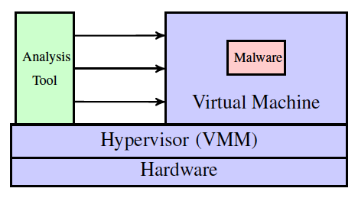
Traditional Malware Analysis
Using virtualization technology to create an isolated execution environment for malware debugging
Running malware inside a VM
Running analysis tools outside a VM
Notes:
- Incapable of analyzing rootkits with the same or higher privilege level (e.g., hypervisor and firmware rootkits)
Unable to analyze armored malware with anti-virtualization or anti-emulation techniques
Anti-virtualization:
Interrupt Descriptor table (IDT) is diff for bare metal and VM
CPUID instruction is emulated – timing attack on ITLB
Anti-Debugging:
- Check for 0xCC (int 3h) bytes for software interrupt
- isBeingDebugged() function
GetThreadContex => Gives away the hardware breakpoints
Use Structured Exception Handling (SEH)

Slide 4
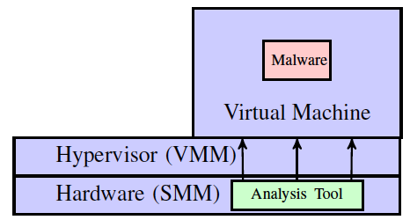
Our Approach
We present a bare-metal debugging system called MalT that leverages System Management Mode for malware analysis
Uses SMM as a hardware isolated execution environment to run analysis tools and can debug hypervisors

Slide 5
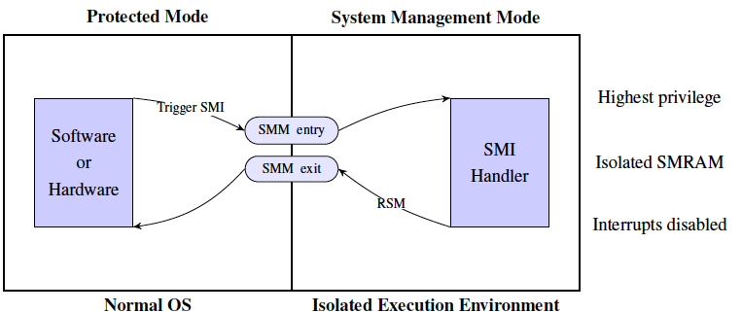
System Management Mode
Approaches for Triggering a System Management Interrupt (SMI)
Software-based: Write to an I/O port specified by Southbridge datasheet (e.g., 0x2B for Intel)
Hardware-based: Network card, keyboard, hardware timers
Notes:
- Originally designed for implementing system functions (e.g., power management)
- Isolated System Management RAM (SMRAM) that is inaccessible from OS
- Can access the system resource of OS
- Only way to enter SMM is to trigger a System Management Interrupt (SMI)
- Executing RSM instruction to resume OS (Protected Mode)

Slide 6
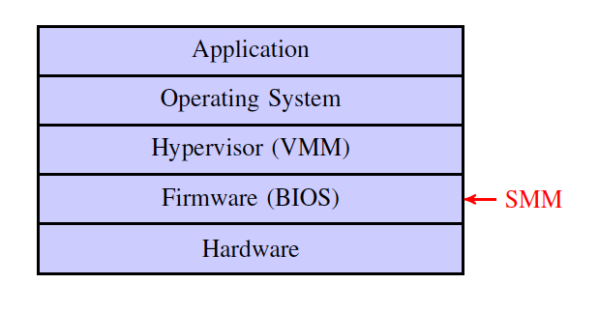
Software Layer

Slide 7
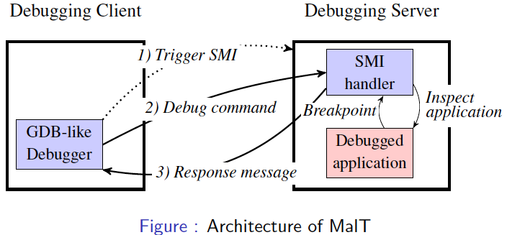
System Architecture
Traditionally malware debugging uses virtualization or emulation
MalT debugs malware on a bare-metal machine, and remains transparent in the presence of existing anti-debugging, anti-VM, and anti-emulation techniques.
Notes:
- Connection between client and server via serial port.

Slide 8
Basic Debug Commands
R: read all registers
Wr1r2…rn: write to certain register
mAAAALLLL: read from particular memory address
sAAAALLLL: write to particular memory address
BAAAA: set a new breakpoint
KAAAA: remove a breakpoint
X: clear all breakpoints
C: continue execution after a breakpoint
SI, SB, SF, SN: stepping command
Debugging memory needs to fill the semantic gaps, since all the addresses are virtual addresses.

Slide 9
Breakpoints in MalT
Software-based breakpoints are not stealthy.
We use hardware-based breakpoints
For each Protected Mode instruction, the SMI handler takes the following steps:
Check if the target application is the running thread when the SMI is triggered
Check if the current EIP equals to a stored breakpoint address
Start to count instructions in the performance counter, and set the corresponding performance counter to the maximum value
Configure LAPIC so that the performance counter overflow generates an SMI.
Notes:
- Software breakpoints done using manually writing to the out I/O port

Slide 10
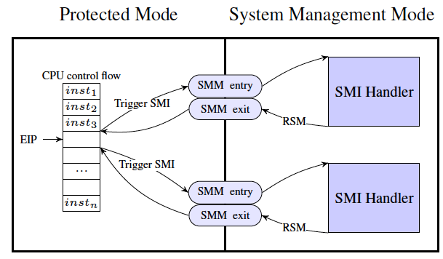
Step-by-step Debugging in MalT
Debugging program instruction-by-instruction
Using performance counters to trigger an SMI for each instruction

Slide 11
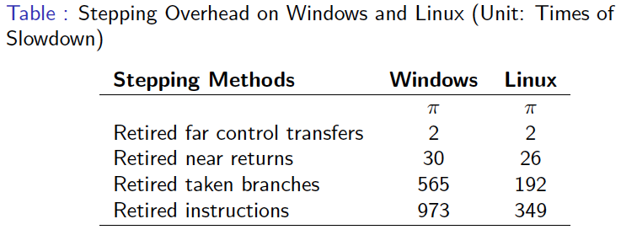
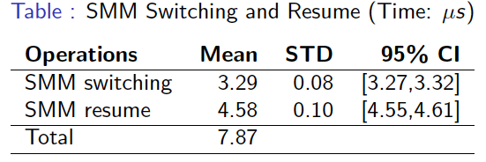
Performance Analysis
Testbed Specification
Motherboard: ASUS M2V-MX SE
CPU: 2.2 GHz AMD LE-1250
Chipsets: AMD K8 Northbridge + VIA VT8237r Southbridge
BIOS: Coreboot + SeaBIOS
Notes:
- Performance Analysis for: ls, ps, pwd, tar
- Tested for anti-debuggers / anti-emulation: notepad.exe

Slide 12
Conclusion
Benefit: Able to mitigate existing anti-debugging, anti-VM, and anti-emulation techniques
Limitations of MaLT
SMM-based / ring-2 based rootkits
External timer based timing
Kernel exploits that can inspect LAPCI
Kernel exploits that mutate data structures to confuse MaLT

