Slide 1
Toronto’s Neighborhoods Clustering based on
Attractiveness of Living and Venue Types
Mirena Trifonova
07 May 2020

Slide 2
Introduction and Data
Toronto is among the 5 biggest North American cities, divided into 140 neighborhoods.
Two main sources of information are being use to explore this bustling city:
https://torontolife.com/neighbourhood-rankings/#
https://foursquare.com/
The first is employed when clustering Toronto neighborhoods based on attractiveness of living. It provides a list of the neighborhoods, their latitude and longitude and ranking based on 10 criteria: housing, safety, transit, shopping, health, entertainment, community, diversity, education and employment. Each neighborhood is ranked form 0 to 100 for each criteria .
The second, is used to explore each neighborhood and find maximum 100 venues within radius of 500 meters of its longitude and latitude via Foursquare API . Afterwards, the data serve when in clustering based on venues types.

Slide 3
Methodology
The analysis rests on K-means Clustering algorithm to divides the neighborhoods into K-optimal groups/clusters, in which each observation belongs to the cluster with the nearest centroid.
Special attention is given to the selection of optimal number of clusters, K. The Elbow Method is employed. In both clustering cases the optimum is 3.
When clustering based on attractiveness of living, the features are the 10 ranking criteria: housing, safety, transit, shopping, health, entertainment, community, diversity, education and employment, plus the average rating.
When clustering based on venues categories, the features are the unique venues categories after applying ‘one hot encoding’.

Slide 4
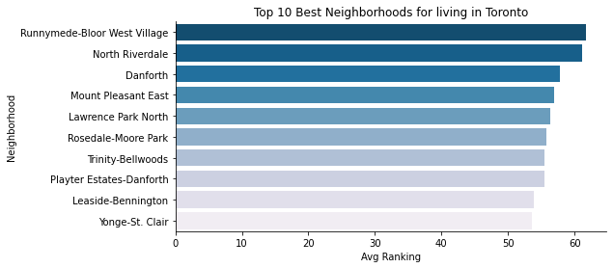
Exploratory Data Analysis
Top 10 Toronto Neighborhoods by average ranking, which places equal importance of each of the 10 ranking criteria:
housing, safety, transit, shopping, health, entertainment, community, diversity, education and employment.

Slide 5
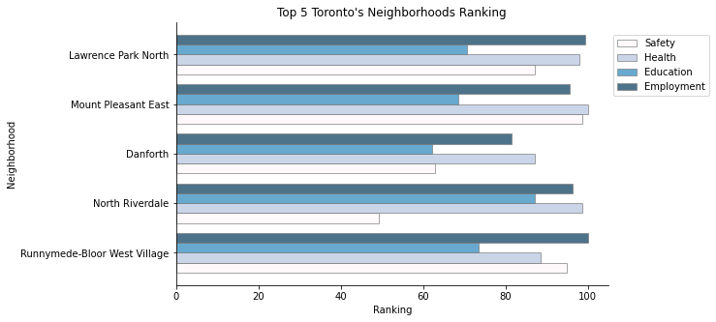
Exploratory Data Analysis
Top 5 Toronto Neighborhoods by average ranking with 4 of the 10 criteria plotted:
safety, education, employment and health.

Slide 6
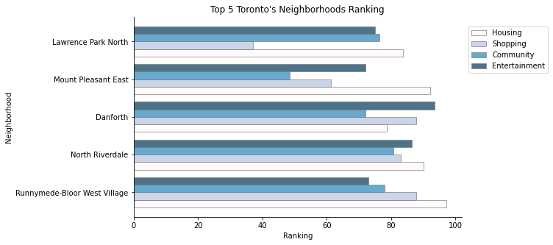
Exploratory Data Analysis
Top 5 Toronto Neighborhoods by average ranking with 4 of the 10 criteria plotted:
housing, shopping, community, entertainment.

Slide 7
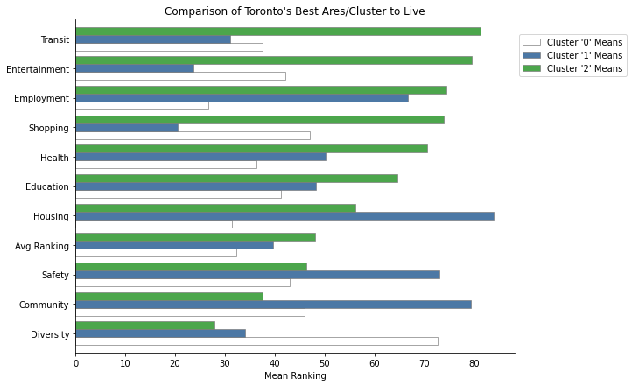
Clustering Based on Attractiveness of Living

Slide 8
Clustering Based on Attractiveness of Living
The third cluster (in green) contains 46 neighborhoods and is the second largest cluster in terms of number of neighborhoods. It has highest average ranking and highest employment, education, entertainment, health, shopping and transit, meaning that the second largest cluster is the leader in 6 of 10 ranking criteria.
The second cluster (in blue), has only 27 neighborhoods and is the smallest (based on number of neighborhoods). It has the last but one average ranking and highest average scores for community, safety, housing.
The first cluster (in white), is the largest (based on number of neighborhoods). It includes 67, almost half of the 140 neighborhoods and yet it is the worst graded. It is the leader in terms of diversity. However, it yields the worst average results for education, employment, health, safety and housing.

Slide 9
Clustering Based on Venue Types
The first cluster contains 110 neighborhoods. The most common venues accounting for 51.18% of the 1st most common venues in the neighborhoods in the cluster is/are Coffee Shops, Cafés, Italian Restaurants.
The second cluster contains 2 neighborhoods. The most common venues that account for 100.00% of the 1st most common venues in the neighborhoods in the cluster is/are Pools.
The third cluster contains 28 neighborhoods. The most common venues that account for 51.59% of the 1st most common venues in the neighborhoods in the cluster is/are Parks.

