Slide 1

Super Flash
Online flashcard system for study
SPRINT 5 REVIEW
Scrum Master: Nhi Dinh Team members: Nhi Dinh, Tu Dinh, Kim Tran

Slide 2
Sprint 5 Review
Sprint 1 Review
Project: Super Flash - Online flashcard system for study
Objectives
Deliverables
This sprint focused on:
Preparing our application for localization, both in the user interface and database layers
Updating our product backlog accordingly
Localizing UI Interface of main pages
Product backlog updated
Localization resources identified
Translation Tracking Document
UI prepared for localization
Database supports multilingual content
Language selection feature added
UI localization completed for all main pages

Slide 3
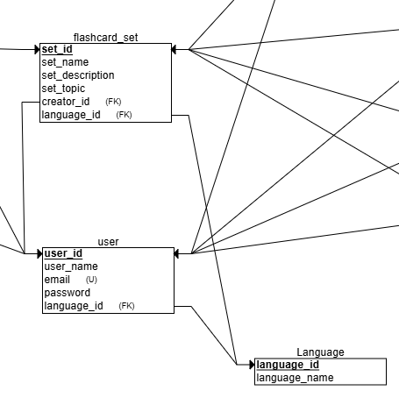
Sprint 5 Review
Sprint 1 Review
Project: Super Flash - Online flashcard system for study
Database Localization
Add field language in FlashcardSets table

Slide 4
Sprint 5 Review
Sprint 1 Review
Project: Super Flash - Online flashcard system for study
Individual Contributions
Tasks Assigned | Team Member | Time Spent (hrs)
Update product Backlog | Nhi Dinh | 2
Identify Translatable Content | Tu Dinh | 10
Set up Resource Bundles | Kim Tran | 2
Set up Localization Strategy | Nhi Dinh | 5
DB schema changes | Nhi Dinh | 2
Implement Choose Preferred Language Feature | Kim Tran | 10
UI localization for main pages | Nhi Dinh, Tu Dinh, Kim Tran | 17
Sprint planning and sprint report | Nhi Dinh | 5
Nhi Dinh: 31h Tu Dinh: 27h Kim Tran: 29h

Slide 5
Sprint 5 Review
Sprint 1 Review
Project: Super Flash - Online flashcard system for study
Sprint 6 Planning
Codebase Updates & Refactoring
Modify database schema to follow the new localization structure.
Update codebase to support localized database queries.
Unit & Integration Testing
Modify and update unit tests to align with the new database structure.
Run integration tests to ensure UI localization works correctly.
UI/UX Finalization
Final review of UI localization for consistency across all languages.
Fix any remaining UI/UX bugs related to localization.

