Slide 1

START
Nhi Dinh
Tu Dinh
Kim Tran

Slide 2





SuperFlash
Flashcard-based learning platform for students and teachers
Key Features:
Create, review, and organize flashcards.
Study with tools like flipping, shuffling.
Quiz mode for self-assessment.
Classroom management for teachers to assign sets and track progress.

Slide 3
Applied AI, GitHub, and Trello
Use of AI: ChatGPT, Copilot
Review organize user stories and research new technology
GitHub link
Trello link

Slide 4
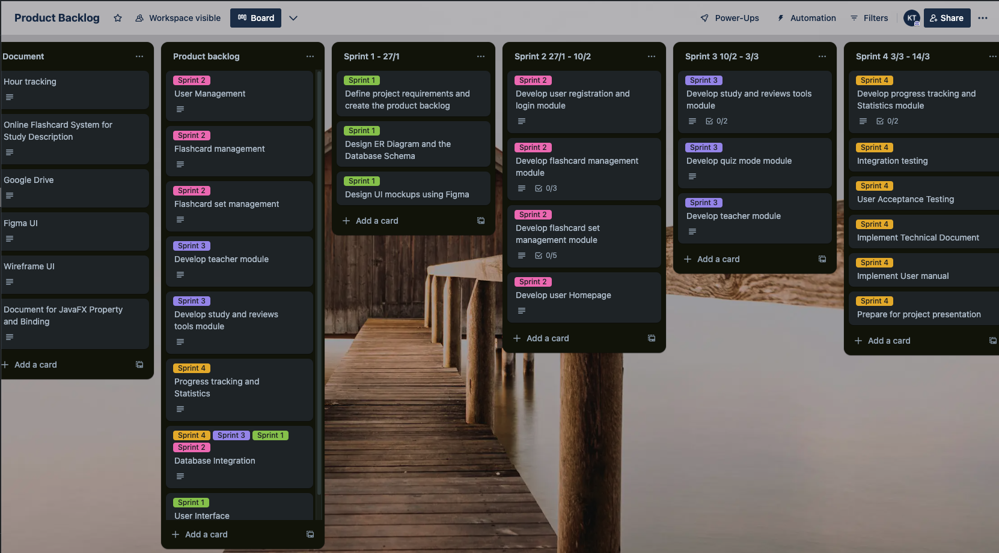
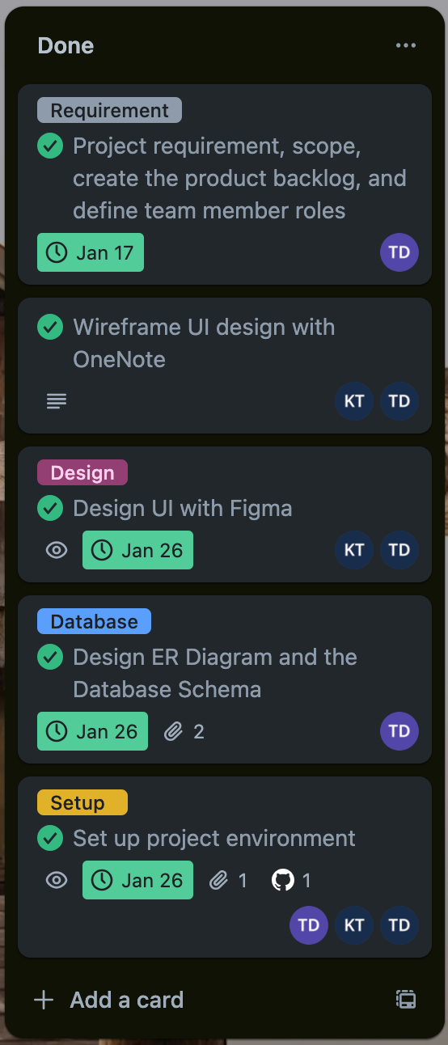
Product Backlog
Use of AI: ChatGPT, Copilot
Review organize user stories and research new technology
GitHub link
Trello link

Slide 5
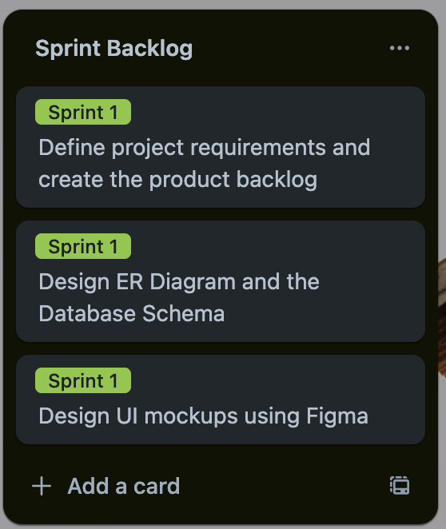
Sprint 1
Scrum Master: Nhi Dinh
Sprint Backlog: Planning and Design tasks
Done: All tasks
Postpone: None
Testing: None

Slide 6
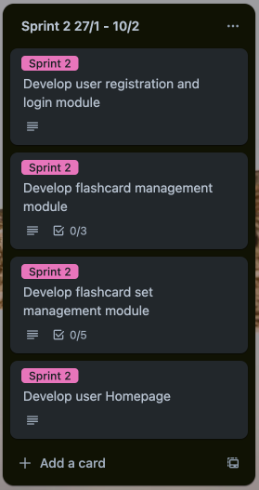
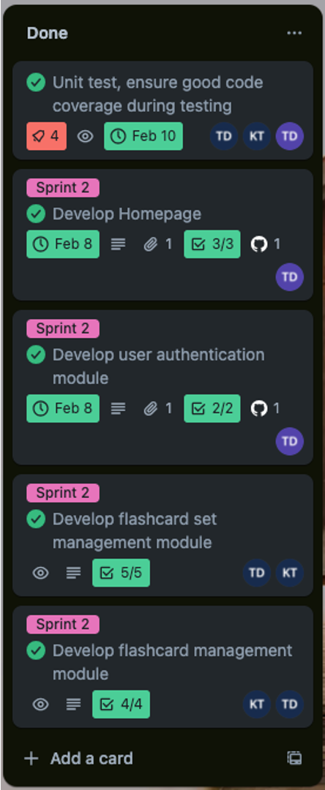
Sprint 2
Scrum Master: Tu Dinh
Sprint Backlog: 4 main tasks + Testing
Done: All tasks
Postpone: None
Testing: 182 test cases

Slide 7
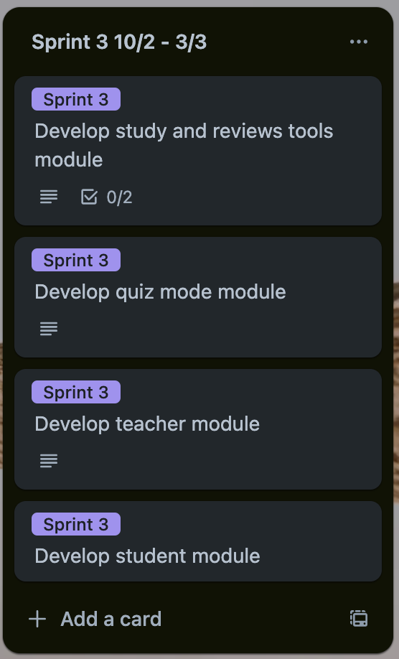
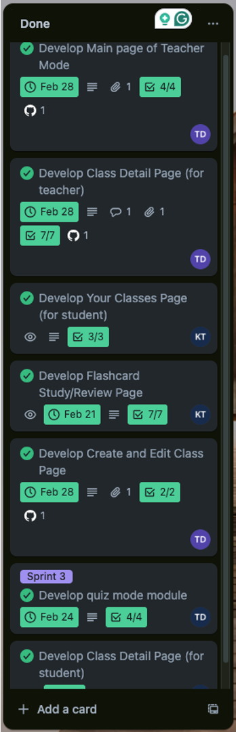
Sprint 3
Scrum Master: Kim Tran
Sprint Backlog: 4 main tasks + Testing
Done: All tasks
Postpone: None
Testing: 245 test cases

Slide 8
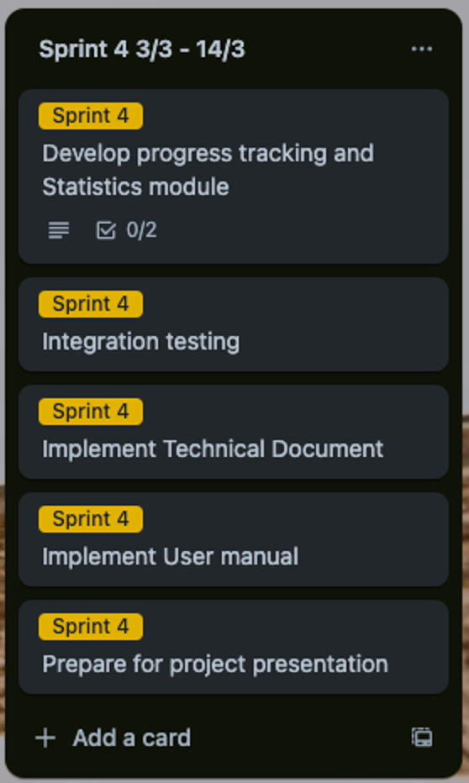
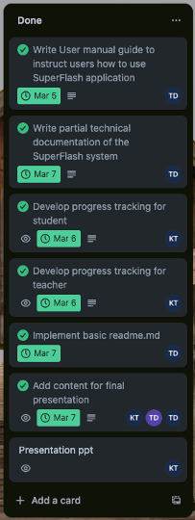
Sprint 4
Scrum Master: Kim Tran
Sprint Backlog: 4 main tasks + Testing
Done: All tasks
Postpone: None
Testing: 256 test cases

Slide 9
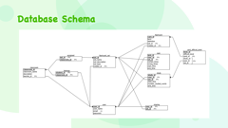
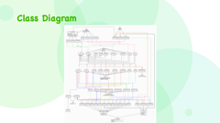
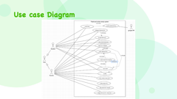
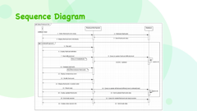
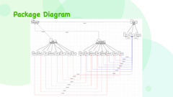
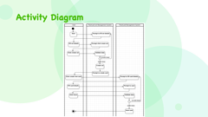
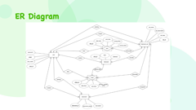
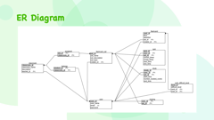
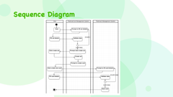
Architectural Design
1

Slide 10
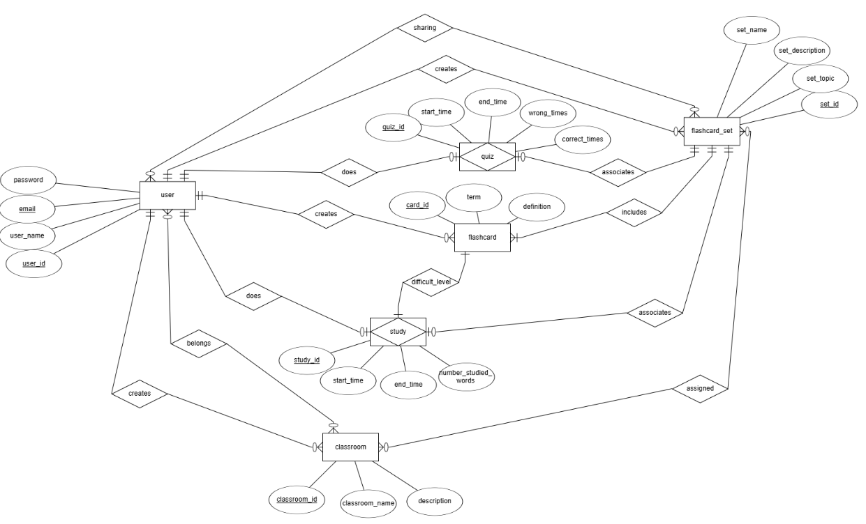
ER Diagram
1

Slide 11
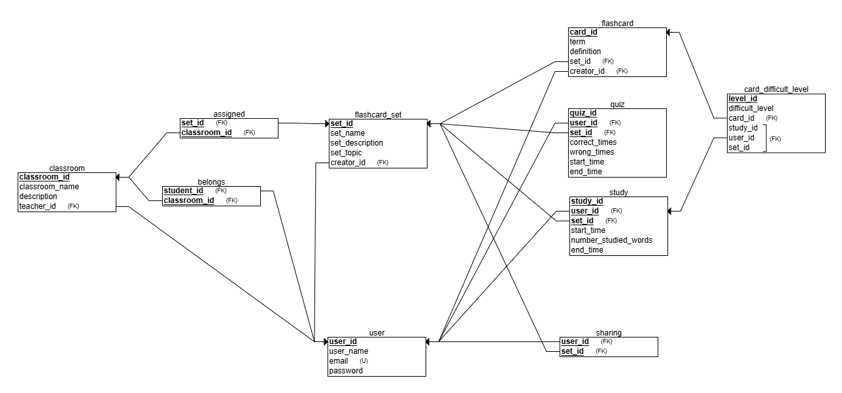
Database Schema
1

Slide 12
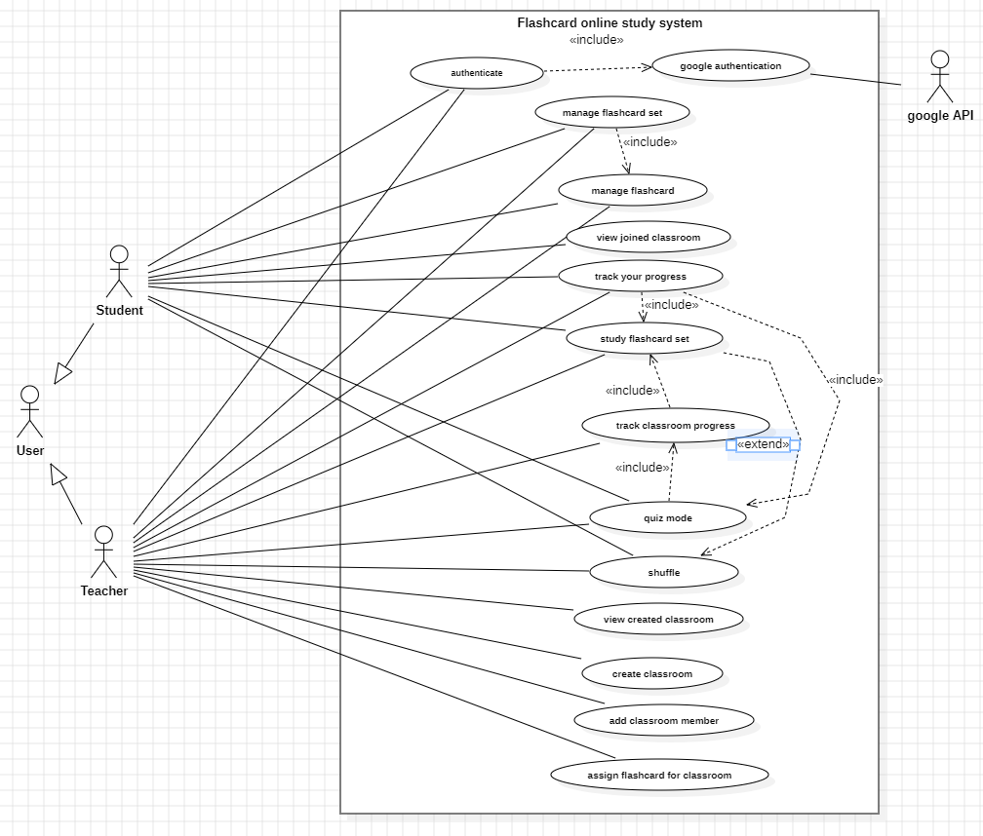
Use case Diagram
1

Slide 13
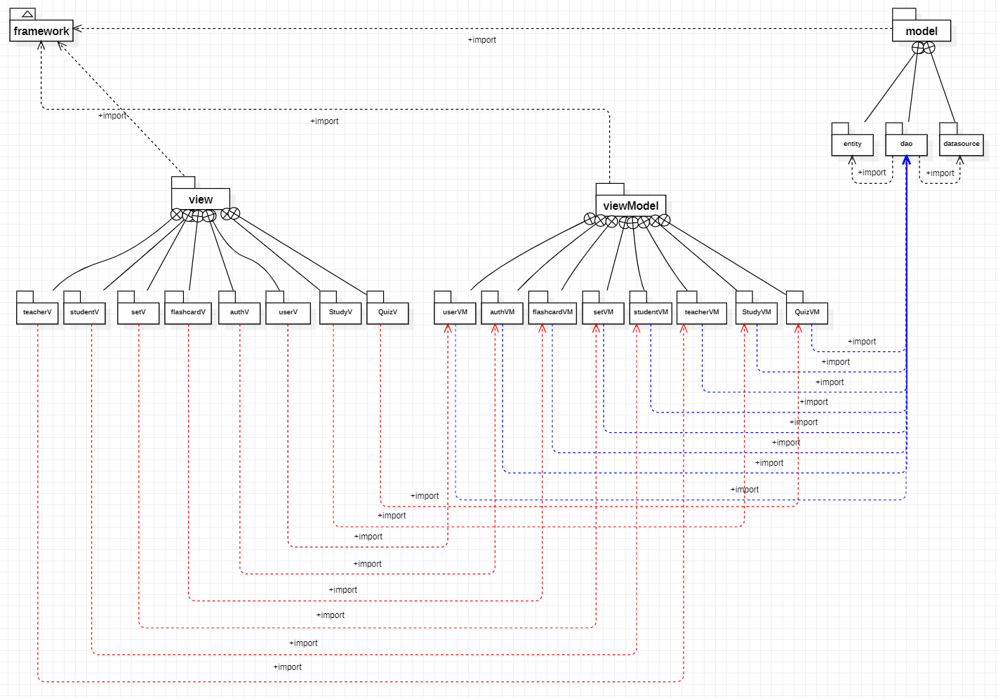
Package Diagram
1

Slide 14
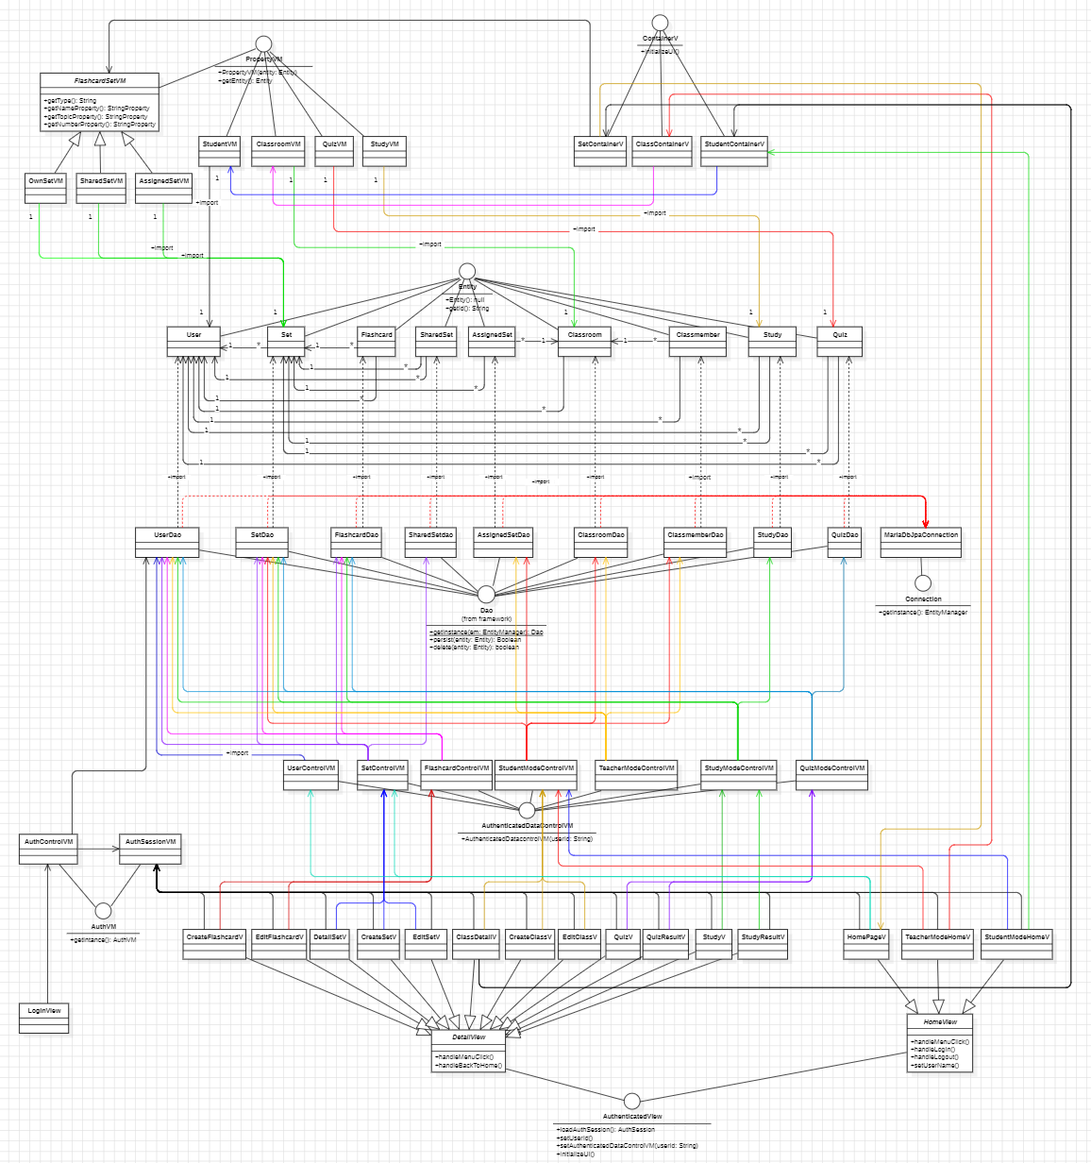
Class Diagram
1

Slide 15
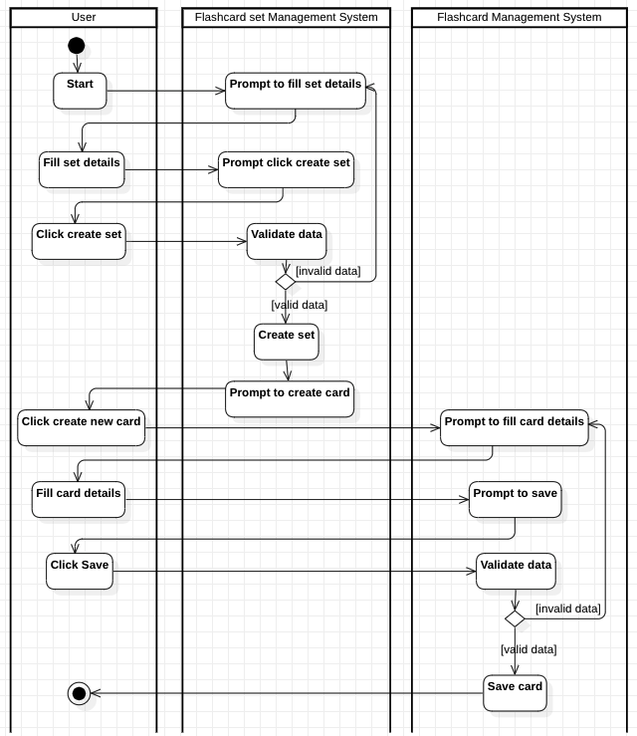
Activity Diagram
1

Slide 16
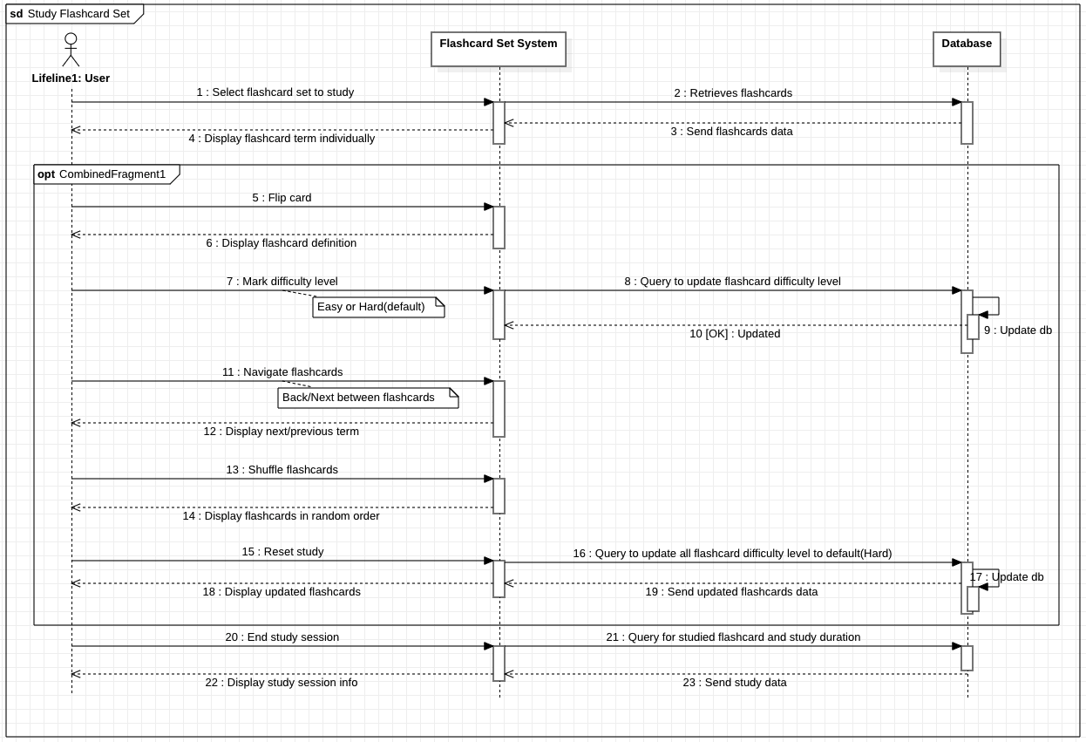
Sequence Diagram
1

Slide 17
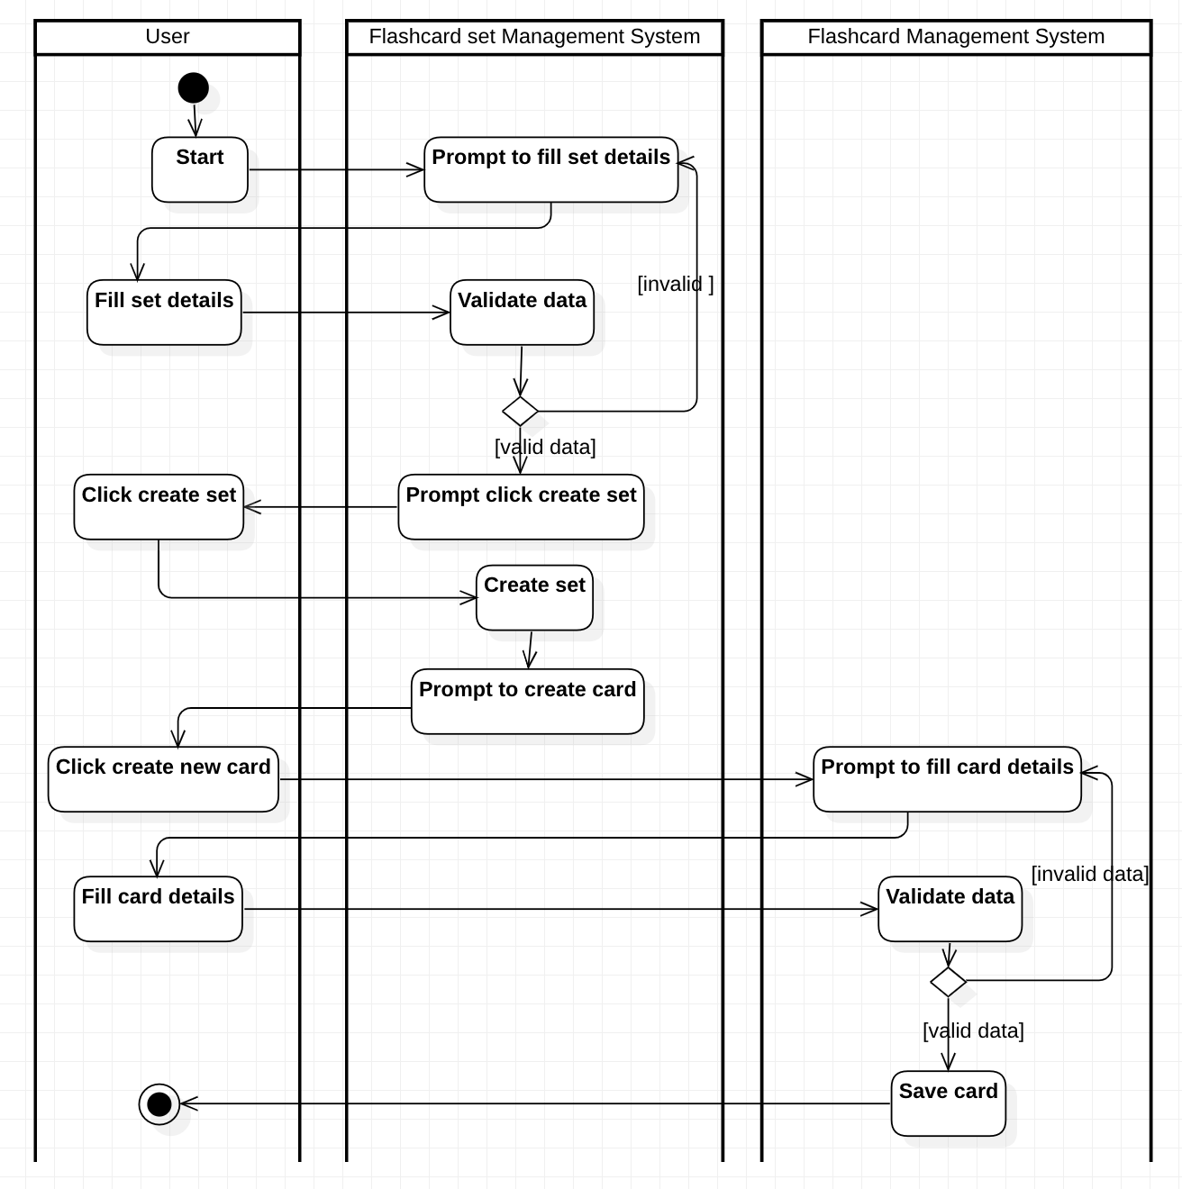
Applied Technologies
Architectural pattern: MVVM
Using JavaBeans API ( properties binding) for MVVM
Programming language: Java
Java UI framework: JavaFX
Database: MariaDB
Interaction with Database: Hibernate - A java ORM framework of JPA
Authentication with Google API using OAuth2.0

Slide 18

Demo
1

Slide 19


Learning achievement
Technical Skills Developed
MVVM Pattern: Improved separation of concerns, enhancing code maintainability and scalability.
JUnit Testing: Strengthened ability to write and execute unit tests for reliable code.
Strengthened ability to design and develop a full-fledged Java-based application.
Learned the importance of test-driven development (TDD) in building robust applications.
Agile Methodology & Teamwork
Learned to prioritize tasks using Agile principles, ensuring efficiency and adaptability.
Improved communication and collaboration through regular sprint reviews and retrospectives.

Slide 20
Plan for further development
Enhancing Flashcard Intelligence
External API integration: refine multiple-choice answer quality,intelligent flashcard generation.
UI/UX Enhancements
Cross-Platform Support: Expand to mobile and web versions for broader accessibility.
Agile Development & User Feedback
Continuous Iterations: Follow Agile methodology to refine features based on user feedback (User Acceptance Testing).

Slide 21

THANK YOU!
Enhancing Flashcard Intelligence
External API integration: refine multiple-choice answer quality,intelligent flashcard generation.
UI/UX Enhancements
Cross-Platform Support: Expand to mobile and web versions for broader accessibility.
Agile Development & User Feedback
Continuous Iterations: Follow Agile methodology to refine features based on user feedback (User Acceptance Testing).

