Slide 1

Sprint 3 Review
Sprint 1 Review
Project: Super Flash - Online Flashcard System
Group 1
Nhi Dinh
Tu Dinh
Kim Tran-Do

Slide 2
Sprint 3 – Tasks breakdown
Sprint 1 Review
Super Flash - Online Flashcard System
Study and Review Module (Kim):
Implement flip, shuffle, reset, difficulty classification and display result
Quiz Module (Tu):
Generate quizzes, verify answers and display result
Teacher Module (Nhi):
Teacher’s Main Page: Display list of classes, navigation to Teacher’s Class Detail Page and Edit Class Page
Teacher’s Class Detail Page: Display list of assigned flashcard sets and students, implement add/remove Student and assign/remove Flashcard Functionality
Create and Edit Class Page: Implement create and edit class functionality
Student Module (Tu & Kim):
Student’s Class Page: Display list of attended classes, navigation to Student’s Class Detail Page
Student’s Class Detail Page: Display all added flashcard sets of the class, navigation to Study/Quiz for each set
Jenkins and Docker Deployment (Nhi):
Implement Jenkinsfile and Dockerfile for Super Flash project
Unit Testing and Test Coverage (Everyone):
Implement unit tests for all major features to ensure stability and maintainability

Slide 3
Sprint 3 – Timeline and total working hours
Sprint 1 Review
Super Flash - Online Flashcard System
Time and event | Description
11.2.2025 - Sprint Kickoff | Summarize results from Sprint 2 Clarify sprint 3 requirements
24.02.2025 - Mid Sprint Review | Present the progress and conduct code review Gather feedbacks from peers and resolve challenges
02.03.2025 - Tasks completion deadline | Complete the assigned tasks Conduct unit testing
03.03.2025 - End of Sprint Meeting | Conduct second code review Review unit test results and ensure adequate test coverage Conduct integration tests for all features Prepare for sprint 4
Total working hours:
Nhi Dinh: ? hours
Tu Dinh: ? hours
Kim Tran: 48 hours

Slide 4
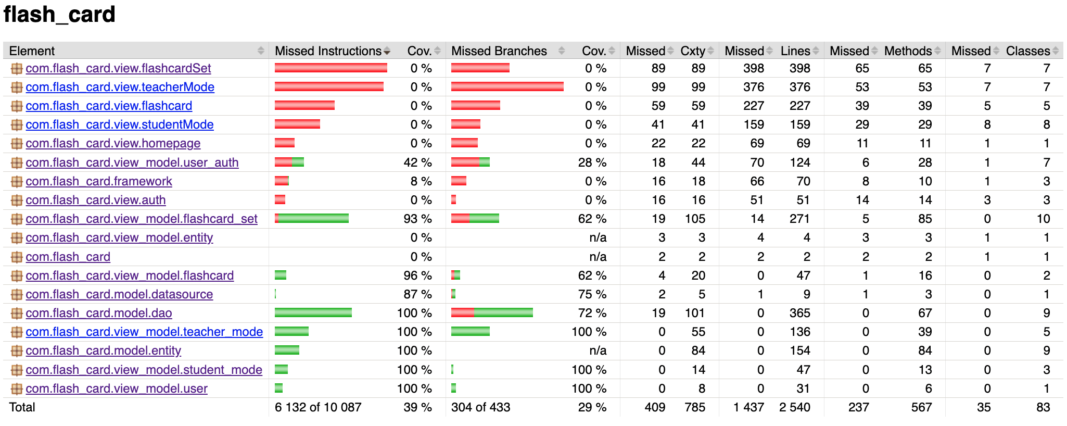
Sprint 3 –Test Coverage
Sprint 1 Review
Super Flash - Online Flashcard System
Test coverage result:
Test cases: 245 cases

Slide 5
Sprint 3 – Challenges and solutions
Sprint 1 Review
Super Flash - Online Flashcard System
Challenges:
Underestimating task complexity and overlooking many sub tasks.
Solutions:
Identified the issue early and distributed sub-tasks to balance the workload.

Slide 6
Sprint 3 – Overview
Sprint 1 Review
Super Flash - Online Flashcard System
All tasks completed within the planned timeline
Integration testing to ensure the app ran smoothly and without errors
No AI tool

Slide 7
Sprint 4 - Plan
Sprint 1 Review
Super Flash - Online Flashcard System
App deployment - Nhi
Implement progress tracking for Student and Teacher -Kim
Implement User Manual and Technical Document - Tu
Timeline: 03/03-10/03 (7 days)

Slide 8

Sprint 1 Review
Sprint 1 Review
Project: Super Flash - Online flashcard system for study
Thank you for listening to our team!

