Slide 1
Phishing Awareness Training
Understanding, Identifying and Preventing Phishing Attacks
Mitul Jith
CodeAlpha Cyber Security Internship

Slide 2
What is Phishing?
Phishing is a cyberattack where attackers impersonate trusted entities
to steal sensitive information.
Key Characteristics:
Pretends to be a trusted source
Creates urgency or fear
Requests sensitive information
Uses deceptive links or attachments
Manipulates human behavior

Slide 3
Why Phishing is Dangerous
For Individuals
Financial Loss
Identity Theft
Credential Theft
For Organizations
Data Breaches
Reputation Damage
Financial Impact
Why Attackers Like Phishing
Low Cost
Targets Human Behavior
Easy to Scale

Slide 4
How Attackers Trick Victims
Common Social Engineering Techniques
Urgency
Fear
Authority
Curiosity
Rewards
Attack Process
Create a convincing message
Gain the victim's trust
Trigger an emotional response
Steal information or credentials

Slide 5
Common Types of Phishing
Email Phishing
Fraudulent emails sent to many users
Spear Phishing
Targeted attacks against specific individuals
Whaling
Attacks targeting executives and managers
Smishing
Phishing through SMS messages
Vishing
Phishing through phone calls

Slide 6
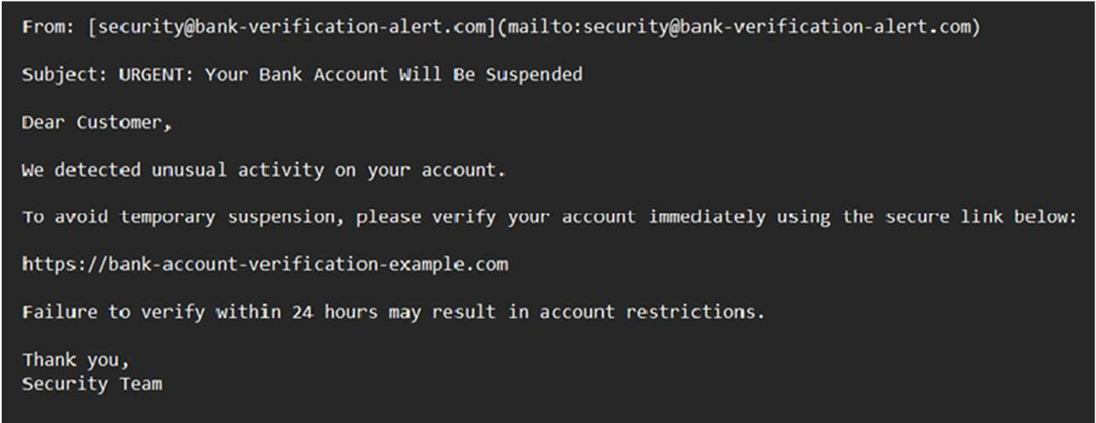
Anatomy of a Phishing Email
Warning Signs
Generic Greeting
Urgent Language
Suspicious Sender
Suspicious Links
Unexpected Attachments

Slide 7
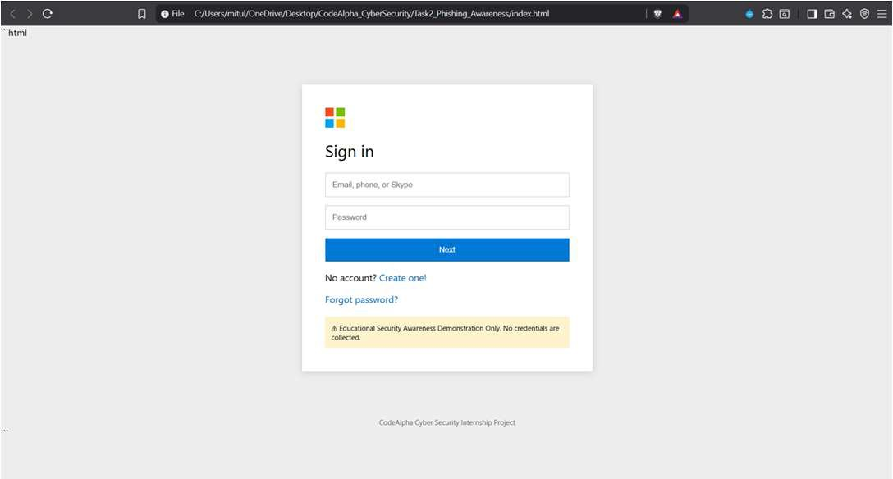
Fake Websites and Login Pages
Warning Signs
Looks similar to legitimate websites
Requests credentials
Uses suspicious URLs
Designed to steal information
Educational Demonstration Only

Slide 8
Real-World Phishing Examples
Bank Scam
Microsoft Scam
Delivery Scam
Fake account verification
Creates urgency
Requests credentials
Password expiry warning
Fake login page
Credential theft attempt
Fake package notification
Delivery reschedule lure
Suspicious links

Slide 9
How to Identify Phishing Attempts
✓ Verify sender address
✓ Inspect URLs carefully
✓ Avoid unexpected attachments
✓ Be cautious of urgent requests
✓ Verify through official channels
✓ Check grammar and spelling

Slide 10
Best Security Practices
Organizational Security Practices
Personal Security Practices
Conduct regular security awareness
Enable Multi-Factor Authentication (MFA)
training
Use strong and unique passwords
Implement email filtering solutions
Keep software and systems updated
Establish incident reporting procedures
Avoid clicking unknown links
Apply least privilege access control
Verify website URLs before login
Perform regular security audits
Never share passwords or OTPs
Maintain data backups
Use password managers
Enforce password policies
Report suspicious emails immediately
Monitor suspicious activities

Slide 11
Interactive Quiz
Question 1
Question 2
Question 3
An email says your account will be suspended within 1 hour and asks you to click a link immediately.
What should you do before clicking a link in an email?
What does MFA stand for?
Click immediately
Verify the URL
Multi-Factor Authentication
Multiple File Access
Safe
Suspicious
Answers: 1-B, 2-B, 3-A

Slide 12
Conclusion
Key Takeaways
Phishing targets human behavior
Attackers use urgency and deception
Always verify emails, links, and requests
Security awareness reduces risk
Small precautions prevent major incidents
Think Before You Click
Awareness is the First Line of Defense

