Slide 1
UNIT 5
App Implementation
in the Cloud
Cloud Computing • Virtual Machines • Docker • Kubernetes
Full Stack Development

Slide 2

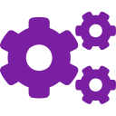




What You Will Learn in Unit 5
By the end of this unit, you will be able to:
Cloud Basics
Kubernetes
Understand what cloud computing is and how it helps developers host websites and apps online.
Understand how Kubernetes automatically manages and scales many Docker containers.
Virtual Machines
Scaling
Learn what virtual machines and virtual networks are, and how they work like a computer inside a computer.
Learn horizontal and vertical scaling to handle more users without breaking your application.
Docker
Deploy to Cloud
Use Docker to package your app into containers so it runs the same on every computer.
Deploy a full-stack app to the cloud and understand how real websites go live on the internet.

Slide 3
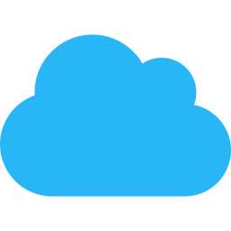
☁ What is Cloud Computing?
💡 Analogy: Think of cloud computing like electricity from the power grid. You don't build your own power plant — you just plug in and pay for what you use. Similarly, the cloud lets you use someone else's powerful computers over the internet!
Imagine you are writing an important file and you save it on Google Drive — not on your own computer. You can open that file from your phone, laptop, or a friend's computer. This is the basic idea of cloud computing. Instead of keeping everything on your personal machine, you store and run things on powerful computers owned by big companies — accessible through the internet.
☁ Cloud = Internet Servers
🖥 AWS (Amazon)
🌍 Real-Life Cloud Examples
🔷 Microsoft Azure
📧 Gmail – Your emails are stored in Google's cloud servers
🌐 Google Cloud (GCP)
🎵 Spotify / YouTube – Music and videos streamed from the cloud
🔸 IBM Cloud
📁 Google Drive / Dropbox – Files saved and shared online
🛒 Amazon / Flipkart – Websites hosted on cloud (AWS / Azure)
📦 DigitalOcean

Slide 4
☁ Types of Cloud
🌐 Public Cloud
🏢 Private Cloud
🔀 Hybrid Cloud
e.g. AWS, Google Cloud
e.g. Company Datacenters
e.g. Mix of both
A public cloud is like a shared apartment building — many people live there, but each person has their own private space. Big companies (AWS, Google, Microsoft) own the servers and you rent them. It is cheap, easy to use, and great for most apps.
A private cloud is like owning your own house. The company builds and manages its own cloud servers. Only that company uses those servers. This is very secure but very expensive. Banks and hospitals often use private clouds to protect sensitive data.
A hybrid cloud is like living in your own house but also renting a hotel room when guests come. You use your private cloud for important/secure data, and the public cloud for extra capacity. This gives you the best of both worlds.
Example: Netflix runs on AWS — you stream videos, but Netflix doesn't own the physical servers!
Example: A hospital stores patient records on its own private cloud so nobody else can access it.
Example: A company keeps employee salaries on a private cloud, but hosts its public website on AWS.

Slide 5




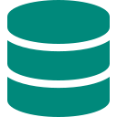
🌟 Advantages of Cloud Computing
Cost Saving 💰
Security & Backup 🔒
You don't need to buy expensive servers or hardware. You only pay for what you actually use — like paying your electricity bill only for the power you consume. This is very helpful for small businesses and students.
Cloud providers keep your data safe with multiple backups. Even if one server fails, your data is safe on another server. They have teams of experts protecting your data around the clock.
Access from Anywhere 🌍
Automatic Updates ♻
Your app or data is available 24/7 from any device with internet. A student in Surat can access their project hosted on a cloud server in the USA without any problem!
The cloud provider handles all software updates and maintenance. You don't need to worry about upgrading servers or fixing hardware. This saves a lot of time for developers.
Easy Scaling 📈
Flexible Storage 📦
If 10 people visit your website, you need less power. If 10,000 people visit, you need more. Cloud lets you scale up or down instantly — no need to buy new hardware.
You can store any amount of data — from a few files to terabytes of data. You can increase storage in seconds with just a few clicks — no need to buy a new hard drive.

Slide 6
🖥 Virtual Machines, Ethernet & Switches
🖥 What is a Virtual Machine (VM)?
🌐 Virtual Private Cloud (VPC)
& Ethernet
A Virtual Machine is like having a computer inside your computer. Imagine one powerful physical server running 5 separate fake computers inside it — each running its own operating system and apps, completely isolated from each other. This is called virtualization.
Ethernet connects computers in a local network — like the cables in your college lab. In the cloud, virtual Ethernet does the same thing digitally.
A Virtual Private Cloud (VPC) is your own private section inside a public cloud. It's like renting a private room in a big hotel — you share the building, but your room is yours only.
Switches manage and direct traffic between computers in a network — like a traffic signal for data packets.
VM Architecture
Physical Server Hardware (Real Computer)
Hypervisor (Virtual Machine Manager)
VM 1
OS + App
VM 2
OS + App
VM 3
OS + App

Slide 7
📈 Scaling: Horizontal & Vertical
Scaling means increasing the power of your system when more users visit your website. Imagine your app is a shop — when more customers come, you either make the shop bigger (vertical) or open more branches (horizontal).
⬆ Vertical Scaling (Scale Up)
➡ Horizontal Scaling (Scale Out)
Big
Server
16 CPU
64 GB
Small
Server
2 CPU
4 GB
Server 1
Server 2
Server 3
➡
➕ Add More
You upgrade the same server — add more RAM, CPU, or storage to make it faster.
✅ Simple to do
✅ No code changes needed
❌ Has a limit — you can't upgrade forever
❌ More expensive at high levels
You add more servers (clones of the same server) to handle more requests. A load balancer divides work equally.
✅ Can scale to millions of users
✅ If one server fails, others continue
❌ More complex to set up
❌ Code must be written to support this

Slide 8
Docker

Slide 9
Problems Without Docker
The most famous developer problem: "It works on my machine!" — but breaks on the server. Sound familiar?
💻 Different Operating Systems
🔧 Manual Setup is Error-Prone
A developer uses Windows, but the server runs Linux. The same code may behave differently or crash completely. There's no easy way to make sure the environment is the same.
Setting up a new server requires installing many tools one by one. Even a small mistake (wrong version, wrong config) can break everything. This is frustrating and time-consuming.
📦 Missing Dependencies
👥 Team Conflicts
Your app needs a specific library (e.g., Node.js 18). But the server has Node.js 14. Installing the right version takes time and can break other apps already running on that server.
Three developers on the same team may have different versions of Python, different OS settings, different databases. Code that works for one person may fail for another — causing confusion.

Slide 10

🐳 What is Docker?
Docker is a tool that packages your application along with everything it needs — the code, libraries, settings, and even the operating system — into a single unit called a Container. This container runs the same on every computer, whether it's your laptop, your teammate's laptop, or a cloud server. Docker solves the "it works on my machine" problem!
Docker
🐳 Key Facts About Docker
Created in 2013 • Written in Go language • Used by companies like Google, Netflix, Uber
📦 Container
🖼 Image
📋 Dockerfile
🎯 Why Docker?
🛒 Docker Hub (Registry)
✅ Runs the same everywhere — no environment issues
✅ Start a full app (code + database) with one command
🐙 Docker Compose
✅ Lightweight — containers start in seconds, not minutes
Notes:
📦 Analogy: Think of Docker like a Tiffin Box (lunch box). Your mom packs dal, rice, and sabzi in separate compartments so nothing mixes. Docker packages your app + all its requirements into one tidy box — ready to open anywhere!

Slide 11
🐳 Docker Concepts: Image vs Container
🖼 Docker IMAGE
📦 Docker CONTAINER
A Docker Image is a file made up of multiple layers that contains the instructions to build and run a Docker container. It acts as an executable package that includes everything needed to run an application code, runtime, libraries, environment variables, and configurations.
An Image is like a BLUEPRINT. It contains all the instructions needed to create a container — which OS to use, which libraries to install, which code to include.
Images are read-only — you cannot change them directly. You can only use them to create containers.
You can share images on Docker Hub (like GitHub for Docker images). Anyone can download your image and run it instantly.
Docker Image = Blueprint (static, read only).
A Docker Container is a lightweight, runnable instance of a Docker Image. It packages the application code together with all its dependencies and runs it in an isolated environment. Containers allow applications to run quickly and consistently across different environments — whether on a developer’s laptop, test servers, or production.
Containers share the host OS instead of having their own, making them start much faster than VMs.
You can run multiple containers from the same image simultaneously — like baking multiple cakes from one recipe.
Docker Container = Live instance of that blueprint (dynamic, executable)

Slide 12
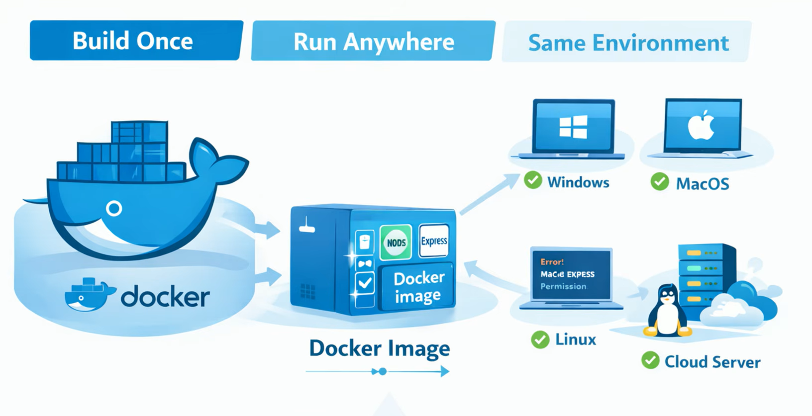

Slide 13
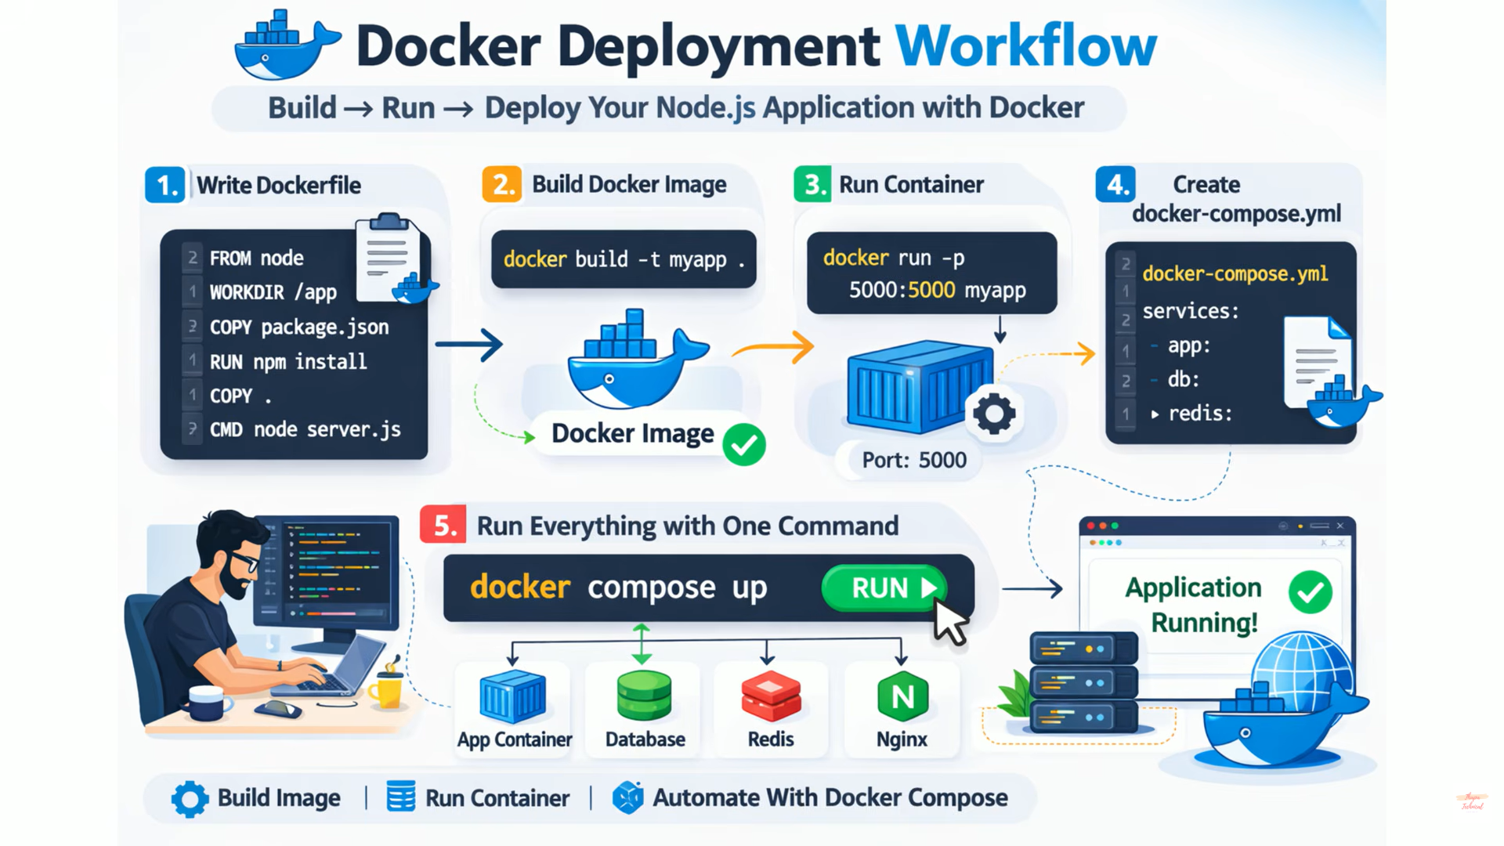

Slide 14
🔄 Basic Docker Workflow: Build → Run → Share
1
2
3
4
Write Dockerfile
Build the Image
Run a Container
Share on Docker Hub
FROM node:18
WORKDIR /app
COPY . .
RUN npm install
CMD ["node","index.js"]
docker build -t myapp .
Building 5/5 layers...
Successfully built abc123
docker run -p 3000:3000 myapp
🚀 Server running on port 3000
docker push myusername/myapp
Pushing image to Docker Hub...
✅ Done! Public image available
→
→
→
The Dockerfile is a text file with instructions. It tells Docker: "Start with Node.js, copy my code, install packages, and run it.
Run the build command and Docker reads your Dockerfile and creates an Image — a frozen, ready-to-use snapshot of your app with all its files and settings packed inside.
Docker creates a live Container from your Image and starts it. Your app is now running! The -p flag connects the container's port to your computer's port.
Push your image to Docker Hub (a free registry). Now anyone in the world can download your image with one command and run your app in seconds!

Slide 15
🐳 Docker Basic Commands?
Command
docker --version | Shows installed Docker version
docker pull node, docker pull mysql | Pull an image from Docker Hub
docker images | View downloaded images
docker run nginx | Run a container
docker run -d nginx | -d = detached mode (background)
docker run -d --name mynginx nginx | --name gives custom container name
docker run -d -p 8080:80 nginx | Connect container port to your machine.

Slide 16
🐳 Docker Basic Commands?
Command
docker ps | Shows only running containers.
docker ps -a | See all containers
docker stop container_id / docker stop mynginx | Stop container
docker start mynginx | Start stopped container
docker restart mynginx | Restart container
docker rm mynginx | Remove container
docker rmi nginx | Remove image

Slide 17
🐳 Docker Basic Commands with Dockerfile?
Command
docker build -t myapp . | Build image from Dockerfile
docker run -d -p 3000:3000 myapp | Run your built image -d means run in background -p means connect your system port to container port
docker compose up -d --build | Start everything using one command

Slide 18
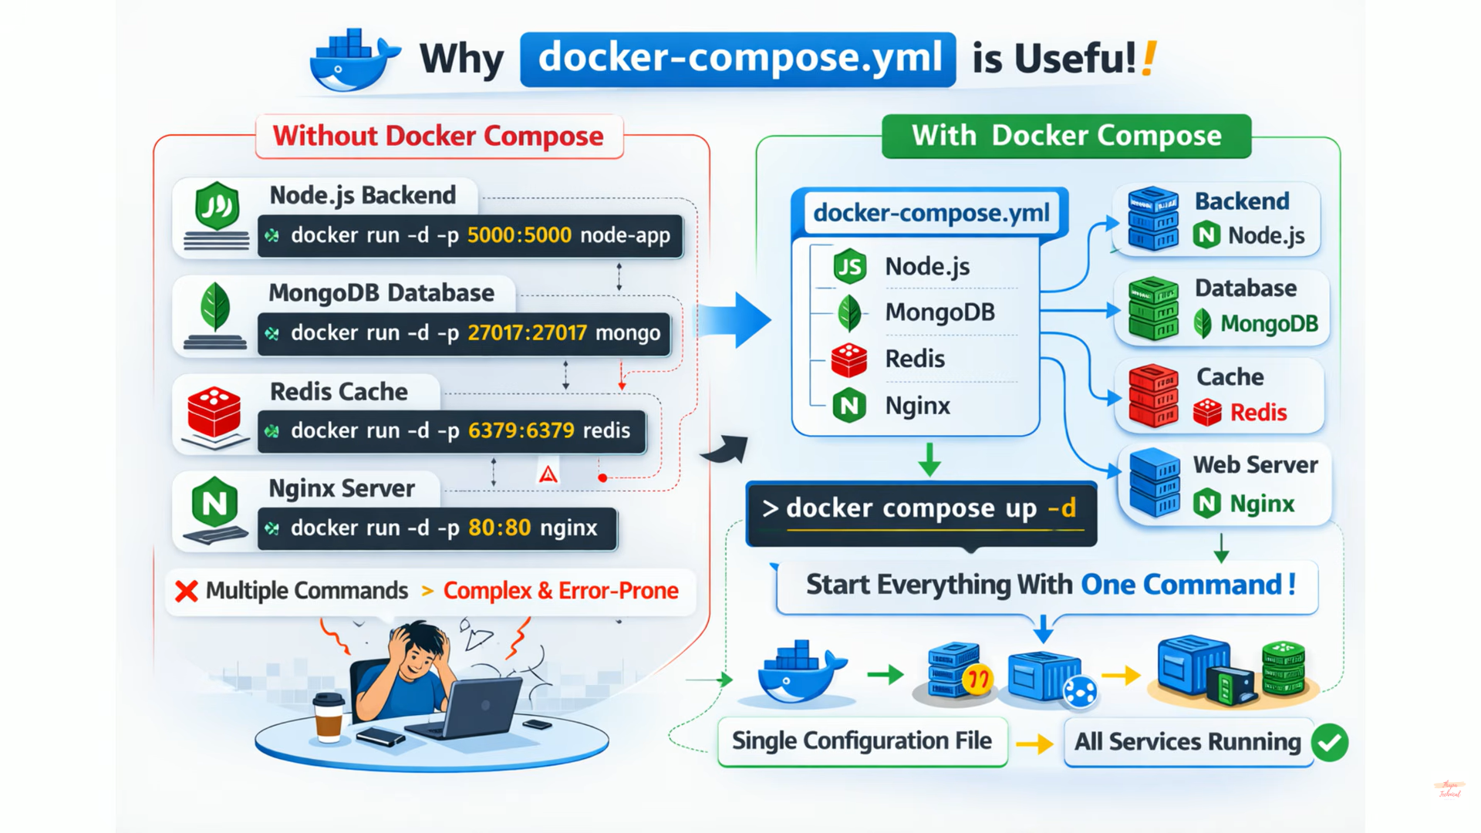

Slide 19
🐳 What is Docker Compose?
docker-compose.yml:
services:
app:
build:
context: .
dockerfile: Dockerfile
restart: unless-stopped
ports:
- "8082:5000"
In a typical setup, services like a web server, backend API, database, and cache run in separate containers.
Compose allows you to configure and manage them together as a single application using one docker-compose.yml file.

Slide 20
⚙ What is Kubernetes?
💡 Analogy: Imagine you run a restaurant chain with 100 branches. Kubernetes is like the central manager who automatically assigns staff, opens new branches when there are more customers, and closes branches when it's quiet — all without you having to do anything manually!
⚙ K8s Key Terms
Pod
Smallest unit — one or more containers
Kubernetes (also called K8s) is an open-source system that automatically manages containers. When you have an app running in many Docker containers, Kubernetes decides where to run them, keeps them healthy, scales them up when traffic increases, and restarts them if they crash. It is like a smart autopilot for your containers.
Node
A physical or virtual server
Cluster
Group of nodes working together
⚖ Load Balancing
🔁 Auto-Restart
Deployment
Defines how many Pods to run
Distributes traffic equally across all running containers.
If a container crashes, K8s restarts it automatically.
Service
Exposes your app to the world
📈 Auto-Scaling
🔄 Rolling Updates
Adds more containers when user traffic increases.
Update your app with zero downtime — no service interruption.

Slide 21
⚙ Why Do We Need Kubernetes?
Imagine your website gets 1,000 visitors one hour, then 100,000 visitors the next hour! Without Kubernetes, you would have to manually start more Docker containers. Kubernetes handles this automatically — it watches your containers and takes action on its own.
🚦 Managing Many Containers
🛡 Fault Tolerance (Self-Healing)
A production app can have hundreds of Docker containers running at once. Keeping track of them all manually is impossible. Kubernetes acts like a conductor — it knows where every container is and what it's doing.
If a container crashes (e.g., due to a bug or server failure), Kubernetes immediately replaces it with a fresh one. Your app stays running 24/7 even if individual parts fail.
📈 Auto-Scaling (Smart Resizing)
🔄 Zero-Downtime Deployments
K8s monitors your app's traffic. If too many users arrive, it automatically starts new containers. When traffic drops, it removes extra containers to save money. You only pay for what you use!
When you update your app, Kubernetes slowly replaces old containers with new ones — one at a time. Users never experience an outage during updates. This is called a Rolling Update.

Slide 22
🔍 Cloud vs Docker vs Kubernetes — Side by Side
☁ Cloud Computing
🐳 Docker
⚙ Kubernetes
What it is:
What it is:
What it is:
Renting servers and infrastructure over the internet.
A tool to package your app + all its needs into one portable container.
A system that automatically manages, scales, and maintains your Docker containers.
How it works:
How it works:
How it works:
Use platforms like AWS, Google Cloud, or Microsoft Azure through a browser or API.
Write a Dockerfile, build an Image, run it as a Container on any computer.
Define desired state (e.g., 5 replicas). K8s ensures that state is always maintained.
🏨 Like renting a hotel room. You get a fully equipped room without owning the building.
📦 Like a tiffin box — everything packed. Open it anywhere and the food is ready.
🎛 Like a restaurant manager — assigns tasks, handles busy periods, replaces absent staff.
• Provides: Servers, Storage, Network
• Packages: Code + Libraries + Config
• Manages: Many containers at once
• You pay monthly or per-hour
• Runs the same everywhere
• Auto-scales based on traffic
• Examples: AWS, GCP, Azure
• No 'works on my machine' problem
• Self-heals if containers crash
• Used for: Hosting websites, apps, databases
• Used for: App packaging & deployment
• Used for: Large-scale production apps

Slide 23
🌐 Real-World Example: How a Website Goes Live
How a full-stack app (like an online shopping site) uses Cloud + Docker + Kubernetes together:
👨‍💻 Developer builds the app
☁ Cloud hosts everything
1
4
A developer writes a React frontend and a Node.js backend. They write a Dockerfile to package the entire app.
All of this runs on AWS or Google Cloud servers. The cloud provides VMs, storage, networking — everything needed at scale.
🐳 Docker packages it
📈 Traffic spikes happen
2
5
docker build creates an Image. The image is pushed to Docker Hub. Now the app is ready to run anywhere, consistently.
Suddenly 50,000 users visit! Kubernetes sees high traffic and adds 20 more containers automatically. No action needed from the developer.
⚙ Kubernetes deploys it
✅ Users use the app
3
6
Kubernetes reads the image and starts 5 containers of the app. It sets up load balancing and monitors all containers.
Users get fast, reliable service. If any container crashes, Kubernetes replaces it in seconds. The app is always available!

Slide 24
📝 Unit 5 Summary — What We Learned
Cloud Computing
Docker
☁
✓ Renting powerful internet servers instead of buying them
🐳
✓ Packages app + environment into a container
✓ Types: Public, Private, Hybrid Cloud
✓ Image = blueprint; Container = running instance
✓ Benefits: Cost savings, scaling, accessibility
✓ Solves 'works on my machine' problem permanently
Virtual Machines & Networking
Kubernetes
🖥
✓ VM = a computer inside a computer (virtualization)
⚙
✓ Manages many containers automatically
✓ VPC = your private section inside a public cloud
✓ Auto-scaling, self-healing, load balancing
✓ Ethernet & Switches manage data traffic in networks
✓ Used for large-scale production deployments
Scaling
📈
✓ Vertical Scaling = upgrade same server (more CPU/RAM)
✓ Horizontal Scaling = add more servers (scale out)
✓ Cloud makes scaling easy and affordable

