Slide 1

Got Space? We’ll take it!

Slide 2
International shipping is an expensive, lengthy and archaic process
TAG introduces an innovative, modern and revolutionary solution.

Slide 3
Global Parcel Market
Tourism
$641.9B
$6.42B
3B
Air Traffic
Global Parcel Revenue
Niche Product Revenue
Passengers per Year
Millennials

Slide 4
Who Are We Reaching Out To?
Customers
Travellers
Seeking rare international products
Willing to pay cheaper shipping fees
Willing to make money
Utilize their extra luggage space

Slide 5







Competitors
Long Shipping Time
From Canada to Australia (1-4lb)
UPS = $63.50 – 10 days
FedEx = 245.50 –5 days
Post Canada = $173.86 – 7 days
From Canada to China (1-4lb)
UPS = $61.50 – 5 days
FedEx = 218.31 –4 days
Post Canada = $176.96 – 8 days
Low Prices
High Prices
From Japan to Canada (1-4lb)
Grabr
Japan Post = $56.30 – 7 days
Japan Express = $26.20 – 2 months
From UK to Canada (1-4lb)
Royal Mail = $ $110.72 – 1 day
Short Shipping Time
Notes:
s

Slide 6
Growth Prospects
Sell Data to Determine Trends
Sell Data to Countries Establishing New Trade Relationships
Insurance For More Monetization
Expansion Beyond Canada
Deals Within the Platform
Exclusive Market Data About Exclusive Pop-Up Items
Partnerships

Slide 7
Why Us?

Slide 8
Appendix

Slide 9
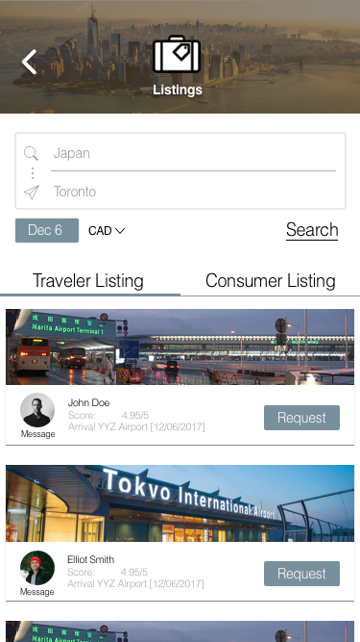
Product Offering
Minimizing International Shipping Costs
Monetizing Excess Luggage Space
Guaranteed Delivery Date
Connecting Customer and Travellers
Access to One-of-a-Kind Products

Slide 10
Process
Customers make an item request, or traveller lists an opening
Traveller puts the item in their luggage and travels overseas
Traveller accepts the request
Traveller purchases the product
Traveller and Customer Meet

Slide 11
Inflows and Outflows
Inflows | Outflows
7.5% Per Transaction | Engineer Cost
Insurance (Potential) | Server and Data Management
Data (Potential) | Marketing Cost
Super Size (Potential) | Legal Team
 | Rent Cost (Potential)

Slide 12
