Slide 1
Designing an Efficient Search Algorithm for Internet of Things (IoT)
Guided By
Dr. Vaskar Raychoudhuray
Prepared By
Shah Mitul Abhaykumar

Slide 2
Internet of Things - What is it?

Slide 3




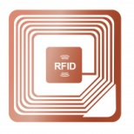

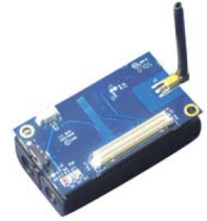











Connect
Everything!
Living
Entities!
RFID
Tags
Internet of Things
Sensor
Motes
QR Code
Everyday Things
Smart Home

Slide 4
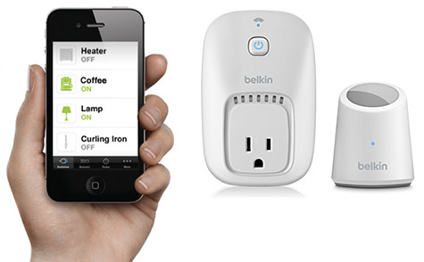
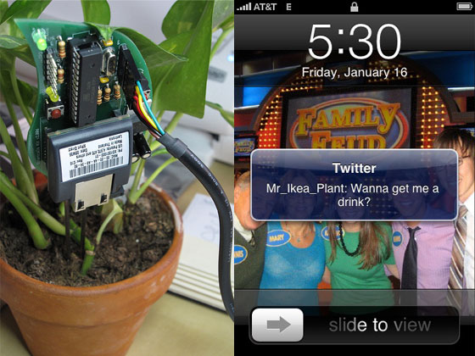
IoT: Products
WEMO: Control your home appliances with motion or a simple smart phone app.
Botanicalls: Plants which talks to their owner when they need water!

Slide 5
Motivation
“The most important objective of technology is to make people’s life better.”
-Anonymous

Slide 6
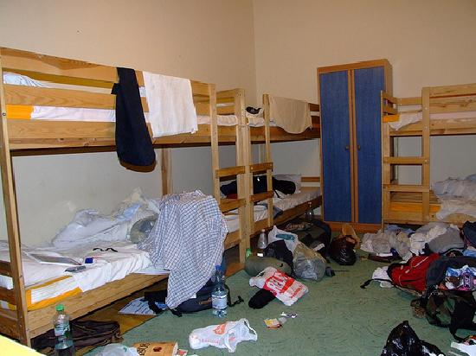
Motivation
THIS!!

Slide 7
Motivation
6,700,000,000
Number of people on earth in 2008.
<
Number of `things’ connected to Internet in 2008!!

Slide 8
Literature Study
Classifications
  Object Search
    Snoogle
    MAX
  Place Search
    Dyser
  Enabling Technologies for IoT
  Description Models

Slide 9
Major Challenges
What makes IoT search difficult than normal web search?

Slide 10
Major Issues
Localized Search
  Unlike web, users want to search for things which are physically ‘near’ to them.
Real-time Nature/Frequent updates
  The most important feature of IoT
  In IoT, the updates are more frequent then traditional web.
    Push Based
    Pull Based

Slide 11
Major Issues
Architecture Design
  Due to high mobility current indexing, crawling and storage techniques wont work.
Scalability
  Billions of sensors and their huge readings + sensor reading posses short life span.
Privacy and Security
  Data is more important then traditional web data e.g. user’s current location.

Slide 12
Proposed Work

Slide 13
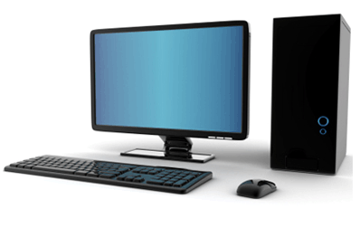

System Architecture
Base Station
Localities representing room of office
Mediator
Level 2
Mediator
Level 2
Localities like cupboard, table
Mediator Level 1
Real-world Entities
Tag
Tag
Tag

Slide 14
Real-Time Updates
Push Approach: Tags keep pushing their details to central node.
Pull Approach: Tags will just reply to keep alive message from central node whenever needed.
Communication Paradigm | Advantages | Disadvantages
Push Based Approach | Faster Search | High n/w traffic, Huge database, Energy inefficient
Pull Based Approach | Energy efficient Less traffic | Slow response to user query

Slide 15

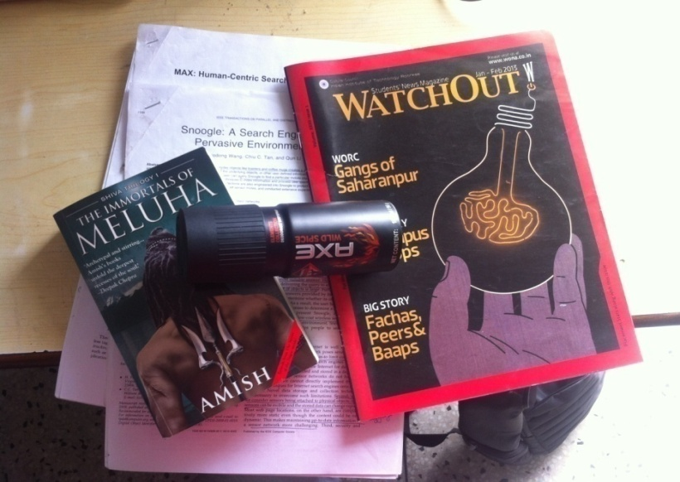
Proposed Hybrid Approach
Hybrid of both push and pull approach
  Push for the items which are misplaced frequently and required in emergency.
  Pull approach for relatively static items.

Slide 16
Proposed Hybrid Approach
Advantages
  Less network traffic as there will small number of items using push approach
  Faster results for the items which are required immediately.
  Small database to maintain at server side.
  Energy efficient approach.

Slide 17
Data Aggregation Algorithm
BS
2
1
10
11
12
13
7
8
9
Consider a building structure like above

Slide 18
Data Aggregation Algorithm
BS
2
1
10
11
12
13
7
8
9
Node 11 wants to send a packet to BS

Slide 19
Data Aggregation Algorithm
BS
2
1
10
11
12
13
7
Transmission Range
8
9
Node 11 will broadcast that packet in its range

Slide 20
Data Aggregation Algorithm
BS
2
1
10
11
12
13
7
8
9
Node 10 and 12 would receive that packet

Slide 21
Data Aggregation Algorithm
BS
2
1
10
11
12
13
7
8
10 < 11 but 12 !< 11
9
So only node 10 will forward it, and 12 will discard

Slide 22
Data Aggregation Algorithm
BS
2
1
10
11
12
13
7
8
9
Data finally reached at Base Station

Slide 23

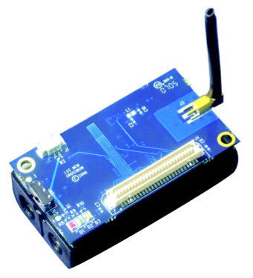
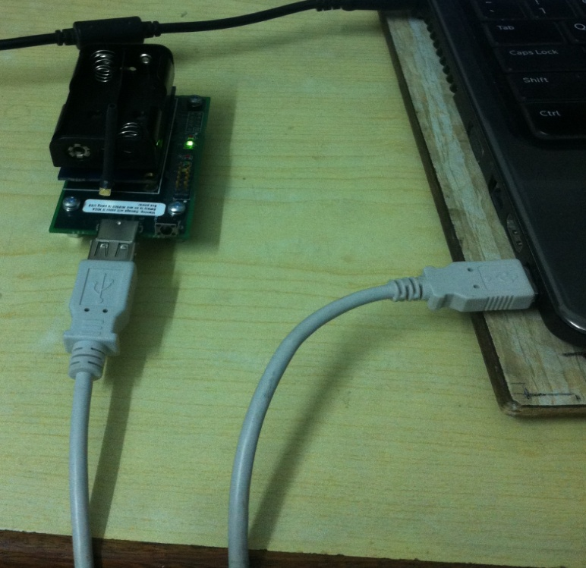
Implementation Details
IRIS Mote
Base Station

Slide 24
Implementation Details
System Modules
  Tags
    Items which keep broadcasting their location (Push)
    Items which will respond to only user queries (Pull)
  Mediators
    Used to pass data from Tags to BS and vice-versa
  Base Station
    Network sink, which collects whole n/w data.
    Provides query interface and shows results.

Slide 25
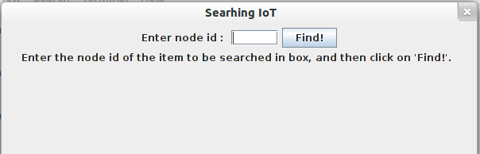
System Operation
Query Interface
Enter node id of the item to be found.

Slide 26
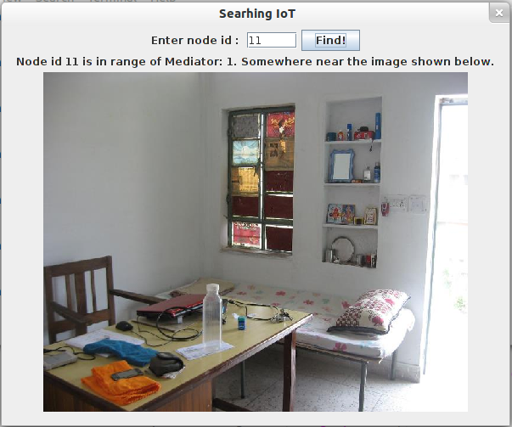
System Operation
Results are displayed with the help of preloaded image of every place.

Slide 27
Live Demonstration
(Finding bag’s location in Information Security Lab)

Slide 28
Conclusions
IoT is future of Internet
Searching will be an important application as we misplace our items frequently.
Our system helps person to find any item in home/office or with preloaded image.
It also handles various issues like scalability, quick results, minimal setup.

Slide 29
Research Publication
Mitul Shah, Anjali Sardana, “Searching Internet of Things using VCS”, 1st International Conference on Securing Internet of Things, ACM, August 2012.

Slide 30
Key References
Wang, Haodong, Chiu C. Tan, and Qun Li. “Snoogle: A search engine for pervasive environments.” IEEE Transactions on Parallel and Distributed Systems, pp. 1188-1202, 2010.
Yap, Kok-Kiong, Vikram Srinivasan, and Mehul Motani. “Max: human-centric Search of the physical world.” In Proceedings of the 3rd international conference on Embedded networked sensor systems, pp. 166-179. ACM, 2005.
Romer, Kay, Benedikt Ostermaier, Friedemann Mattern, Michael Fahrmair, and Wolfgang Kellerer. “Real-time search for real-world entities: A survey.”Proceedings of the IEEE, no. 11: 1887-1902, 2010.

Slide 31
Thank you!
Queries??

