Slide 1
Speech to Text Converter Application
Guided By:
Prepared By:
Mitul Shah (CE-104) Ruchik Shah (CE - 107)
Prof. Mrudang Mehta

Slide 2
Introduction
The main functioning of our system is to execute any application on host machine without using keyboard or mouse!
It basically works on speech technology.
The user have to just speak name of application. And if that application is added to database before it starts executing.
It mainly reduces human efforts and saves time also.

Slide 3
Technologies and Tools used
Java Speech API
Microsoft Access as database
Cloudgarden implementation of JSAPI
Microsoft SAPI v5.1 (Recognizer)
Eclipse IDE
JSGF

Slide 4
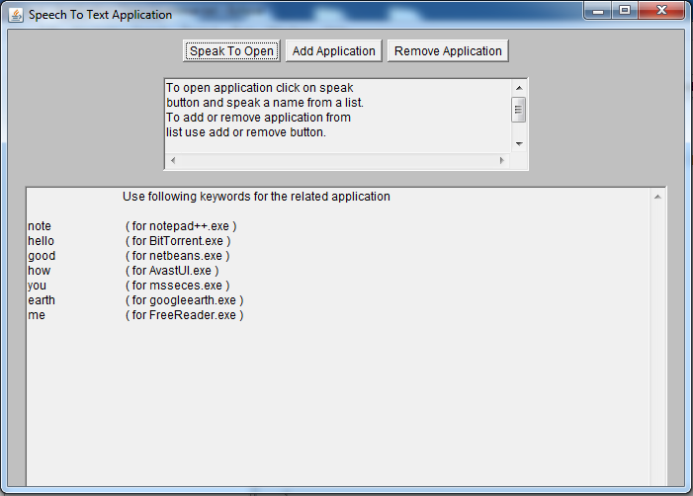
Basic idea
When you run our application it looks like this :

Slide 5
Basic idea
In the GUI shown there are 3 main parts
Buttons to perform certain actions
Text area to guide the user
List of application in the database added before
Now to start executing any application user first have to press “Speak to Open”. And than speak to open any listed application.
If user wants to add or remove any application he can do that by pressing according buttons.

Slide 6
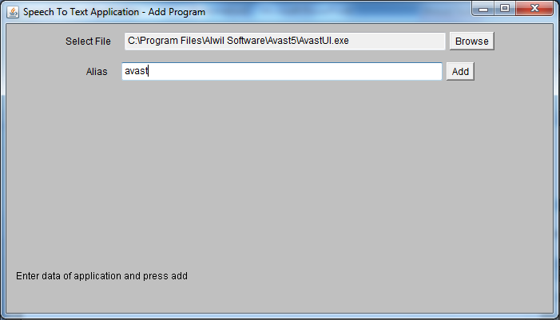
Basic idea
Add Application : Here user have to specify absolute path to .exe file and alias that will be used for that application

Slide 7
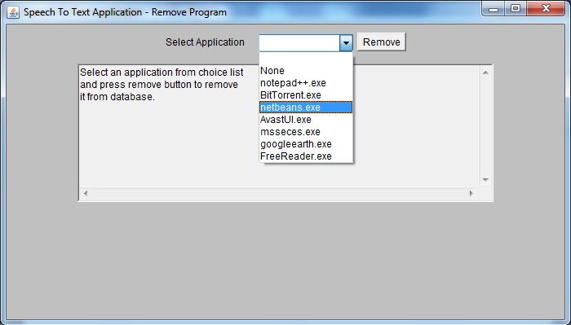
Basic idea
Remove Application : To remove any application user just have to select the particular application from list and press Remove button.

Slide 8
How it works?
In the first when you run this program, it creates a JDBC:ODBC connection to our underlying database.
It find outs different applications already added and the aliases for that apps accordingly.
Then lists that applications in text area.

Slide 9

How it works?
Whenever user presses the Speak to open button, first our application loads the particular grammar from a grammar file. Which looks something like below :
It also lists different Speech Engines and selects one.
The speech engine can only recognize those words which are listed in this grammar file.

Slide 10
How it works?
Now when user speaks anything the engine creates an event and accordingly engine tries to match the spoken word with entry in grammar file.
Once system recognizes the spoken word which is given alias of any application, system again creates the database connection and finds the specific path for that application.
And if that alias is proper than it will find an entry in database and that spoken application will start running!

Slide 11
Some testing results
No | Test Case | Expected Output | Avg. Accuracy (%)
1 | Speaking a filename that exists in the grammar file. | Open particular application | 60
2 | Speaking a filename that is not in the grammar file. | Filename should not be recognized | 90
3 | User doesn’t speak for a considerable time. | Don’t do anything | 90

Slide 12
Some testing results
Word Used | Test case 1 | Test case 2 | Test case 3
Hello | Executed | Not recognized | Automatically opens
How | Executed | Not recognized | Idle
Good | Not executed | Not recognized | Idle
Fine | Not executed | Not recognized | Idle
You | Executed | Not recognized | Idle
Me | Executed | Not recognized | Idle
Bittorrent | Not executed | Not recognized | Idle
Note | Executed | Recognized | Idle
Notepad | Executed | Not recognized | Idle
Avast | Not executed | Not recognized | Idle

Slide 13
Advantages
Provides friendly user interface
Reduces human efforts
Saves time
Helpful for physically disabled

Slide 14
Disadvantages
As this Java Speech API Implementation is new it lacks of efficiency.
Sometimes it recognizes same word more than one time.
Supports single specified language.

Slide 15
Conclusions
It provides easy way of computing
Engine supports only limited words that are defined in grammar file.
The efficiency of recognizing the spoken word is less and that is the main problem.

Slide 16
References
Java speech API guide
Cloudgarden documentation
Wikipedia

