Slide 1
Idea / Approach Details
Problem Statement: Website for Advanced Ambulance Assistance.
Team Name : Tech Tycoons
Team Leader Name: Mitul Gajera

Slide 2
Project Idea
→ PROBLEMS :-
Fast Transportation of an Ambulance.
Divert traffic when an ambulance come using traffic signals
Patient/Dead-Body identification

Slide 3
SOLUTION OF PROBLEMS
(A). Fast Transportation of an Ambulance
Firstly the find the Fire station /hospital (in which most off case ambulance is placed or parked) so that it can reach on patient place very soon(immediately).
After that the list of fire station/hospital(in which an ambulance is AVAILABLE & NEAREST) will reach and easily the carry the patient.

Slide 4
CRITERIA / ALGORITHM
Hospital/Fire station should be database with location(latitude and longitude).
Based on DIJKSTRA’s Algorithm which hospital/fire station in which an ambulance is available or not and than which has short distance (from hospital/fire station to patient ), according to distance they take away from fire station/hospital and carry the patient.
and such condition of carrying patient through shortest path and fast forwarding to reach hospital is :
--------------#condition#-------------------

Slide 5
(B). Divert traffic when an ambulance come using traffic signals.
Using IoT concepts we can communicate both ,traffic signal and an ambulance .
How much time taken by an ambulance to cut 300m ,and this data is send to traffic signal and traffic signal open or close according to that data which is sent by an ambulance

Slide 7
(C). Patient/Dead-Body identification
In nowadays as per our indian government rules compulsory Aadhar card(UIDAI) so that we assume that all have aadhar card so our proposed plan that “we implement biometric fingerprint scanner identification in an ambulance ” so that we identify a unknown patient or unknown dead body so it is easy to find patient’s family information him/her/they family.
Benefit of these functionality is for police or doctor who need to find unknown patient family information for give them to news or body(if patient dead) which identify very quickly and very less time .

Slide 8
PROTOTYPE
Check out our working prototype here:
(https://drive.google.com/open?id=1aemYBIKI1r9U7L0O7DG3MVXX2zwrgKi9)
(Download HTML file and open in browser.)

Slide 9
TECHNOLOGY STACK
Biometric fingerprint scanner
HTML
Node.js
mongoDB

Slide 10
USE CASE
Check out use case here:
(https://drive.google.com/open?id=1FXSHwgLYWuozPitnegoTWm8zjQydNO5N)

Slide 11
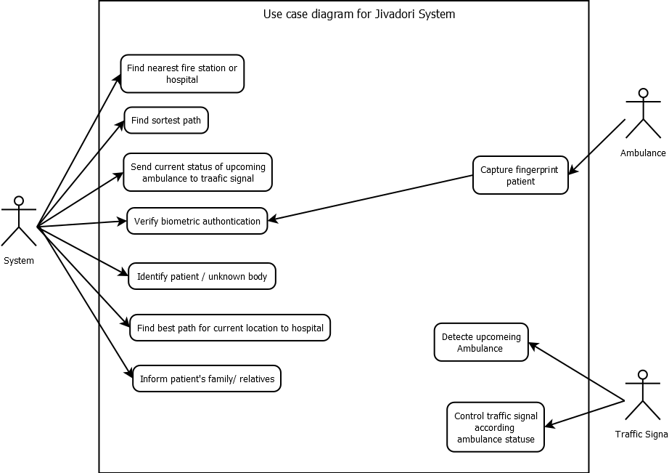

Slide 12
DEPENDENCIES/SHOWSTOPPER
For biometric fingerprint scanner of patient each ambulance must be require at least one Biometric scanner.

