Slide 1
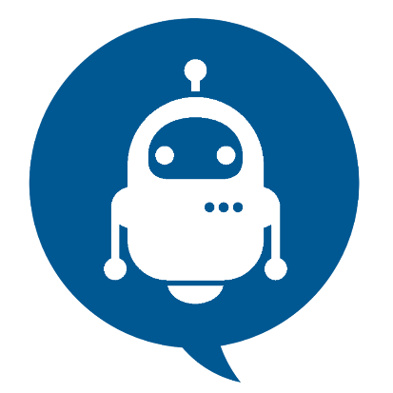
Chat bots
A computer program that can talk to humans in natural language
Prepared By: Mitul Patel
Branch : Information Tech
Enrollment No : 16012021040
Guide By : Prof. Keyur Jani

Slide 2
Questions We’ll Answer
What is it? Who wants it? Why?
Since when is it around?
How does it work?
How do you test it?
Can it answer all my questions?
Can I make one of my own?
Where can I put it to work?

Slide 3
Introduction
Chat Bot: A computer program that can talk to humans in natural language!
Uses Artificial Intelligence Markup Language (AIML) to represent knowledge.
Can replace a human for monotonous jobs of answering queries, e.g. E-help desk

Slide 4
How It All Started
Eliza – the first chat bot made by Joseph Weizenbaum.
Working of Eliza is based on
Knowledge Representation
Pattern Recognition
Substitution of key words into known phrases.

Slide 5
What is chatbot and how it works?
A chatbot works in much the same way as a human manning a help desk. When a customer opens a chat dialogue to ask for assistance, the chatbot is the medium responding. ... This is also a chatbot and, using your location, a response can be given, in natural, conversational replies.

Slide 6
Natural Language Processing
Natural language processing (NLP) is the ability of a computer program to understand human speech as it is spoken. NLP is a component of artificial intelligence .
It makes computer to perform useful tasks with the natural languages humans use.
Current approaches to NLP are based on machine learning • The input and output of an NLP system can be −
Speech
Written Text

Slide 7
NLP has 3 specific concepts as follows
Entities:
This essentially represents an idea to your chatbot. For example, it may be a payment system in your E-commerce chatbot.

Slide 8
Natural Language Processing
Context:
When a natural language understanding algorithm examines a sentence, it doesn’t have the historical backdrop of the user’s text conversation. This implies that, if it gets a response to a question it has been recently asked, it won’t recall the inquiry. So, the phases during the conversation of chat are separately stored. It can either be banners like “Ordering Pizza”. Or could include other parameters like “Domino’s: Restaurant”. With context, you can easily relate expectations with the necessity of comprehending the last question.

Slide 9
Natural Language Processing
Expectations:
This is what a chatbot must fulfill when the customer says sends an inquiry. Which can be the same for different inquiries. For example, the goal triggered for, “I want to purchase a white pair of shoes”, and “Do you have white shoes? I want to purchase them” or “show me a white pair of shoes”, is the same: a list of shops selling white shoes. Hence, all user typing text show a single command which is the identifying tag; white shoes.

Slide 10
Types Of Chat Bots
Rule-based chatbots
that can respond to specific commands.
Artificial intelligence chatbots
that respond to natural language.

Slide 11
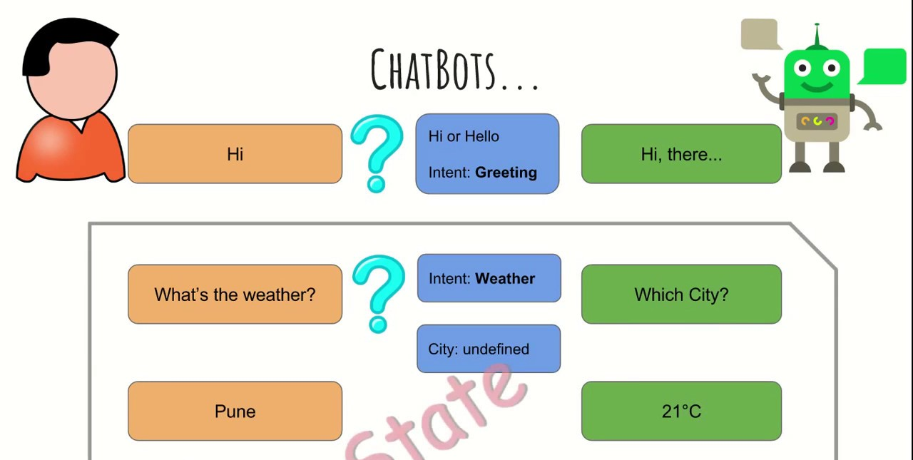
Working

Slide 12
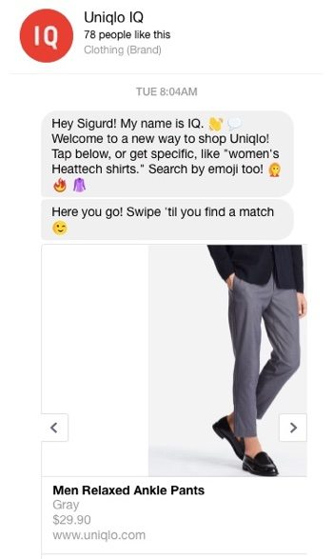
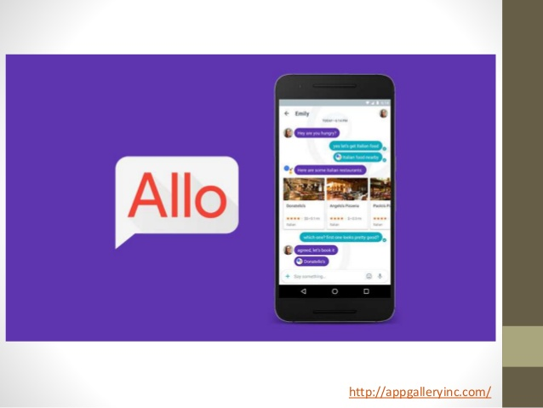
Basic Kinds of Chatbot Applications

Slide 13
How to create bot in Facebook messenger :
• First create the Facebook app at Facebook developer site.
• Select your page , you will get page access token that will be used later
For AI agent: • Api.ai • Bostify
These are the Natural Language Understanding platform.
Call back generated by any of them , will have to submit to our Facebook app and your bot is ready .
To make your Messenger bot public, submit your app for approval in the 'App Review for Messenger' section on the Messenger page of your Facebook app.

Slide 14
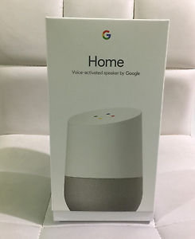
Google Home
Google Home is a voice-activated home product that allows you and your family to get answers from Google, stream music, and manage everyday tasks.

Slide 15
Advantages To Use Of Chatbots
Keeping Up with the Trends: Being Present on Messaging Platforms2.
Improved Customer Service
Increased Customer Engagement
Monitoring Consumer Data & Gaining Insights
Better Lead Generation, Qualification and Nurturing
Easier Approach to Global Markets
Cost Savings

Slide 16
Conclusion
The best conversations are the ones where a lot is yet to be said. Chatbots are at that stage of their journey right now.

Slide 17
Thank You !

