Slide 1

Fleet manager (Car Leasing System)
Project Guide : Kaushik Kathiriya sir
Prepared By : Mitul Patel

Slide 2
Content
Project Definition
Project Plan
Software and Hardware requirements
Functional requirements
Non-Functional requirements
Class Diagrams
UI Design
Bibliography

Slide 3
Fleet Manager
Fleet Manager is web based application built for the car leasing System.
The role fleet manager is the client’s manager that can handle various drivers and give them access to portal and quote.
So this web application is intended to serve that problem by providing an interface for the company as well as the manager and driver.

Slide 4
Project Plan
Requirement Gathering
Design Class Diagram
Developing Wire Frame
Defining end-points
Developing Front-End
Deployment
Testing

Slide 5
Software & Tools Requirements
Eclipse IDE (STS tool)
Mysql
Postman
Java Jdk 1.8
Noide.Js(npm)
Angular8
Apache Tomcat 8.5

Slide 6
Hardware Requirements
8 GB of RAM recommended
1.8 GHz or faster processor. i-3 or better recommended
.

Slide 7
Functional Requirements
Add and view (List) all drivers details.
Search for desired driver and update.
Give them a portal and quote access .
Allow the Drivers to logIn.
Allow administrators to customize all changes

Slide 8
Functional Requirements
Allow Fleet Manager to give Budget plan as per requirement
Allow the Driver to Login and request quote access and budget.
End-to-End leasing via only fleet manager
Searching ,sorting, filtering the data
Generating Bills and send to the fleet manager

Slide 9
Non-Functional Requirements
Simple and Useful
Safe and Secure
All Time Availibility
GDPR ( General Data Protection Regulation )

Slide 10
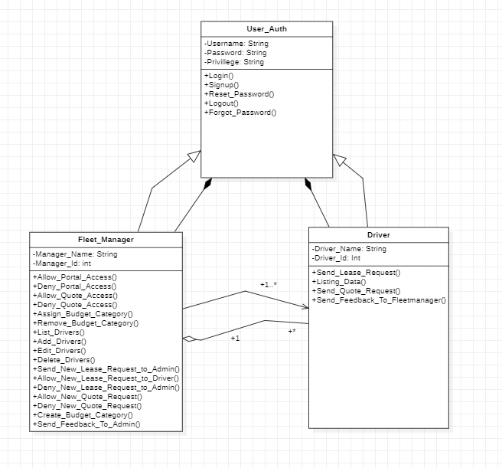
Class Diagram

Slide 11
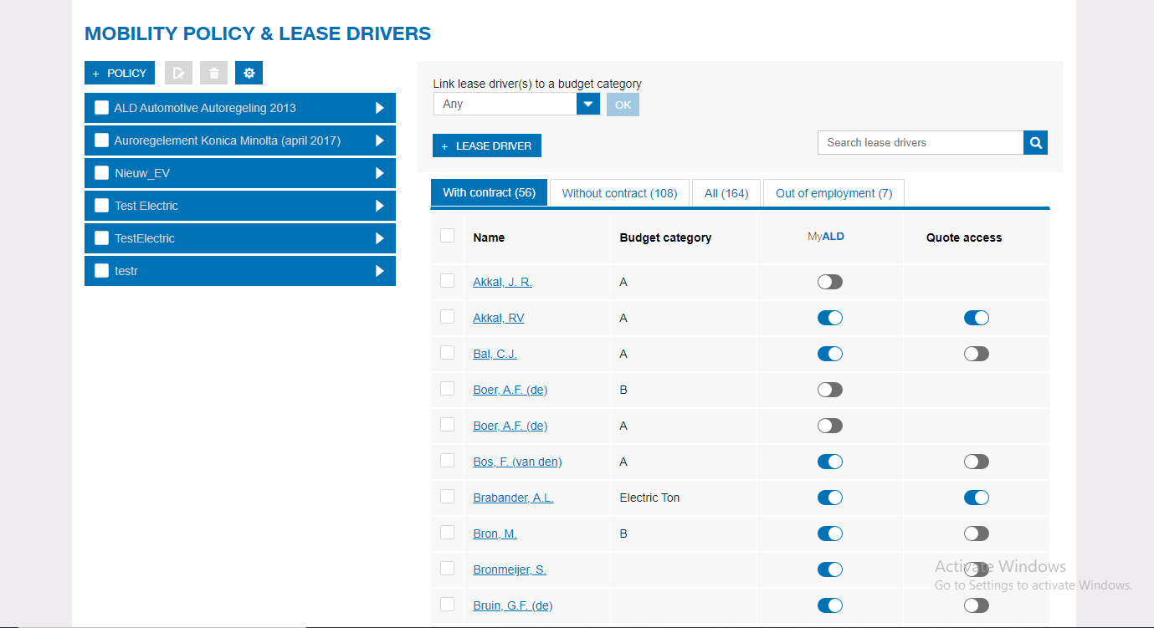
UI Design

Slide 12
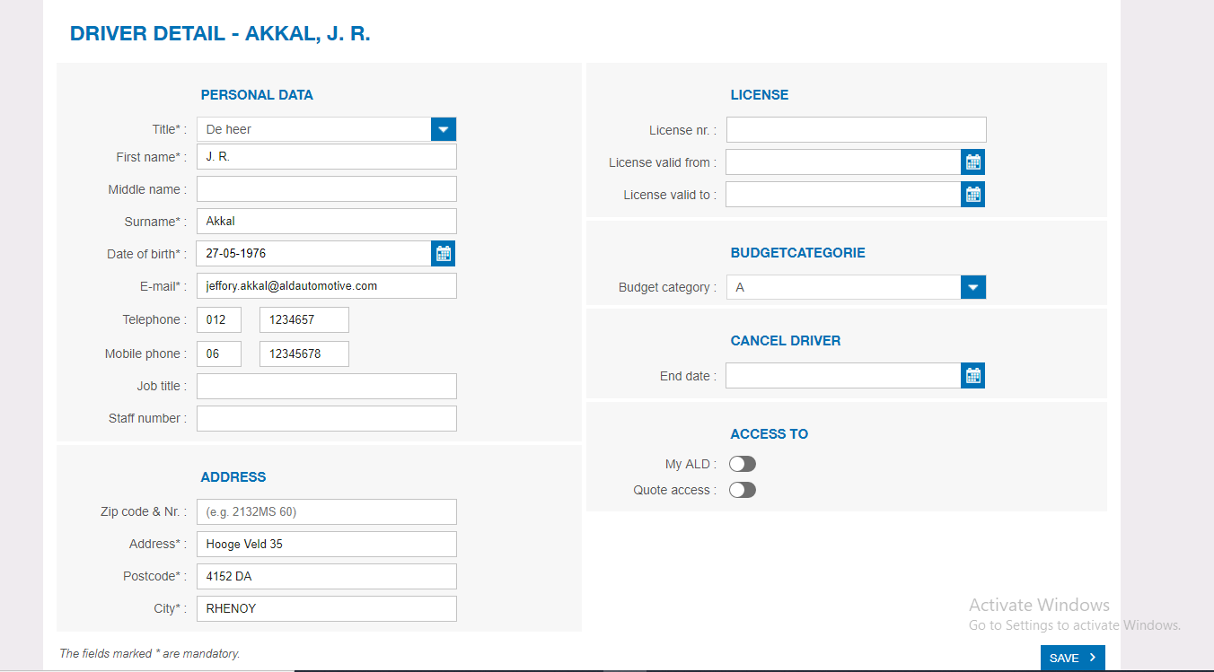
UI Design

Slide 13
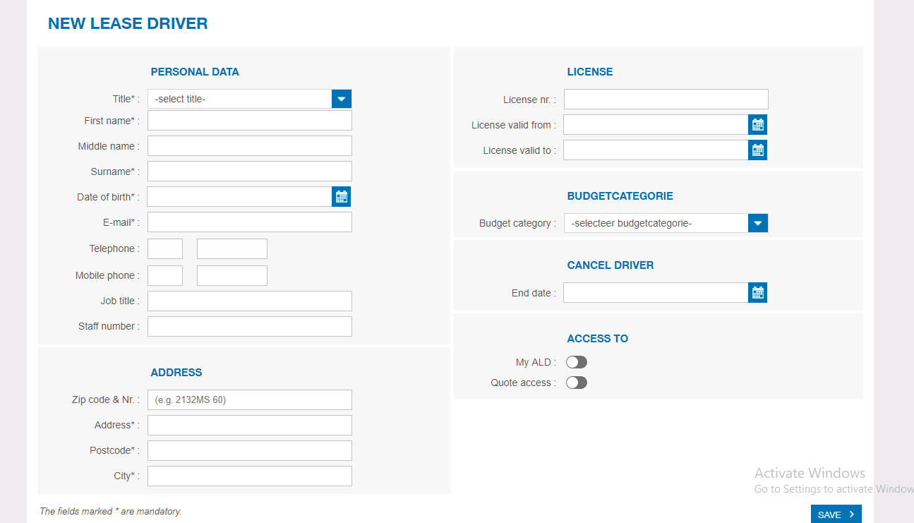
UI Design

Slide 14
Bibliography
https://www.myald.in/
https://gist.github.com/pcan/16faf4e59942678377e0
Source
https://github.com/mitulp236/Fleet-Manager

Slide 15
THANK YOU !!!!

