Slide 1



ANZ Dataset
View in Power BI

Slide 2
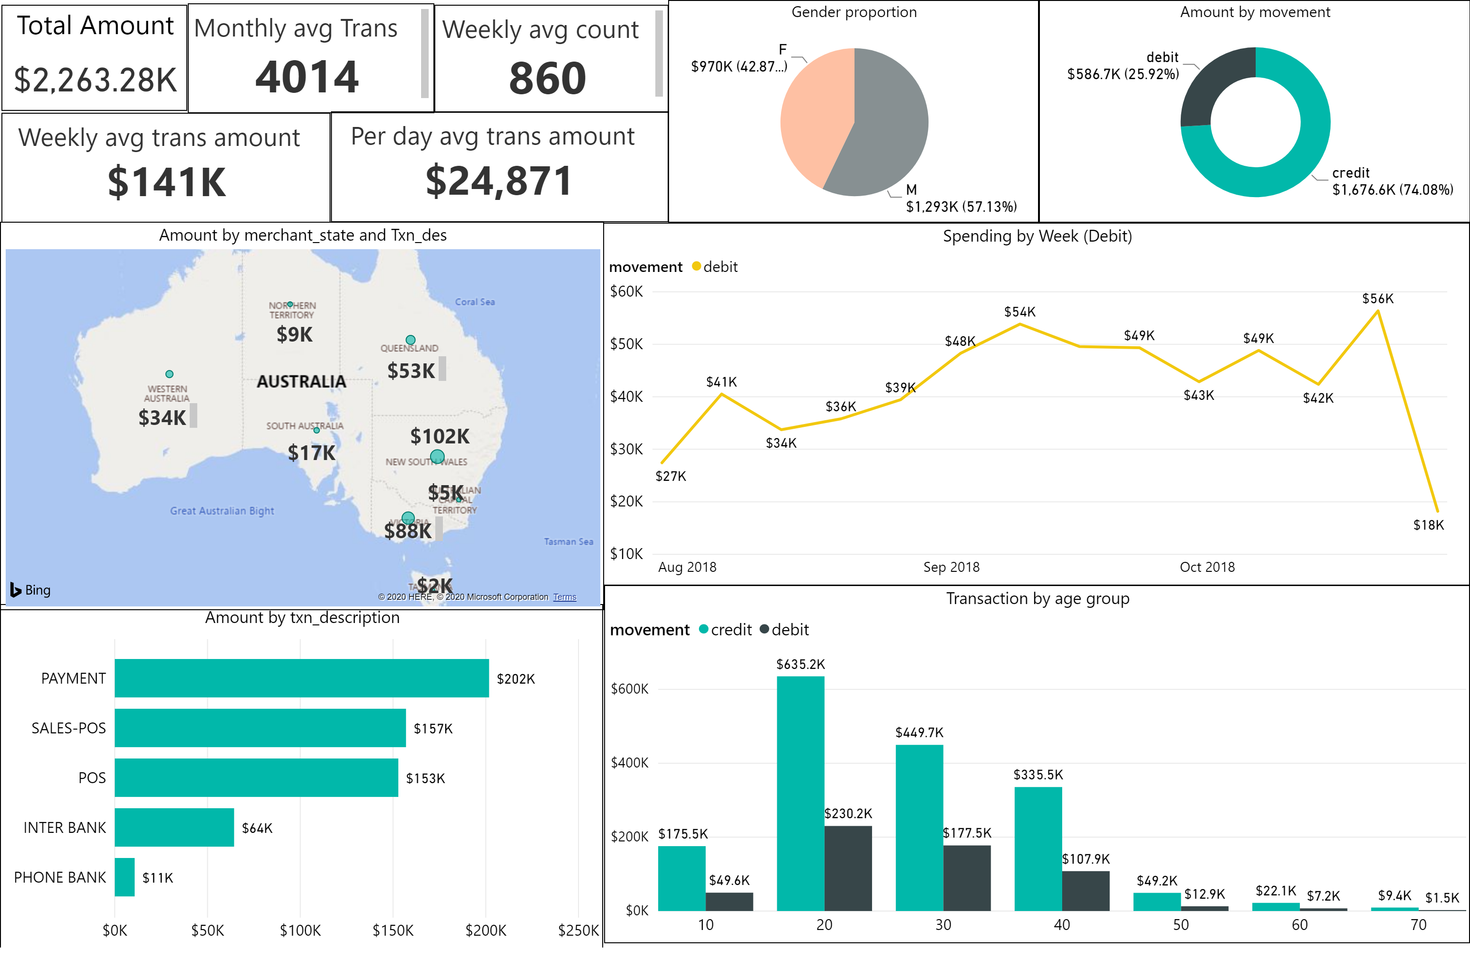

Slide 3
Key Amounts
Total transaction amount - $2263K ($2.3M)
Average weekly transaction amount $141,000
Average per day transaction amount $24,871
Average monthly transaction count 4014
Average weekly transaction count 860

Slide 4
Key Insights
Age group - Age of 20-30, Spending higher than the other age groups.
‘PAYMENT’ is the most popular type of transaction description. Meanwhile, ‘PHONE BANK’ type used very less time.
In terms of Merchant_state (POS, SALES-POS) – New South Wales and Victoria leading in Australia. ANZ have strong control over large states. ANZ should focus on Tasmania, ACT, and Northern territory.
Proportion of gender – ANZ have more Male customers than Female. But, it’s not much significant ratio. Male to Female ratio (57-43%) is a quite good for gender diversity.
In 3 months of period transaction amount split : Credit 74% (PAY/SALARY)- Debit 24%(SPENDING).
Weekly spending pattern (Debit) – First and last week spending very lower than the rest of the week. Starting from the first week, spending grew slowly and end up with lowest spend.

