Slide 1
Swarm Robotics:Information sharing by multirobot system using distributed control and cooporative manipulation
MITUL TAILOR
PARAS GOSALIA
SHAILESH JAIN
VIDYAVARDHINI’S COLLEGE OF ENGINEERING AND TECHNOLOGY

Slide 2
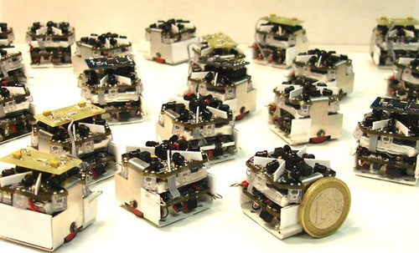
INTRODUCTION TO SWARM ROBOTICS
New approach to the coordination of multirobot systems .
Consist of large numbers of mostly simple physical robots.

Slide 3
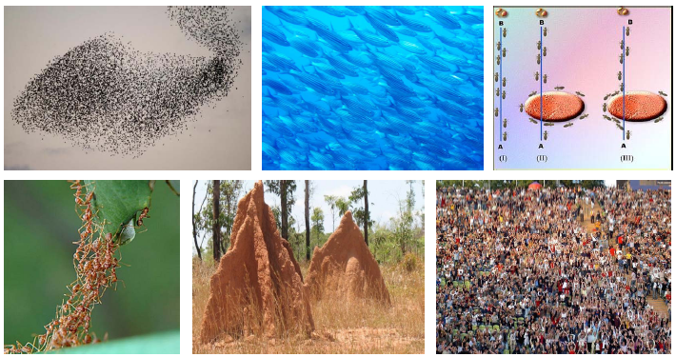
Sources of Inspiration

Slide 4
Project idea
This project is to develop a distributed algorithm for a team of simple robots (here we are using 4 SPARC V robots) searching for targets in an unknown environment. It is supposed that a desired collective behaviour emerges from the interactions between the robots and interactions of robots with the environment

Slide 5
Problem statement
In this system, we have described a design and implementation of an information sharing system performed by autonomous robots. . Various phases of the algorithm have been implemented to be run on swarms of robots.
It provide basic functionality, such as dispersion, localization and mapping, information sharing and task distribution. In these system autonomous robots follows the grid as per the algorithm to pick the object or block kept at any random co-ordinates without colliding by communicating with each other and place it in the desired position.

Slide 6
Hardware requirements
Hardware | Use in system
Spark V robots(4) | The robot that will be used is Sparc V robot from Nex-robotics
Zigbee modules (5) | The communication between sever computer and Spark V robot will take place via 5 Zigbee modules, Maxstream XBee /XBee Pro. 4 modules for each robot 1 module for central server
Servo motors | Gripper has been designed using servos to pick up the object found in its path.

Slide 7
SOFTWARE REQUIREMENTS
Software | Use in system
AVR Studio and WinAvr | To compile and burn programs.
X-CTU | To send the signals from central system to the robots for monitoring and debugging
AVR Boot Loader | The hex code of the program is burnt into the microcontroller using this software.

Slide 8
IMPLEMENTATION
Consider a square black and white grid of square as region of exploration (arena).Here in this project we consider the objects (plates) placed randomly on the arena. The task begins initially with the bots placed randomly in the environment (grid).To complete the given task we have used selected number of swarm robotics algorithms. For each steps of algorithm we discuss how well they conformed to the ideals of swarm robotics.

Slide 9
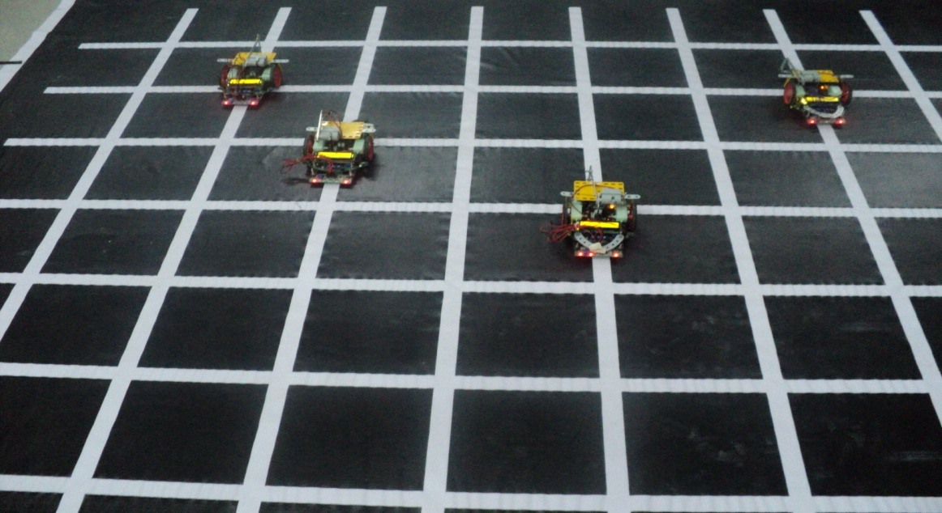
task specification
Techniques and Technologies
Grid solving,
Object sensing.
Boundary Detection
Wireless channel implementation.
Gripping mechanism
Algorithm steps
Dispersion
Localization and Mapping
Task Distribution
Information Sharing

Slide 10
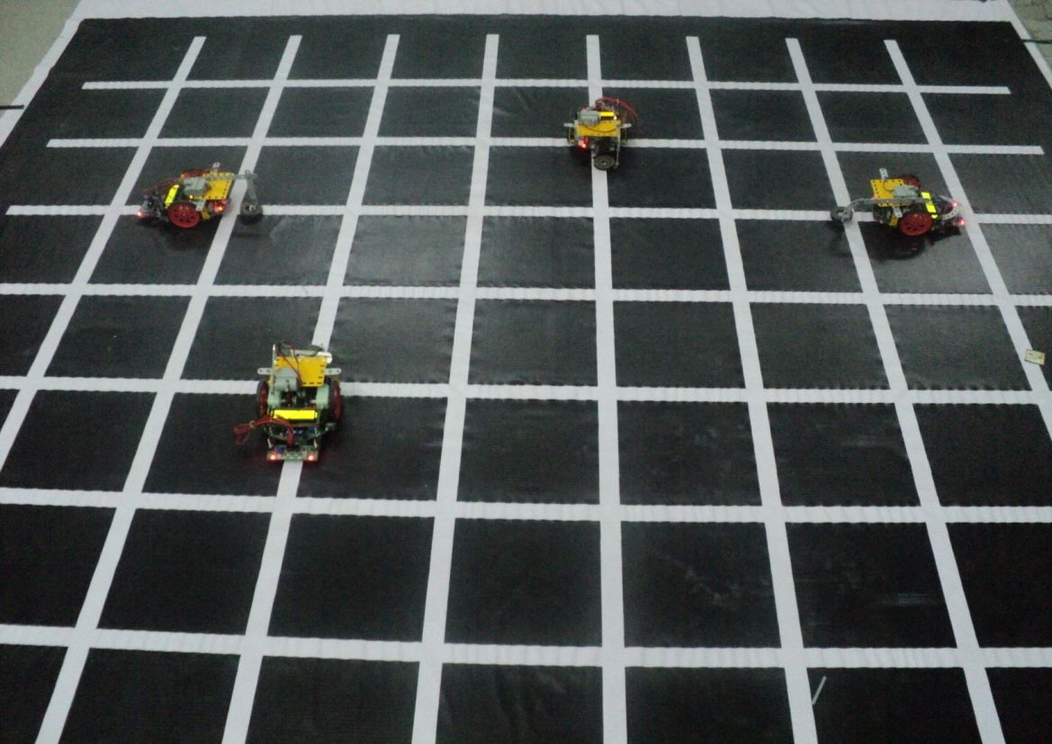
Description of system
The system algorithm consist of following steps:
Dispersion in Environment
Initially robots will be placed on any random node of the grid. In this phase the robot travels to the extreme of the grid in each direction.

Slide 11
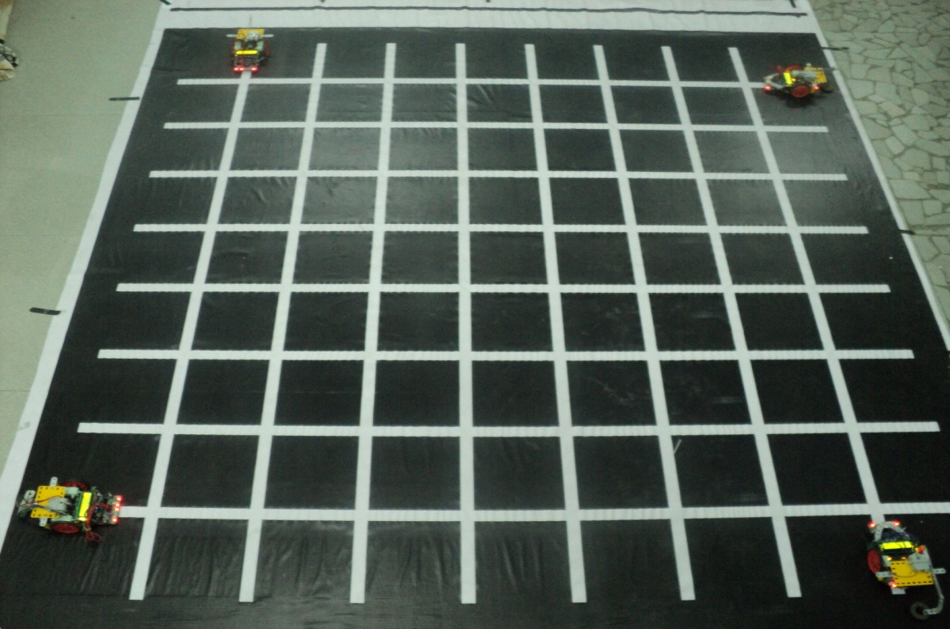
Distributed Localization and Mapping
The robot must know where it is and its orientation to be able to map current sensor readings to a map. While these robots are moving about the environment, they will be generating maps individually.

Slide 12
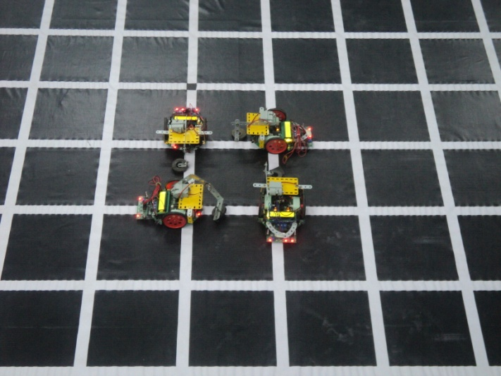
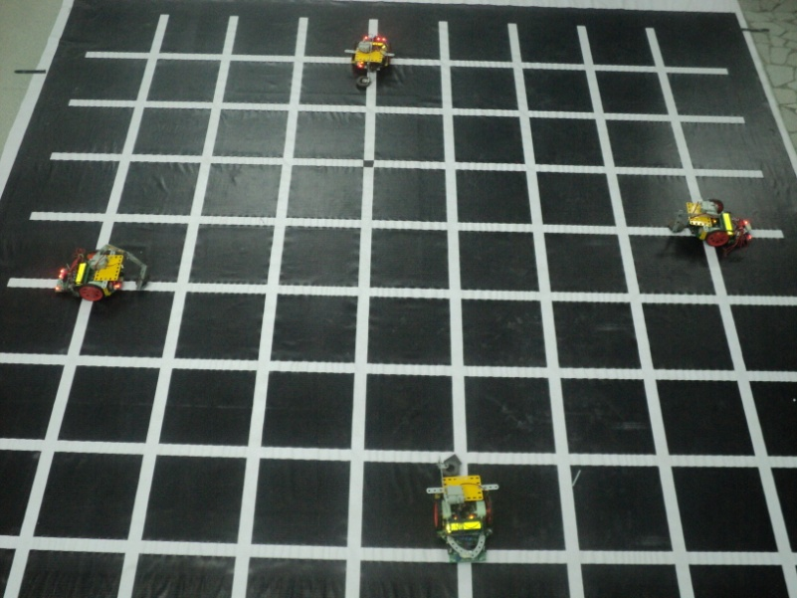
Task Distribution
In this phase the task is divided by the robots . This part of the domain space is typically called collaborative, and is characterized by entities helping each other to achieve their individual, yet compatible goals .

Slide 13
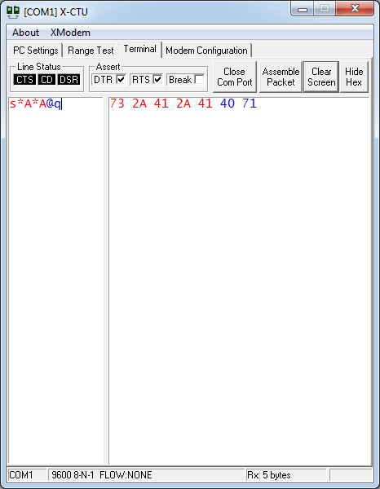
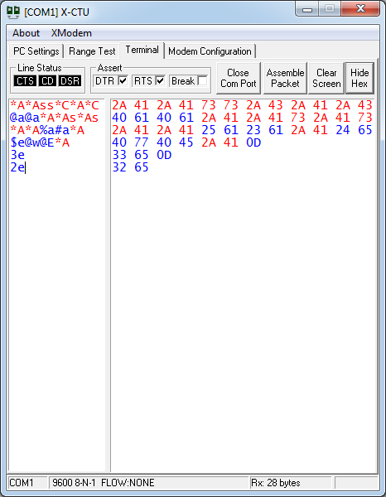
Information Sharing
A multi-robot example of a collaborative team is a group of robots that each must reach specified goal positions that are unique to each member. The robots must work to coordinate their actions to minimize the amount of interference between themselves and other objects.

Slide 14
Project plan
Sr.no | Task
1 | Detail analysis of project idea
2 | Study of different circuit diagram and functioning of each component of Spark V Robot
3 | Implemented different basic programs on robot.
4 | Implementation of Grid solving technique and path planning algorithm.
5 | Designing and Analysis of the whole system algorithm
6 | Code implementation
7 | Integration testing
8 | Debugging and Documentation

Slide 15
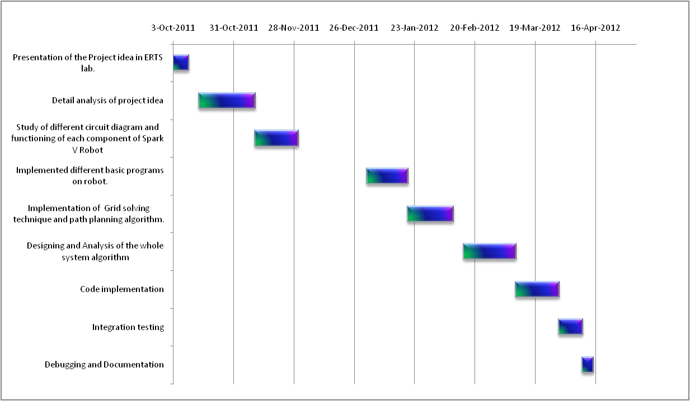

Slide 16
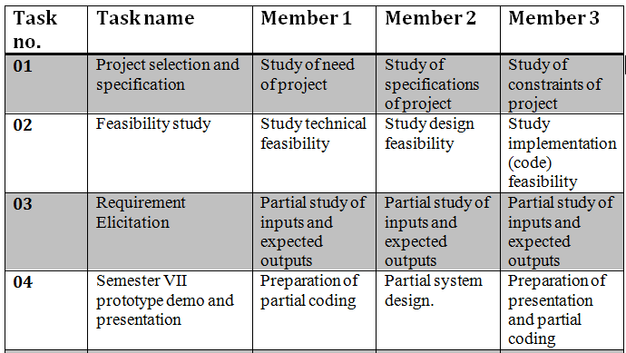
Work division

Slide 17
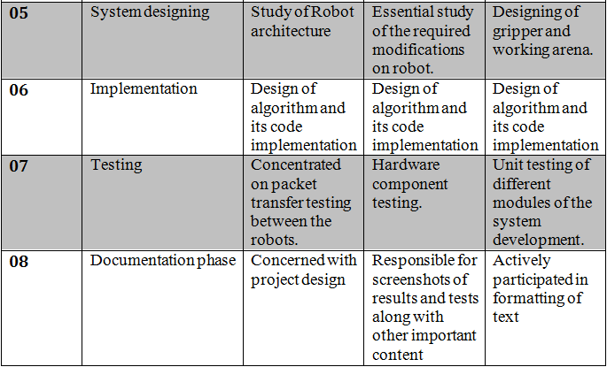

Slide 18
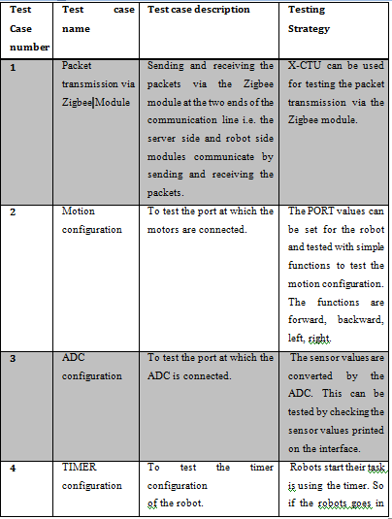
Test cases

Slide 19
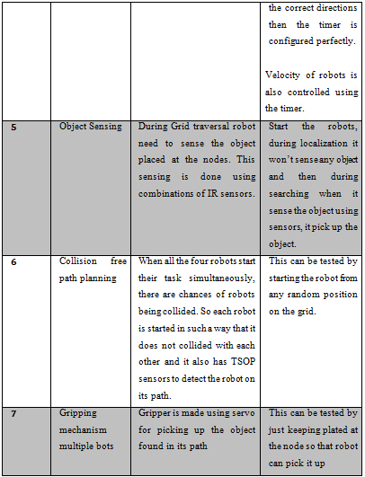

Slide 20
MAJOR technical CHALLENGES
Sending and receiving different data between four robots .
Poor quality and response of Spark V line following sensors
Architecture of robot
Lightning condition problem

Slide 21
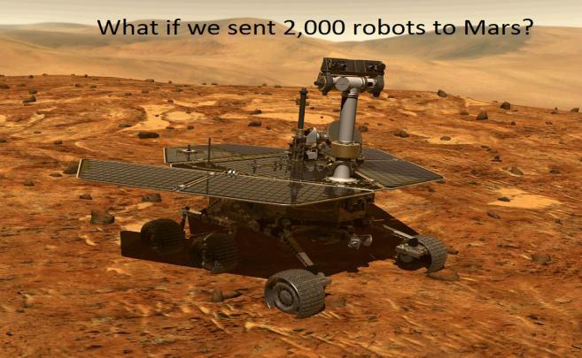
APPLICATIONS
Transportation
Industrial sector
Pick and Place
Disaster Relief
House cleaning
Research Work

Slide 22
CONCLUSION
Future work

Slide 23
References
[1](2011) Swarm Robotics [Online] Available:
http://en.wikipedia.org/wiki/Swarm_robotics
[2] (2011) Ants Colony [Online] Available:
www.datasheetcatalog.com
[3] (2011) Communication modules [Online] Available:
www.robosoftsystems.co.in
[4] Fiona Higgins, Allan Tomlinson and Keith M. Martin,” Survey on Security Challenges for Swarm Robotics”, Autonomic and Autonomous Systems, 2009. ICAS '09. 10.1109/ICAS.2009.62.
[5] Feng, K.; Hoberock, L.L.; “An optimal scheduling of pick place operations of a robot-vision-tracking system by using back-propagation and Hamming networks”, Robotics and Automation, 1992,10.1109/ROBOT.1992.220085
[6] Jason M. Fox and Michael McCurdy, “, Activity Planning for the Phoenix Mars Lander Mission,” in Aerospace Conference, 2007 IEEE, 10.1109/AERO.2007.352951.

Slide 24


Slide 25


