Slide 1
Hadoop the worng way
Iker Martinez de Apellaniz
Data Engineer at Schibsted

Slide 2

Hi!!
/** @author imartinez*/
Person me = new SoftwareEngineer();
me.setName("Iker Mtz de Apellaniz Anzuola");
me.setTwiter("@mitxino77");
me.setChildNumber(2);
me.setLocations({
“St. Cugat, Barcelona”,
"Kanpezu, Euskadi”,
"*, World”
});
me.addExperience({
“Data Engineer at Schibsted”,
“Big Data Team Lead at GFT”,
“Research & Development at Emagister”,
“Other Development Stuff”
});
me.addMainSkills({
“Hadoop”,
“Search”,
“Agile”,
“Java”
});
return me;

Slide 3
“Errare humanum est”
–Séneca

Slide 4
“One who makes no mistakes makes nothing”
–Giacomo Casanova
“We learn from failure, not from success!”
–Bram Stoker, Dracula
“Mistakes are proof that you are trying”
“Mistakes are meant for learning, not repeating!”

Slide 5

Everything

Slide 6
There are lots of stones on the path
Ignorance on what you are doing
That moment before coffee
That brilliant Idea
We don’t have time for that
We need to think about the future

Slide 7
Type of errors you can do/suffer and how to (try to) avoid them
New technologies require time to learn and configure properly
You won’t see your own mistakes
Check and ask feedback on your design
Don’t sacrifice critical features before going life
Do a MVP/PoC previous to a gigantic App

Slide 8
#1: Configuration Issues
Symptom: Misconfiguration led to Data duplication and crazy behaviours
Found: We had less pages than numResults/pageSize on search results
Problem: Incorrect configuration on shards of Solr Cloud

Slide 9
Search result demo
{
"response":{"numFound":5787345824,"start":0,"end":20,"docs":[
{
“id":"MA147LL/A", "name":"Apple 60 GB iPod”, "price":399.0,
},
{
“id":"JKA14YU/A", "name":"Nexus 6 32 GB", "price":639.0,
},
...]
}
———————
{
"response":{"numFound":5787345732,"start":20,"end":40,"docs":[
{
“id”:”XXX", "name":"....","price":###.0,
},
...]
}
———————
{
"response":{"numFound":3482149317,"start":29000,"end":29020,"docs":[
{
"id":"YYY", "name":",,,,,", "price":###.0,
},
...

Slide 10
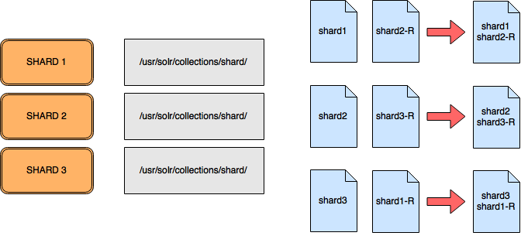
Two different shard’s data stored on one file

Slide 11
cli configuration
Configure command line to attack proper Cluster
Configure consistently, different tools to same cluster
Take care on adding new things, like installing a simple node cluster locally

Slide 12
#2: N block file 1 mapper
Symptom: Humongous file takes only one mapper no matter which configuration I try
Found: changing block size or numMapper params doesn’t change behaviour
Problem: trying to read a gzip file on a parallel way

Slide 13
OH F**K!!
Gzip Files have to be read completely before uncompression
That was obvious once you know it
You need to change mindset to HDFS world
Prepare your data for Hadoop
Use lzo compresion (for example)
Know the effects of the params

Slide 14
#3: Refactor of code makes process slower
Symptom: After refactoring code, process takes longer and writes more bytes
Found: reviewing logs we found one line repeated #M times
Problem: add “simple” log traces on a method

Slide 15
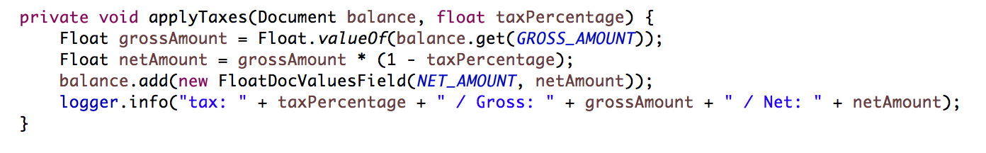
Good intention while coding doesn’t mean doing good

Slide 16
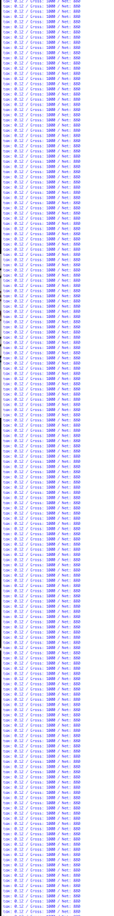


40M times

Slide 17
#4: Think about model changes
Symptom: Exception after releasing a new code
Found: A big red box on the console tells you something is wrong
Problem: Refactoring code misplaced filed on the read/write fields functions breaking backward compatibility

Slide 18
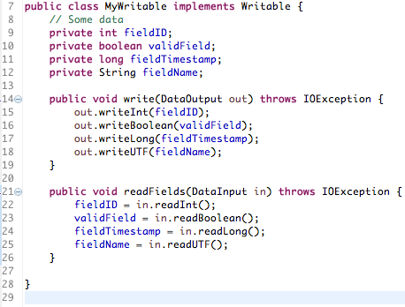
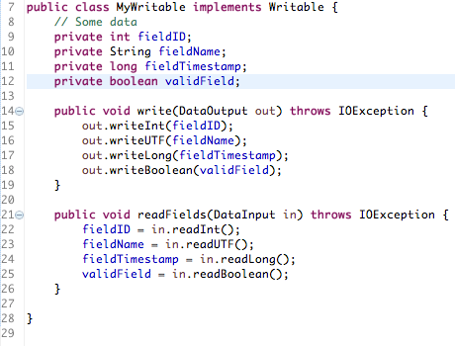
Better field organisation, but how yesterday’s data was stored?

Slide 19
Find Versioning alternatives
First Field is a version field: complicated to maintain
Create your own Protocol for serialization: don’t even try
Use Avro: Solution for new attributes, changes on order, changes on platform, …*
* https://martin.kleppmann.com/2012/12/05/schema-evolution-in-avro-protocol-buffers-thrift.html

Slide 20
#5: Big Data everywhere
Symptom: Bootstraping an App gets more time than executing it
Found: Log reviewing
Problem: Do you really need hadoop to process a 30 MBytes file??

Slide 21
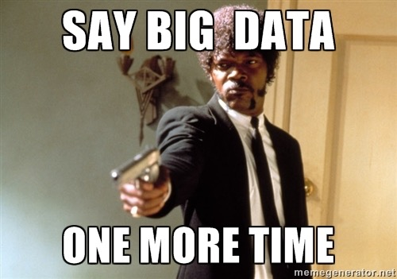



Slide 22
#6: Redoing things from scratch
Symptom: Estimation on scaling the app to be distributed requires redoing everything
Found: Product Owner’s face is getting red
Problem: Wrong design, business logic is embebed on the framework.

Slide 23
Best Practices
Clean Code
SOLID
Software Craftmanship
Delta Architecture
Microservices
…

Slide 24
#7: Over Design
Simptom: Inability to move forward due to dependencies and technical debt
Found: Every day you have a pain in the ass seen unused classes
Problem: You added this very useful functionality on your code that you have never used.

Slide 25

Use Common Sense
Think on the use you are going to give to this data/app
Make of the world a better place by parsing my apache logs
Understand your fellow Data Science colleagues’ needs
Apply Machine Learning
Make Data Available for reporting or Visualisation

Slide 26
Take away #1
Forget About Hadoop
Keep your business logic separated from the framework you use

Slide 27
Take away # 2
Keep Hadoop in mind
Remember that you are processing distributed and at scale when implementing

Slide 28

Qeustions??

Slide 29

We are hiring
Data Engineers
DevOps
Mobile Developers
Senior Software Engineers
Feedback is welcome
iker@schibsted.es
@mitxino77

