Slide 1
Reliable UDP and Circular DHT implementation for the MediaSense Open-Source Platform
Bachelor Thesis, Computer Science 2012
Florian Rüter, Timo Schröder

Slide 2
Background
Internet-of-Things explanation

Slide 3
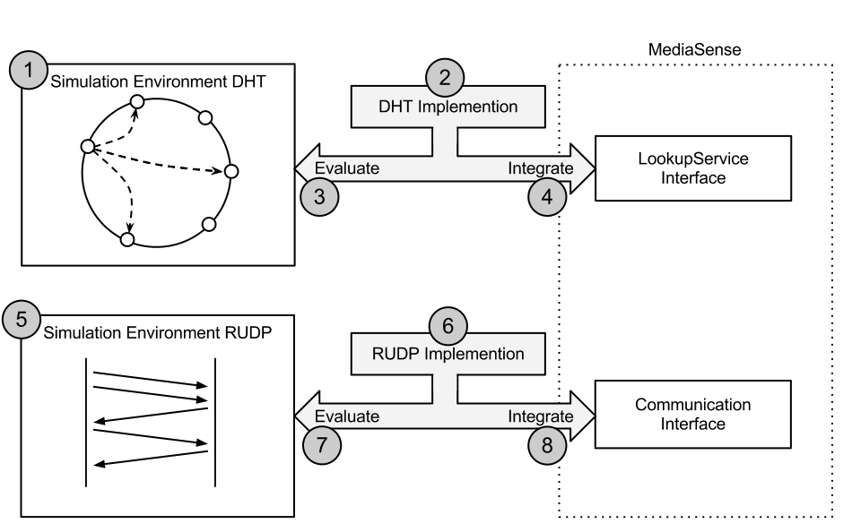
Methodology

Slide 4
0
F
F
1
<
E
2
D
3
C
5
4
B
5
A
A
6
7
9
7
8
Notes:
Virtual overlay network
Space of the length of the hash function
...

Slide 6
Sender
Receiver
4
6
7
1
2
3
4
5
AckStartSeq 1 ACK 1-3,5
1
2
3
5
AckStartSeq 4 ACK 4-7

