Slide 1
OG/PO Subset RNA Velocity Figures
All figures from figures_og_exact/
SutureRNAVelocity | GSE163693 | E17.5 OG1–4 + PO1–2

Slide 2
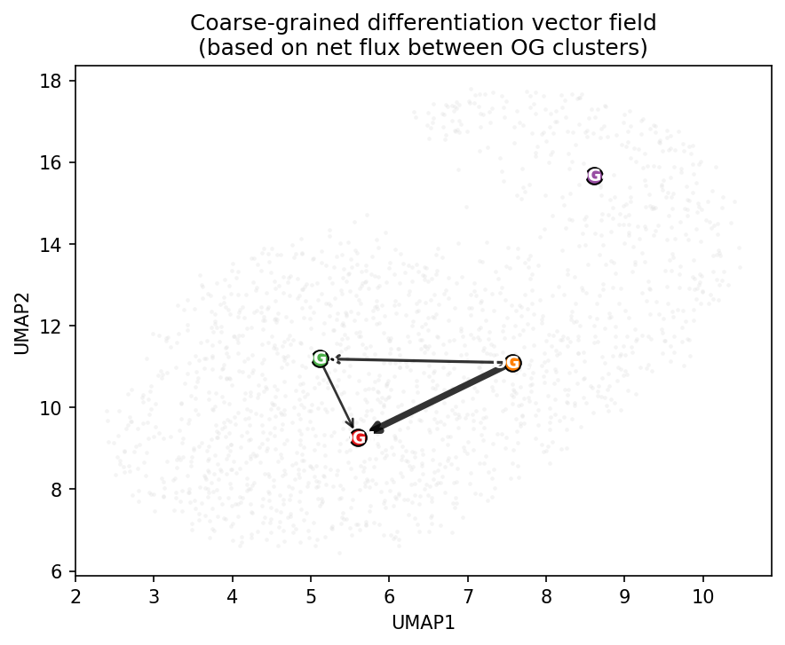
cr_diff_vector_field.png
Coarse-grained differentiation vector field (net flux)
figures_og_exact/cr_diff_vector_field.png

Slide 3
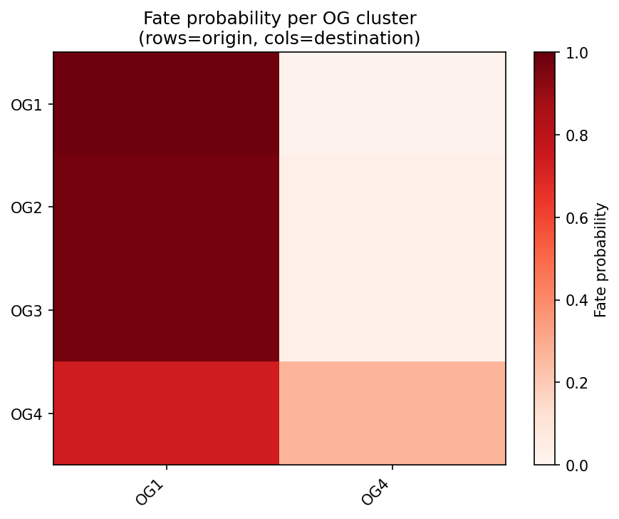
cr_fate_heatmap.png
figures_og_exact/cr_fate_heatmap.png

Slide 4
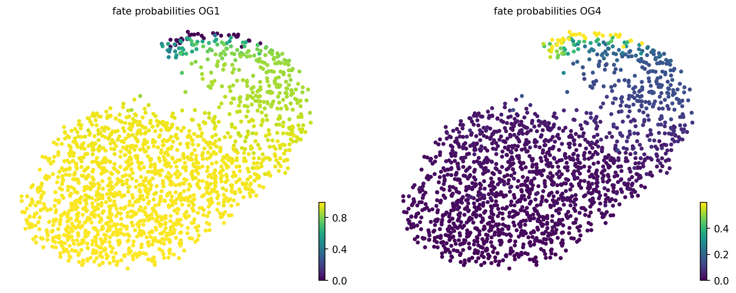
cr_fate_probabilities.png
figures_og_exact/cr_fate_probabilities.png

Slide 5
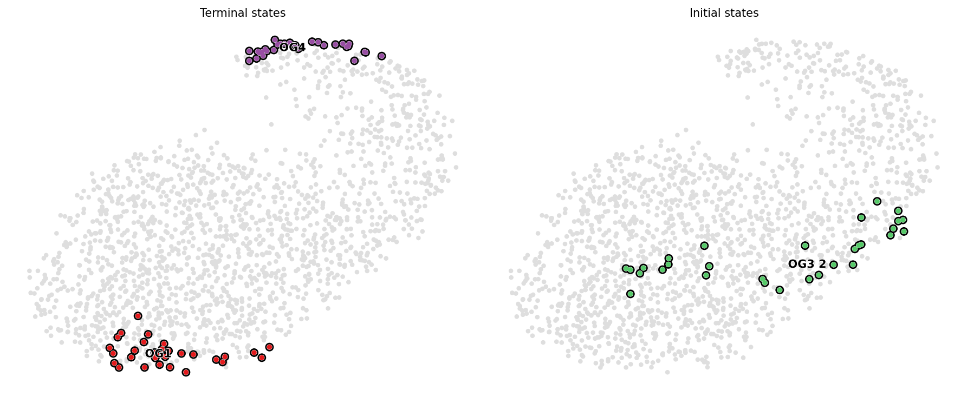
cr_initial_terminal.png
figures_og_exact/cr_initial_terminal.png

Slide 6
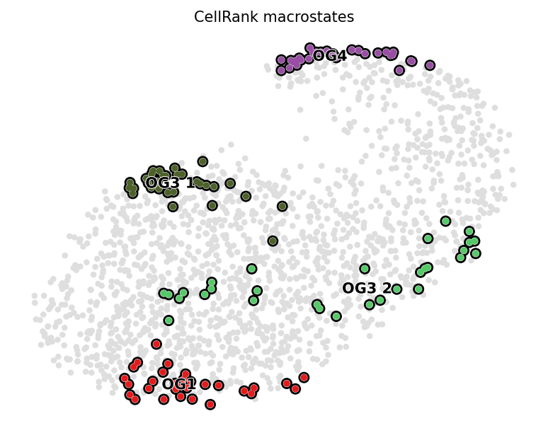
cr_macrostates.png
CellRank GPCCA macrostates
figures_og_exact/cr_macrostates.png

Slide 7
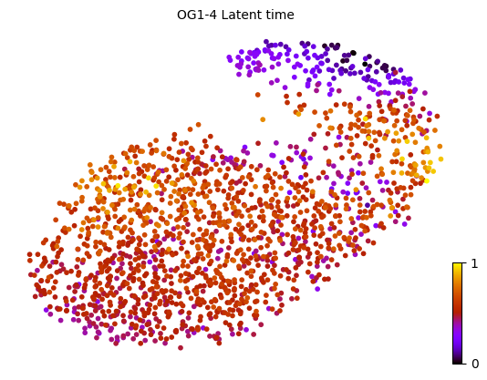
latent_time.png
figures_og_exact/latent_time.png

Slide 8
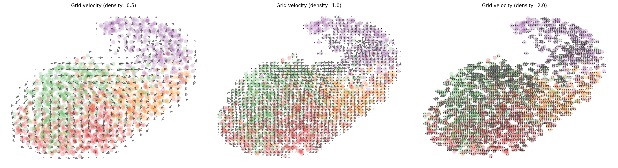
local_grid_velocity.png
Local grid velocity at different densities
figures_og_exact/local_grid_velocity.png

Slide 9
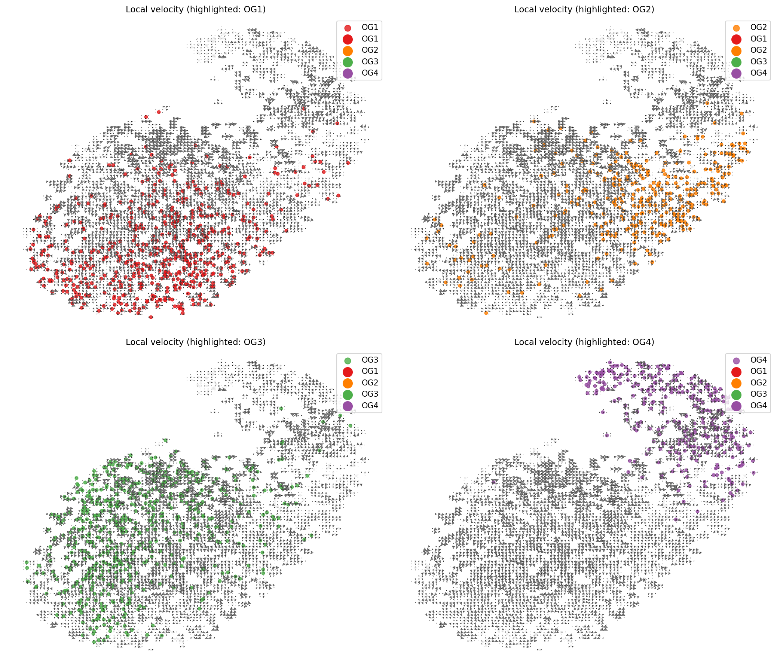
local_per_cluster_stream.png
Local velocity around each OG/PO cluster
figures_og_exact/local_per_cluster_stream.png

Slide 10
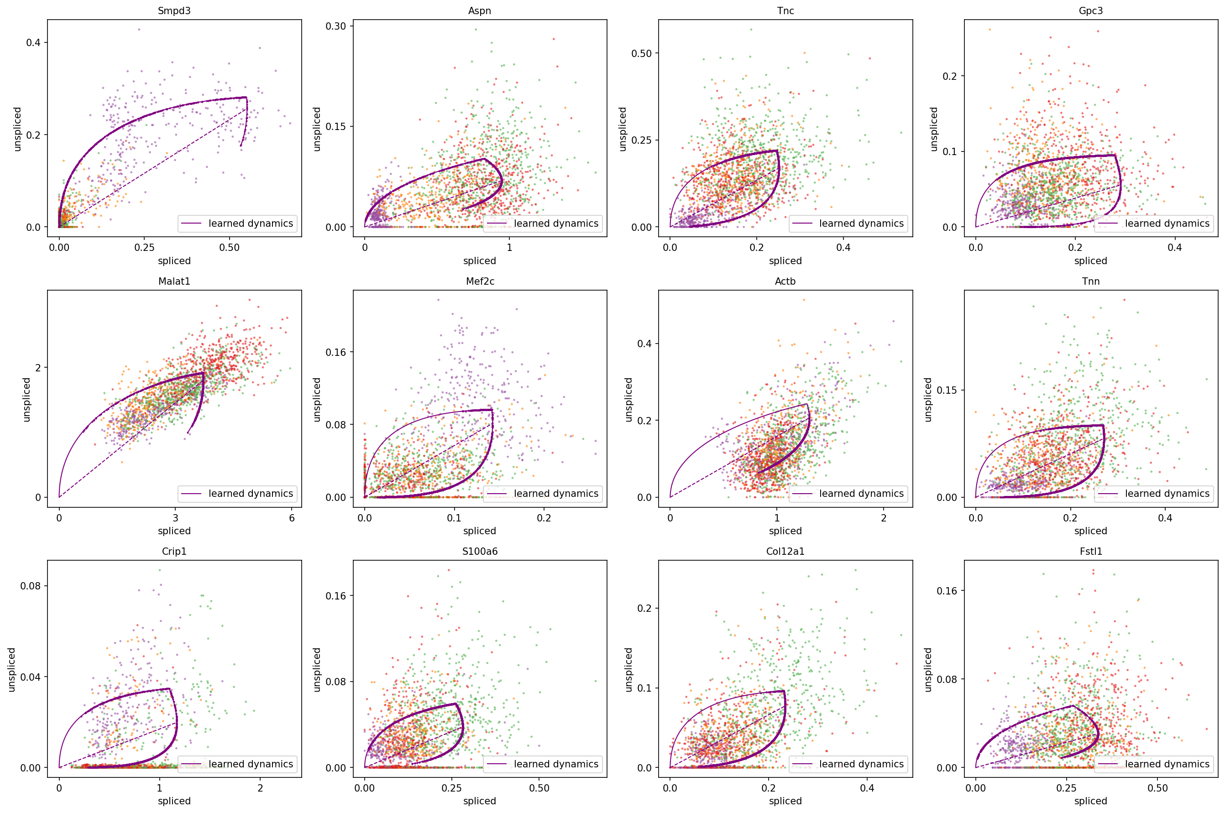
local_phase_portraits.png
Phase portraits (spliced vs unspliced) for top genes
figures_og_exact/local_phase_portraits.png

Slide 11
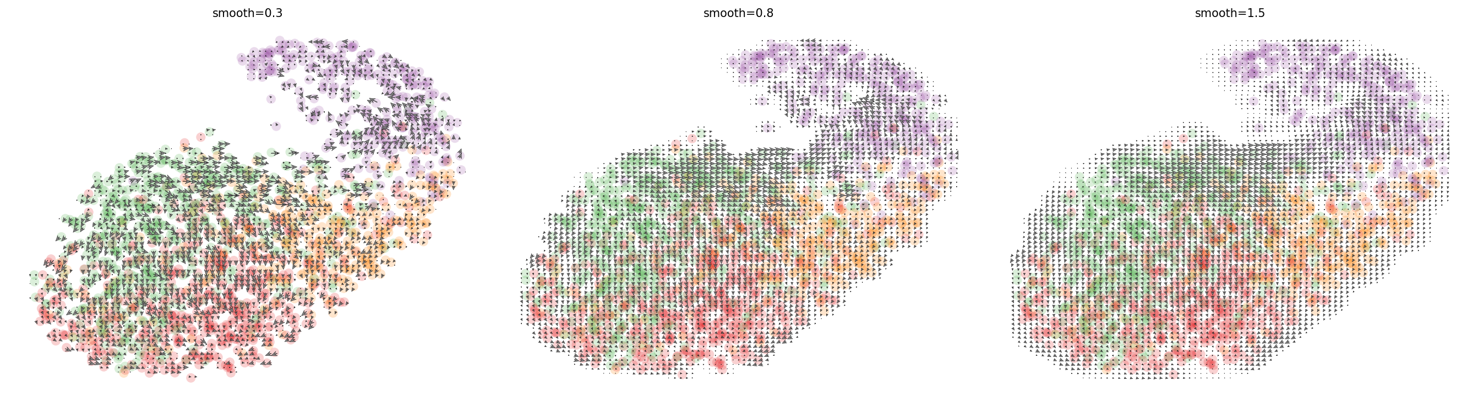
local_smooth_compare.png
figures_og_exact/local_smooth_compare.png

Slide 12
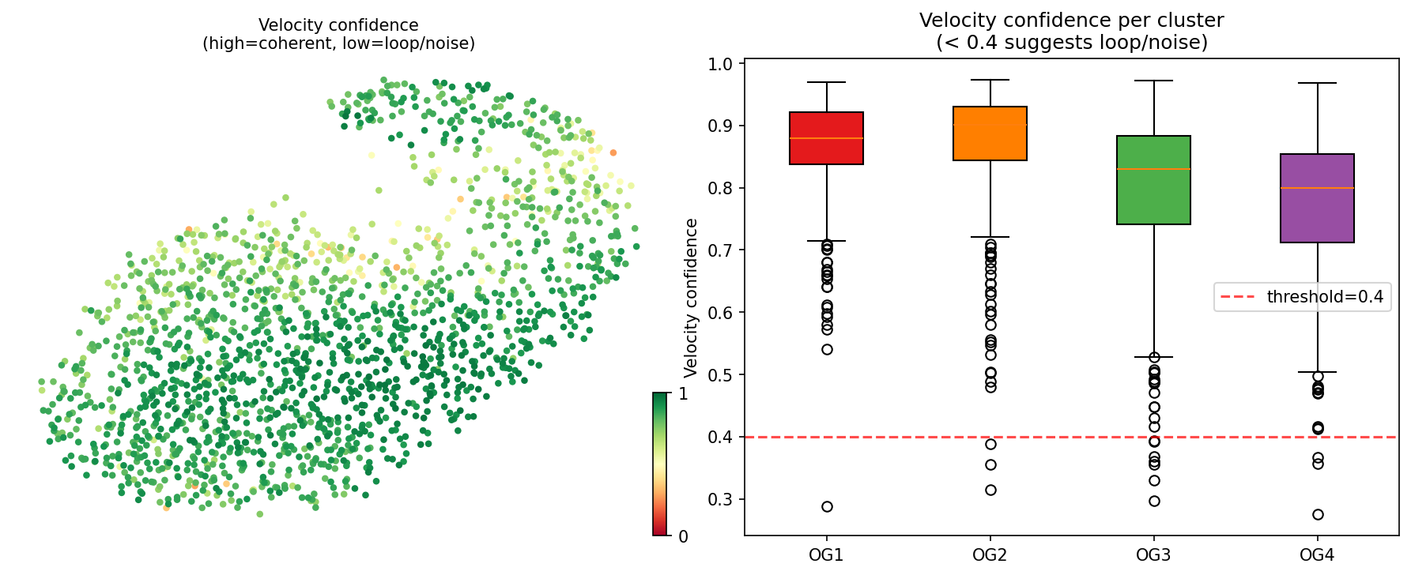
local_velocity_confidence.png
Velocity confidence per cell and per cluster
figures_og_exact/local_velocity_confidence.png

Slide 13
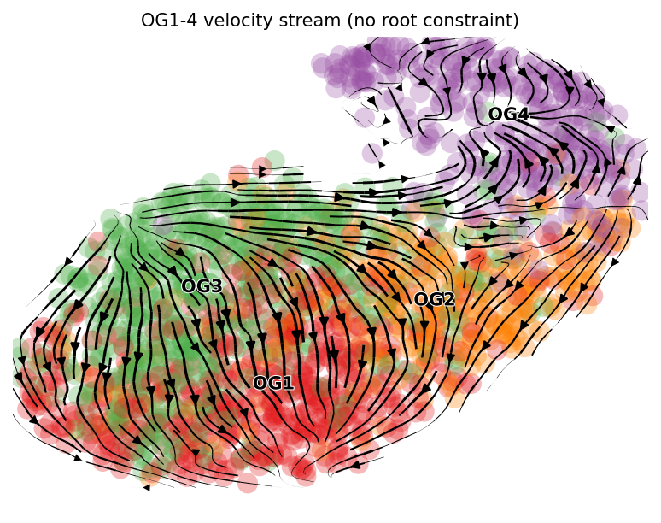
noroot_stream.png
figures_og_exact/noroot_stream.png

Slide 14
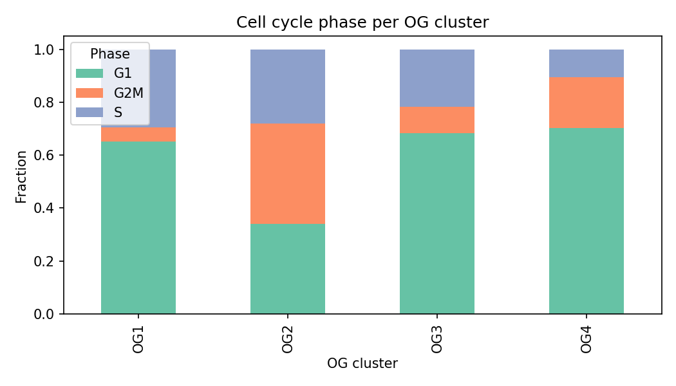
og_cellcycle_fraction.png
figures_og_exact/og_cellcycle_fraction.png

Slide 15
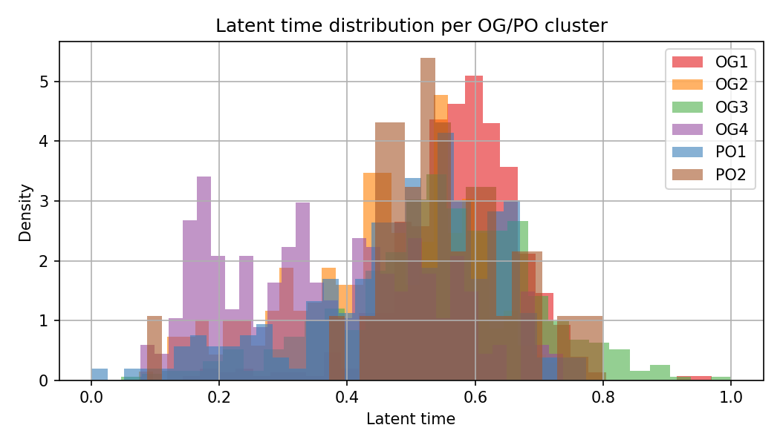
og_latent_time_hist.png
figures_og_exact/og_latent_time_hist.png

Slide 16
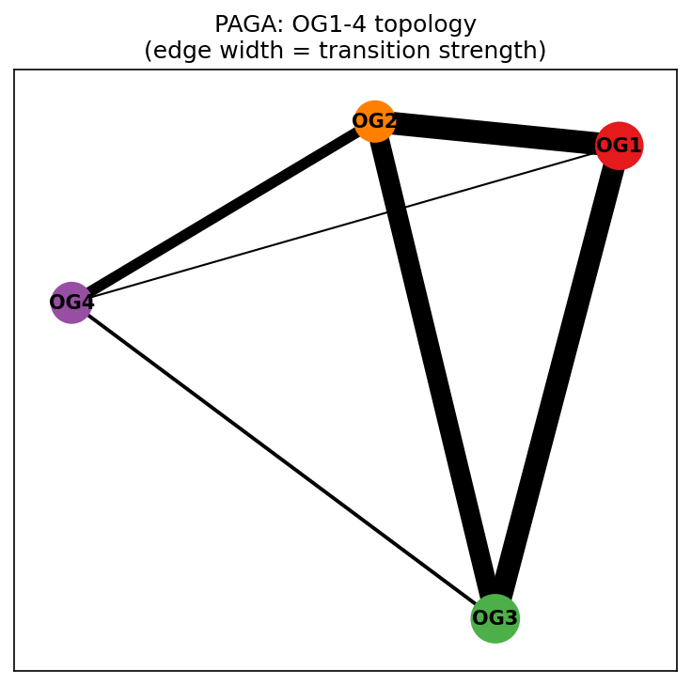
og_paga_graph.png
PAGA topology graph between OG/PO clusters
figures_og_exact/og_paga_graph.png

Slide 17
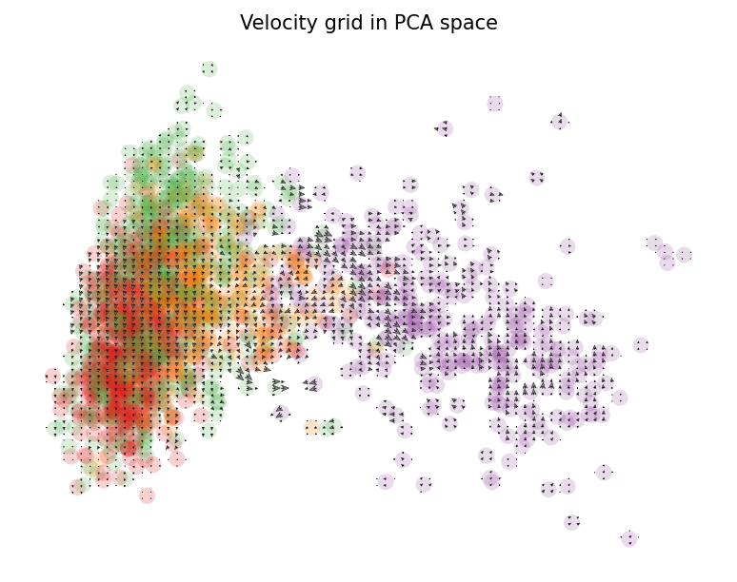
pca_grid.png
figures_og_exact/pca_grid.png

Slide 18
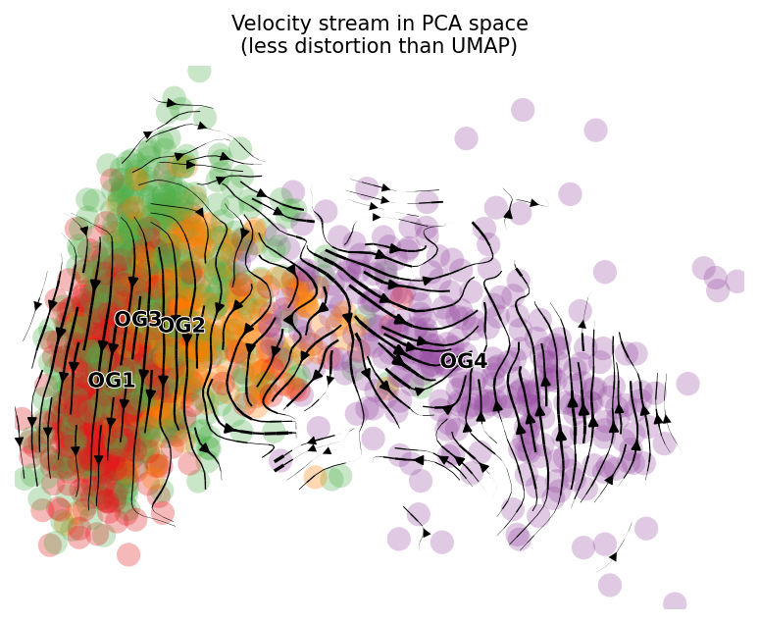
pca_stream.png
figures_og_exact/pca_stream.png

Slide 19
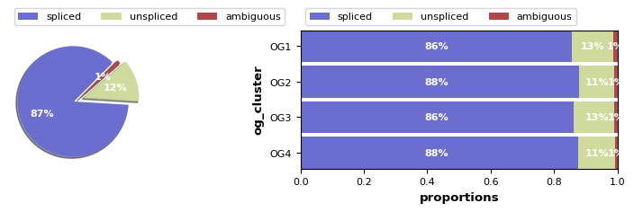
proportions.png
figures_og_exact/proportions.png

Slide 20
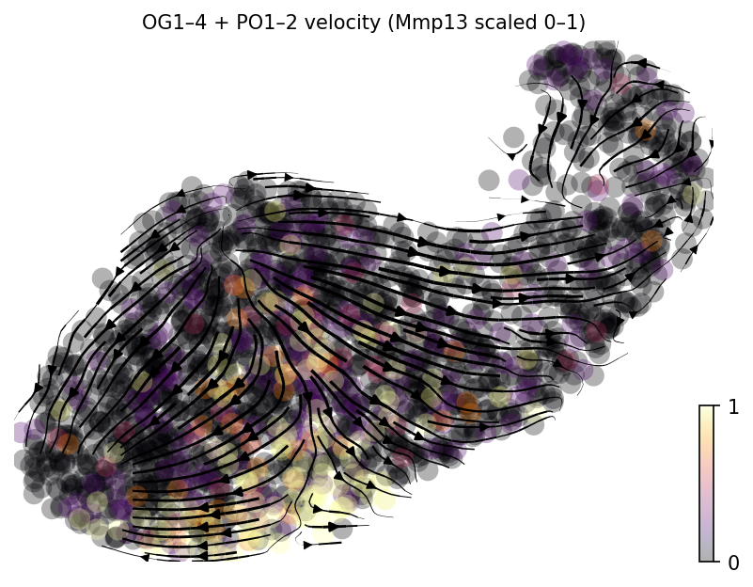
scvelo__og_exact_Mmp13_scaled.png
figures_og_exact/scvelo__og_exact_Mmp13_scaled.png

Slide 21
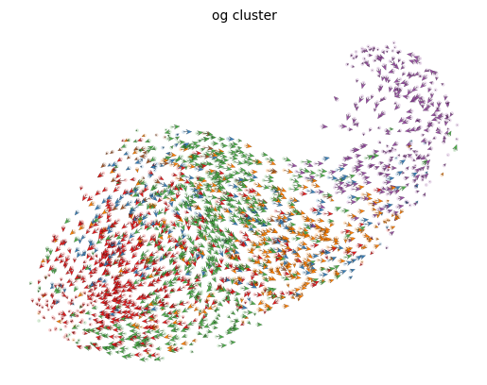
scvelo__og_exact_arrows.png
figures_og_exact/scvelo__og_exact_arrows.png

Slide 22
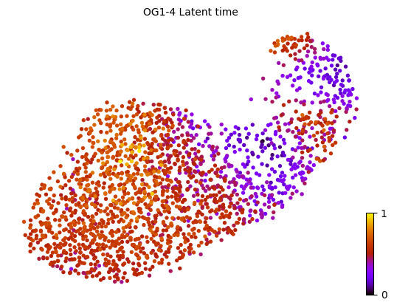
scvelo__og_exact_latent_time.png
figures_og_exact/scvelo__og_exact_latent_time.png

Slide 23
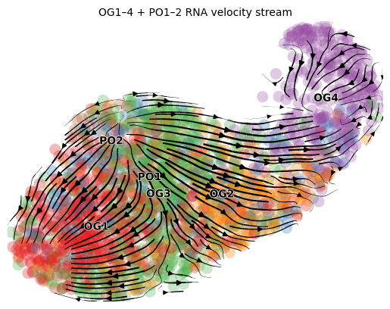
scvelo__og_exact_stream.png
figures_og_exact/scvelo__og_exact_stream.png

Slide 24
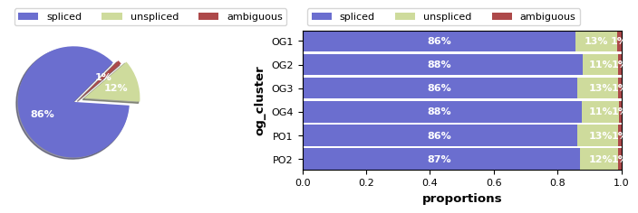
scvelo_proportions__og_proportions.png
figures_og_exact/scvelo_proportions__og_proportions.png

Slide 25
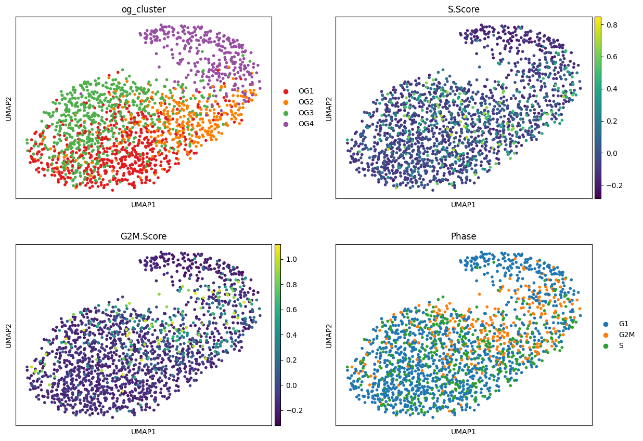
umap_og_cellcycle.png
figures_og_exact/umap_og_cellcycle.png

Slide 26
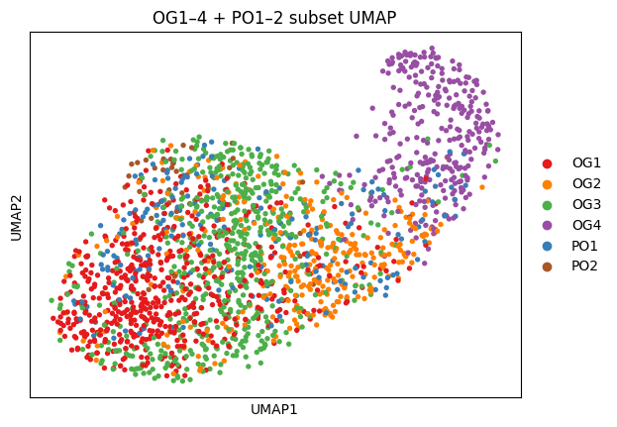
umap_og_exact_clusters.png
UMAP of OG1–4 + PO1–2 subset (cluster colors)
figures_og_exact/umap_og_exact_clusters.png

Slide 27
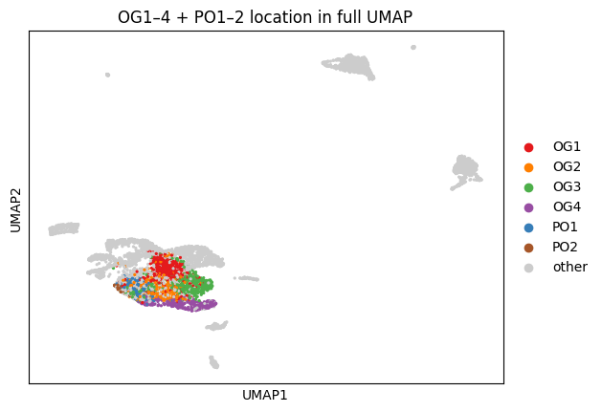
umap_og_in_full_umap.png
figures_og_exact/umap_og_in_full_umap.png

Slide 28
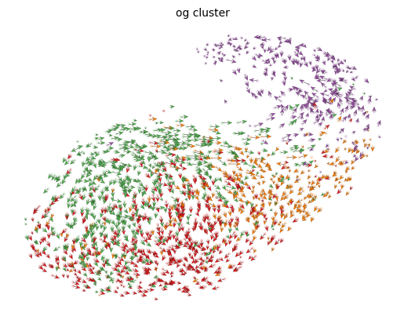
velocity_arrows.png
figures_og_exact/velocity_arrows.png

Slide 29
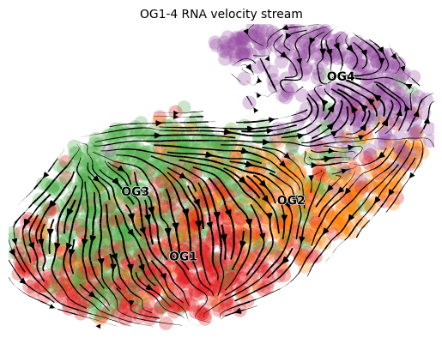
velocity_stream.png
RNA velocity stream on OG/PO UMAP
figures_og_exact/velocity_stream.png

