Slide 1
Mouse Cranial Suture RNA Velocity Analysis
Osteogenic cell differentiation and dedifferentiation trajectories in E17.5 coronal suture
Data: GSE163693 | Farmer et al. 2021, Nature Communications | scVelo + CellRank
OG1
OG2
OG3
OG4
PO1
PO2
SutureRNAVelocity Pipeline

Slide 2
Analysis Overview
Farmer et al. 2021 | GSE163693 | E17.5 mouse coronal suture
1
Data Download
2
velocyto
3
scVelo – Full dataset
3 BAM files (SRR13288596–98) via aria2c E17.5 coronal suture, 3 batches
Spliced / Unspliced count generation Gencode vM25 annotation (chr-prefix removed)
5,407 cells × 904 genes Dynamical model, Leiden clustering (19 clusters)
4
OG/PO Subset
5
CellRank (GPCCA)
6
Local Velocity
2,017 cells (OG1–4 + PO1–2) identified by metadata labels (GSE163693_E15_17_composite_metadata.csv.gz)
Bidirectional trajectory analysis Terminal: OG4 + OG1 | Initial: OG3
Velocity confidence ≥ 0.77 for all clusters Phase portraits, PCA-space velocity

Slide 3
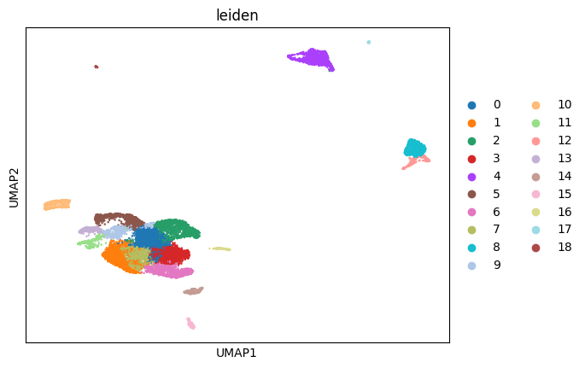
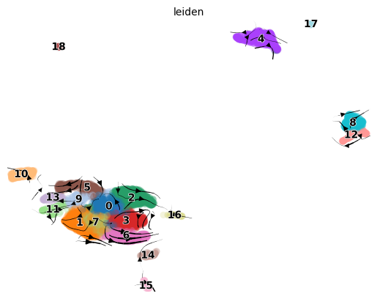
Full Dataset: UMAP and RNA Velocity
5,407 cells | Leiden clustering (19 clusters) | Dynamical model
Leiden clusters (19 groups)
RNA velocity stream (dynamical model)
scVelo dynamical model | Gencode vM25 annotation | E17.5 coronal suture

Slide 4
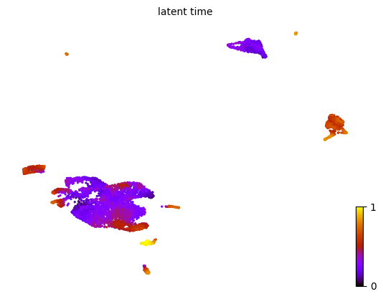
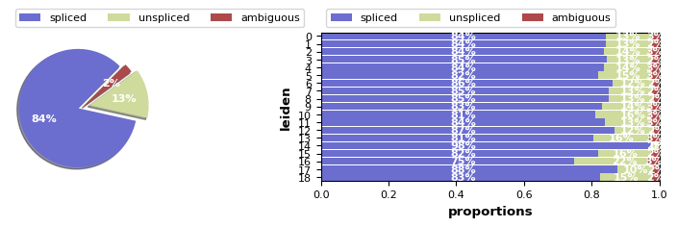
Full Dataset: Latent Time and Splicing Dynamics
Latent time (full dataset)
Spliced / Unspliced proportions per cluster

Slide 5
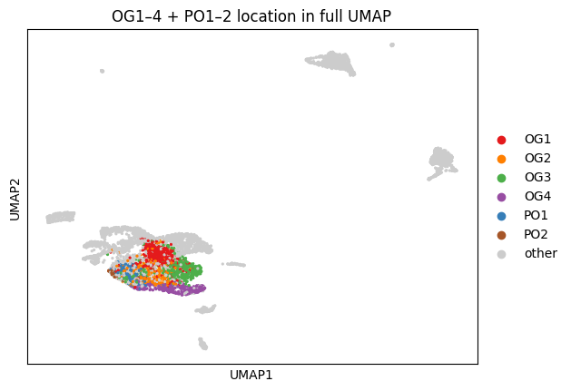
OG/PO Cluster Definition
Farmer et al. 2021 | Barcode-level identification using metadata labels
Cluster
Cells
Cell type
Markers
OG1
548 cells
Osteoprogenitors (earliest)
Erg, Pthlh, Six2
OG2
315 cells
Suture-resident pre-osteoblasts
Lef1, Inhba
OG3
603 cells
Periosteal pre-osteoblasts
Mmp13, Podnl1
OG4
306 cells
Mature osteoblasts
Ifitm5, Dmp1, Sost
PO1
206 cells
Periosteal osteoblasts (outer bone)
Total: 2,017 E17.5 OG/PO cells
OG1–4 + PO1–2 location in full UMAP
Barcodes matched to GSE163693_E15_17_composite_metadata.csv.gz
PO2
39 cells
Periosteal osteoblasts (mature subset)

Slide 6
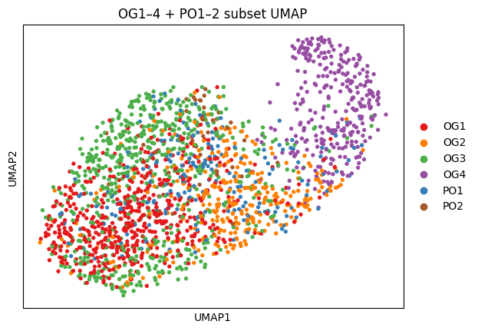
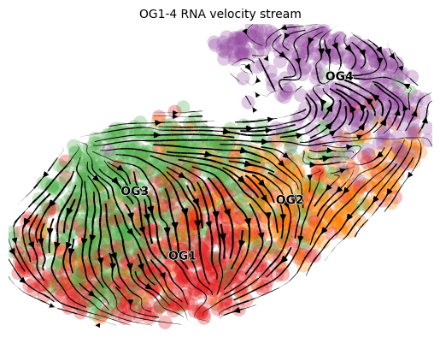
OG/PO Subset: UMAP and RNA Velocity
2,017 cells (OG1–4 + PO1–2) | Re-computed neighbors, UMAP, and velocity | Dynamical model
OG1–4 + PO1–2 subset UMAP
RNA velocity stream (dynamical model)
OG1 (red): progenitors | OG2 (orange): suture pre-OB | OG3 (green): periosteal pre-OB | OG4 (purple): mature OB | PO1 (blue): periosteal OB | PO2 (brown): periosteal OB (mature subset)

Slide 7
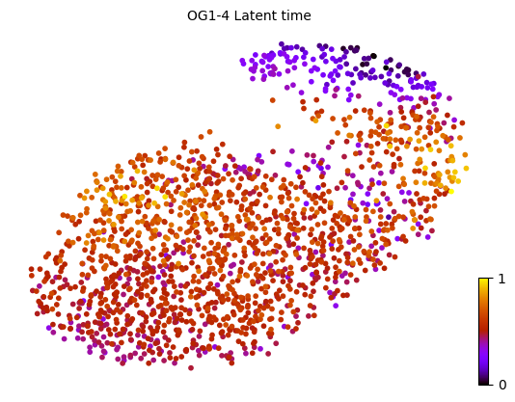
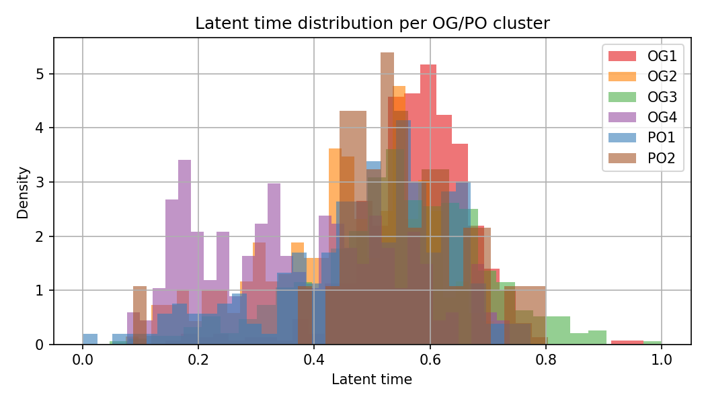
OG/PO Subset: Latent Time
Differentiation pseudotime estimated by scVelo dynamical model
Latent time on UMAP
Latent time distribution per OG/PO cluster
0 = earliest (progenitor), 1 = latest (mature osteoblast)

Slide 8
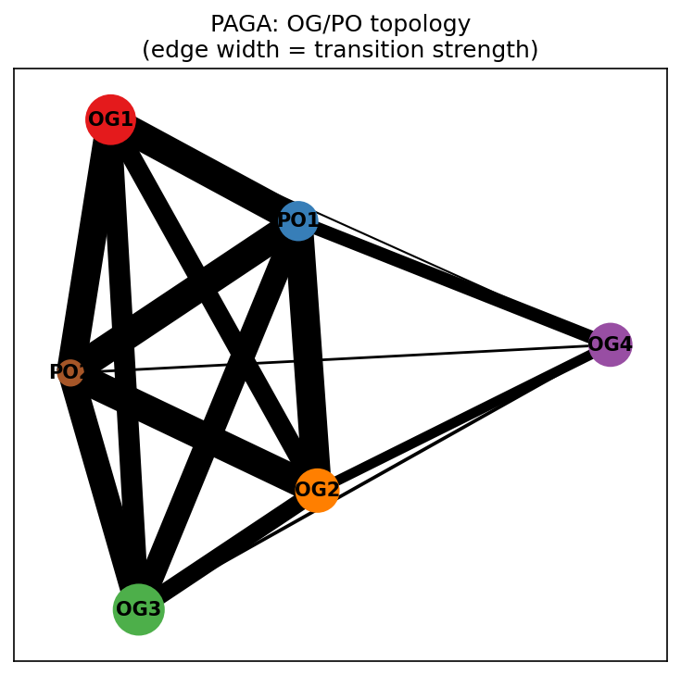
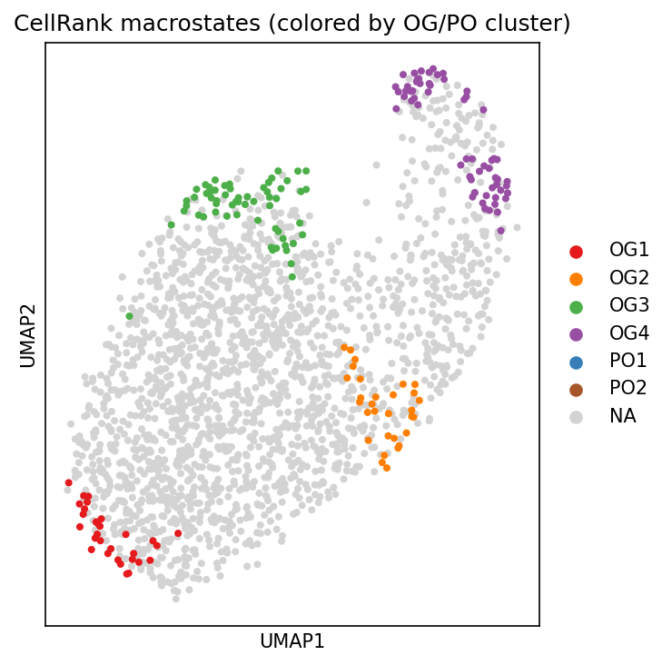
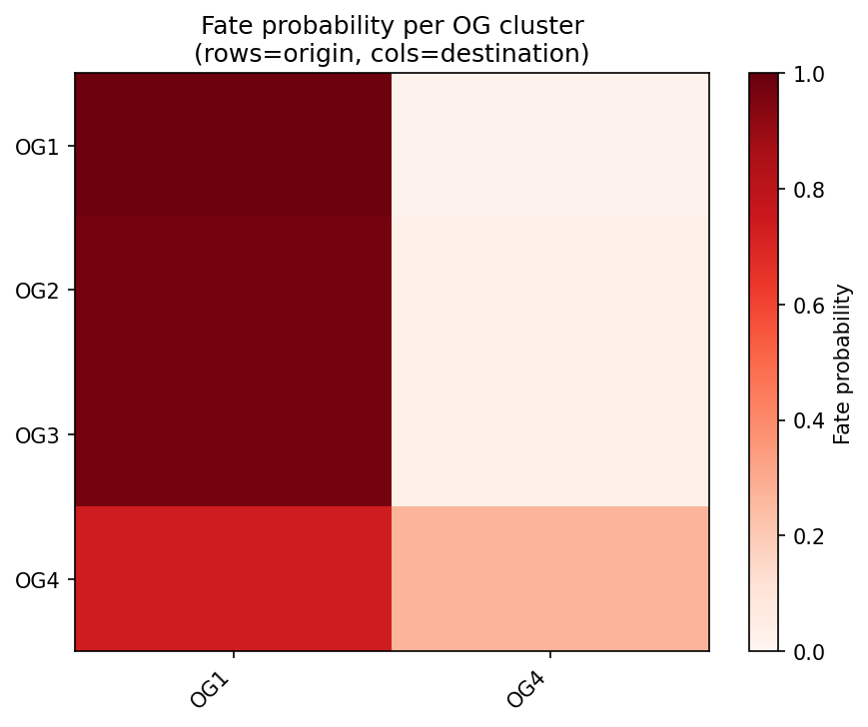
PAGA Topology and CellRank Analysis
Bidirectional analysis allowing dedifferentiation (OG4 → OG2)
PAGA graph (edge width = transition strength)
GPCCA macrostates
Fate probability heatmap
CellRank GPCCA | VelocityKernel (80%) + ConnectivityKernel (20%) | Terminal: OG4 + OG1 | Initial: OG3

Slide 9
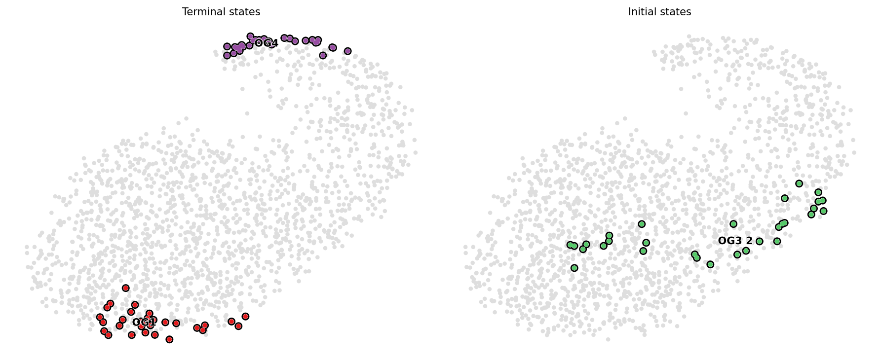
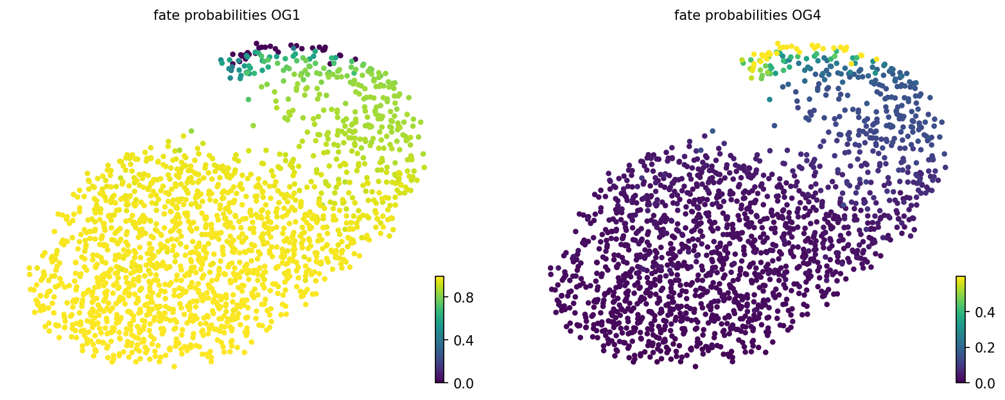
CellRank: Initial / Terminal States and Fate Probabilities
GPCCA identified OG1 as both initial and terminal state → dedifferentiation signal
Initial (left) and terminal (right) states
Fate probabilities per cell
Key finding: OG4 cells show 73% fate probability toward OG1 direction, suggesting a dedifferentiation pathway from mature osteoblasts to progenitors.

Slide 10
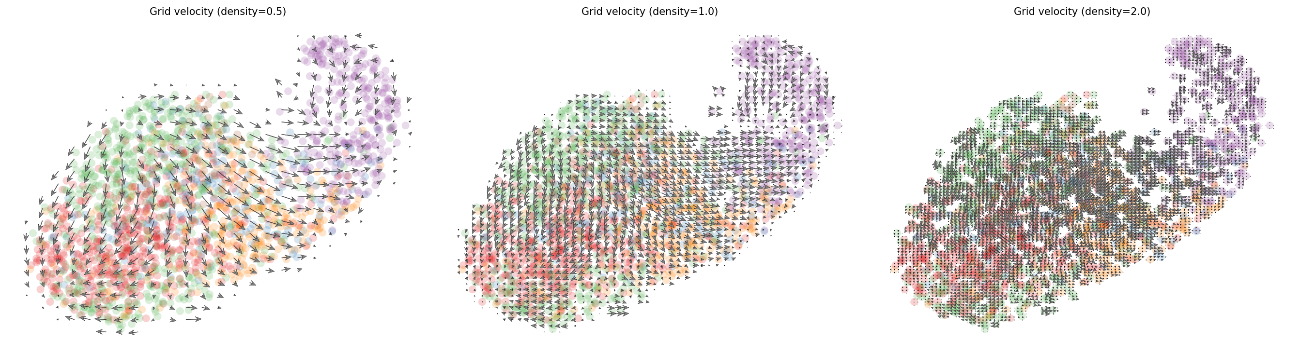
Local Velocity Analysis
Grid arrows and phase portraits to distinguish true loop from UMAP projection artifact
Grid velocity arrows at different densities (density = 0.5 / 1.0 / 2.0) Locally coherent arrows indicate directional flow, not a true cycle.

Slide 11
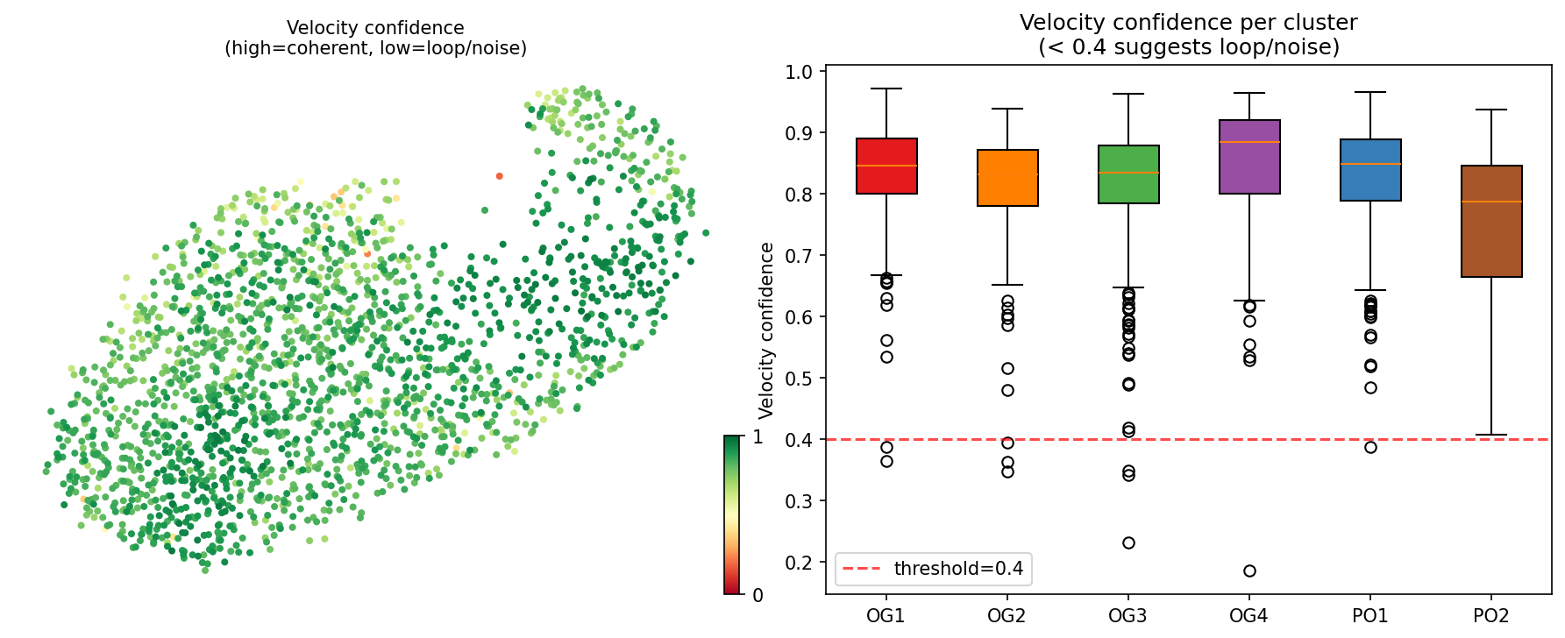
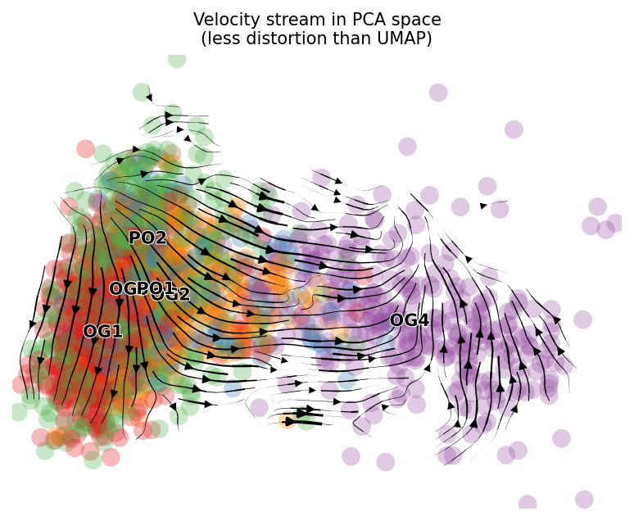
Velocity Confidence and PCA-Space Velocity
Confidence ≥ 0.77 for all clusters | PCA reduces UMAP distortion
Velocity confidence (left: UMAP, right: boxplot per cluster)
Velocity stream in PCA space
Cluster
Mean
Median
OG1
0.839
0.845
OG2
0.815
0.832
OG3
0.820
0.834
OG4
0.852
0.884
PO1
0.822
0.849
PO2
0.747
0.788

Slide 12
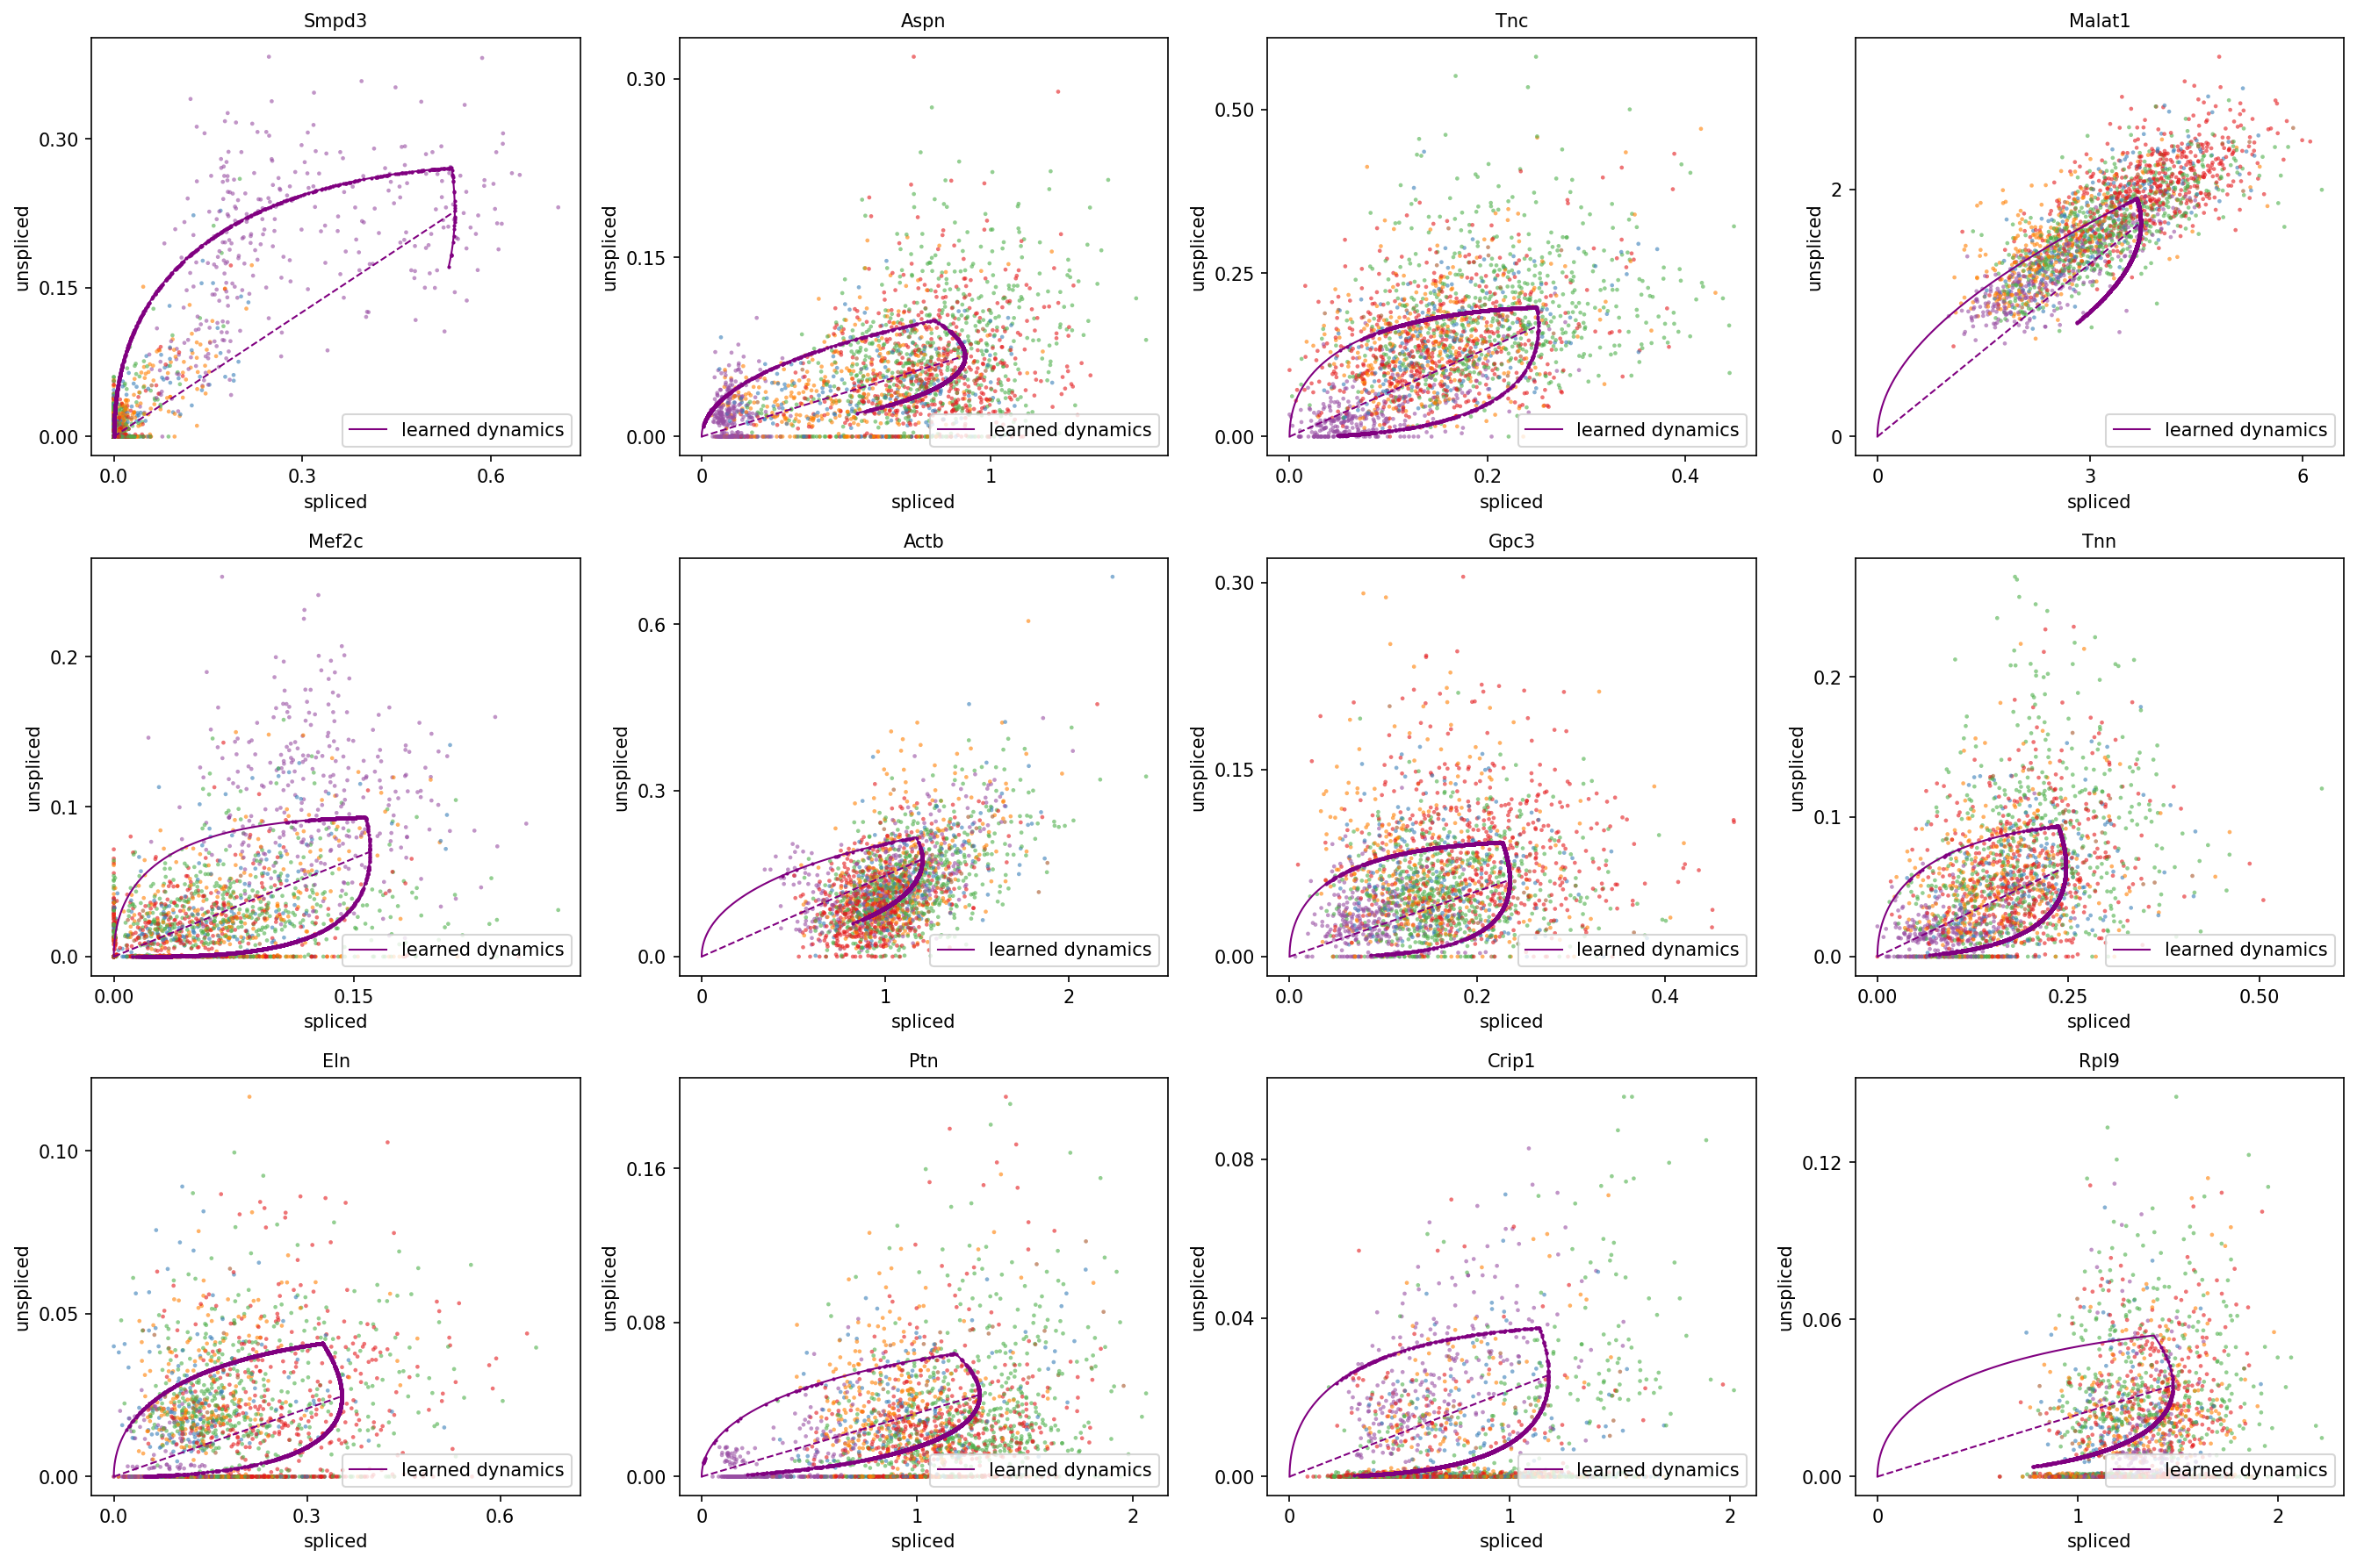
Phase Portraits: Spliced vs Unspliced
Diagonal distribution indicates monotonic kinetics (not a true cycle)
Diagonal: induction/repression (directional flow) | Ellipse: cyclic (true loop) | Top genes by fit_likelihood from dynamical model

Slide 13
Summary
Differentiation trajectory
OG1 (progenitors) → OG2/OG3 (pre-osteoblasts) → OG4 (mature osteoblasts) confirmed by RNA velocity in E17.5 coronal suture.
Bifurcation
PAGA reveals two branches from OG1: suture-resident (OG2, edge=0.77) and periosteal (OG3, edge=0.75), both converging on OG4.
Dedifferentiation signal
CellRank GPCCA identifies OG1 as a terminal state. OG4 cells show 73% fate probability toward OG1, suggesting dedifferentiation from mature osteoblasts to progenitors.
Loop is a projection artifact
Velocity confidence ≥ 0.77 for all clusters. Phase portraits show diagonal (monotonic) rather than elliptic (cyclic) distribution. The loop in UMAP reflects a Y-shaped bifurcation compressed in 2D.
Data: GSE163693 | Farmer et al. 2021, Nat Commun 12:4797 | Tools: scVelo, CellRank, scanpy

