Slide 1

Generic compression, decompression, archive library for 7zip: py7zr
Hiroshi Miura
https://github.com/miurahr

Slide 2
Popular compression formats for data science
Namep | Born | Algorithm and Strategy | Python
lzo | 2005 | Improved LZ77 | python-lzo (**)
quicklz | 2006 | Improved LZ77, speed | python-quicklz (**)
brotli | 2009 | Improved LZ77, Hafmann encode, 2nd context model | python-brotli(**)
lz4 | 2011 | Improved LZ77, speed | python-lz4 (**)
snappy | 2011 | Improved LZ77, speed | python-snappy(**)
Zstarndard | 2015 | Improved LZ77, speed、 entropy encode | python-zstandard(**)
** Binding to C library

Slide 3
Popular data compression and archiving formats
Name | Born | Compression Algorithm | Tools | Python
TAR | 1979 | None | GNU tar | tarfile
ZIP | 1989 | Deflate,(bzip2,LZMA,PPMd *) | PKZIP, WinZip | zipfile
GZIP | 1992 | Deflate | GNU gzip, zlib | gzip
xz | 1996 | LZMA, LZMA2 | XZ Utils, 7-zip | lzma
Bzip2 | 1996 | RLE,BWT,MTF,huffman code, delta | Bzip2, 7-zip, | bz2
7zip | 1999 | LZMA, LZMA2, Bzip2, PPMd, Deflate | 7-Zip p7zip | py7zr

Slide 4
Pure Python 7zip library - py7zr
Utilize lzma support on Python core (> python 3.3)
  Python 3.7 Supports LZMA, LZMA2, BCJ, Delta
  No support for BCJ2, PPMd compression algorithms.
7-zip compression and decompression with Pure python
  Supports UNIX extensions for file permission as compatible with p7zip.
Quality
  CI/CD, coverage with azure-pipelines and travis-CI
  Static type checks with mypy
  Documentations

Slide 5
Usage
$ pip install py7zr
$ py7zr l sample.7z
import py7zr
sf = py7zr.SevenZipFile("sample.7z", “r”)
sf.list()
sf.extractall(path=”tmp”)
sf.close()

Slide 6
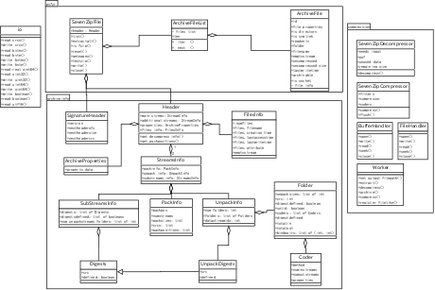
Inside py7zr: Class design
archiveinfo package: hold classes to represent 7zip header
structures.
py7zr package: provide
compression/decompression APIs
compressor package:
Implement compression algorithms

Slide 7
Inside py7zr: design patterns
Utilize Observer pattern
  Minimum memory foot print for compression/decompression
  Small number of file descriptor utilization.
  Support selectable decompression
  from archive.
  Not implement yet: progress display

Slide 8
Inside py7zr: safety with type check
class ArchiveFile:
def __init__(self, id: int, file_info: Dict[str, Any]) -> None:
self.id = id
self._file_info = file_info
def file_properties(self) -> Dict[str, Any]:
properties = self._file_info
if properties is not None:
properties['readonly'] = self.readonly
properties['posix_mode'] = self.posix_mode
properties['archivable'] = self.archivable
properties['is_directory'] = self.is_directory
return properties
def _get_property(self, key: str) -> Any:
try:
return self._file_info[key]

Slide 9
Inside py7zr
Multi-threading compression/decompression for large scale archive file
  lzma core library in Python core is not thread safe
  Generate LZMADecompressor object for each threads.
Unit tests and file extraction tests

Slide 10
Copyright and license
py7zr is distributed under GNU general public license 2.1 and later
Copyrights
  2019 Hiroshi Miura
  pylzma copyright(c) 2004-2015 by Joachim Bauch
  7-Zip copyright (c) 1999-2010 Igor Pavlov

Slide 11
Active community
Community development on github project
https://github.com/miurahr/py7zr
As usual, forks and pull requests are welcome.
Decompression is now beta quality, compression is now alpha.
Implementation of compression is under active development.

