Slide 1
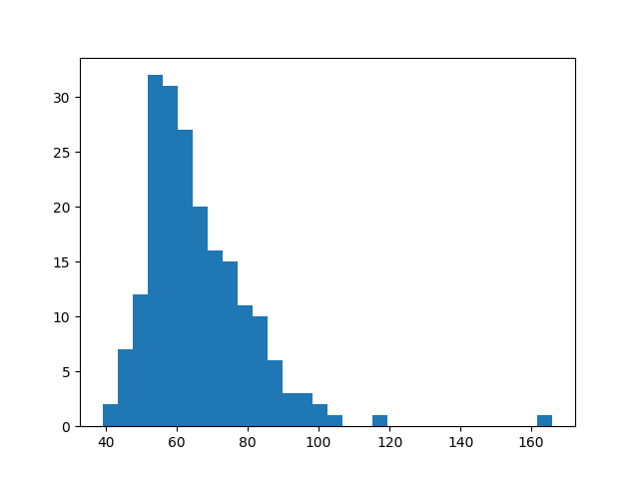
データセット表示
https://vincentarelbundock.github.io/Rdatasets/datasets.html
RにあるデータセットをCSV形式でダウンロード可能
Davis.csvを体重に関して頻度分布図作成
import numpy as np
import pandas as pd
import matplotlib.pyplot as plt
df = pd.read_csv("Davis.csv")
plt.hist(df["weight"], bins=30)
plt.show()

Slide 2
平均と分散算出
import numpy as np
import pandas as pd
import matplotlib.pyplot as plt
df = pd.read_csv("Davis.csv")
m = df.weight.mean()
s2 = ((df.weight-m) ** 2).mean()
print(m,s2)

Slide 3
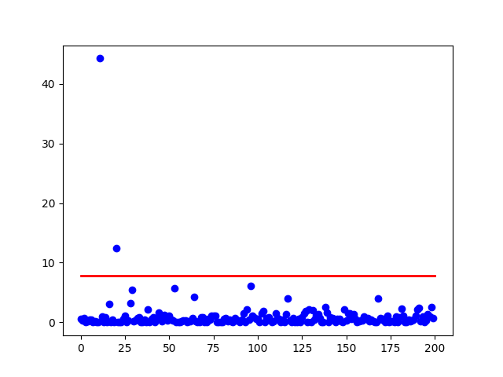
異常度、閾値、プロット
import numpy as np
import pandas as pd
import matplotlib.pyplot as plt
from scipy import stats
df = pd.read_csv("Davis.csv")
mu = df.weight.mean()
s2 = ((df.weight-mu) ** 2).mean()
a = ((df.weight-mu)**2)/s2
th = stats.chi2.interval(0.99,1)[1]
plt.scatter(np.arange(df.weight.size), a, color = 'b')
plt.plot([0,200], [th,th],'k-', color = "r", linewidth=2)
plt.show()

Slide 4
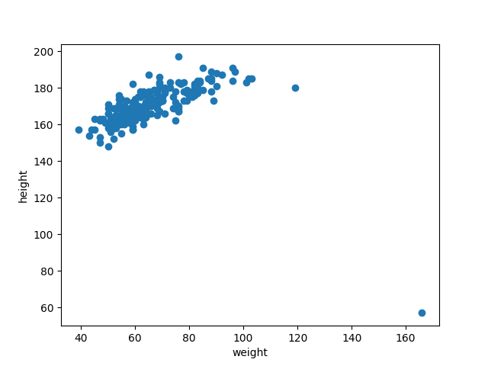
二変数の散布図
import numpy as np
import pandas as pd
import matplotlib.pyplot as plt
from scipy import stats
weight = pd.read_csv('Davis.csv')['weight'].values
height = pd.read_csv('Davis.csv')['height'].values
plt.scatter(weight,height)
plt.xlabel('weight')
plt.ylabel('height')
plt.show()

Slide 5
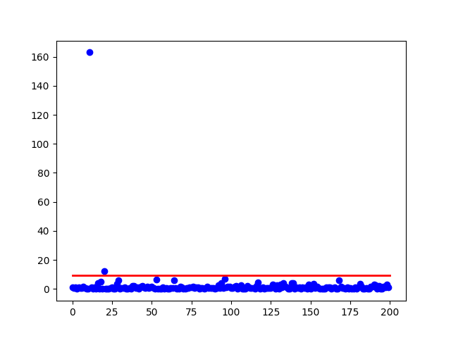
二変数の標本平均、標本共分散、異常度、閾値、プロット
import numpy as np
import pandas as pd
import matplotlib.pyplot as plt
from scipy import stats
from numpy import linalg as la
df = pd.read_csv('Davis.csv').values
x = df[: ,2:4]
mx = x.mean(axis = 0)
xc = x - mx
xc.shape
sx = (xc.T.dot(xc) / x[:,0].size).astype(float)
ap = np.dot(xc, np.linalg.inv(sx)) * xc
a = ap[:,0] + ap[:,1]
th = stats.chi2.ppf(0.99,2)
plt.scatter(np.arange(a.size), a, color='b')
plt.plot([0,200],[th,th],'k-',color='r',linewidth=2)
plt.show()

Slide 6
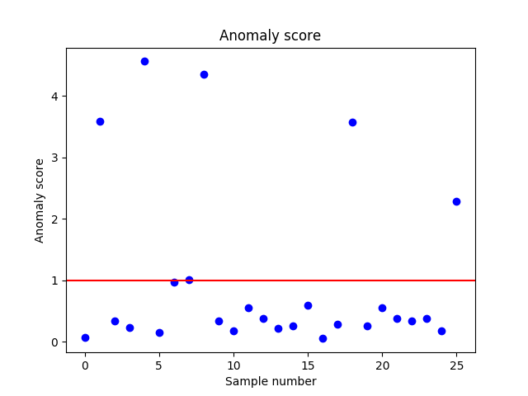
マハラノビス＝タグチ法
import numpy as np
import pandas as pd
from matplotlib import pyplot as plt
df = pd.read_csv('road.csv',index_col=0)
X = df.drop("drivers", axis=1).values
drivers = df.as_matrix(columns=["drivers"])
X = X / drivers
X = np.log(X + 1)
mx = X.mean(axis=0)
Xc = X-mx
Sx = np.cov(X,rowvar=0,bias=1)
a = (Xc.dot(np.linalg.pinv(Sx))*Xc).sum(axis=1) / X.shape[1]
th = 1.0
plt.plot(range(len(a)), a, "bo")
plt.axhline(y=th,color='red')
plt.title("Anomaly score")
plt.xlabel("Sample number")
plt.ylabel("Anomaly score")
plt.show()

Slide 7
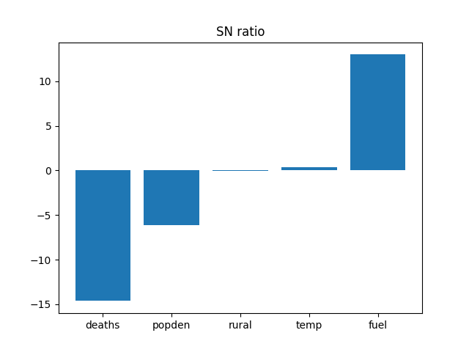
マハラノビス＝タグチ法 ある州のSN比解析
import numpy as np
import pandas as pd
from matplotlib import pyplot as plt
df = pd.read_csv('road.csv',index_col=0)
X = df.drop("drivers", axis=1).values
drivers = df.as_matrix(columns=["drivers"])
X = X / drivers
X = np.log(X + 1)
mx = X.mean(axis=0)
Xc = X-mx
Sx = np.cov(X,rowvar=0,bias=1)
xc_prime = Xc[4,:]
SN1 = 10 * np.log10(xc_prime**2 / np.diag(Sx))
plt.bar(range(len(SN1)), SN1, tick_label=["deaths","popden","rural","temp","fuel"], align="center")
plt.title("SN ratio")
plt.show()

Slide 8
ガンマ分布のk,sの推定（モーメント法、最尤法）
import numpy as np
import pandas as pd
import matplotlib.pyplot as plt
import scipy.stats as stats
df = pd.read_csv("Davis.csv")
mu = df.weight.mean()
si = np.std(df.weight)*(len(df.weight) - 1)/len(df.weight)
kmo = mu ** 2 /si ** 2
smo = si ** 2 / mu
print(kmo,smo)
fit_alpha, fit_loc, fit_beta = stats.gamma.fit(np.array(df.weight), floc=0)
print(fit_alpha,fit_beta)

Slide 9
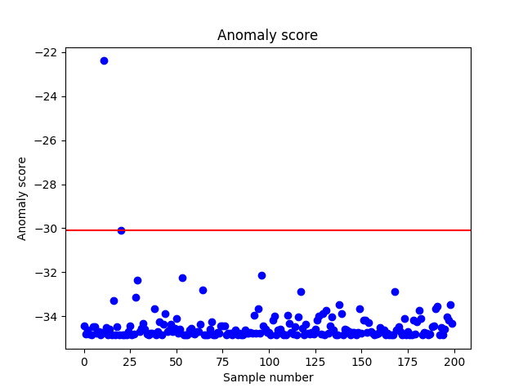
ガンマ分布での異常度プロット
import numpy as np
import pandas as pd
import matplotlib.pyplot as plt
import scipy.stats as stats
df = pd.read_csv("Davis.csv")
mu = df.weight.mean()
si = np.std(df.weight)*(len(df.weight) - 1)/len(df.weight)
kmo = mu ** 2 /si ** 2
smo = si ** 2 / mu
fit_alpha, fit_loc, fit_beta = stats.gamma.fit(np.array(df.weight), floc=0)
a = df.weight / smo - (kmo - 1) * np.log(df.weight / smo)
sorted_a = sorted(a,reverse = True)
th = sorted_a[(int(len(df.weight) * 0.01 - 1))]
plt.plot(range(len(a)), a, "bo")
plt.axhline(y=th,color='red')
plt.title("Anomaly score")
plt.xlabel("Sample number")
plt.ylabel("Anomaly score")
plt.show()

Slide 10
混合正規分布作成
import numpy as np
from scipy.stats import norm
import math
n0 = norm.rvs(3.0, 0.5, size=600)
n1 = norm.rvs(0, 3.0, size=400)
n = np.concatenate([n0, n1]) ＃本来は出現確率で標本数1000を
np.random.shuffle(n) 分けたかった
norm.rvsの引数に少数をとるときはそのまま入れたほうがいい！

Slide 11
混合正規分布の期待値ー最大化法
import numpy as np
from scipy.stats import norm
import math
n0 = norm.rvs(3.0, 0.5, size=600)
n1 = norm.rvs(0, 3.0, size=400)
n = np.concatenate([n0, n1])
np.random.shuffle(n)
N = 1000
pi0 = 0.5
pi1 = 0.5
mu0 = 5.0
mu1 = -5.0
sig0 = 1.0
sig1 = 5.0
ite = range(10)
for i in ite:
piN0 = norm.pdf(x=n, loc=mu0, scale=sig0)
piN1 = norm.pdf(x=n, loc=mu1, scale=sig1)
qn0 = piN0 / (piN0 + piN1)
qn1 = piN1 / (piN0 + piN1)
pi0 = qn0.sum() / N
pi1 = qn1.sum() / N
mu0 = (qn0 * n).sum() / (N * pi0)
mu1 = (qn1 * n).sum() / (N * pi1)
sig0 = math.sqrt((qn0 * (n - mu0) * (n - mu0)).sum() / (N * pi0))
sig1 = math.sqrt((qn1 * (n - mu1) * (n - mu1)).sum() / (N * pi1))
print(pi0, mu0, sig0)
print(pi1, mu1, sig1)

Slide 12
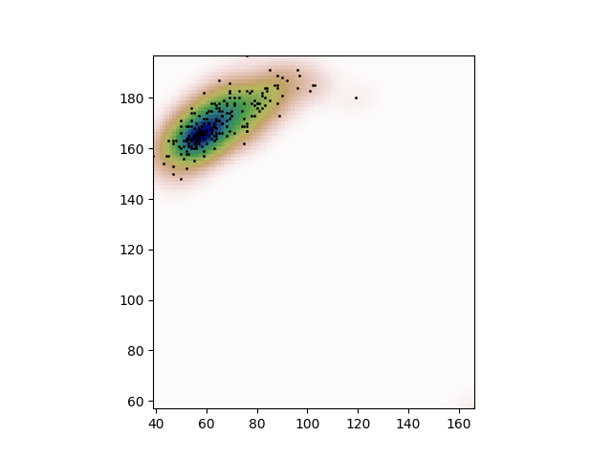
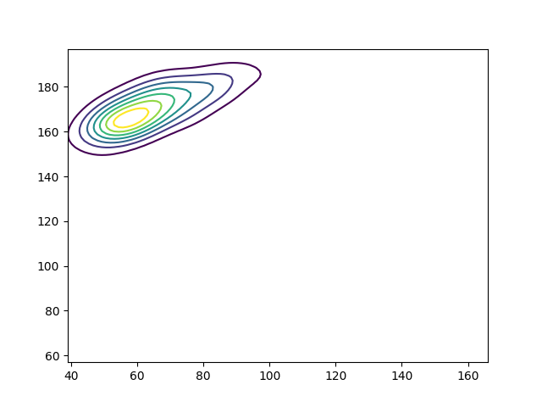
二次元の密度推定
import numpy as np
import pandas as pd
from matplotlib import pyplot as plt
from scipy.stats import gaussian_kde
df = pd.read_csv("Davis.csv")
weight = df["weight"]
height = df["height"]
values = np.vstack([weight, height])
kernel = gaussian_kde(values)
weight_max = weight.max()
weight_min = weight.min()
height_max = height.max()
height_min = height.min()
x, y = np.mgrid[weight_min:weight_max:100j, height_min:height_max:100j]
positions = np.vstack([x.ravel(), y.ravel()])
z = np.reshape(kernel(positions).T, x.shape)
fig, ax = plt.subplots()
ax.imshow(np.rot90(z), cmap=plt.cm.gist_earth_r, extent=[weight_min, weight_max, height_min, height_max])ax.plot(weight, height, 'k.', markersize=2)
ax.set_xlim([weight_min, weight_max])
ax.set_ylim([height_min, height_max])
plt.show()
plt.contour(x,y,z)
plt.show()

Slide 13
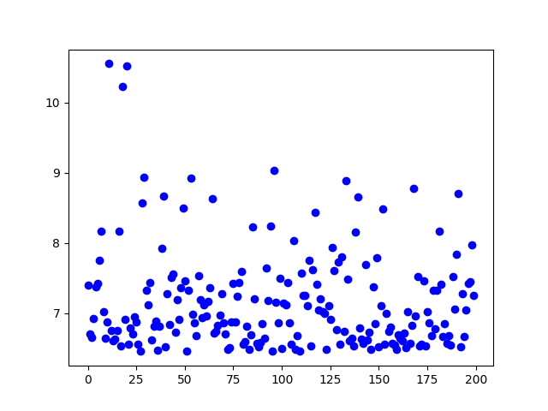
カーネル推定からの異常度
import numpy as np
import pandas as pd
from matplotlib import pyplot as plt
from scipy.stats import gaussian_kde
df = pd.read_csv("Davis.csv")
weight = df["weight"]
height = df["height"]
values = np.vstack([weight, height])
kernel = gaussian_kde(values)
a = -kernel.logpdf(values)
plt.plot(range(len(a)), a, "bo")
plt.show()

Slide 14
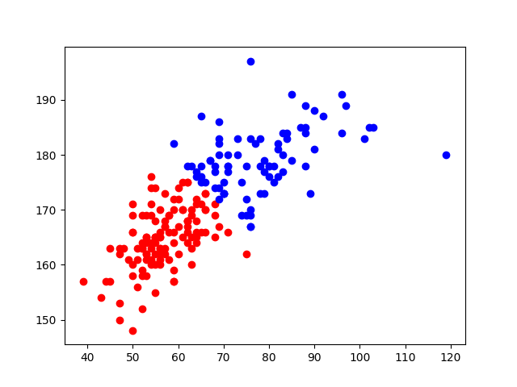
クラスタリング
import numpy as np
import pandas as pd
from matplotlib import pyplot as plt
from sklearn.mixture import GMM
df = pd.read_csv("Davis.csv")
weight = df["weight"]
height = df["height"]
X = pd.concat([weight, height], axis=1)
X_train = X.drop(11)
X = X.values
X_train = X_train.values
clf = GMM(n_components=2)
clf.fit(X_train)
X_pred = clf.predict(X_train)
cluster0 = X_train[X_pred == 0]
cluster1 = X_train[X_pred == 1]
plt.scatter(cluster0[:,0], cluster0[:,1], color="red")
plt.scatter(cluster1[:,0], cluster1[:,1], color="blue")
plt.show()
gmm = BayesianGaussianMixture(n_components=10, verbose=1, max_iter=10000)
こうすることで、クラスタ数の推定も行える！

Slide 15
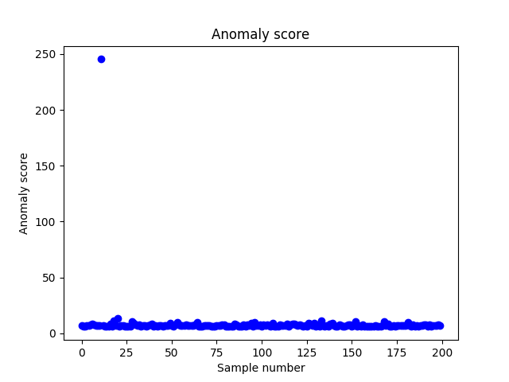
混合正規分布の異常度
import numpy as np
import pandas as pd
from matplotlib import pyplot as plt
from sklearn.mixture import GMM
df = pd.read_csv("Davis.csv")
weight = df["weight"]
height = df["height"]
X = pd.concat([weight, height], axis=1)
X_train = X.drop(11)
X = X.values
X_train = X_train.values
clf = GMM(n_components=2)
clf.fit(X_train)
X_pred = clf.predict(X_train)
anomaly_scores = -clf.score_samples(X)[0]
plt.title("Anomaly score")
plt.xlabel("Sample number")
plt.ylabel("Anomaly score")
plt.plot(range(len(anomaly_scores)), anomaly_scores, "bo")
plt.show()

Slide 16
混合正規分布の作成、標準化、、１クラス支持ベクトル分類器
import numpy as np
from matplotlib import pyplot as plt
from sklearn import preprocessing
from sklearn import svm
from scipy import stats
X1 = np.random.normal(0.0, 1.0, (60,2))
X2 = np.random.normal(3.0, 1.0, (60,2))
X = np.vstack([X1, X2])
X_train = preprocessing.scale(X)
clf = svm.OneClassSVM(nu=0.1, kernel="rbf", gamma=0.5)
clf.fit(X_train)
y_pred_train = clf.predict(X_train)

Slide 17
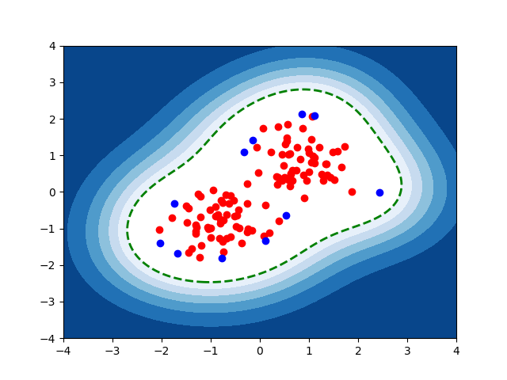
支持ベクトルデータの基づく異常度
import numpy as np
from matplotlib import pyplot as plt
from sklearn import preprocessing
from sklearn import svm
from scipy import stats
X1 = np.random.normal(0.0, 1.0, (60,2))
X2 = np.random.normal(3.0, 1.0, (60,2))
X = np.vstack([X1, X2])
X_train = preprocessing.scale(X)
clf = svm.OneClassSVM(nu=0.1, kernel="rbf", gamma=0.5)
clf.fit(X_train)
y_pred_train = clf.predict(X_train)
th = stats.scoreatpercentile(y_pred_train, 100 * 0.05)
xx, yy = np.meshgrid(np.linspace(-4, 4, 500), np.linspace(-4, 4, 500))
Z = clf.decision_function(np.c_[xx.ravel(), yy.ravel()])
Z = Z.reshape(xx.shape)
plt.contourf(xx, yy, Z, levels=np.linspace(Z.min(), th, 7), cmap=plt.cm.Blues_r)
plt.contour(xx, yy, Z, levels=[th], linewidths=2, colors='green')
plt.scatter(X_train[y_pred_train==1][:,0], X_train[y_pred_train==1][:,1], color="red")
plt.scatter(X_train[y_pred_train==-1][:,0], X_train[y_pred_train==-1][:,1], color="blue")
plt.show()

Slide 18
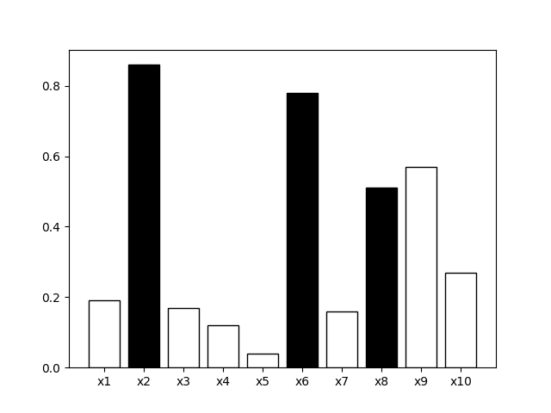
異常度と異常かどうかの識別１
import numpy as np
import matplotlib.pyplot as plt
from matplotlib.colors import ListedColormap
score = np.array([0.19,0.86,0.17,0.12,0.04,0.78,0.16,0.51,0.57,0.27])
anomaly = ["1.0","0.0","1.0","1.0","1.0","0.0","1.0","0.0","1.0","1.0"]
data0 = np.vstack((score,anomaly))
plt.bar(range(len(score)),score,tick_label=["x1","x2","x3","x4","x5","x6","x7","x8","x9","x10"],color=anomaly,edgecolor = "0.0")
plt.show()

Slide 19
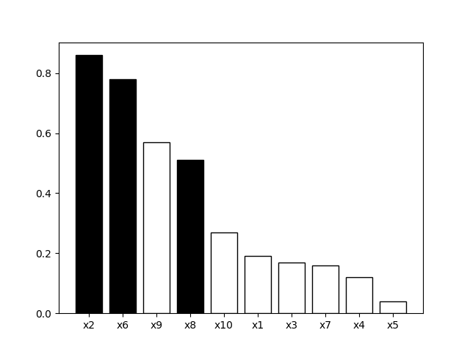
異常度と異常かどうかの識別２
import numpy as np
import matplotlib.pyplot as plt
from matplotlib.colors import ListedColormap
score = np.array([0.19,0.86,0.17,0.12,0.04,0.78,0.16,0.51,0.57,0.27])
anomaly = ["1.0","0.0","1.0","1.0","1.0","0.0","1.0","0.0","1.0","1.0"]
data0 = np.vstack((score,anomaly))
data1 = data0[:, np.argsort(data0[0])[::-1]]
score_sorted = np.sort(score)[::-1]
plt.bar(range(len(data1[0])),score_sorted,tick_label=["x2","x6","x9","x8","x10","x1","x3","x7","x4","x5"],color=data1[1],edgecolor = "0.0")
plt.show()

Slide 20
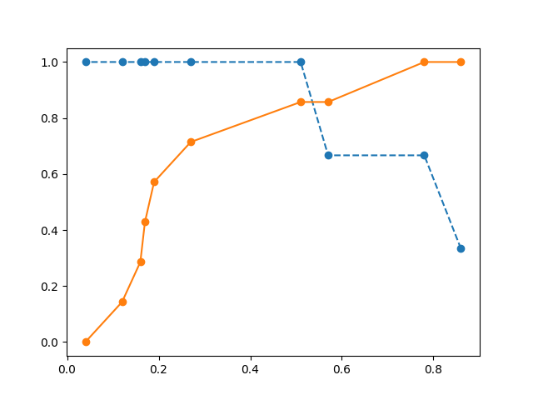
分岐点
import numpy as np
import matplotlib.pyplot as plt
from matplotlib.colors import ListedColormap
score = np.array([0.19,0.86,0.17,0.12,0.04,0.78,0.16,0.51,0.57,0.27])
anomaly =np.array([0.0,1.0,0.0,0.0,0.0,1.0,0.0,1.0,0.0,0.0])
data0 = np.vstack((score,anomaly))
data1 = data0[:, np.argsort(data0[0])[::-1]]
score_sorted = data1[0]
anomaly_sorted = data1[1]
n_total = len(anomaly)
n_norm = sum(anomaly)
n_anom = n_total - n_norm
coverage = [0] * n_total
detection = [0] * n_total
for i in range (n_total):
n_detectedAnom = sum(anomaly_sorted[0:i+1])
n_detectedNorm = (n_total-i-1) - sum(anomaly_sorted[i+1:10])
coverage[i] = n_detectedAnom / n_norm
detection[i] = n_detectedNorm / n_anom
plt.plot(score_sorted,coverage,marker = "o",linestyle="dashed")
plt.plot(score_sorted,detection,marker = "o")
plt.show()

Slide 21
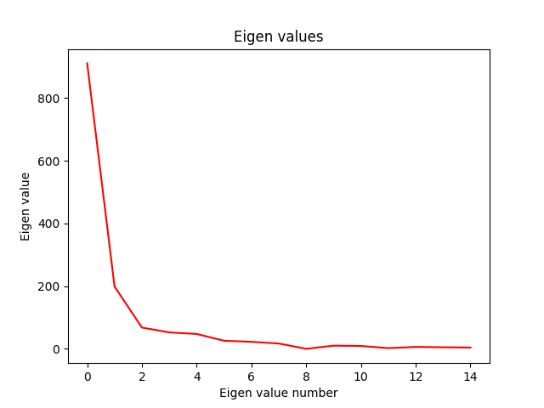
主成分分析による異常検知 固有値のプロット
import pandas as pd
import numpy as np
from matplotlib import pyplot as plt
df = pd.read_csv("Cars93.csv")
mask = ["Min.Price", "Price", "Max.Price", "MPG.city", "MPG.highway", "EngineSize", "Horsepower", "RPM", "Rev.per.mile", "Fuel.tank.capacity","Length", "Wheelbase","Width", "Turn.circle", "Weight"]
X = df[mask]
X = (X - X.mean()) / X.std()
X = X.T
Xc = X.values
S = Xc.dot(Xc.T)
evd, v = np.linalg.eig(S)
plt.plot(range(len(evd)), evd, color="red")
plt.title("Eigen values")
plt.xlabel("Eigen value number")
plt.ylabel("Eigen value")
plt.show()

Slide 22
主成分分析による異常検知 異常度上位六つを出力 散布行列
import pandas as pd
import numpy as np
from matplotlib import pyplot as plt
df = pd.read_csv("Cars93.csv")
mask = ["Min.Price", "Price", "Max.Price", "MPG.city", "MPG.highway", "EngineSize", "Horsepower", "RPM", "Rev.per.mile", "Fuel.tank.capacity","Length", "Wheelbase","Width", "Turn.circle", "Weight"]
X = df[mask]
X = (X - X.mean()) / X.std()
X = X.T
Xc = X.values
S = Xc.dot(Xc.T)
evd, v = np.linalg.eig(S)
plt.plot(range(len(evd)), evd, color="red")
plt.title("Eigen values")
plt.xlabel("Eigen value number")
plt.ylabel("Eigen value")
plt.show()
m = 2
x2 = v[:,0:m].T.dot(Xc)
a1 = (Xc * Xc).sum(axis=0) - (x2 * x2).sum(axis=0)
result = pd.DataFrame({ "name": df["Make"], "a": a1 })
print(result.sort_values(by='a', ascending=False)[:6])

Slide 23
主成分分析による異常検知 異常度上位3つを出力 グラム行列
import pandas as pd
import numpy as np
from matplotlib import pyplot as plt
df = pd.read_csv("Cars93.csv")
mask = ["Min.Price", "Price", "Max.Price", "MPG.city", "MPG.highway", "EngineSize", "Horsepower", "RPM", "Rev.per.mile", "Fuel.tank.capacity","Length", "Wheelbase","Width", "Turn.circle", "Weight"]
X = df[mask]
X = (X - X.mean()) / X.std()
X = X.T
Xc = X.values
G = (Xc.T).dot(Xc)
evd, v = np.linalg.eig(G)
plt.plot(range(len(evd)), evd, color="red")
plt.title("Eigen values")
plt.xlabel("Eigen value number")
plt.ylabel("Eigen value")
plt.show()
m = 2
Lam_12 = np.diag(evd[0:m] ** (-0.5))
xx2 = Lam_12.dot(v[:,0:m].T).dot(Xc.T).dot(Xc)
aa1 = (Xc * Xc).sum(axis=0) - (xx2 * xx2).sum(axis=0)
result = pd.DataFrame({ "name": df["Make"], "a": aa1 })
print(result.sort_values(by='a', ascending=False)[:3])

Slide 24
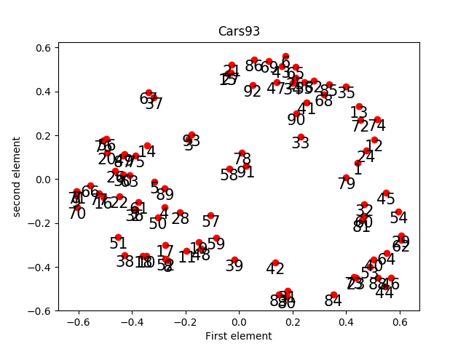
カーネル主成分分析による検知
import pandas as pd
import numpy as np
from matplotlib import pyplot as plt
from sklearn.decomposition import PCA, KernelPCA
df = pd.read_csv("Cars93.csv")
mask = ["Min.Price", "Price", "Max.Price", "MPG.city", "MPG.highway", "EngineSize", "Horsepower", "RPM", "Rev.per.mile", "Fuel.tank.capacity","Length", "Wheelbase","Width", "Turn.circle", "Weight"]
X = df[mask]
X = (X - X.mean()) / X.std()
X = X.T
Xc = X.values
m = 2
sig = 0.1
kpca = KernelPCA(n_components=m,kernel="rbf", gamma=sig)
Xc_kpca = kpca.fit_transform(Xc.T)
plt.scatter(Xc_kpca[:,0], Xc_kpca[:,1], color="red")
for i in range(len(Xc_kpca[:,0])):
plt.text(Xc_kpca[i,0], Xc_kpca[i,1], i+1, ha="center", va="top", size=15)
plt.title("Cars93")
plt.xlabel("First element")
plt.ylabel("second element")
plt.show()

Slide 25
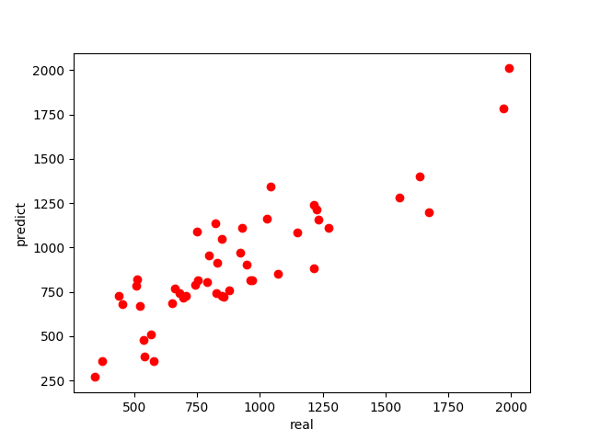
リッジ回帰モデルによる予測
import pandas as pd
import numpy as np
from matplotlib import pyplot as plt
from sklearn import linear_model
df = pd.read_csv("UScrime.csv")
mask = ["M", "Ed", "Po1", "Po2", "LF", "M.F", "Pop", "NW", "U1", "U2","GDP", "Ineq","Prob", "Time"]
X = df[mask]
y = df["y"]
clf = linear_model.Ridge()
clf.fit(X,y)
coefs = clf.coef_
ypred = clf.predict(X)
plt.scatter(y, ypred, color="red")
plt.xlabel("real")
plt.ylabel("predict")
plt.show()

Slide 26
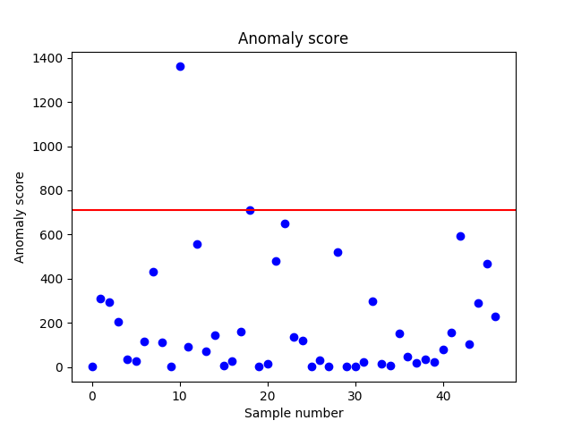
リッジ回帰モデルによる異常検知
import pandas as pd
import numpy as np
from matplotlib import pyplot as plt
from sklearn import linear_model
df = pd.read_csv("UScrime.csv")
mask = ["M", "Ed", "Po1", "Po2", "LF", "M.F", "Pop", "NW", "U1", "U2","GDP", "Ineq","Prob", "Time"]
X = df[mask]
y = df["y"]
N = len(y)
clf = linear_model.RidgeCV()
clf.fit(X,y)
coefs = clf.coef_
npcoefs = np.array(coefs)
lam = clf.alpha_
ypred = clf.predict(X)
sig2 = (lam* (npcoefs**2).sum() +sum(y-ypred)**2) /N
X = X - X.mean()
X = X.T
Xc = X.values
M = len(Xc)
H = (Xc.T).dot(np.linalg.solve(Xc.dot(Xc.T)+lam*(np.identity(M)),Xc))
TrHN = np.trace(H) / N
a = (ypred - y)**2 / (((1-TrHN)**2)*sig2)
sorted_a = sorted(a,reverse = True)
th = sorted_a[(int(N * 0.05 - 1))]
plt.title("Anomaly score")
plt.xlabel("Sample number")
plt.ylabel("Anomaly score")
plt.plot(range(len(a)), a, "bo")
plt.axhline(y=th,color='red')
plt.show()

Slide 27
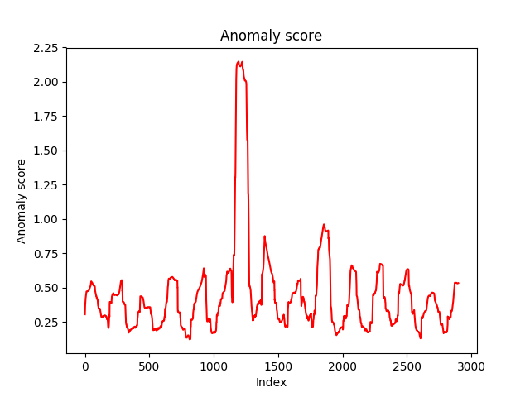
時系列データ 近傍法
import pandas as pd
import numpy as np
from matplotlib import pyplot as plt
df = pd.read_csv("qtdbsel102.txt", delimiter="\t")
X = df.ix[:,1]
X = X.values
w = 100
nk = 1
T = 3000
Xtr = X[:T]
X = X[T+1:2*T+1]
def create_slide_data(data, w):
D = []
T = len(data)
N = T - w + 1
for i in range(N):
D.append(data[i:i+w])
return D
def dist(pt1, pt2):
return np.sqrt(((pt2 - pt1) ** 2).sum())
def score(dist_list, k):
dist_list.sort()
return sum(dist_list[:k]) / k
Dtr = create_slide_data(Xtr, w)
D = create_slide_data(X, w)
a_list = []
for x in D:
dist_list = []
for xtr in Dtr:
dist_list.append(dist(x, xtr))
a = score(dist_list, nk)
a_list.append(a)
plt.plot(range(len(a_list)), a_list, linestyle="solid", color="red")
plt.title("Anomaly score")
plt.xlabel("Index")
plt.ylabel("Anomaly score")
plt.show()

Slide 28
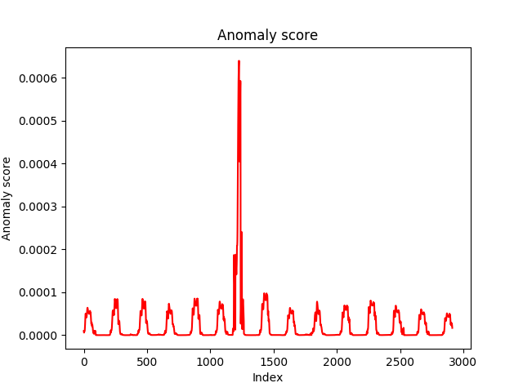
時系列データ 特異スペクトラム変換法
import pandas as pd
import numpy as np
from matplotlib import pyplot as plt
df = pd.read_csv("qtdbsel102.txt", delimiter="\t")
X = df.ix[:,1]
X = X.values
w = 50
k = w / 2
L = k / 2
m = 2
Tt = 3000
xi = X[Tt+1:2*Tt+1]
def create_slide_data(data, w):
D = []
T = len(data)
N = T - w + 1
for i in range(N):
D.append(data[i:i+w])
return D
a_list = []
for t in range(w+k-1, Tt-L):
begin_at = t-w-k+1
end_at = t
X1 = pd.DataFrame(create_slide_data(xi[begin_at:end_at],w)).T
X1 = X1.iloc[::-1]
begin_at = t-w-k+1+L
end_at = t+L
X2 = pd.DataFrame(create_slide_data(xi[begin_at:end_at],w)).T
X2 = X2.iloc[::-1]
U1, s1, V1 = np.linalg.svd(X1, full_matrices=False)
U1 = U1[:, 0:m]
U2, s2, V2 = np.linalg.svd(X2, full_matrices=False)
U2 = U2[:, 0:m]
U3, s3, V3 = np.linalg.svd(np.dot(U1.T , U2))
sig1 = s3[0]
a = 1 - sig1 * sig1
a_list.append(a)
plt.plot(range(len(a_list)), a_list, linestyle="solid", color="red")
plt.title("Anomaly score")
plt.xlabel("Index")
plt.ylabel("Anomaly score")
plt.show()

