Slide 1
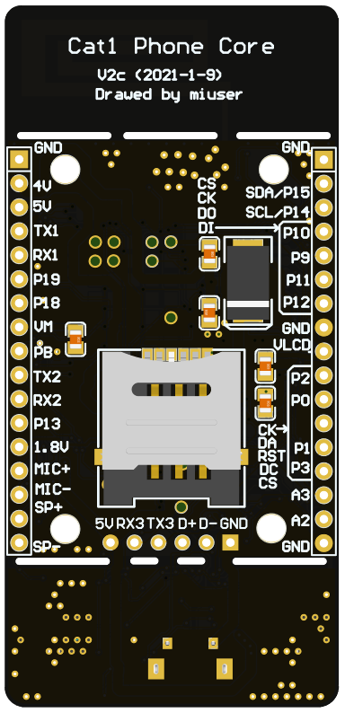
GND
GND
3.7V IN
SCL
SDA
I²C Bus
5V IN
TX
RX
CS
UART1
CLK
SPI
GPIO19
MOSI
MISO
GPIO18
GND
VMMC
SPI
Display
POWER ON
VLCD
TX
RX
CK
UART2
DA
GPIO13
RST
1.8V OUT
DC
MIC+
CS
MIC-
ADC3
SPK-
ADC2
SPK+
GND
5V IN
GND
RX
TX
UART3
D-
D+
* 普通用户不建议使用UART2和GPIO13

Slide 2
CPU:12% RAM 75%
CSQ:26 NET:UMA
>2812DISPLAY,HELLO LUAT
Dynamic connection monitor
GND
GND
3.7V IN
SCL
SDA
I²C Bus
5V IN
TX
RX
CS
UART1
CLK
SPI
GPIO19
MOSI
MISO
GPIO18
GND
VMMC
SPI
Display
POWER ON
VLCD
TX
RX
CK
UART2
DA
GPIO13
RST
1.8V OUT
DC
MIC+
CS
MIC-
ADC3
SPK-
ADC2
SPK+
GND
5V IN
GND
RX
TX
UART3
D-
D+
* 普通用户不建议使用UART2和GPIO13

