Slide 1
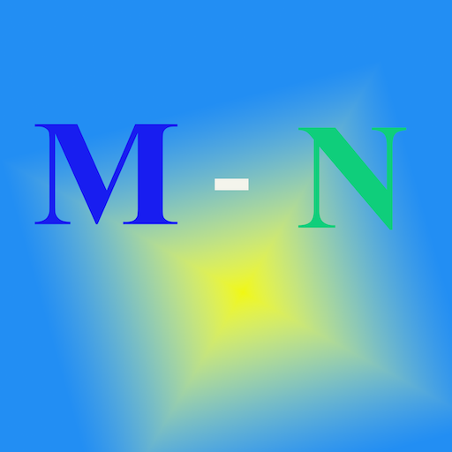
CENtral dogma as a rest api
By: Kayvan mivehnejad, MSHS

Slide 2
Cdaar REST api
The Central Dogma of Biology as a REST API (CDaaR REST API) is a Python-based web service that facilitates biological sequence processing related to DNA transcription and mRNA reverse transcription. It provides endpoints for converting DNA Oligonucleotides into RNA, generating reverse complementary DNA template strand, and reverse transcribing mRNA into complementary double-stranded DNA (cDNA).

Slide 3
Cdaar REST api
API Endpoints
/myAPI-DNA/v1/ → Reverse complement of a DNA coding sequence.
/myAPI-RNA/v1/ → DNA to mRNA transcription.
/myAPI-CDNA/v1/ → Reverse transcription from mRNA to cDNA.

Slide 4
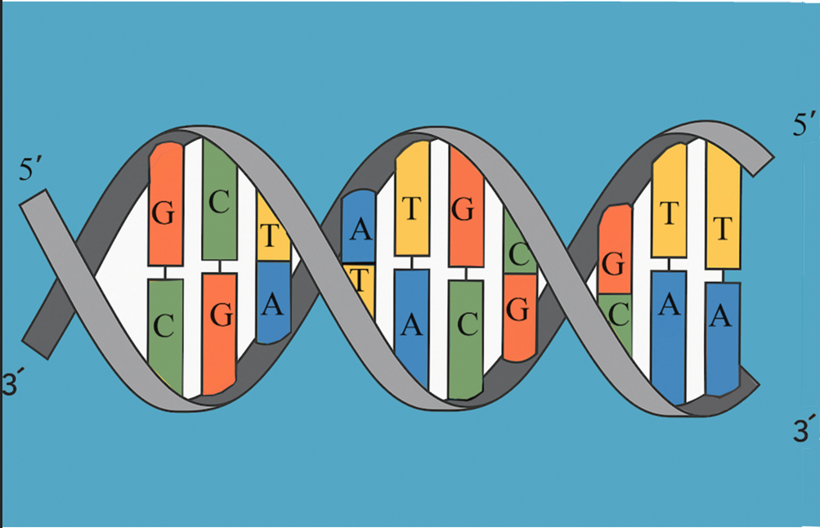
Cdaar REST api
/myAPI-DNA/v1/
5’-ATGC-3’ with its complement strand 3’-TACG-5’
DNA polymerase can only synthesize DNA in
the 5' to 3' direction, so to provide this antisense DNA
strand from 5-to-3 (left-to-right) we perform reverse
complement
First, we need the reverse of coding strand which is 3’-CGTA-5’, then we have its complement 5’-GCAT-3’ - Now look at the last sequence in first comment line
Notes:
DNA is made of double helical strands of acidic nucleotides polymerized by phosphoric acid molecules alternating with furanose deoxyribose sugar to form the backbone of each strand. These backbones are connected at the base by pairs of four nitrogenous bases molecules, that could be one purine (Adenine or Guanine), bonded with cyclohexane ring of one pyrimidine (Cytosine or Thymine).
RNA, on the other hand, is a single-strand polymer of phosphoric acid alternating with furanose ribose sugar with the addition of Hydroxyl group on Carbon 2 prime comapred to DNA and replacing Thymine nitrogenous base with Uracil.
This tool will provide two different C++ APIs to compare oligonucleotides sequence alignment with scoring system. One envision will allow you to enter the sequence on the prompt & other accept sequence files (w/wo) headers which will be trimmed to shorter sequence length.
We also provided a python suites to translate the oligonucleotide sequence reader for python interpreter.
https://github.com/mivehk/Oligonucleotide_Aligner
Oligonucleotide Aligner

Slide 5
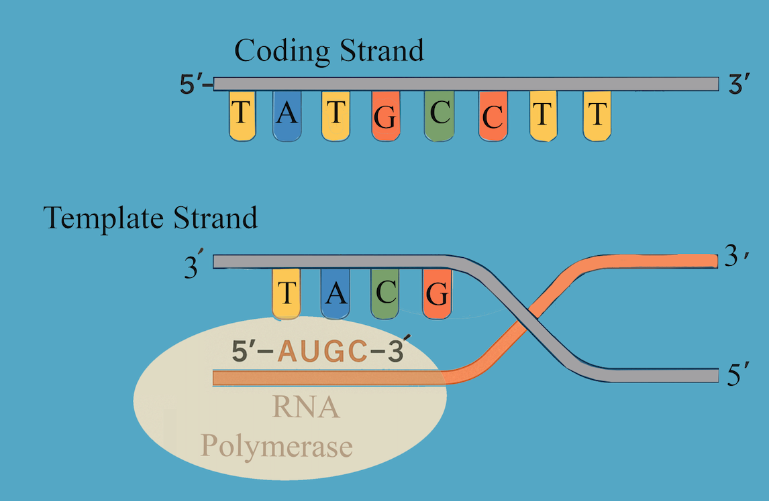
Cdaar REST api
/myAPI-RNA/v1/
5’-ATGC-3’ in a double stranded DNA has a
complement 3’-TACG-5’
RNA Polymerase enzyme only transcribe 5-to-3
so uses template strand 3’-TACG-5’ for
transcription of ’5-AUGC-3’
*** here’s the catch ***
in genomics, we often label the DNA’s coding strand (5’-ATGC-3’), which is the non-template strand,

Slide 6
Cdaar REST api
/myAPI-CDNA/v1/
If we have a mRNA sequence 5’-AUGC-3’, then reverse transcriptase enzyme synthesize single stranded 3’-TACG-5’
Starting from the 5 prime the complementary double stranded DNA would be 5’-ATGC-3’ and 3'-TACG-5'

