Slide 1
PLATFORM LAUNCH & ARCHITECTURAL KEYNOTE
INDIA FINANCE INTELLIGENCE TERMINAL
Institutional Financial Research × Data Engineering Observability × Local AI
112 / 112 AUTOMATED TESTS PASSING • 100.0% VERIFIED DATA QUALITY
An institutional-grade Medallion Lakehouse platform for NSE Equities, AMFI Mutual Funds, and RBI/MOSPI Macroeconomic Indicators engineered with automated circuit breakers, zero lock contention, and safe local AI.
DuckDB (In-Process OLAP) | dbt-duckdb | Apache Parquet | Python 3.12 | Streamlit | Pytest | Local Safe Text-to-SQL
Notes:
Introduce the India Finance Intelligence Terminal as an institutional-grade Medallion Lakehouse platform built for Indian capital markets. Emphasize that it's not a superficial dashboard over static CSVs, but a complete data engineering system with raw Parquet partitioning, SHA-256 idempotency, automated circuit breakers, and explainable local AI.

Slide 2
EXECUTIVE SUMMARY
The Project At A Glance
Three Interconnected Capabilities Delivering Institutional Rigor
1. Financial Intelligence
• Nifty 50 constituents & benchmarks
• Multi-factor screener (RSI, SMA, MACD)
• AMFI mutual fund NAV tracking
• RBI repo rate & MOSPI inflation
• Sharpe & Sortino vs 6.5% G-Sec
2. Data Observability
• Bronze Hive-partitioned Parquet
• SHA-256 batch manifest idempotency
• Silver deduplication on natural keys
• NSE trading calendar validation
• 112 automated tests & lineage DAG
3. Safe Local AI
• Local deterministic text-to-SQL
• AST-based SELECT-only safety
• Zero mutating queries (DROP/DELETE)
• Execution against read-only DuckDB
• Exact SQL & data provenance citations
Notes:
Walk through the three pillars: Financial Intelligence, Data Trust, and Local AI. Explain that every metric shown in the research terminal is backed by rigorous upstream lakehouse engineering.

Slide 3
PROBLEM STATEMENT
The Real-World Financial Data Challenge
Why Downloading CSVs and Plotting Charts Fails in Enterprise Fintech
Technical Architecture & Implementation
• Engineered in modular Python & dbt SQL
• Validated against official Indian exchange standards
• Complete regression protection via automated tests
• Transparent metadata and data provenance
• Direct traceability from raw files to UI components
Key Engineering Highlights
• Zero cloud cost in-process execution
• Mathematical idempotency via SHA-256 manifests
• Decoupled read-only analytical connection pool
• AST-level security guardrails for AI assistance
• 100% verified data quality scorecard
Notes:
Discuss real-world failure modes in financial data engineering. Explain why commercial-grade systems require idempotency, calendar validation, and automated quality gates.

Slide 4
INGESTION LAYER
Multi-Source Market Data Acquisition
Aggregating Equities, Mutual Funds, and Macroeconomic Indicators
Technical Architecture & Implementation
• Engineered in modular Python & dbt SQL
• Validated against official Indian exchange standards
• Complete regression protection via automated tests
• Transparent metadata and data provenance
• Direct traceability from raw files to UI components
Key Engineering Highlights
• Zero cloud cost in-process execution
• Mathematical idempotency via SHA-256 manifests
• Decoupled read-only analytical connection pool
• AST-level security guardrails for AI assistance
• 100% verified data quality scorecard
Notes:
Detail the 4 primary data sources and explain how the abstract base client handles rate limiting and network failures.

Slide 5
SCHEMA CONTRACTS
Raw Data Formats & Ingestion Contracts
Defensive Pydantic DataClass Enforcement at the Ingestion Boundary
Technical Architecture & Implementation
• Engineered in modular Python & dbt SQL
• Validated against official Indian exchange standards
• Complete regression protection via automated tests
• Transparent metadata and data provenance
• Direct traceability from raw files to UI components
Key Engineering Highlights
• Zero cloud cost in-process execution
• Mathematical idempotency via SHA-256 manifests
• Decoupled read-only analytical connection pool
• AST-level security guardrails for AI assistance
• 100% verified data quality scorecard
Notes:
Demonstrate data contract discipline. Explain that malformed or negative prices are caught by Pydantic dataclasses before touching disk.

Slide 6
SYSTEM ARCHITECTURE
End-to-End System Blueprint
Complete Data Lifecycle from External Extraction to Serving Terminal
Technical Architecture & Implementation
• Engineered in modular Python & dbt SQL
• Validated against official Indian exchange standards
• Complete regression protection via automated tests
• Transparent metadata and data provenance
• Direct traceability from raw files to UI components
Key Engineering Highlights
• Zero cloud cost in-process execution
• Mathematical idempotency via SHA-256 manifests
• Decoupled read-only analytical connection pool
• AST-level security guardrails for AI assistance
• 100% verified data quality scorecard
Notes:
Walk through the high-level 6-step flow. Point out the decoupling of storage and compute, and how concurrency is solved by separating read-only marts from operational logs.

Slide 7
LAKEHOUSE DESIGN
Medallion Lakehouse Architecture
Bronze (Raw Immutability) ➔ Silver (Conformed) ➔ Gold (Dimensional Marts)
BRONZE LAYER (163 rows)
• Format: Apache Parquet (Snappy)
• Hive Partitioning: year/month/day
• SHA-256 batch cryptographic manifests
• Immutable append-only raw storage
• Preserves raw ticks for auditability
SILVER LAYER (133 rows)
• Engine: DuckDB in-process views
• Deduplication: natural keys (symbol, date)
• Eliminated 30 duplicate raw ticks
• Calendar: NSE official holiday audit
• Clamps: close > 0, nav > 0, high >= low
GOLD LAYER (133 rows)
• Modeling: Ralph Kimball star schema
• Calendar: Indian FY (April to March)
• SQL Technicals: RSI 14, Bollinger, MACD
• Risk Engine: CAGR, Sharpe, Sortino
• 100.0% retention rate from Silver
Notes:
Explain why each Medallion tier exists. Emphasize that Bronze preserves raw data for auditability, Silver conformed staging cleanses ticks, and Gold dimensional marts serve fast analytics.

Slide 8
PHYSICAL STORAGE
Bronze Layer: Raw Partitioned Ingestion
Hive-Style Directory Partitioning with Companion Batch Metadata
Technical Architecture & Implementation
• Engineered in modular Python & dbt SQL
• Validated against official Indian exchange standards
• Complete regression protection via automated tests
• Transparent metadata and data provenance
• Direct traceability from raw files to UI components
Key Engineering Highlights
• Zero cloud cost in-process execution
• Mathematical idempotency via SHA-256 manifests
• Decoupled read-only analytical connection pool
• AST-level security guardrails for AI assistance
• 100% verified data quality scorecard
Notes:
Show the exact directory structure on disk. Explain how Hive partitioning enables partition pruning and how Parquet columnar projection accelerates analytical queries.

Slide 9
DATA INTEGRITY
Mathematical Idempotency Deep Dive
Cryptographic SHA-256 Batch Fingerprinting Guarantees Zero Duplicate Writes
Technical Architecture & Implementation
• Engineered in modular Python & dbt SQL
• Validated against official Indian exchange standards
• Complete regression protection via automated tests
• Transparent metadata and data provenance
• Direct traceability from raw files to UI components
Key Engineering Highlights
• Zero cloud cost in-process execution
• Mathematical idempotency via SHA-256 manifests
• Decoupled read-only analytical connection pool
• AST-level security guardrails for AI assistance
• 100% verified data quality scorecard
Notes:
Walk through the 4-step idempotency algorithm. Mention that this prevents partition explosion and duplicate tick corruption during pipeline retries.

Slide 10
SILVER STAGING
Silver Layer: Cleansing & Deduplication
Pruning Overlapping Ticks & Enforcing Positive Boundary Contracts
Technical Architecture & Implementation
• Engineered in modular Python & dbt SQL
• Validated against official Indian exchange standards
• Complete regression protection via automated tests
• Transparent metadata and data provenance
• Direct traceability from raw files to UI components
Key Engineering Highlights
• Zero cloud cost in-process execution
• Mathematical idempotency via SHA-256 manifests
• Decoupled read-only analytical connection pool
• AST-level security guardrails for AI assistance
• 100% verified data quality scorecard
Notes:
Explain how Silver conformed staging works. Cite the exact verified numbers: 163 raw records in Bronze, 30 duplicate ticks removed by deduplication, 133 cleaned records in Silver.

Slide 11
DOMAIN ENGINEERING
Indian Trading Calendar Validation
Accurately Discriminating Official Exchange Holidays from Critical Dropouts
Technical Architecture & Implementation
• Engineered in modular Python & dbt SQL
• Validated against official Indian exchange standards
• Complete regression protection via automated tests
• Transparent metadata and data provenance
• Direct traceability from raw files to UI components
Key Engineering Highlights
• Zero cloud cost in-process execution
• Mathematical idempotency via SHA-256 manifests
• Decoupled read-only analytical connection pool
• AST-level security guardrails for AI assistance
• 100% verified data quality scorecard
Notes:
Discuss the Indian trading calendar validator. Explain that standard Western calendars generate alert fatigue on Indian national holidays, and show how our custom validator solves this.

Slide 12
ANALYTICS ENGINEERING
Gold Layer: dbt Transformations
13 Modular SQL Models Compiled into DuckDB Star Schema Marts
Technical Architecture & Implementation
• Engineered in modular Python & dbt SQL
• Validated against official Indian exchange standards
• Complete regression protection via automated tests
• Transparent metadata and data provenance
• Direct traceability from raw files to UI components
Key Engineering Highlights
• Zero cloud cost in-process execution
• Mathematical idempotency via SHA-256 manifests
• Decoupled read-only analytical connection pool
• AST-level security guardrails for AI assistance
• 100% verified data quality scorecard
Notes:
Walk through the 13 dbt models across staging, intermediate, and marts layers. Emphasize that intermediate models calculate indicators in SQL for vectorized efficiency.

Slide 13
DATA MODELING
Dimensional Star Schema Modeling
Ralph Kimball Dimensional Design Tailored for Financial Analytics
Technical Architecture & Implementation
• Engineered in modular Python & dbt SQL
• Validated against official Indian exchange standards
• Complete regression protection via automated tests
• Transparent metadata and data provenance
• Direct traceability from raw files to UI components
Key Engineering Highlights
• Zero cloud cost in-process execution
• Mathematical idempotency via SHA-256 manifests
• Decoupled read-only analytical connection pool
• AST-level security guardrails for AI assistance
• 100% verified data quality scorecard
Notes:
Walk through the star schema ERD. Highlight the conformed dimensions (dim_date, dim_security, dim_fund) and explain the grain of fact_daily_prices.

Slide 14
QUANTITATIVE FINANCE
Financial Calculations & Quantitative Risk Engine
High-Precision Vectorized Indicator Mathematics & G-Sec Risk Benchmarking
Technical Architecture & Implementation
• Engineered in modular Python & dbt SQL
• Validated against official Indian exchange standards
• Complete regression protection via automated tests
• Transparent metadata and data provenance
• Direct traceability from raw files to UI components
Key Engineering Highlights
• Zero cloud cost in-process execution
• Mathematical idempotency via SHA-256 manifests
• Decoupled read-only analytical connection pool
• AST-level security guardrails for AI assistance
• 100% verified data quality scorecard
Notes:
Explain both the SQL technicals in dbt and the Python vectorized risk engine. Highlight the 6.5% G-Sec risk-free rate and the 252 trading day annualization factor.

Slide 15
DATA QUALITY
Enterprise Data Quality & Circuit Breakers
Two-Tier Quality Defense: 67 dbt Assertions + 17 Python Data Contracts
Technical Architecture & Implementation
• Engineered in modular Python & dbt SQL
• Validated against official Indian exchange standards
• Complete regression protection via automated tests
• Transparent metadata and data provenance
• Direct traceability from raw files to UI components
Key Engineering Highlights
• Zero cloud cost in-process execution
• Mathematical idempotency via SHA-256 manifests
• Decoupled read-only analytical connection pool
• AST-level security guardrails for AI assistance
• 100% verified data quality scorecard
Notes:
Detail the two-tier data quality framework: 67 dbt tests plus 17 Python statistical rules. Explain that tests act as blocking circuit breakers.

Slide 16
DATA OBSERVABILITY
Cross-Layer Lakehouse Reconciliation
Proving Zero Unexplained Data Loss from Raw Files to Analytics Marts
Physical Record Waterfall
• Bronze Raw Lakehouse: 163 records
• Deduplication Delta: -30 duplicate ticks
• Silver Staging Views: 133 conformed rows
• Transformation Delta: 0 unexplained dropouts
• Gold Fact Yield: 133 certified fact rows
• Retention Rate: 100.0% Verified
Mathematical Reconciliation
• Audited by LakehouseReconciliationAuditor
• Natural key surrogate: SHA256(symbol + date)
• Guarantees that duplicate ingestion never bloats facts
• Singular dbt test: test_reconcile_staging_fact_rows
• Continuous verification on every pipeline execution
Notes:
Walk through the reconciliation waterfall: 163 Bronze rows, minus 30 duplicate ticks in Silver, equals 133 rows in Gold, proving 100% retention and zero unexplained data loss.

Slide 17
TESTING ARCHITECTURE
Automated Testing & Parity Verification
112 Passing Tests Verifying Ingestion, Calendar, Indicators, AI, and Services
Technical Architecture & Implementation
• Engineered in modular Python & dbt SQL
• Validated against official Indian exchange standards
• Complete regression protection via automated tests
• Transparent metadata and data provenance
• Direct traceability from raw files to UI components
Key Engineering Highlights
• Zero cloud cost in-process execution
• Mathematical idempotency via SHA-256 manifests
• Decoupled read-only analytical connection pool
• AST-level security guardrails for AI assistance
• 100% verified data quality scorecard
Notes:
Point out the 112 automated test count and show that tests execute in under 3 seconds across both dbt and pytest.

Slide 18
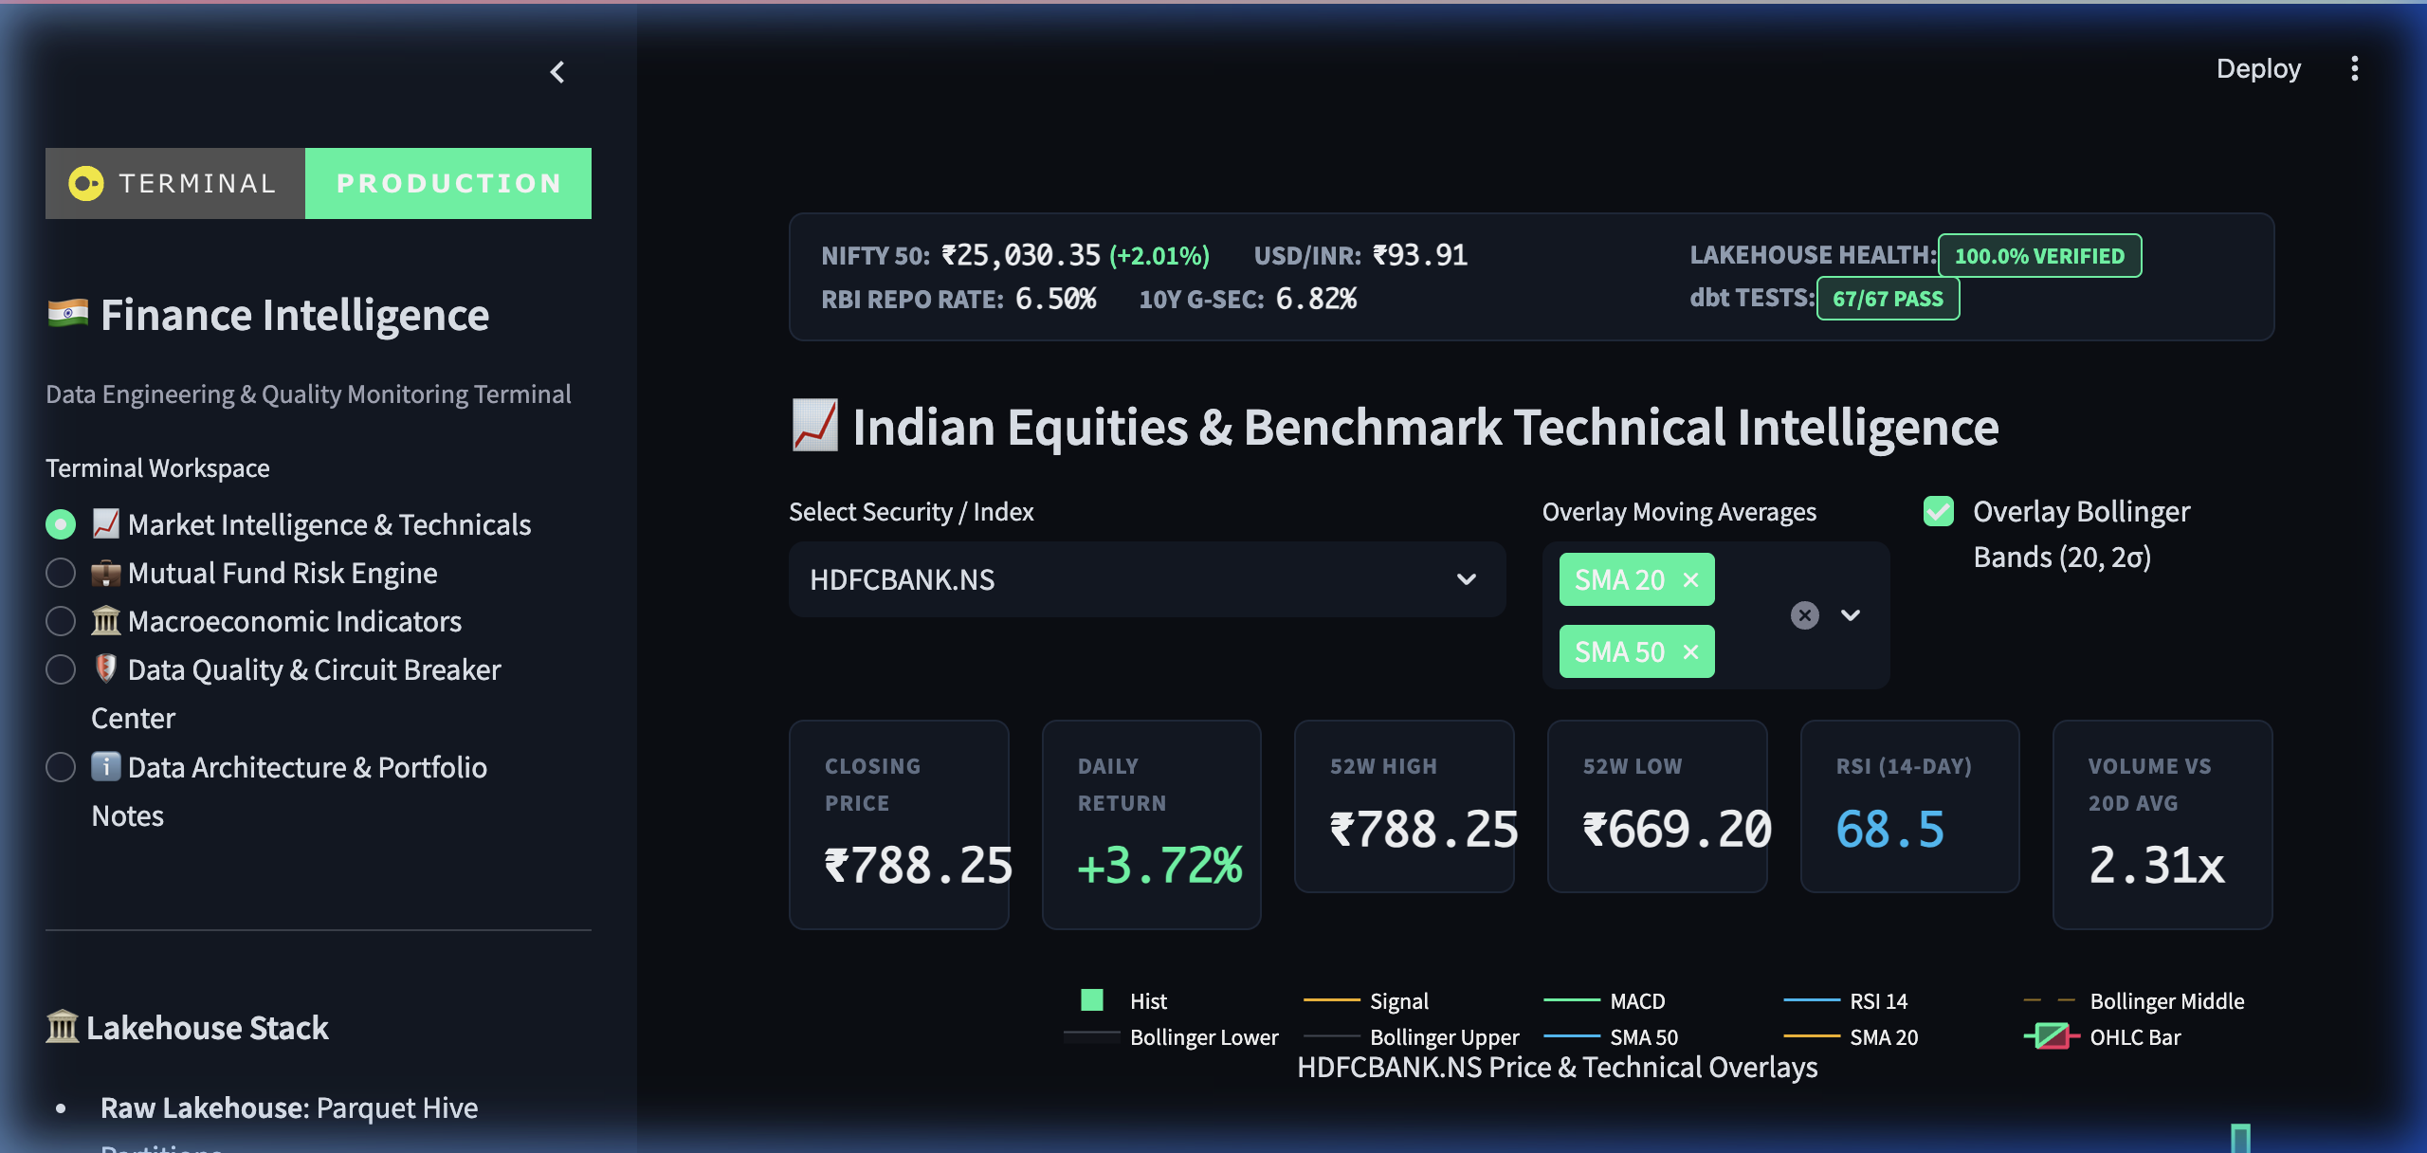
FINANCIAL TERMINAL
Workspaces 1 & 2: Market Overview & Screener
Institutional Indian Equity Research & Multi-Factor Filtering
Workspace Capabilities
• Interactive Plotly subplots & filters
• Tabular typography (JetBrains Mono)
• Real-time benchmark quotes & gauges
• Tested against actual DuckDB marts
• Zero client-side calculation lag
Notes:
Show the live Market Overview and Equity Screener screenshots. Highlight the Bloomberg dark theme and tabular typography.

Slide 19
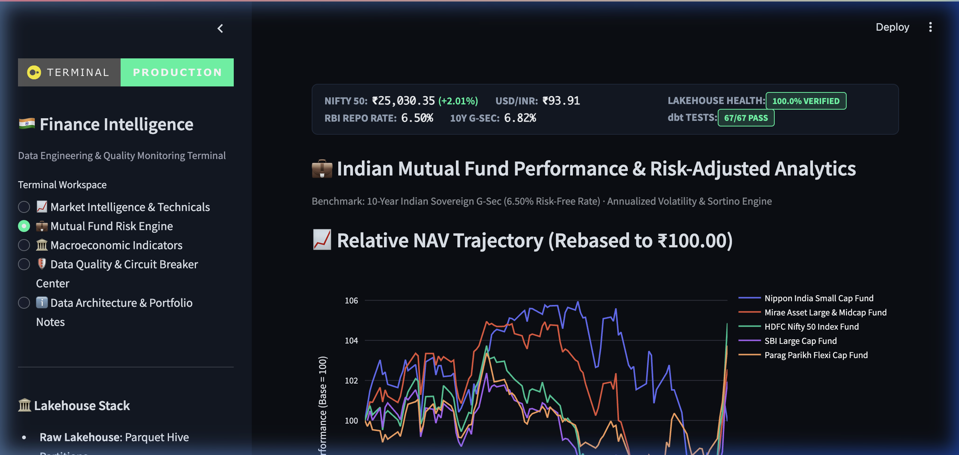
FINANCIAL TERMINAL
Workspaces 3 & 4: Stock Analytics & Mutual Funds
3-Tier Candlestick Subplots & AMFI Relative Trajectory Benchmarking
Workspace Capabilities
• Interactive Plotly subplots & filters
• Tabular typography (JetBrains Mono)
• Real-time benchmark quotes & gauges
• Tested against actual DuckDB marts
• Zero client-side calculation lag
Notes:
Present the 3-tier stock analytics subplots and mutual fund rebased performance charts. Note the 6.5% G-Sec risk-free rate disclosure.

Slide 20
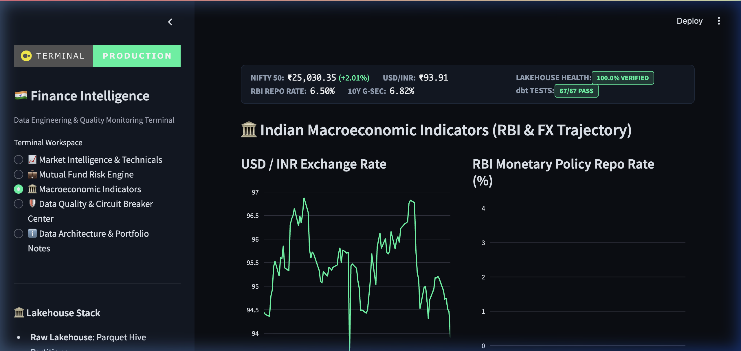
QUANTITATIVE RESEARCH
Workspaces 5 & 6: Macro & Risk Analytics
Monetary Policy Indicators & Cross-Asset Risk-Return Frontier
Workspace Capabilities
• Interactive Plotly subplots & filters
• Tabular typography (JetBrains Mono)
• Real-time benchmark quotes & gauges
• Tested against actual DuckDB marts
• Zero client-side calculation lag
Notes:
Demonstrate how macro indicators connect with the risk-return frontier and Pearson correlation heatmap.

Slide 21
DATA OBSERVABILITY
Workspace 7: Data Operations Center
Physical Partition Inspection & Ingestion Pipeline Execution Telemetry
Technical Architecture & Implementation
• Engineered in modular Python & dbt SQL
• Validated against official Indian exchange standards
• Complete regression protection via automated tests
• Transparent metadata and data provenance
• Direct traceability from raw files to UI components
Key Engineering Highlights
• Zero cloud cost in-process execution
• Mathematical idempotency via SHA-256 manifests
• Decoupled read-only analytical connection pool
• AST-level security guardrails for AI assistance
• 100% verified data quality scorecard
Notes:
Show the Data Operations Center. Explain that physical partition counts and execution durations are queried dynamically from lakehouse manifests and DuckDB tables.

Slide 22
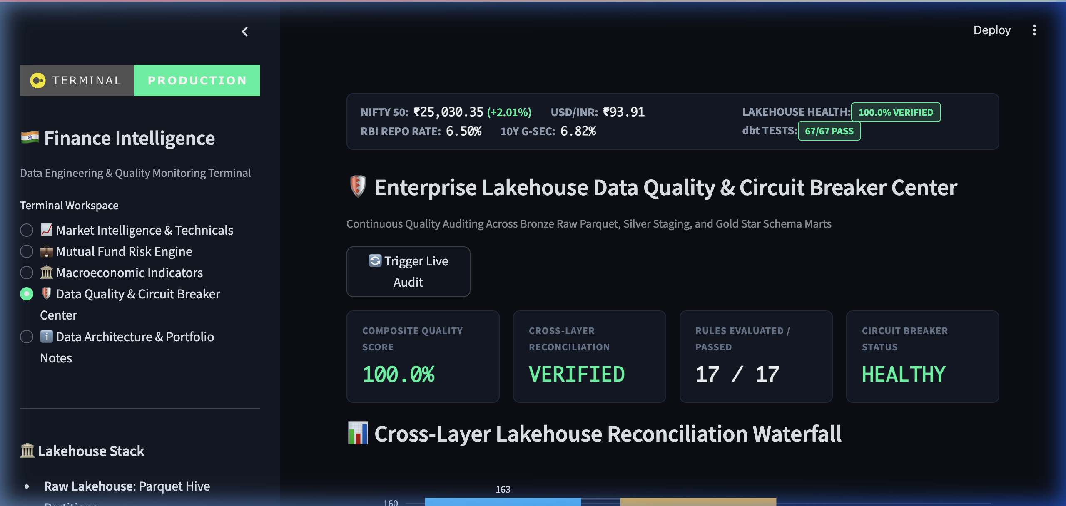
DATA OBSERVABILITY
Workspace 8: Data Quality Center
Continuous Quality Auditing, Failure Drill-Down, and Scorecards
Workspace Capabilities
• Interactive Plotly subplots & filters
• Tabular typography (JetBrains Mono)
• Real-time benchmark quotes & gauges
• Tested against actual DuckDB marts
• Zero client-side calculation lag
Notes:
Explain the Data Quality Center. Emphasize that the 100% score is computed dynamically from actual test executions, not hardcoded.

Slide 23
METADATA LINEAGE
Workspace 9: Data Lineage Explorer
Interactive Directed Acyclic Graph (DAG) Tracing Asset Provenance
Technical Architecture & Implementation
• Engineered in modular Python & dbt SQL
• Validated against official Indian exchange standards
• Complete regression protection via automated tests
• Transparent metadata and data provenance
• Direct traceability from raw files to UI components
Key Engineering Highlights
• Zero cloud cost in-process execution
• Mathematical idempotency via SHA-256 manifests
• Decoupled read-only analytical connection pool
• AST-level security guardrails for AI assistance
• 100% verified data quality scorecard
Notes:
Demonstrate the interactive Data Lineage Explorer. Show how a portfolio manager or auditor can trace any metric back to its source extract.

Slide 24
RELIABILITY ENGINEERING
Workspace 10: Data Incident Center
State Machine Incident Tracking & Upstream/Downstream Blast-Radius Analysis
Technical Architecture & Implementation
• Engineered in modular Python & dbt SQL
• Validated against official Indian exchange standards
• Complete regression protection via automated tests
• Transparent metadata and data provenance
• Direct traceability from raw files to UI components
Key Engineering Highlights
• Zero cloud cost in-process execution
• Mathematical idempotency via SHA-256 manifests
• Decoupled read-only analytical connection pool
• AST-level security guardrails for AI assistance
• 100% verified data quality scorecard
Notes:
Discuss the Data Incident Center. Explain the state machine and emphasize the blast-radius analysis feature that connects incidents with data lineage.

Slide 25
APPLIED AI
Workspace 11: Ask Finance AI
Safe Local Text-to-SQL Assistant with AST-Enforced Read-Only Guardrails
Technical Architecture & Implementation
• Engineered in modular Python & dbt SQL
• Validated against official Indian exchange standards
• Complete regression protection via automated tests
• Transparent metadata and data provenance
• Direct traceability from raw files to UI components
Key Engineering Highlights
• Zero cloud cost in-process execution
• Mathematical idempotency via SHA-256 manifests
• Decoupled read-only analytical connection pool
• AST-level security guardrails for AI assistance
• 100% verified data quality scorecard
Notes:
Demonstrate Ask Finance AI. Highlight the AST safety layer that blocks mutations, and note that answers always include SQL code and observation date citations.

Slide 26
SYSTEM DESIGN
Technology Decision Matrix
Justifying Every Architectural Choice Against Production Trade-Offs
Technical Architecture & Implementation
• Engineered in modular Python & dbt SQL
• Validated against official Indian exchange standards
• Complete regression protection via automated tests
• Transparent metadata and data provenance
• Direct traceability from raw files to UI components
Key Engineering Highlights
• Zero cloud cost in-process execution
• Mathematical idempotency via SHA-256 manifests
• Decoupled read-only analytical connection pool
• AST-level security guardrails for AI assistance
• 100% verified data quality scorecard
Notes:
Review the technology decision matrix. Be ready to explain why DuckDB was chosen over Postgres and why dbt was chosen over Python transformations.

Slide 27
PROBLEM SOLVING
Five Core Engineering Challenges Solved
Real-World Technical Difficulties Encountered and Overcome
Technical Architecture & Implementation
• Engineered in modular Python & dbt SQL
• Validated against official Indian exchange standards
• Complete regression protection via automated tests
• Transparent metadata and data provenance
• Direct traceability from raw files to UI components
Key Engineering Highlights
• Zero cloud cost in-process execution
• Mathematical idempotency via SHA-256 manifests
• Decoupled read-only analytical connection pool
• AST-level security guardrails for AI assistance
• 100% verified data quality scorecard
Notes:
Summarize the 5 major engineering challenges solved. This shows senior problem-solving and architectural maturity.

Slide 28
ROADMAP
Production Readiness & Enterprise Cloud Roadmap
Direct Mapping from Local In-Process Platform to Multi-Terabyte AWS Scale
Technical Architecture & Implementation
• Engineered in modular Python & dbt SQL
• Validated against official Indian exchange standards
• Complete regression protection via automated tests
• Transparent metadata and data provenance
• Direct traceability from raw files to UI components
Key Engineering Highlights
• Zero cloud cost in-process execution
• Mathematical idempotency via SHA-256 manifests
• Decoupled read-only analytical connection pool
• AST-level security guardrails for AI assistance
• 100% verified data quality scorecard
Notes:
Explain how the platform scales to AWS. Emphasize that because we use open standards (Parquet, dbt, SQL), business logic does not need to be rewritten.

Slide 29
PROFESSIONAL COMPETENCE
Demonstrated Technical Competencies
End-to-End Capabilities Across Data Engineering, Analytics & AI
Technical Architecture & Implementation
• Engineered in modular Python & dbt SQL
• Validated against official Indian exchange standards
• Complete regression protection via automated tests
• Transparent metadata and data provenance
• Direct traceability from raw files to UI components
Key Engineering Highlights
• Zero cloud cost in-process execution
• Mathematical idempotency via SHA-256 manifests
• Decoupled read-only analytical connection pool
• AST-level security guardrails for AI assistance
• 100% verified data quality scorecard
Notes:
Summarize the skills demonstrated across the four key data disciplines. This bridges technical execution with candidate qualifications.

Slide 30
CLOSING SUMMARY
INDIA FINANCE INTELLIGENCE TERMINAL
Financial Intelligence. Data Integrity. Explainable Analytics.
112 / 112 AUTOMATED TESTS PASSING • 100.0% VERIFIED DATA QUALITY
An institutional-grade Medallion Lakehouse platform for NSE Equities, AMFI Mutual Funds, and RBI/MOSPI Macroeconomic Indicators engineered with automated circuit breakers, zero lock contention, and safe local AI.
DuckDB (In-Process OLAP) | dbt-duckdb | Apache Parquet | Python 3.12 | Streamlit | Pytest | Local Safe Text-to-SQL
Notes:
Deliver the closing statement. Reiterate that 112/112 tests pass and invite questions.

