Slide 1
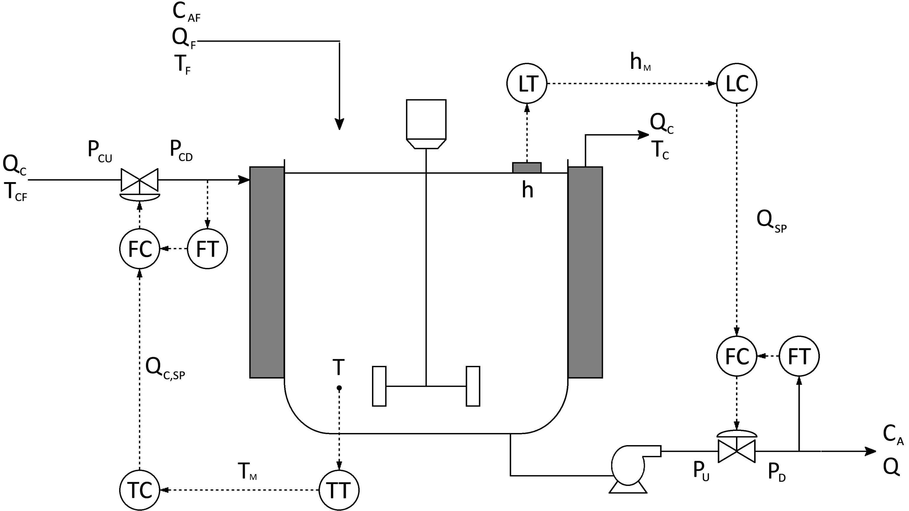
Bayesian PCA With Automatic Dimensionality Selection For Process Monitoring And Fault Detection
D.B. Bovim
Introduction
The aim of this research is to evaluate Bayesian PCA (BPCA) for process monitoring and fault detection
All plants create and store data describing their operation, which can be interrogated to identify fault occurrences
Principal component analysis (PCA), a latent variable modelling technique, is widely applied for this purpose
Choosing principal components (PCs) to retain remains a critical and difficult decision during model development
BPCA may help that decision with automatic relevance determination (ARD) that prunes insignificant PCs using data
A case study using realistic industrial data is needed to provide a faithful comparison of PCA and BPCA
Key Questions
Results
Notable fault detection improvements of BPCA vs PCA?
How does PCA’s PC selection compare to BPCA’s ARD?
CSTR model validated against literature
Datasets with more noise (process and measurement) had worse fault detection performance than datasets with less noise (measurement only)
Retained PCs: 9 by cumulative explained variance; 2 by optimal hard threshold; 8 by Scree plot
No PCs pruned by BPCA ARD, T² inexplicably large
EM without ARD validated against MATLAB’s
Objectives
Implement and compare PCA and BPCA fault detection
Investigate and compare PCA PC selection techniques
Create a CSTR model for a realistic case-study
Generate simulated data similar to literature
Define CSTR operation faults based on literature
9/14 PCs: Feature Subspace Detects Fault
Bayesian PCA Model Development
Expectation-maximisation (EM) to learn parameters
Gaussian priors over parameters: variance (σ²) and mean (μ); latent variables (z); PCs (W’s columns)
Each PC has hyperparameter (α) precision, governs PC activity
2/14 PCs: Noise Subspace Detects Fault
Non-Isothermal CSTR Case Study
Noise added to process inputs and measurements to get data as close to real industrial case as possible
14 variables measured and stored (all labelled below, only pressures not measured or saved), 20 fault types
Conclusions
Pairing Hotelling’s T² statistic and Q-statistic to monitor both subspaces is better than just using one.
PCA fault monitoring performance matches literature at worst, outperforms at best.
BPCA T² monitoring unsuccessful due to inexplicably large T² results, worth investigating as BPCA has computational advantage with very large datasets.
Therefore, BPCA not recommended over PCA as ARD did not prune PCs and T² monitoring unsuccessful.

